Slide 1
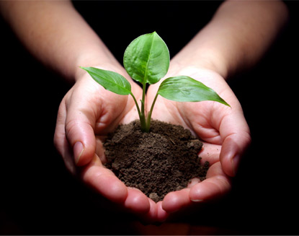
3.4 The Soil System

Slide 2
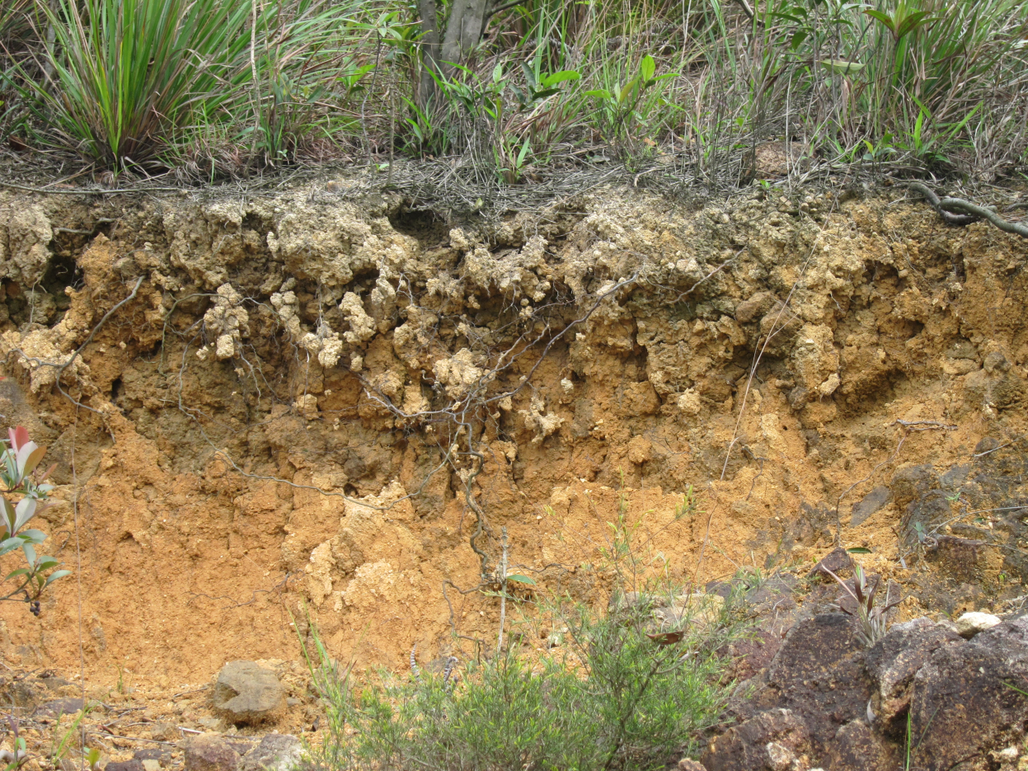
Soil formation is a slow process:
Weathering of rock (mechanical).
Deposition of sediments by erosion (mechanical).
Decomposition of organic matter in dead organisms (chemical).

Slide 3
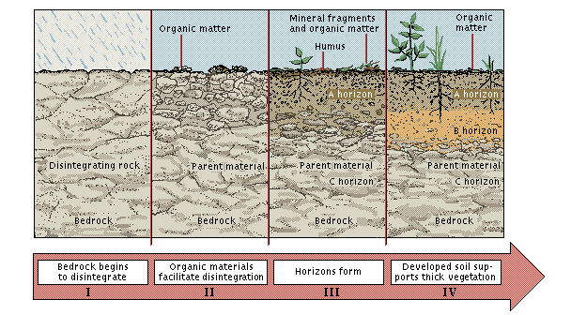
Soil as a system
Parent material, such as bedrock, is weathered to begin process of soil formation.
Parent material = the base geological material in a location
Bedrock = the continuous mass of solid rock that makes up Earth’s crust
Weathering = processes that break down rocks

Slide 4
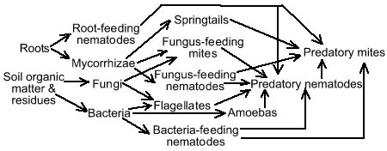
The Soil System
Soil is a complex mixture of eroded rock, mineral nutrients, decaying organic matter, water, air and billions of living organisms (microscopic decomposers).

Slide 5
TRANSFERS
Inputs
OUTPUTS
DEPOSITION
EROSION
Organic material
Leaching
Parent material
Soil
Uptake
Precipitation
infiltration
Mass Movements
Energy
DECOMPOSITION
WEATHERING
NUTRIENT CYCLE
TRANSFORMS

Slide 6
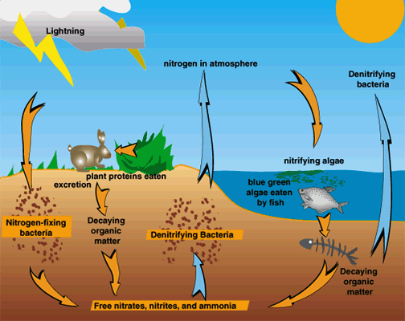

Slide 7
Soil characterization
Soil can be characterized by color and several other traits:
Texture (percentage sand, silt, clay) is determined by the relative amounts of the different types and sizes of mineral particles.
Structure
Porosity-(air spaces)Soil texture helps determine SOIL POROSITY, a measure of the volume of spores or spaces per volume of soil and the average space between those spaces.
Mineral content
pH
Parent Material
Infiltration rate- drainage-is the downward movement of water through soils.( drainage)
Nutrient concentrations
PERMEABILITY is the rate at which water and air move from upper to lower soil layers.

Slide 8
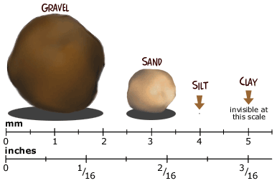
Soil Content
Clay (very fine particles)-<0.002 mm
Silt (fine particles) 0.002 mm—0.05mm
Sand (medium-size particles) 0.05-2mm
Gravel (coarse to very coarse particles)

Slide 9
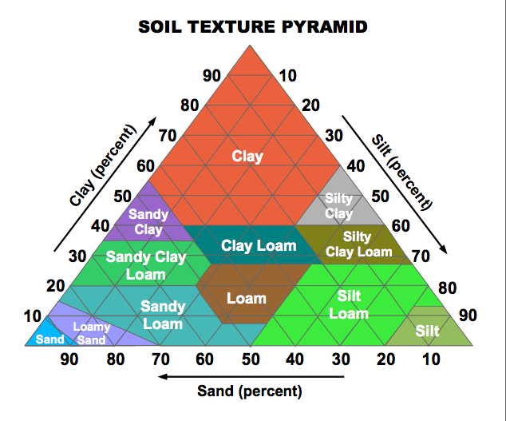
Loam is the ideal soil texture for agriculture. 40-40-20

Slide 10
Properties of Soils with Different Textures
Texture | Mineral Content | Drainage | Hold Organic Material | Water-Holding Capacity | Air Spaces | Primary Productivity
Clay | High | Poor | Low | Very High | Small | Very low
Silt | Medium | Medium | Medium | Medium | Medium | Medium
Sand | High | Very Good | Low | Very Low | Large | Low
Loam | Medium | Good | Medium | Medium | Medium | High

Slide 11
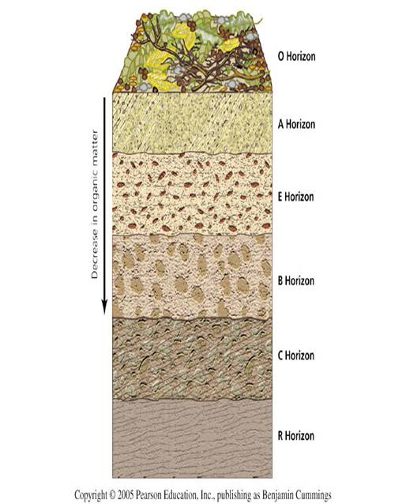
Soil profile
Consists of layers called horizons.
Simplest:
A = topsoil
B = subsoil
C = parent material
But most have O, A, E, B, C, and R
Figure 8.8

Slide 12
Soil profile
O Horizon: Organic or litter layer
A Horizon: Topsoil. Mostly inorganic minerals with some organic material and humus mixed in. Crucial for plant growth

Slide 13
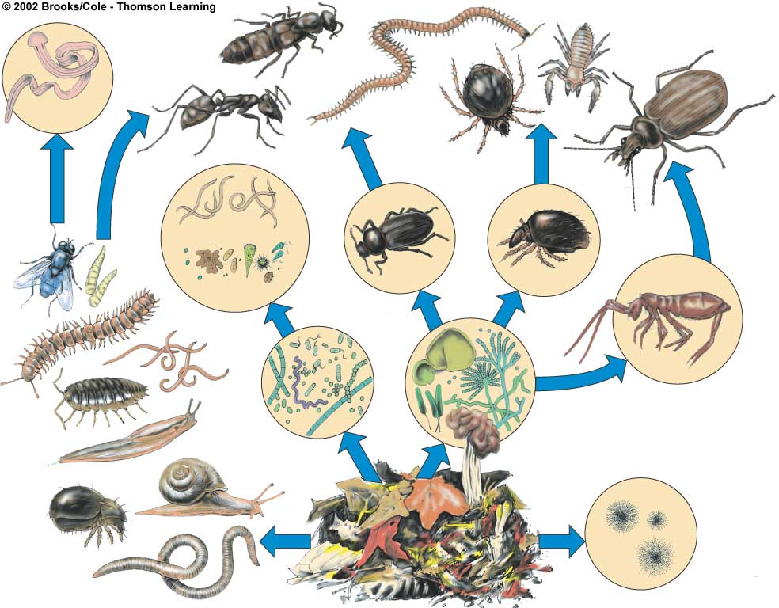
These top two layers (A&O) are most fertile, have the highest concentration of organic matter, and contain large amounts of living organisms.
Rove beetle
Pseudoscorpion
Flatworm
Centipede
Ant
Ground
beetle
Mite
Adult
fly
Fly
larvae
Roundworms
Beetle
Mite
Springtail
Protozoa
Millipede
Sowbug
Bacteria
Slug
Fungi
Snail
Actinomycetes
Mite
Earthworm
Organic debris

Slide 14
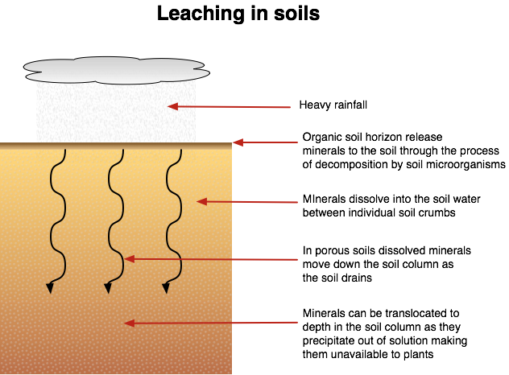
E Horizon: Eluviation horizon; loss of minerals by leaching, a process whereby solid materials are dissolved and transported away
As the water seeps down, it dissolves various soil components in upper layers and carries them down to lower layers in a process called LEACHING.

Slide 15
B Horizon: Subsoil. Zone of accumulation or deposition of leached minerals (Fe & Al) and organic compounds from above
C Horizon: Slightly altered &Fragmented Bedrock parent material
R Horizon: Bedrock- parent material

Slide 16
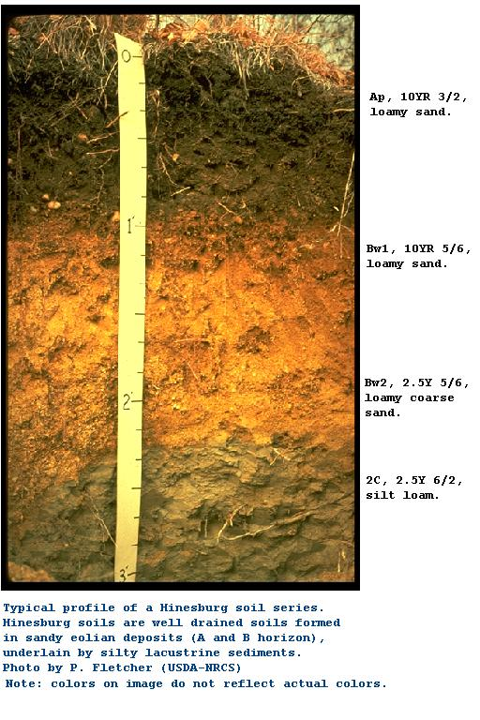

Slide 17
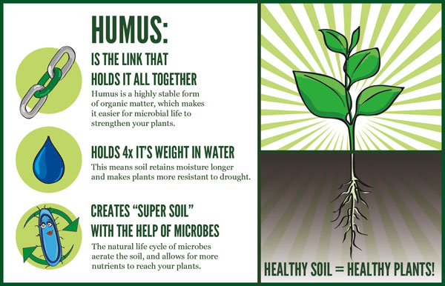
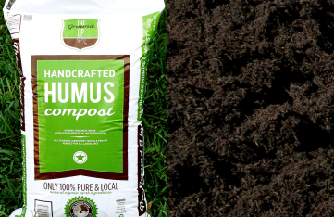
Humus
Dark, crumbly mass of undifferentiated material made up of complex organic compounds
Soils with high humus content:
hold moisture better
Increases Primary productive for plant life.

Slide 18
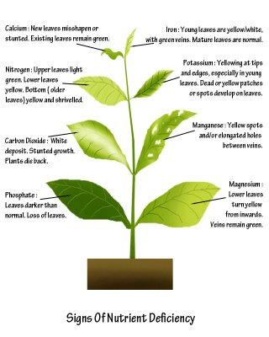
Macronutrients-important for growth & photosynthesis
Nitrogen- Green foliage
Phosphorous-strong roots
Potassium- healthy growth

Slide 19
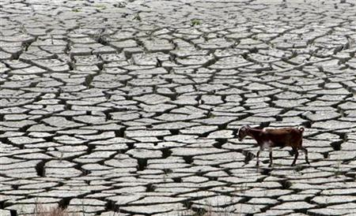
Soil Degradation
The decline in Quality and Quantity of soil
4 parts-
Eroision- water or wind
Biological- Loss of humus due the loss of plants & animals
Physical- loss of soil structure & permeability
Chemical- Acidification due to toxic chemicals, change in pH, salinity

Slide 20
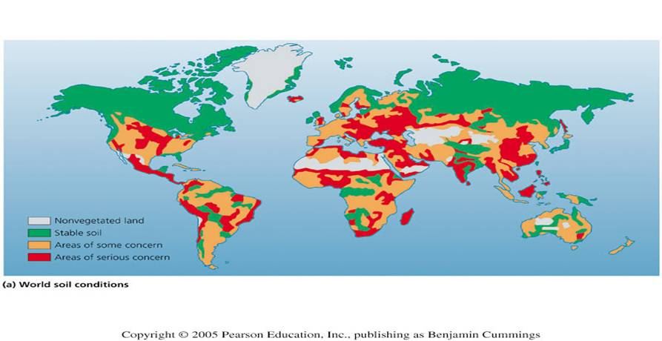
World soil conditions
Soils are becoming degraded in many regions.

Slide 21
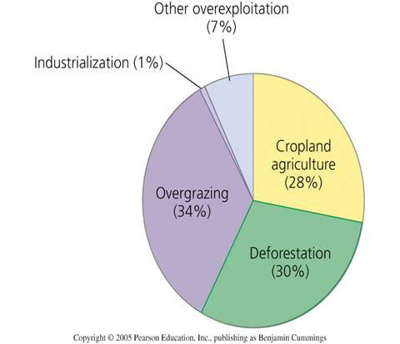
Causes of soil degradation
Most soil degradation is caused by:
• livestock overgrazing
• deforestation
• cropland agriculture.
Figure 8.2

Slide 22
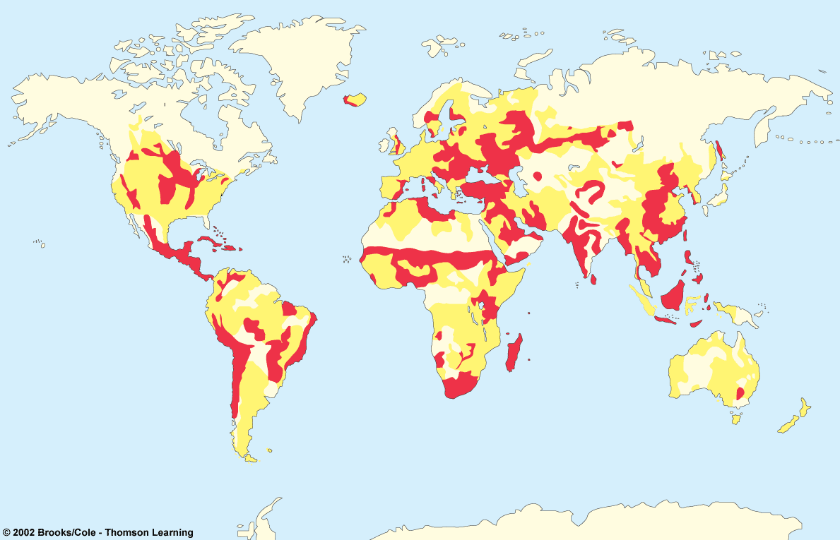
Two major harmful effects of soil erosion:
Loss of soil fertility and its ability to hold water
Runoff of sediment that pollutes water, kills fish and shellfish, and clog irrigation ditches, boat channels, reservoirs, and lakes.
serious concern
some concern
Stable areas

Slide 23
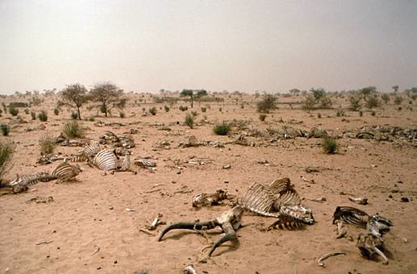
Desertification
A loss of more than 10% productivity due to:
• Erosion
• Soil compaction
• Forest removal
• Overgrazing
• Drought
• Salinization
• Climate change
• Depletion of water resources
When severe, there is expansion of desert areas, or creation of new ones, e.g., the Middle East, formerly, “Fertile Crescent”.

Slide 24
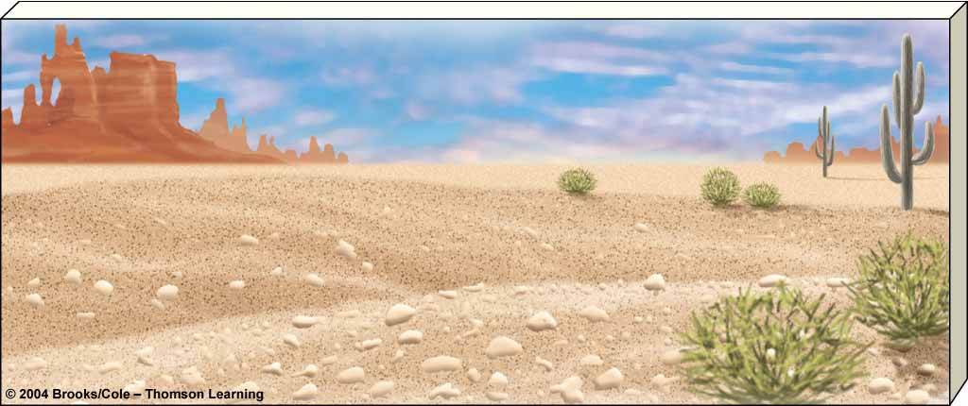
Desertification
Causes
Consequences
Overgrazing
Deforestation
Erosion
Salinization
Soil compaction
Natural climate
change
Worsening drought
Famine
Economic losses
Lower living
standards
Environmental
refugees

Slide 25
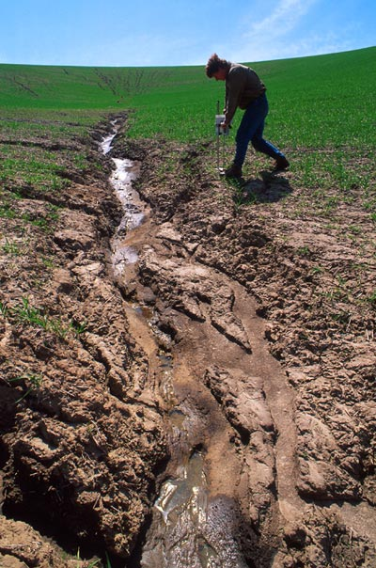
Erosion and Deposition
Erosion = removal of material from one place and its transport elsewhere
by wind
or water
Deposition = arrival of eroded material at a new location
These processes are natural, and can build up fertile soil.
But where artificially sped up, they are a big problem for farming.

Slide 26
Types of soil erosion
Splash erosion
Rill erosion
Gully erosion
Figure 8.11

Slide 27
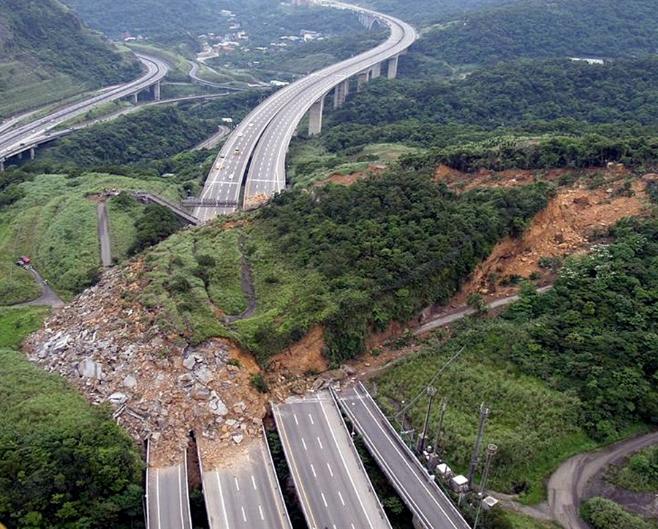
Types of Erosion
Sheet erosion

Slide 28
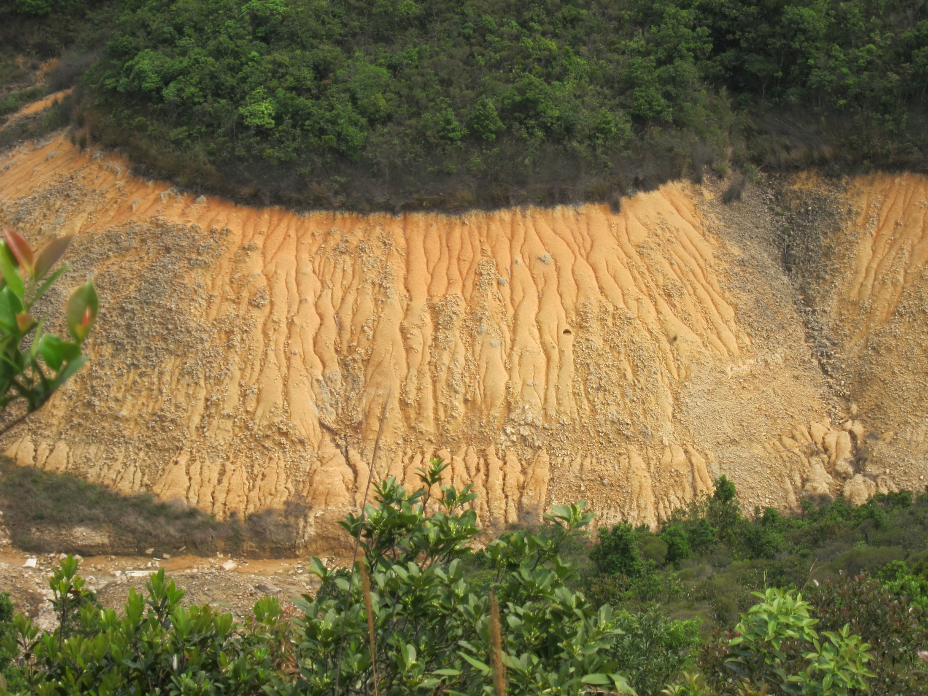
Gully erosion

Slide 29
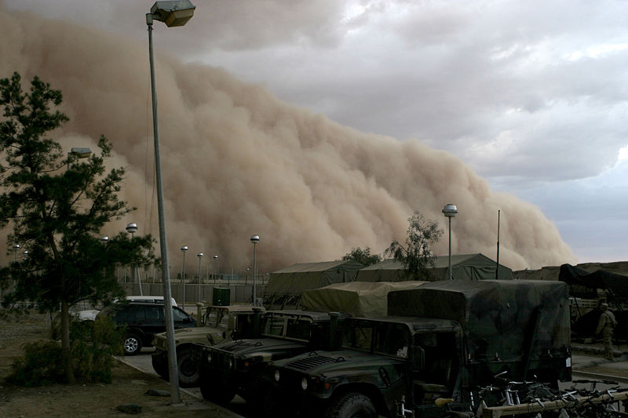
Wind erosion

Slide 30
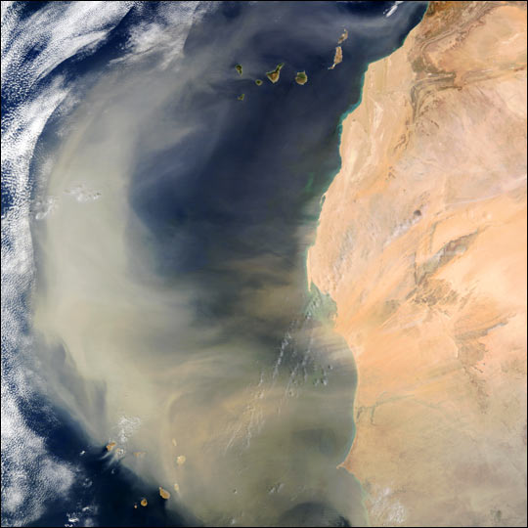
Wind erosion

Slide 31
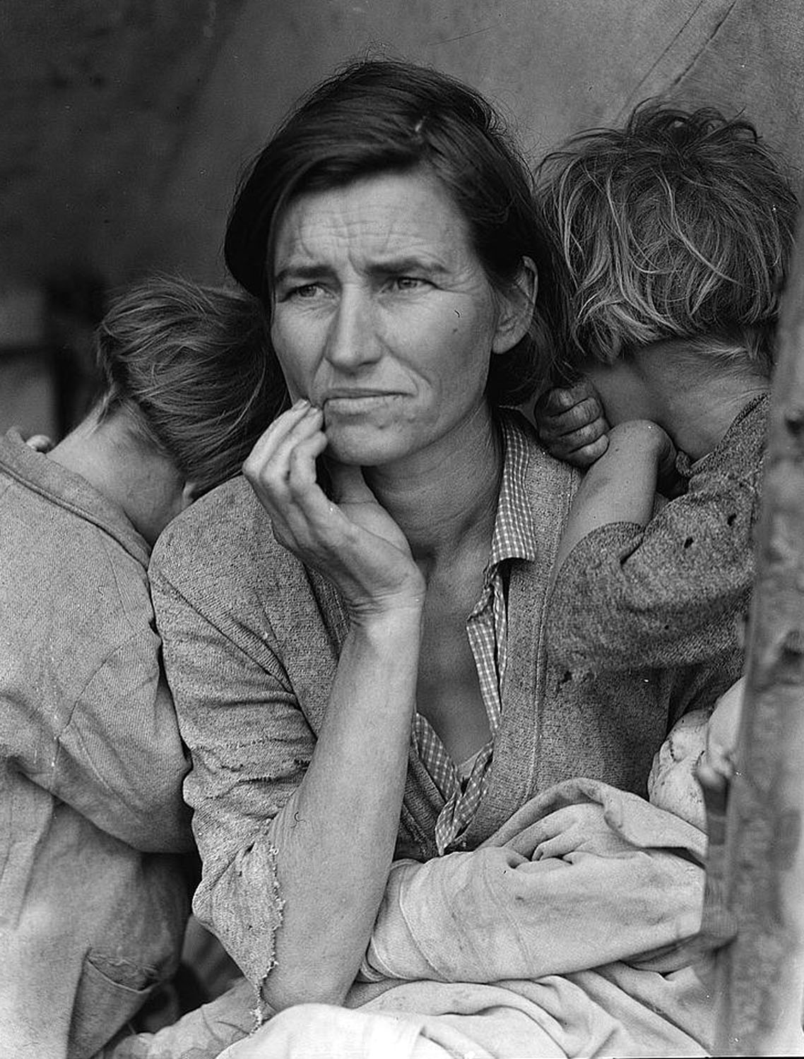
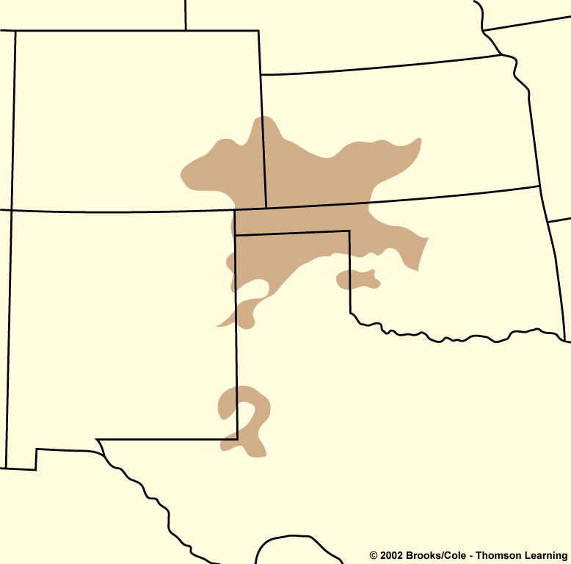
The Dust Bowl
Drought and degraded farmland produced the 1930s Dust Bowl.
Storms brought dust from the U.S. Great Plains all the way to New York and Washington, and wrecked many lives.
Colorado
Kansas
Dust
Bowl
Oklahoma
New Mexico
Texas
Figure 8.14

Slide 32
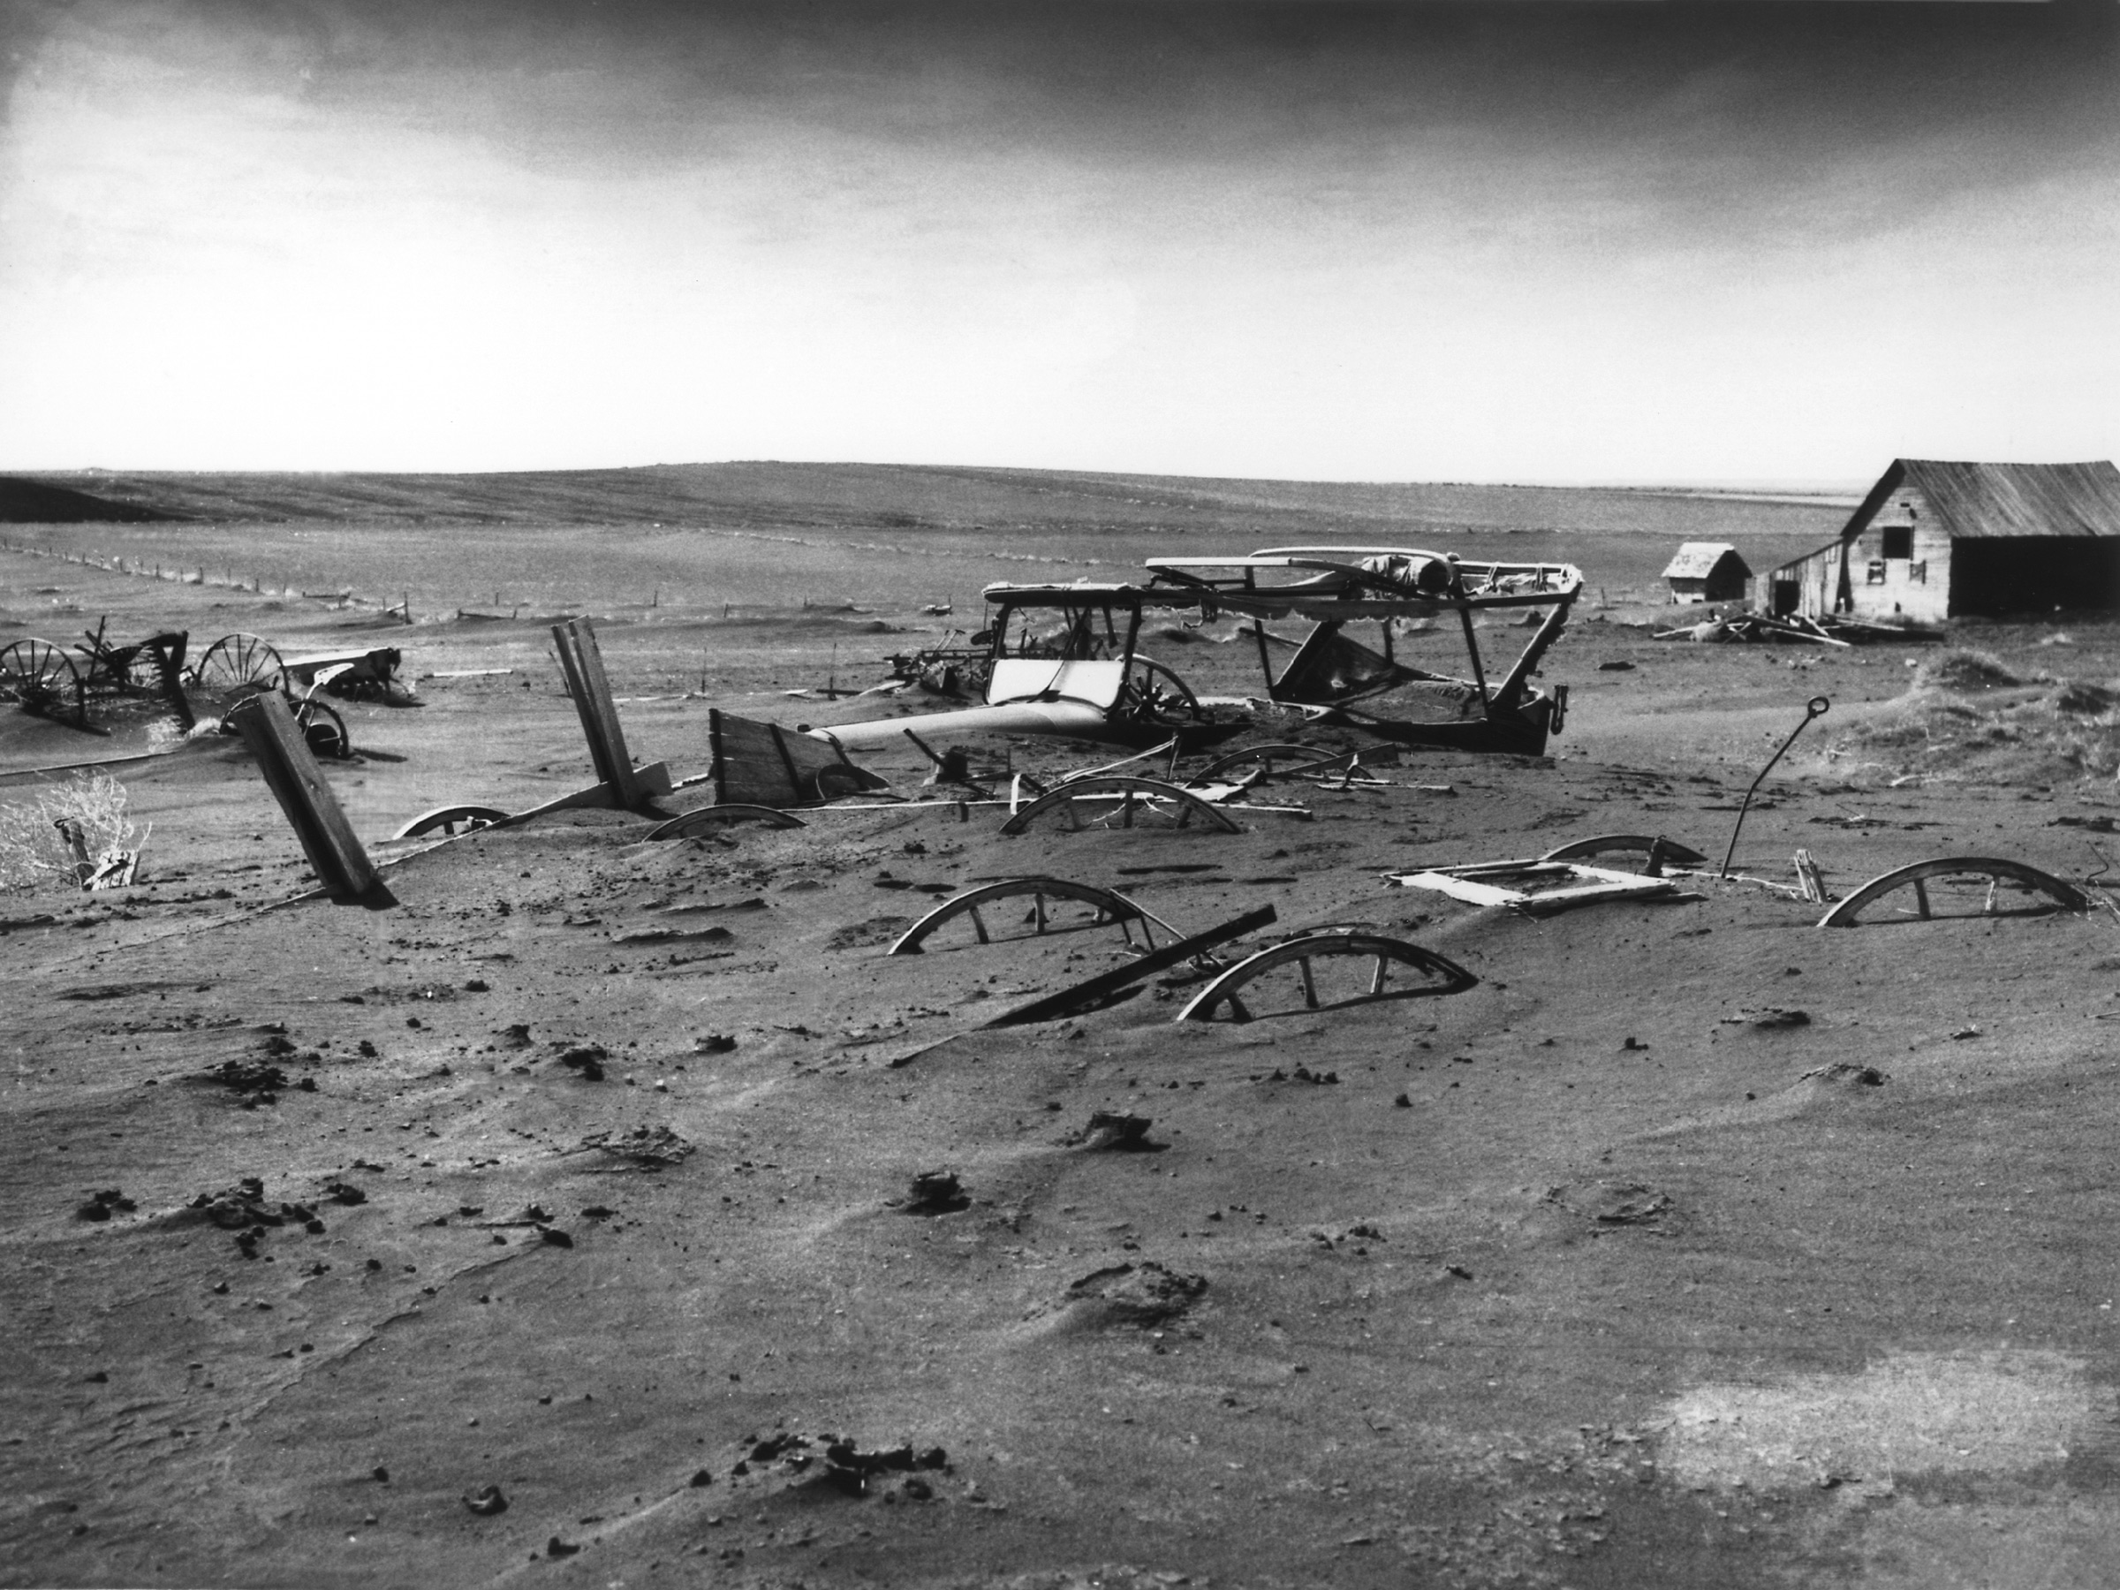

Slide 33
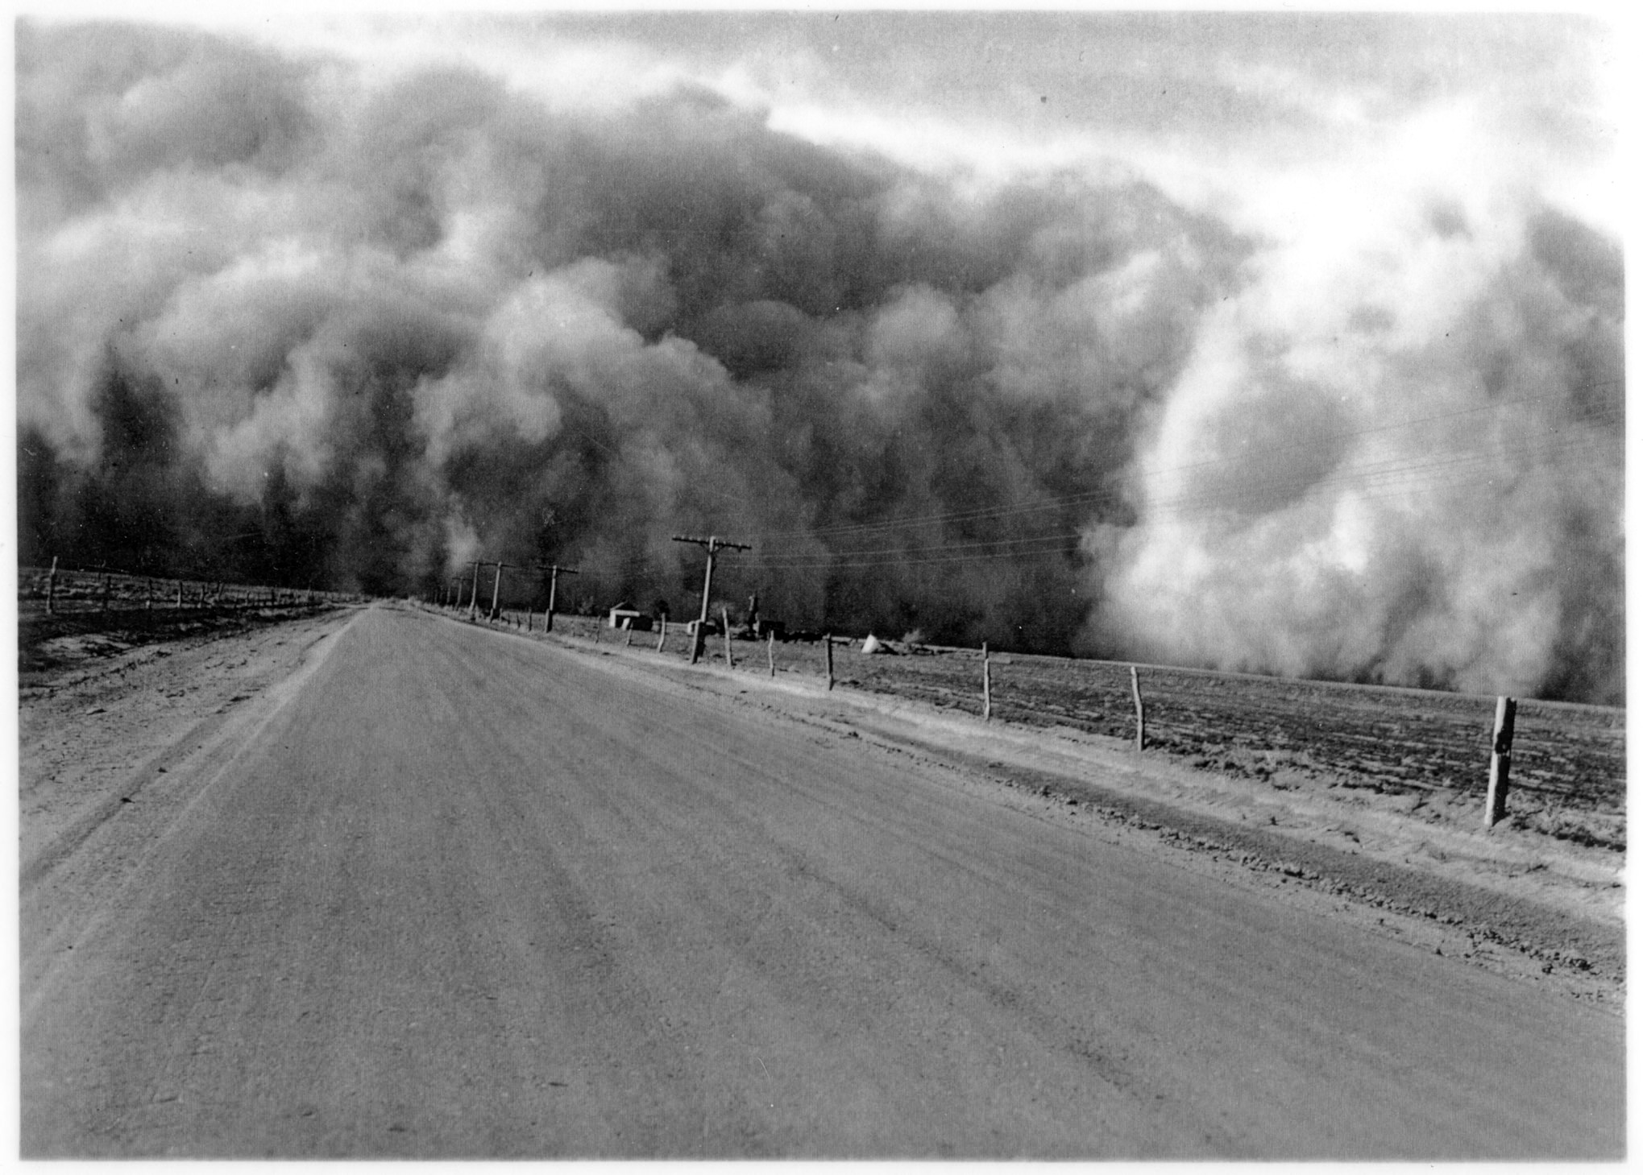

Slide 34
Soil conservation
As a result of the Dust Bowl,
the U.S. Soil Conservation Act of 1935 and
the Soil Conservation Service (SCS) were created.
SCS: Local agents in conservation districts worked with farmers to disseminate scientific knowledge and help them conserve their soil.

Slide 35
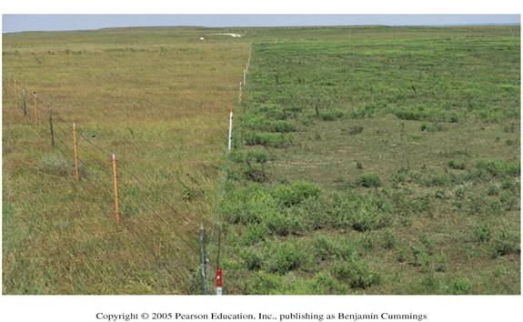
Overgrazing
When livestock eat too much plant cover on rangelands, impeding plant regrowth
The contrast between ungrazed and overgrazed land on either side of a fenceline can be striking.

Slide 36
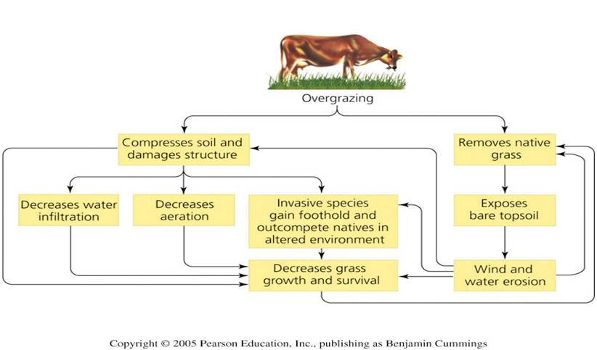
Overgrazing
Overgrazing can set in motion a series of positive feedback loops.

Slide 37
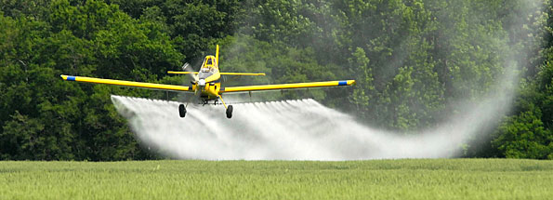
Artificial fertilizers increase crop yields buy:
Toxification of the soil
Acidify and change the pH of the soil

Slide 38
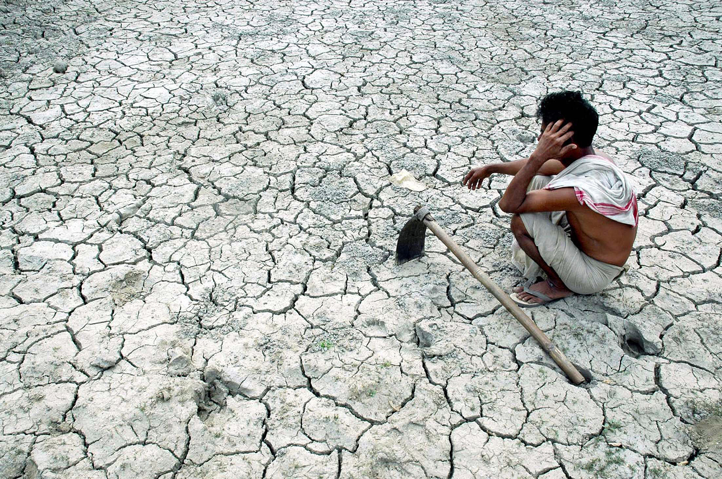
Unsustainable farming practices
Monoculture farming- too much of the same crop reduces specific nutrients
Over cropping- not resting the soil

Slide 39
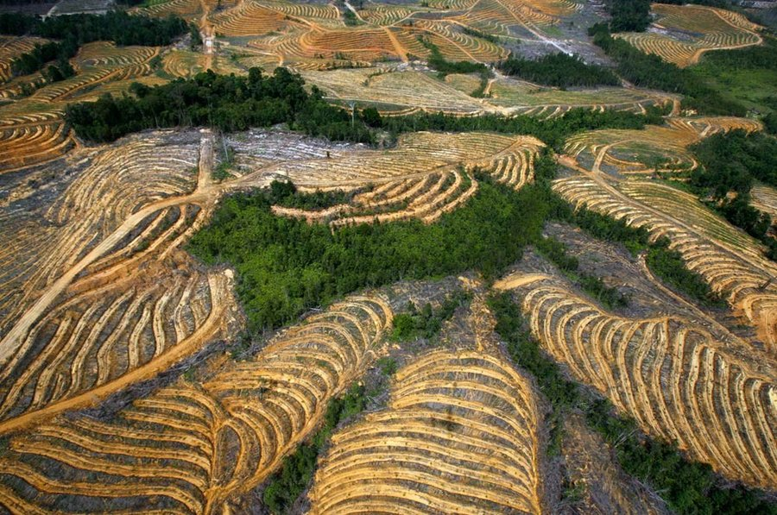
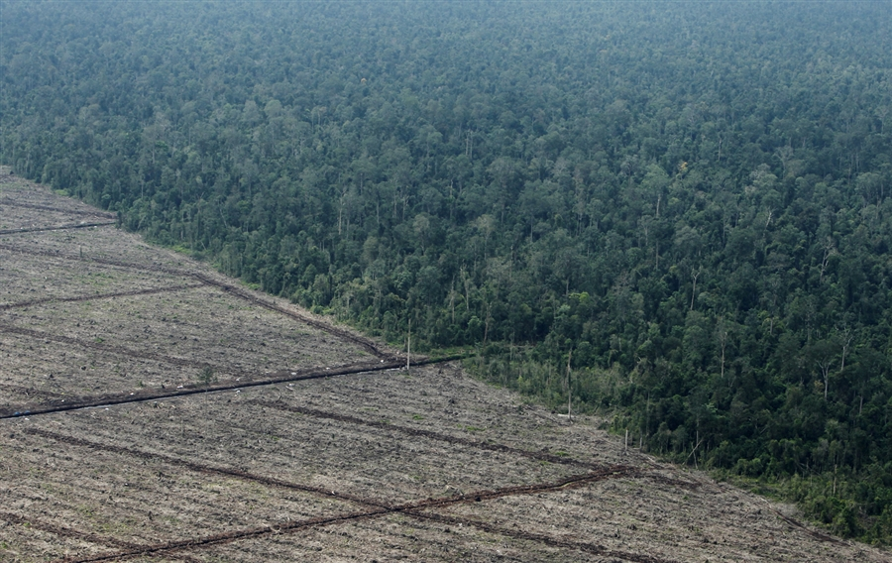
Deforestation
Loss of plant cover by farming, logging, construction, overgrazing by livestock, off-road vehicles, deliberate burning of vegetation and other activities leave soil vulnerable to erosion.

Slide 40
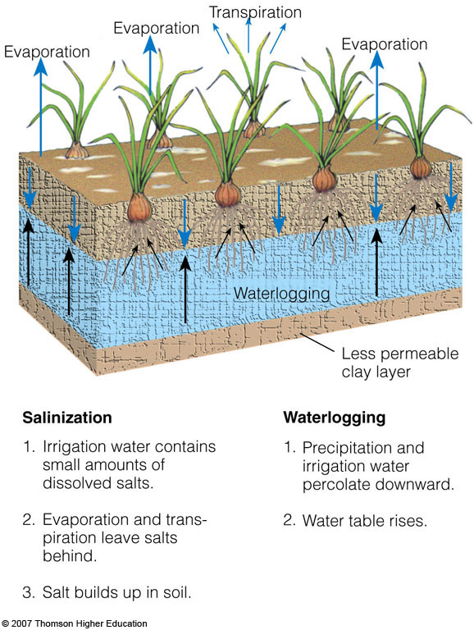
Salinization and Waterlogging
Repeated irrigation can reduce crop yields by causing salt buildup in the soil and waterlogging of crop plants.
Both result in:
stunted plant growth, lower crop yields,
dead plants and ruined land.
Figure 13-13

Slide 41
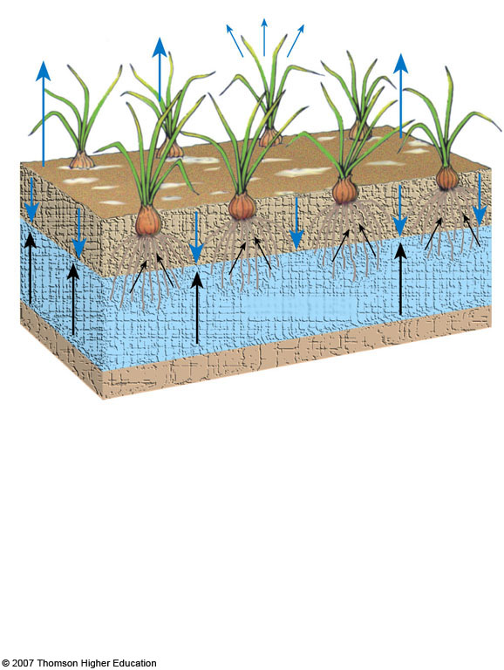
Transpiration
Evaporation
Evaporation
Evaporation
Waterlogging
Less permeable clay layer
Salinization
Waterlogging
1. Irrigation water contains small amounts of dissolved salts
1. Precipitation and irrigation water percolate downward.
2. Evaporation and transpiration leave salts behind.
2. Water table rises.
3. Salt builds up in soil.
Fig. 13-13, p. 281
Notes:
Figure 13.13
Natural capital degradation: salinization and waterlogging of soil on irrigated land without adequate drainage can decrease crop yields.

Slide 42
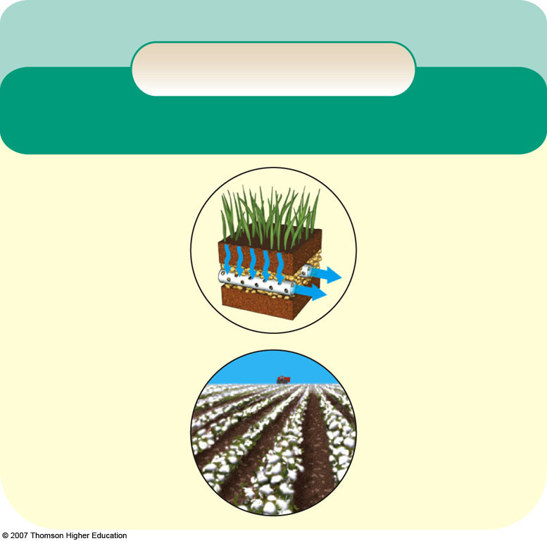
Solutions
Soil Salinization
Prevention
Cleanup
Reduce irrigation
Flush soil (expensive and wastes water)
Stop growing crops for 2–5 years
Switch to salt-tolerant crops (such as barley, cotton, sugarbeet)
Install underground drainage systems (expensive)
Fig. 13-15, p. 281
Notes:
Figure 13.15
Solutions: methods for preventing and cleaning up soil salinization. QUESTION: Which two of these solutions do you think are the most important?

Slide 43
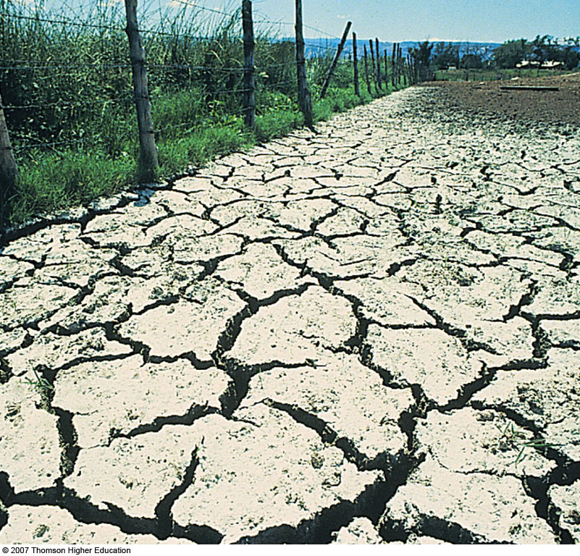
Salinization and Waterlogging of Soils: A Downside of Irrigation
Example of high evaporation, poor drainage, and severe salinization.
White alkaline salts have displaced cops.
Figure 13-14

Slide 44
Monocultures
Intensified agriculture meant monocultures, vast spreads of a single crop.
This is economically efficient, but increases risk of catastrophic failure (“all eggs in one basket”).
Wheat monoculture in Washington
Figure 9.4a

Slide 45
Crop diversity
Monocultures also have reduced crop diversity.
90% of all human food now comes from only 15 crop species and 8 livestock species.

Slide 46
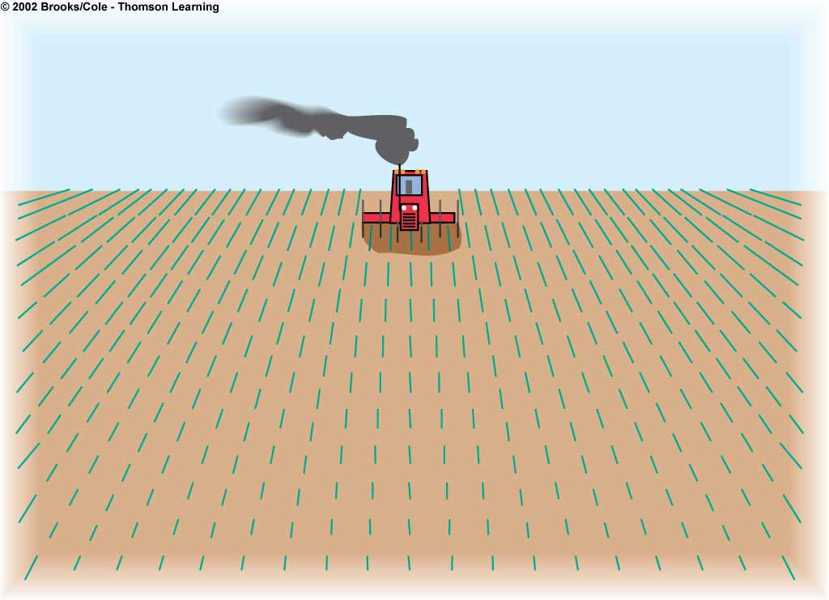
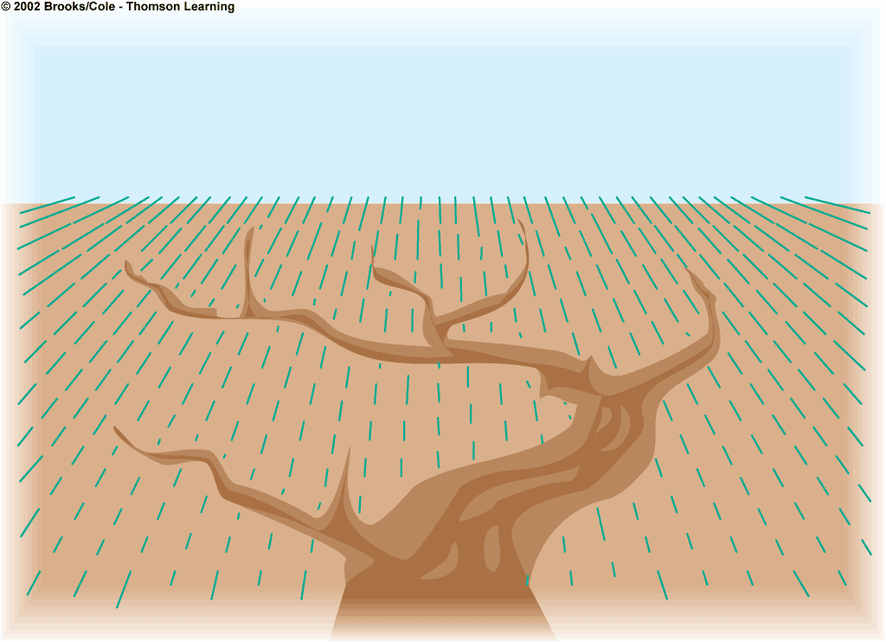
Monocultures
Biodiversity Loss
Soil
Loss and degradation of habitat from
clearing grasslands and forests and
draining wetland
Fish kills from pesticide runoff
Killing of wild predators to protect
livestock
Loss of genetic diversity from
replacing thousands of wild crop
strains with a few monoculture strains
Erosion
Loss of fertility
Salinization
Waterlogging
Desertification

Slide 47
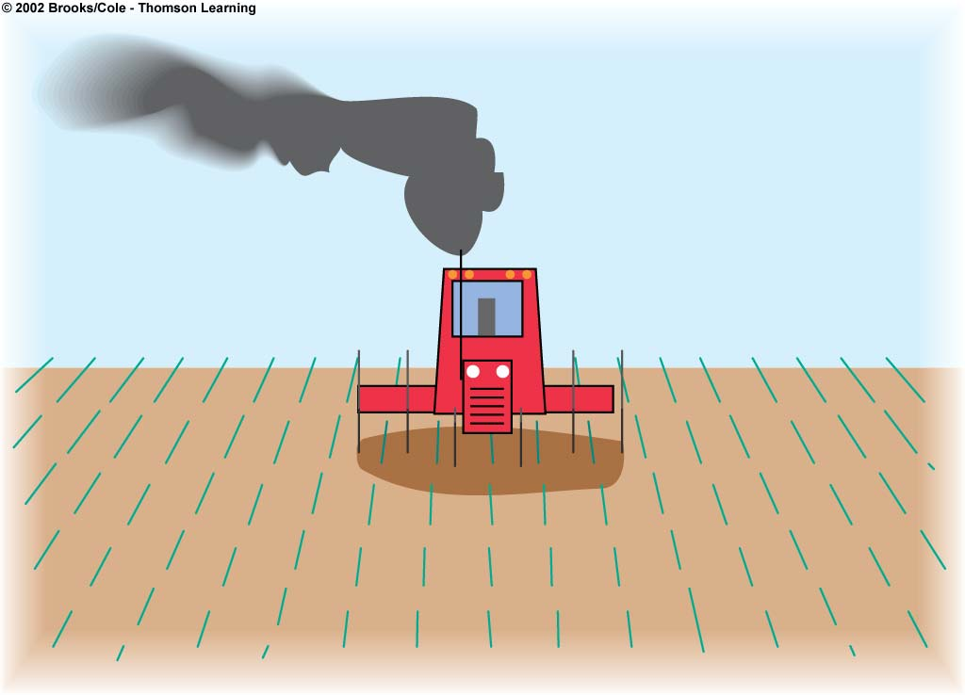
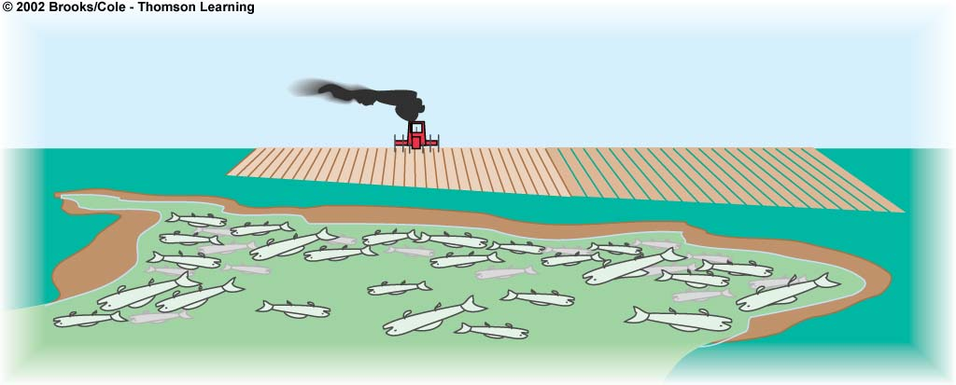
Monocultures
Air Pollution
Water
Greenhouse gas emissions from fossil
Fuel issue
Other air pollutants from fossil fuel use
Pollution from pesticide sprays
Water waste
Aquifer depletion
Increased runoff and
flooding from land cleared
to grow crops
Sediment pollution from
erosion
Fish kills from pesticide
runoff
Surface and groundwater
pollution from pesticides
and fertilizers
Overfertilization of lakes
and slow-moving rivers
from runoff of nitrates
and phosphates from
fertilizers, livestock
wastes, and food
processing wastes

Slide 48
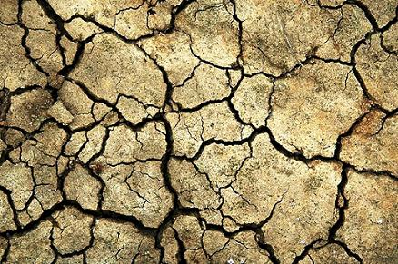
Preventing soil degradation
Several farming strategies to prevent soil degradation:
• Crop rotation
• Contour farming
• Intercropping
• Terracing
• Shelterbelts
• Conservation tillage

Slide 49
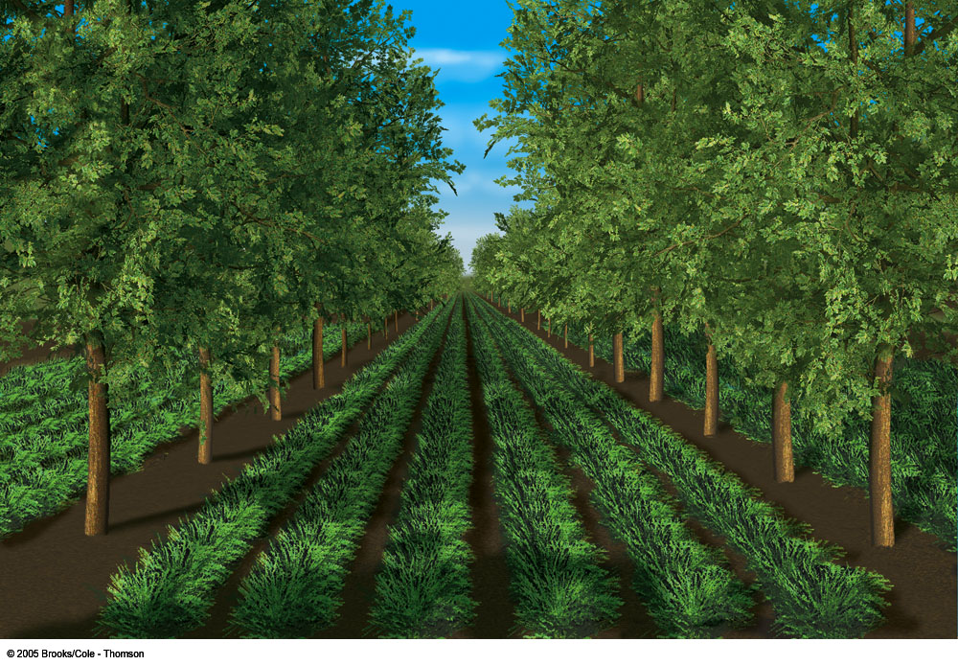
(c) Alley cropping

Slide 50
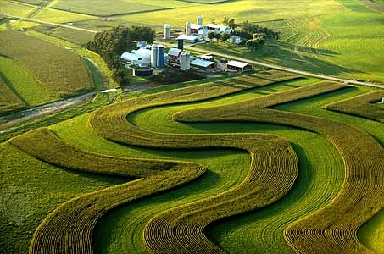
Contour farming
Planting along contour lines of slopes helps reduce erosion on hillsides.

Slide 51
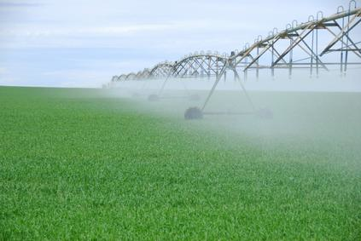
Irrigation
The artificial provision of water to support agriculture
70% of all freshwater used by humans is used for irrigation.
Irrigated land globally covers more area than all of Mexico and Central America combined.
Irrigation has boosted productivity in many places … but too much can cause problems.

Slide 52
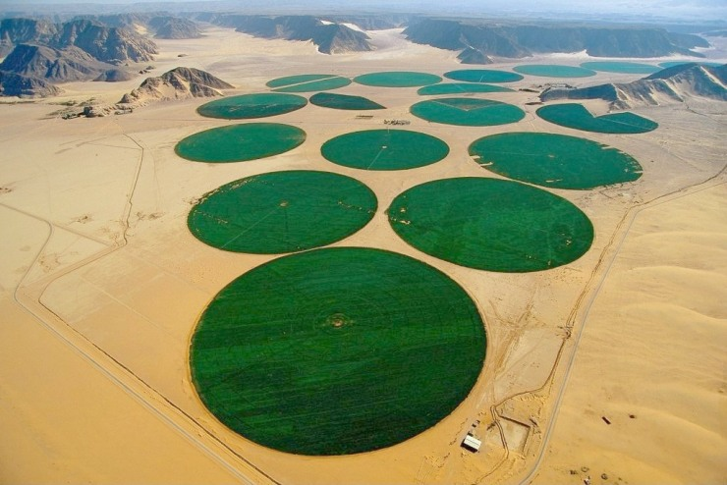

Slide 53
Improved irrigation
In conventional irrigation, only 40% of the water reaches plants.
Efficient drip irrigation targeted to plants conserves water, saves money, and reduces problems like salinization.
Figure 8.17

Slide 54
Crop rotation
Alternating the crop planted (e.g., between corn and soybeans) can restore nutrients to soil and fight pests and disease.
 | Year 1 | Year 2 | Year 3 | Year 4
Field 1 | Soy Beans | Nothing | Cotton | Rice
Field 2 | Rice | Soy Beans | Nothing | Cotton
Field 3 | Cotton | Rice | Soy Beans | Nothing
Field 4 | Nothing | Cotton | Rice | Soy Beans

Slide 55
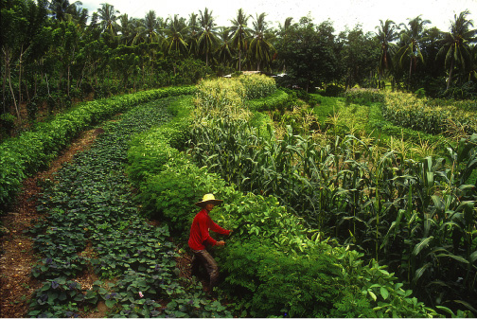
Intercropping
Mixing crops such as in strip cropping can provide nutrients and reduce erosion.
Figure 8.16c

Slide 56
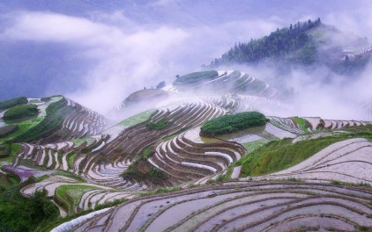
Terracing
Cutting stairsteps or terraces is the only way to farm extremely steep hillsides without causing massive erosion. It is labor-intensive to create, but has been a mainstay for centuries in the Himalayas and the Andes.

Slide 57
Shelterbelts
Rows of fast-growing trees around crop plantings provide windbreaks, reducing erosion by wind.

Slide 58
Conservation tillage
No-till and reduced-tillage farming leaves old crop residue on the ground instead of plowing it into soil. This covers the soil, keeping it in place.
Here, corn grows up out of a “cover crop.”

Slide 59
Conservation tillage
Conservation tillage is not the best practice for all crops everywhere.
It often requires more chemical herbicides (because weeds are not plowed under).
It often requires more fertilizer (because other plants compete with crops for nutrients).
But legume cover crops can keep weeds at bay while nourishing soil, and green manures can be used as organic fertilizers.

Slide 60
Trade-Offs
Conservation Tillage
Advantages
Disadvantages
Reduces erosion
Saves fuel
Cuts costs
Holds more soil
water
Reduces soil
compaction
Allows several crops
per season
Does not reduce
crop yields
Reduces CO₂
release from soil
Can increase
herbicide use for
some crops
Leaves stalks that
can harbor crop
pests and fungal
diseases and
increase pesticide
use
Requires
investment
in expensive
equipment

Slide 61
Organic farming- Straw to reduce water loss and erosion, natural fertilizers, compost

