Slide 1
COMMAND TERMS
Verbs used in examination questions.

Slide 2
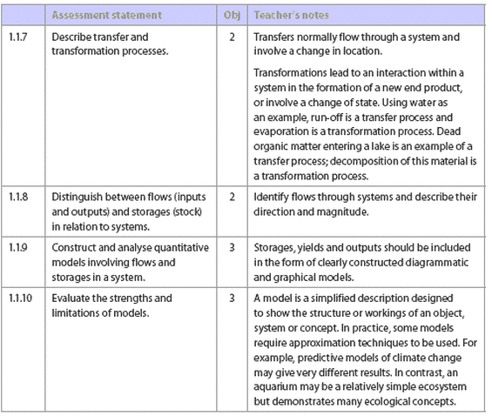
Command terms with definitions
These command terms indicate the depth of treatment required for a given assessment statement and relate to the course objectives in the “Assessment objectives” section.
These terms will be used in examination questions, and so it is important that you are familiar with the following definitions.

Slide 3
Objective 1
Objectives 1 are lower‑order skills and usually worth 1 or 2 points

Slide 4
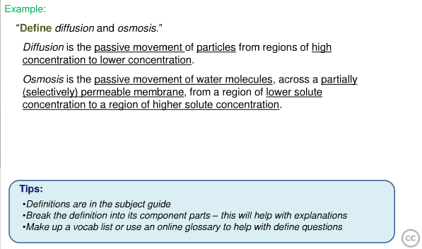
Define
Give the precise meaning of a word, phrase or physical quantity.

Slide 5
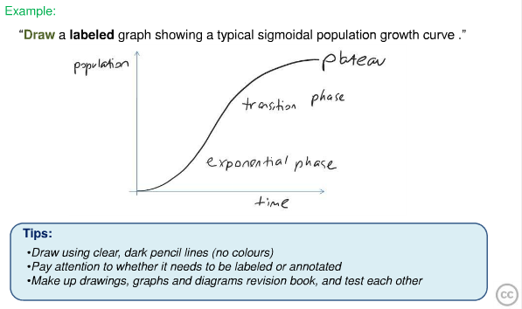
Draw
Represent by means of pencil lines.

Slide 6
Label
Add labels to a diagram.

Slide 7
List
Give a sequence of names or other brief answers with no explanation.

Slide 8
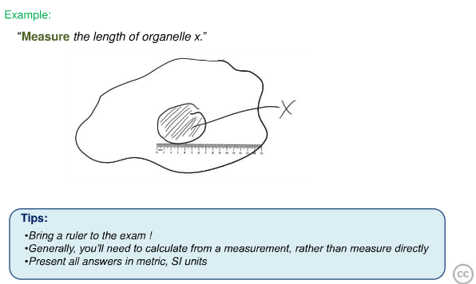
Measure
Find a value for a quantity.

Slide 9
State
Give a specific name, Value, or other brief answer without explanation or calculation.

Slide 10
Objective 2
Objectives 2 are lower‑order skills and

Slide 11
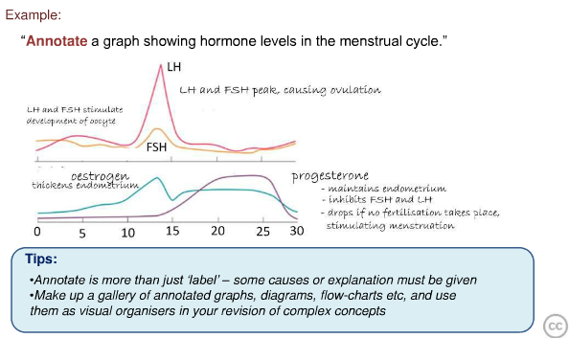
Annotate
Add brief notes to a diagram or graph.

Slide 12
Apply
Use an idea, equation, principle, theory or law in a new situation.

Slide 13
Calculate
Obtain a numerical answer showing the relevant stages of working

Slide 15
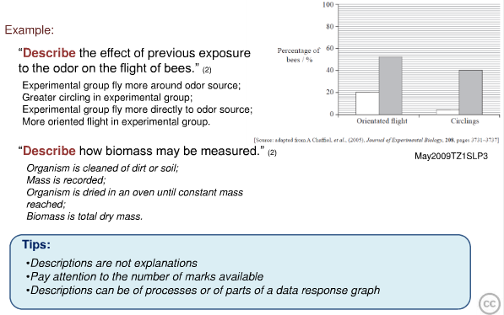
Describe
Give a detailed account.

Slide 16
Distinguish
Make clear the differences between two or more concepts or items.

Slide 17
Estimate
Obtain an approximate value.

Slide 18
Identify
Provide an answer from a number of possibilities.

Slide 19
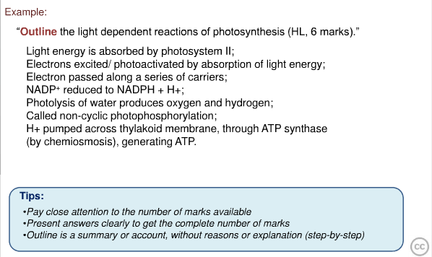
Outline
Give a brief account or summary.

Slide 20
Objective 3
objectives 3 relate to higher-order skills and have a higher point value on the test.

Slide 21
Analyse
Break down in order to bring out the essential elements or structure.

Slide 22
Comment
Give a judgment based on a given statement or result of a calculation.

Slide 23
Compare or Compare & Contrast
Give an account of similarities and differences between two (or more) items, referring to both (all) of them throughout.
Compare and contrast the production : respiration ratios of a food production system you have studied and a natural ecosystem with a climax community.
(6)
Compare the efficiency of terrestrial and aquatic food productions

Slide 24
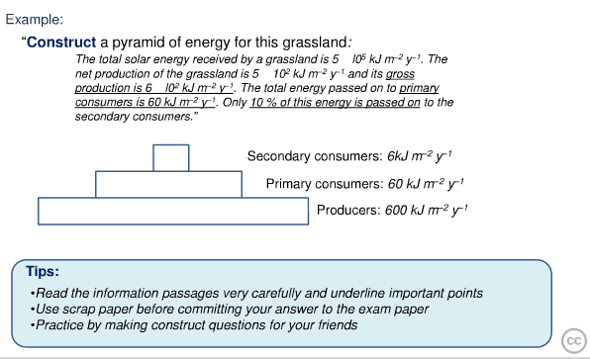
Construct
Display information in a diagrammatic or logical form.

Slide 25
Deduce
Reach a conclusion from the information given.

Slide 26
Derive
Manipulate a mathematical relationship(s) to give a new equation or relationship.

Slide 27
Design
Produce a plan, simulation or model.

Slide 28
Determine
Obtain the only possible answer.

Slide 29
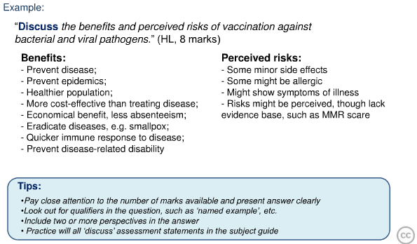
Discuss
Offer a considered and balanced review that includes a range of arguments, factors or hypotheses. Opinions or conclusions should be presented clearly and supported by appropriate evidence.

Slide 30
Evaluate
Make an appraisal by weighing up the strengths and limitations.
Evaluate species based conservation as an approach for preserving biodiversity and suggest why trophy hunting (i.e. hunting animals for sport) may represent an acceptable method of achieving this goal.

Slide 31
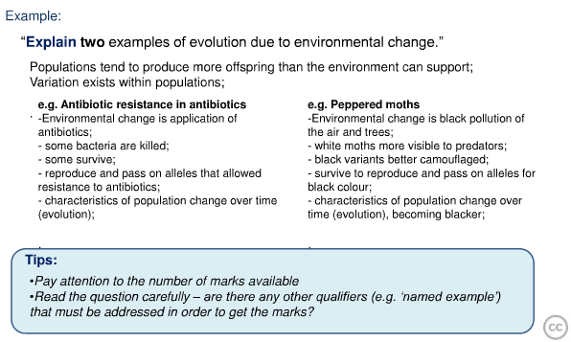
Explain
Give a detailed account of reasons or causes.

Slide 32
Justify
Give valid reasons or evidence to support an answer or conclusion.
Justify whether you believe that sustainable development is possible on Earth in the long term.

Slide 33
Predict
Give an expected result.

Slide 34
Solve
Obtain an answer using algebraic and/or numerical methods.

Slide 35
Suggest
Propose a solution, hypothesis or other possible answer..

