Slide 1
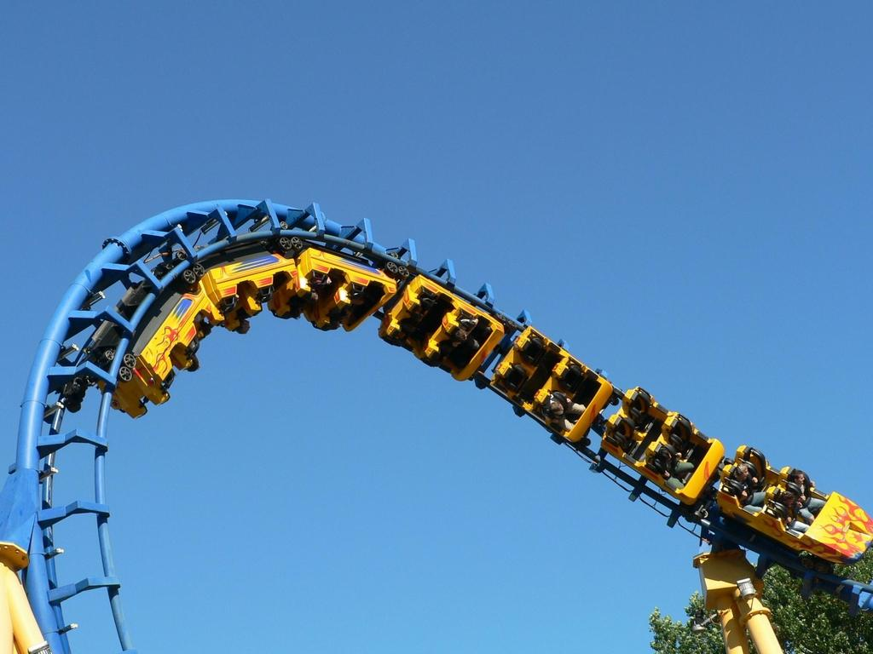
E06 Motion & Forces

Slide 2
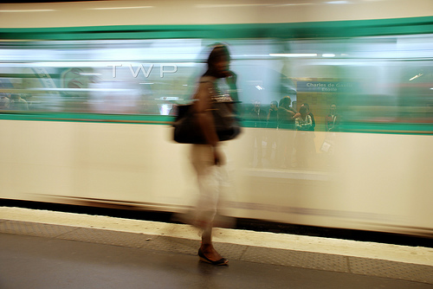
Frame of reference- a system of objects that are not moving with respect to another.
Also called a Point of Reference

Slide 3
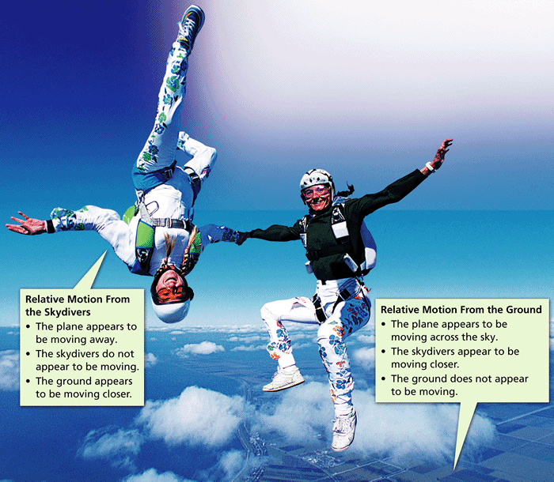
Describing Motion
- Describing and Measuring Motion
Whether or not an object is in motion depends on the reference point you choose.
Relative Motion-movement in reference to the frame of reference/ reference point.

Slide 4
Speed= the distance traveled per unit of time
Speed = distance/ time
Speed = 100m/20 sec
Speed = 5 m/sec
Average Speed=the total distance traveled divided by the total time traveled
Total distance = 23 km + 22km = 45 km
Total time= 2 hr +1 hr = 3 hr
Average speed= 45 km/3hr
Average speed = 15 km/hr

Slide 5
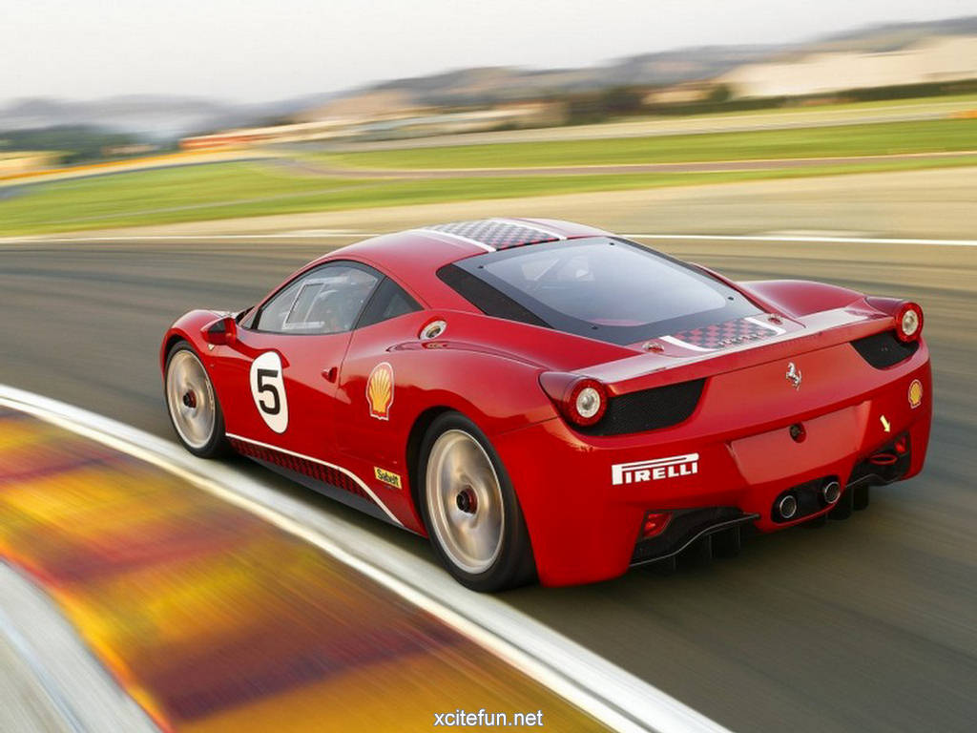
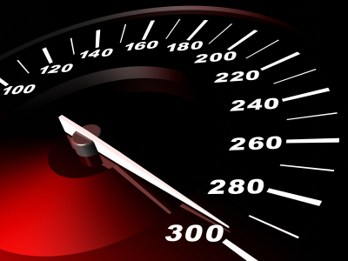
Instantaneous Speed= rate in which an object is moving in a given moment of time.
Speedometer gives you instantaneous speed

Slide 6
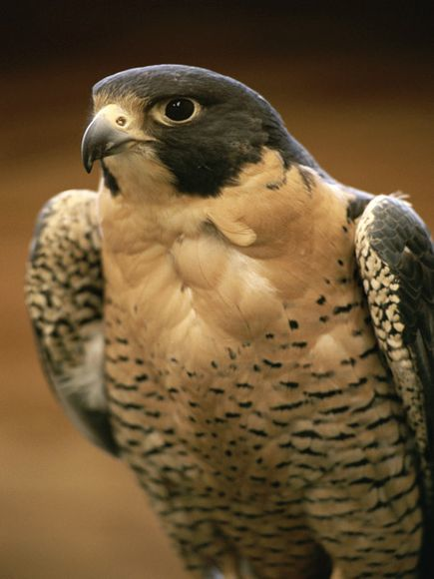
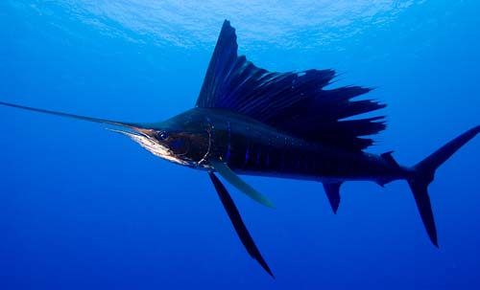
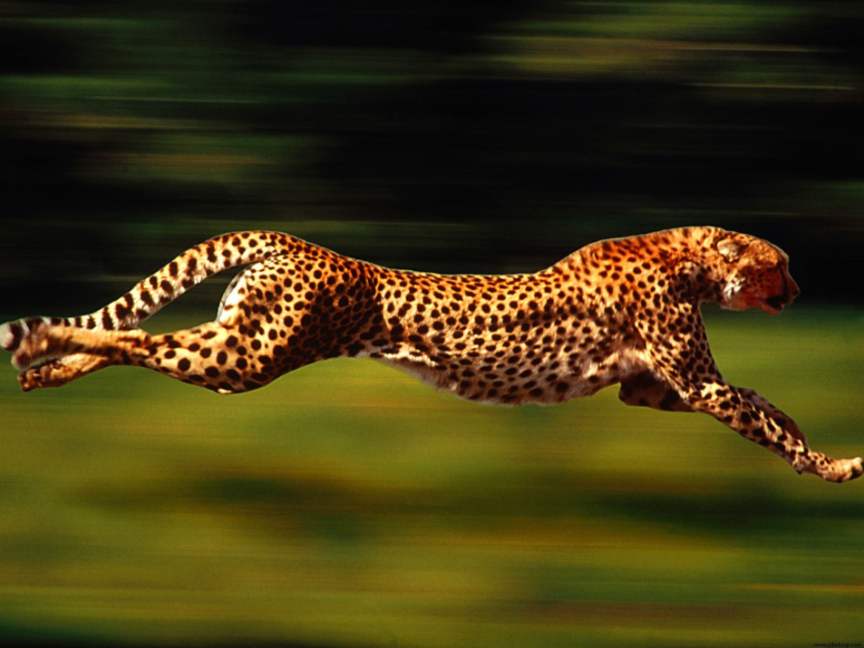
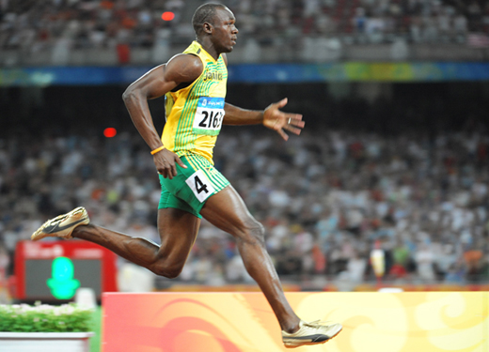
peregrine falcon can dive at almost 300km per hour
Fastest fish: Sailfish 68 mph (110 km/h).
Cheetah can sprint up to 120 km/h, accelerate from 0 to 110 km/h in three seconds.
Usain Bolt 100 m in 9.58 s

Slide 7
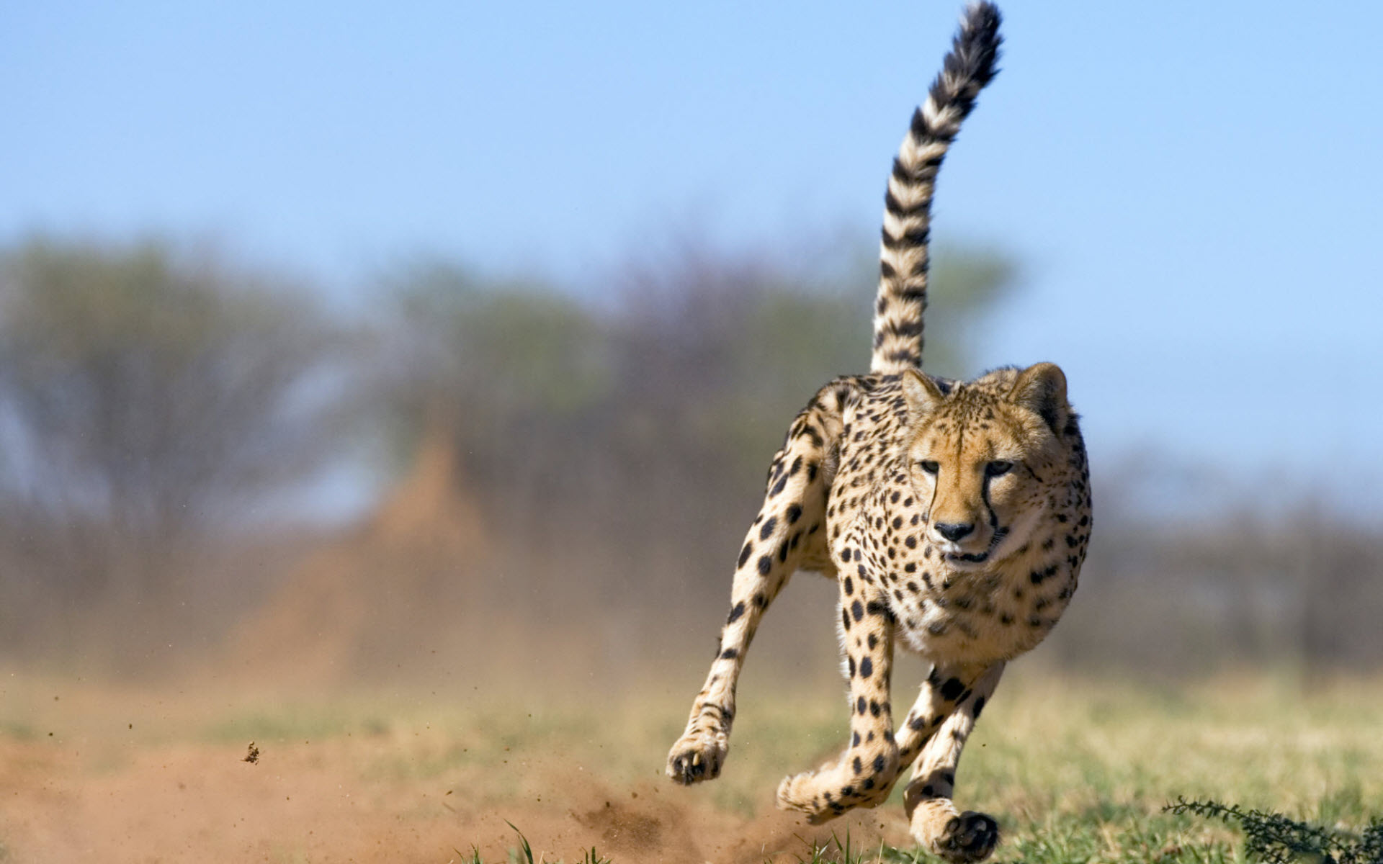
Velocity (v) = speed in a given direction.
This also called a vector.
Vector- a mathematical quantity that has both magnitude and direction
V= d/t
Change in velocity can be the result of a change in speed, change in direction, or both.

Slide 8
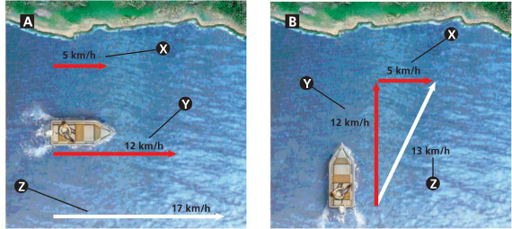
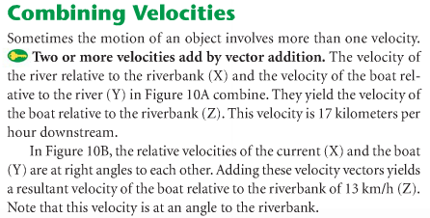
Pythagorean theorem
a² + b² = c²

Slide 9
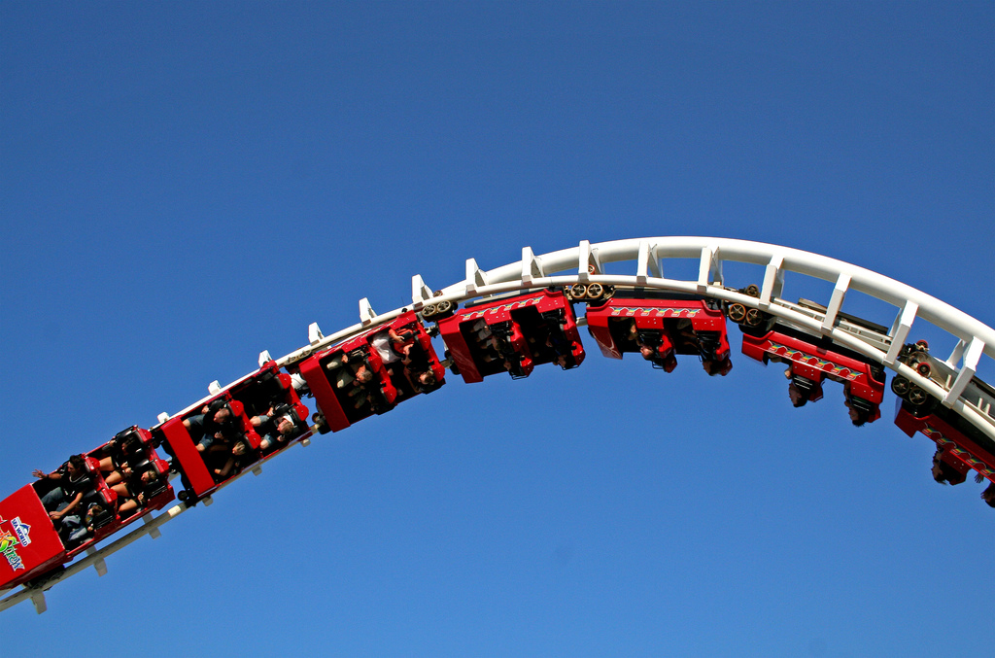
Acceleration- the rate in which velocity changes.
Acceleration can occur 3 different ways:
Speeding up – positive acceleration
Slowing down- negative acceleration (deceleration)
Changing direction

Slide 10
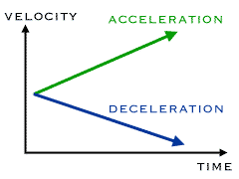
Calculating Acceleration
Acceleration= Change in velocity/ total time
Acceleration= Final velocity- Initial Velocity
Time
a = V_{F} – V_{I}
_____
_{Time}
a = m/s/s
a=m/s²

Slide 11
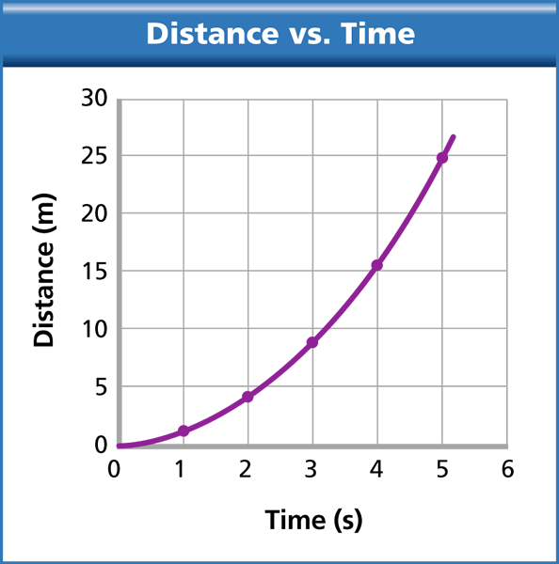
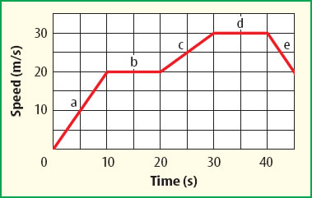
Graphs of Acceleration

Slide 12
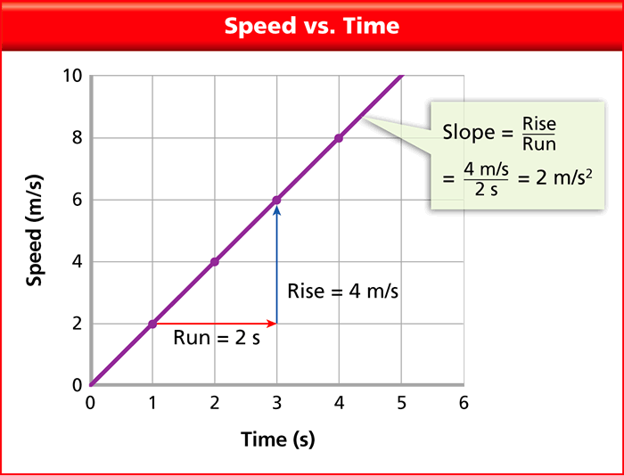
Calculating speed from the slope.
Slope =
Y₂-Y₁/X₂-X₁

Slide 13
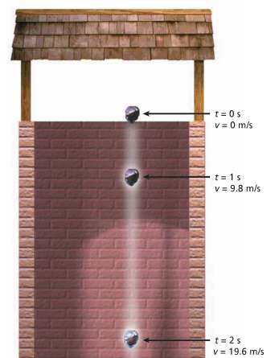
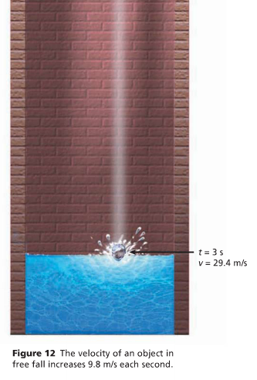
Acceleration due to gravity = 9.8 m/s²
g = 9.8 m/s²
Free fall- the movement of an object toward Earth where gravity is the only force acting on that object.

Slide 14
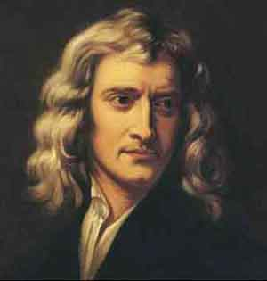
Force is a push or a pull that acts on an object
Unit of Measurement = Newton
A Newton is the force that causes a 1 kg mass to accelerate at a rate of 1 meter per second each second.
Newton (N) = 1 kg * m/s²
Forces are represented by using arrows
The direction of the arrow indicates the direction of the force.
The length of arrow indicates the strength or magnitude of the force.
10 N
5 N

Slide 15
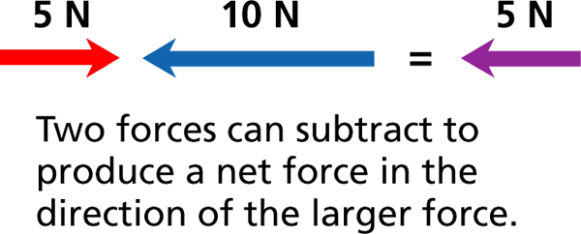
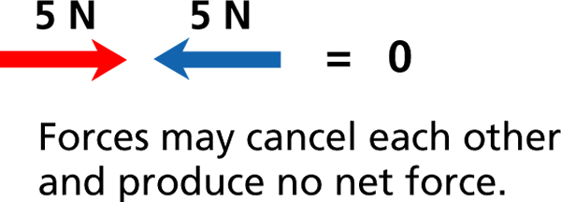
Combining Forces- The combination of all forces acting on an object is called the net force.

Slide 16
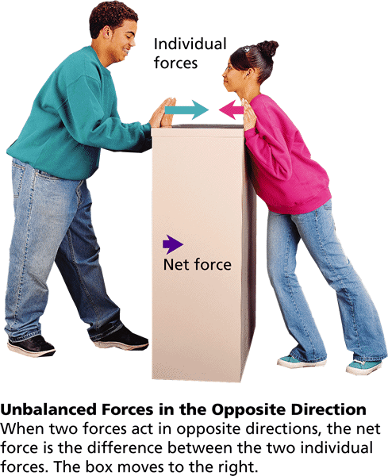
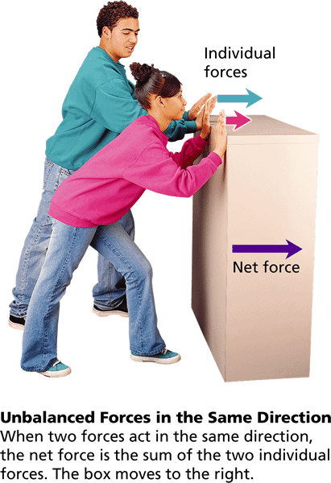
Unbalanced Forces
- The Nature of Force
Unbalanced forces acting on an object result in a net force and cause a change in the object’s motion; acceleration.

Slide 17
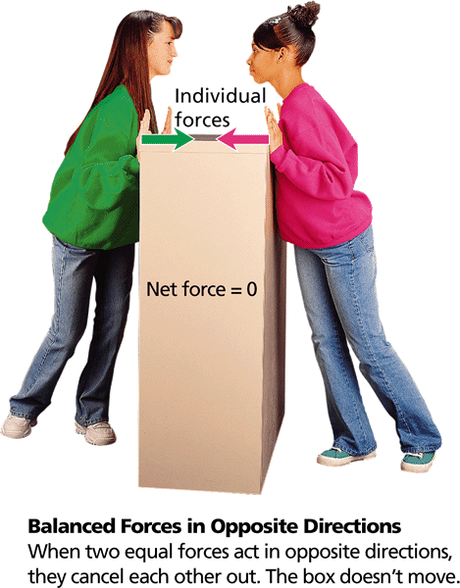
Balanced Forces
- The Nature of Force
Balanced forces acting on an object do not change the object’s motion.

Slide 18
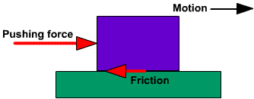
- The Nature of Force
Friction
The force that opposes the motion of objects that touch as they move past each other.
The force that one surface exerts on another when the two rub against each other.
The strength of the force of friction depends on two factors:
The type of surface involved.
How hard the surfaces push against each other.

Slide 19
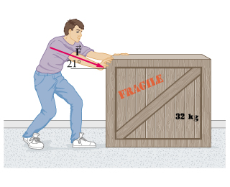
4 types of Friction
1. Static Friction- is the friction force that acts on an object that is not moving.
Always act in the opposite direction to that of the applied force.
Once an object is in motion, static friction is no longer acting on it.
Every time you take a step, you experience static friction.
Force
Static Friction

Slide 20
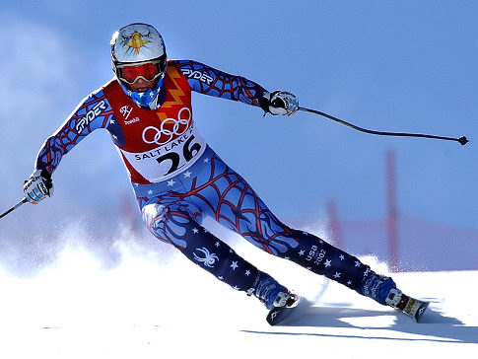
4 types of Friction
2. Sliding Friction: The force that opposes the direction of motion of an object as it slides over a surface.
Because, sliding friction is less than static friction, less force is needed to keep an object moving than to start it moving.

Slide 21
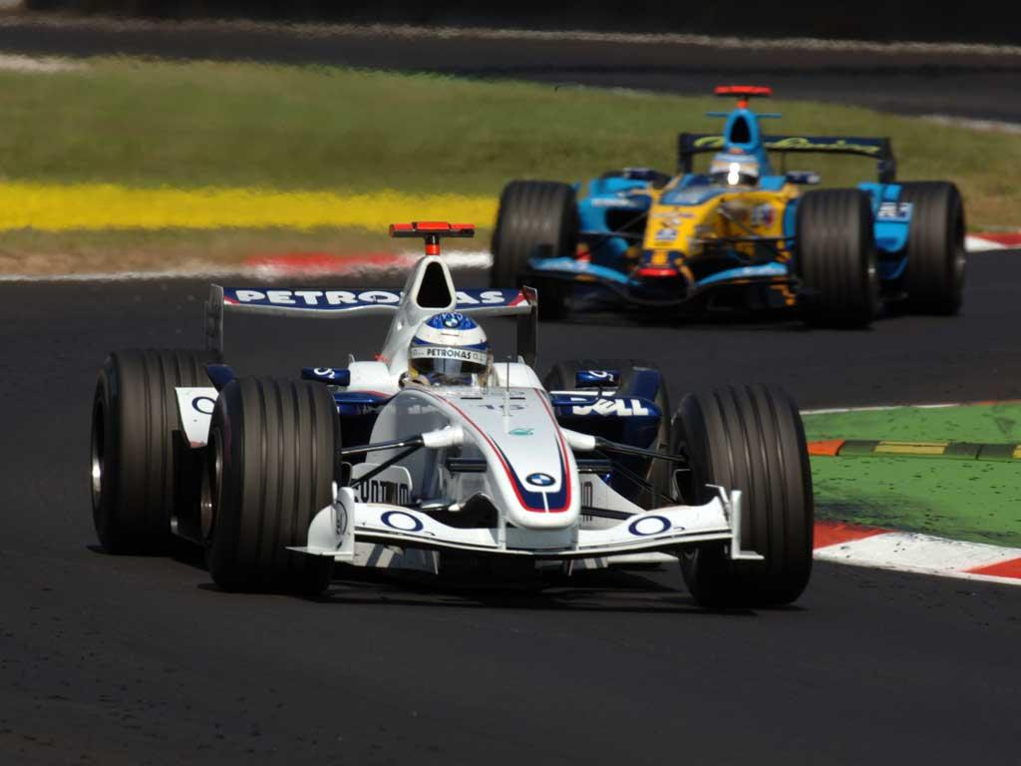
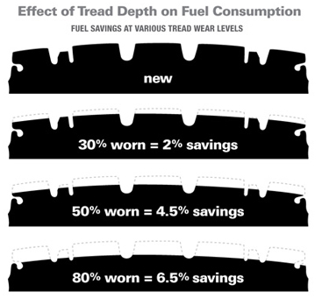
4 types of Friction
3. Rolling Friction- frictional force caused when one object rolls across the surface of another.
When one object rolls across another, both objects are bent slightly out of shape.
The change in shape at the point at the point of rolling contact is the cause of rolling friction.
Is about 100 to 1000 times less than static or sliding friction.

Slide 22
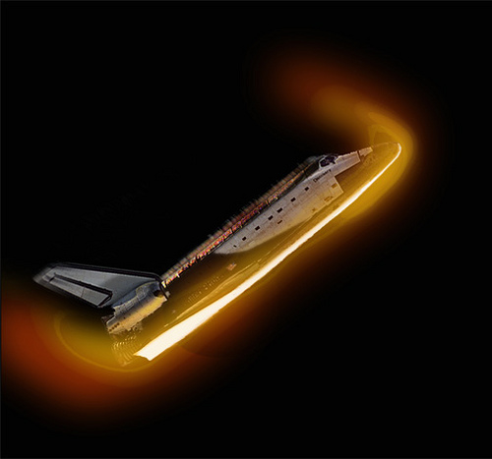
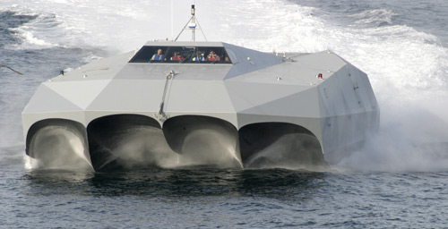
4 types of Friction
4. Fluid Friction-the force that opposes the motion of an object through a fluid.
Fluid is a liquid or a gas.
Increase speed= increase in Fluid friction
(30,000 km/h; 18,000 mph
Burj video

Slide 23
Gravity
- Friction and Gravity
Gravity- attractive force that acts between two masses
Two factors affect the gravitational attraction between objects: mass and distance.

Slide 24
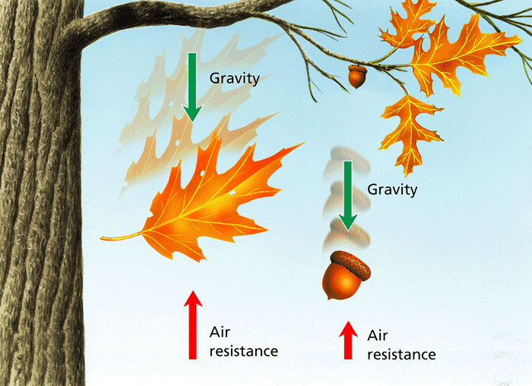
Air Resistance ( Drag)
- Friction and Gravity
Earth’s Gravity act downward towards the center of earth.
Gravity causes objects to accelerate towards earth center, where as air resistance acts in the opposite direction and reduces acceleration.
Falling objects with a greater surface area experience more air resistance.

Slide 25
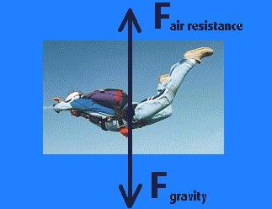
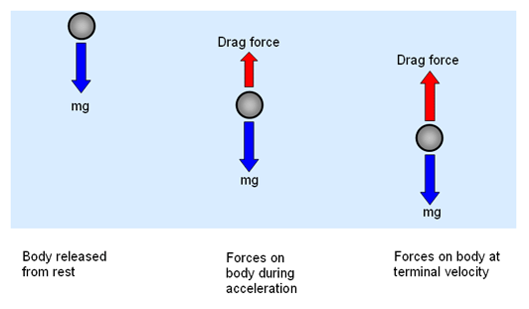
Terminal Velocity- is the constant velocity of a falling object when the force of the air resistance is equal to the force of gravity.( equilibrium)
Maximum acceleration a falling object can have.
Video : Mythbusters

Slide 26
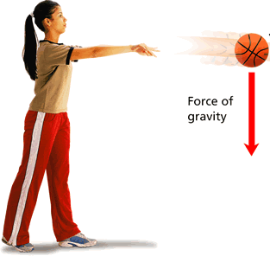
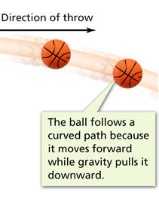
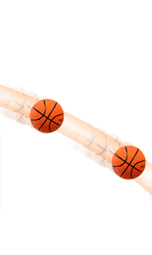
Projectile
- Rockets and Satellites
Projectile – an object that is put into motion through the air
A projectile follows a curved path because the horizontal and vertical motions combine.

Slide 27
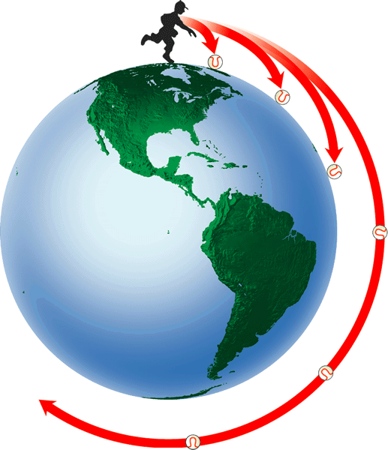
What Is a Satellite?
- Rockets and Satellites
The faster a projectile is thrown, the father it travels before it hits the ground. A projectile with enough velocity moves in a circular orbit. (30,000 km/h; 18,000 mph)

Slide 28
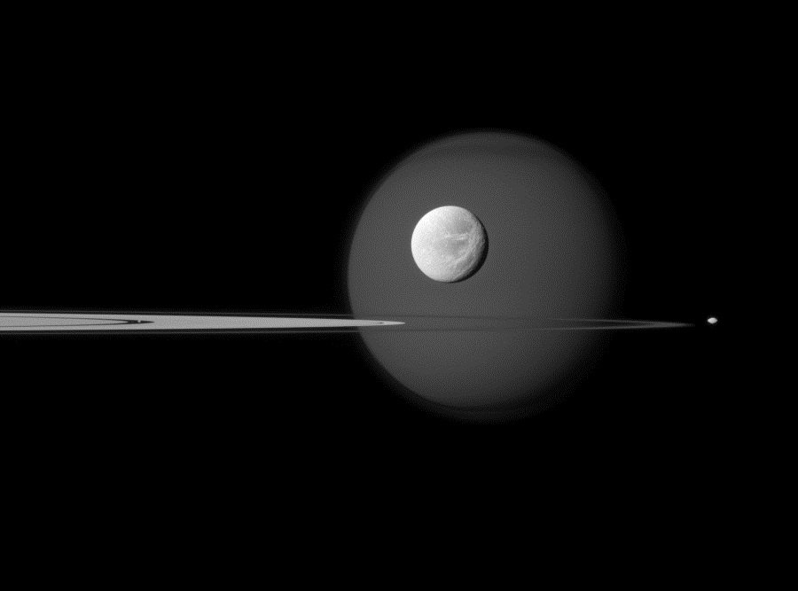
Newton’s Laws of Motion
Newton’s 1st Law of Motion- Law of Inertia
An object at rest will remain at rest unless acted on by an outside force.
An object in motion will remain in motion unless acted on by an outside force.

Slide 29
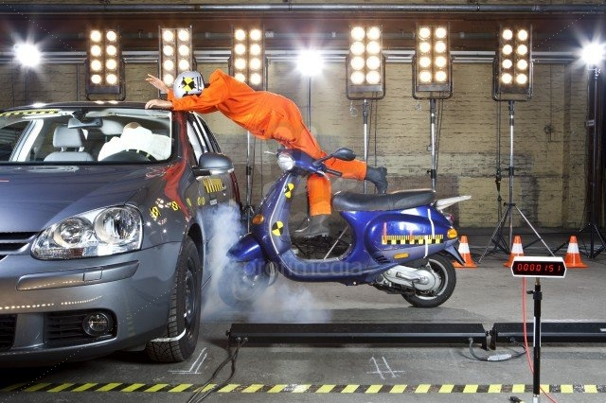
Inertia- the tendency of an object to resist change in motion.

Slide 30
Newton’s Laws of Motion
Newton’s 2nd Law of Motion-
Force is equal to the mass of an object multiplied by acceleration.
F=m*a
Newton (N) = 1 kg * m/s²
The acceleration of an object is equal to the net force acting on it divided by the object's mass.
a= Force(net)/mass
a = Kg*m/s²
kg

Slide 31
Calculation Force:
A speedboat pulls a 55-kg water-skier. The force causes the skier to accelerate at 2.0 m/s². Calculate the net force that causes this acceleration.
F= m X a
F= 55 kg X 2.0 m/s²
F = 110 kg • m/s²
F = 110 N

Slide 33
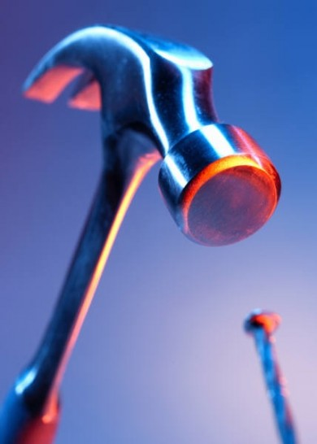
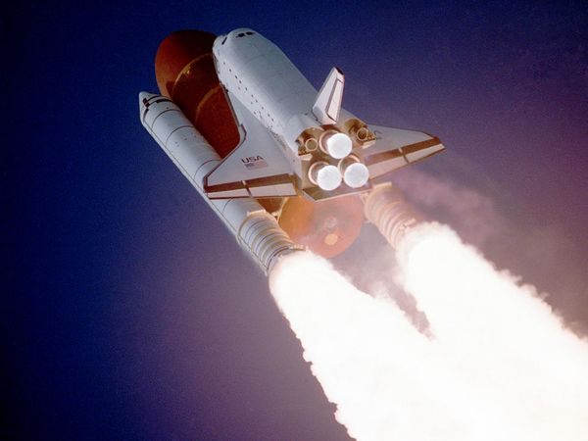
Newton’s Laws of Motion
Newton’s 3rd Law of Motion: Action- Reaction
For every action, there is an equal and opposite reaction.
Whenever one object exerts a force on a 2nd object, the 2nd object exerts an equal and opposite force on the 1st object.

Slide 34
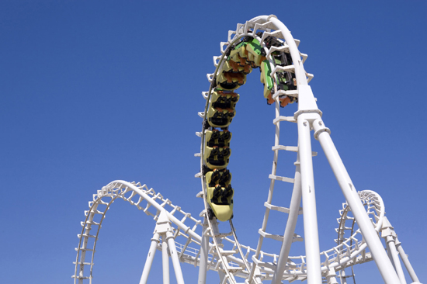
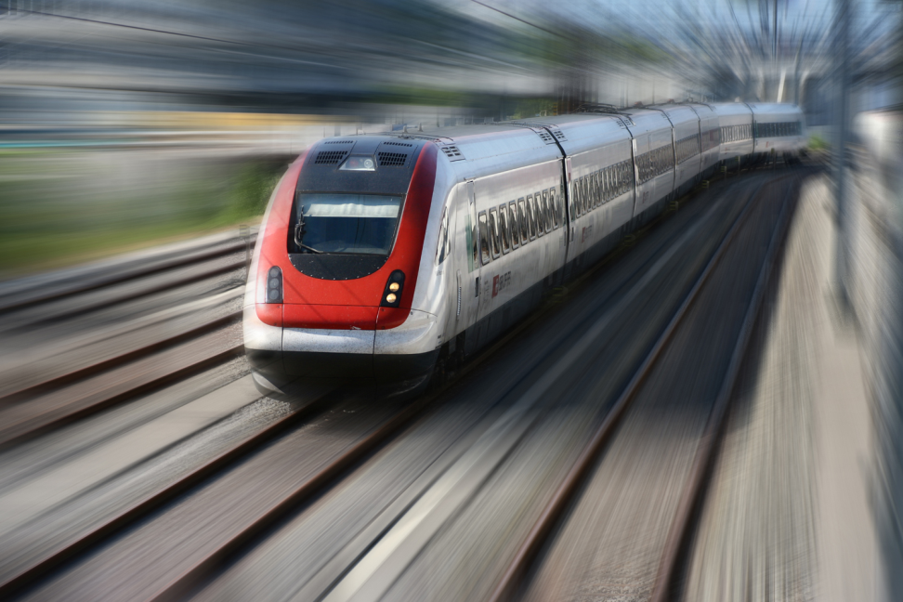
Momentum(p)- is the product of an objects mass and its velocity.
p= mv
An object that has a large momentum is hard to stop.
Can be changed 2 ways:
Change in mass
Change in velocity

Slide 35
Calculating Momentum
- Newton’s Third Law
Which has more momentum: a 3.0-kg sledgehammer swung at 1.5 m/s or a 4.0-kg sledgehammer swung at 0.9 m/s?
Mass of smaller sledgehammer = 3.0 kg
Velocity of smaller sledgehammer = 1.5 m/s
Mass of larger sledgehammer = 4.0 kg
Velocity of larger sledgehammer = 0.9 m/s
Momentum = Mass X Velocity
p= mv
Smaller sledgehammer =
P= 3.0 km X 1.5 m/s = 4.5 kg•m/s
Smaller sledgehammer =
P = 4.0 km X 0.9 m/s = 3.6 kg•m/s

Slide 36
Law of Conservation of Momentum-
The total momentum of an object that interacts does not change.
The quantity of momentum is the same before and after they interact.
Total momentum stays the same unless outside forces act on the object.- Friction

Slide 38
Conservation of Momentum
-
- Newton’s Third Law
In the absence of friction, momentum is conserved when two train cars collide.

Slide 39
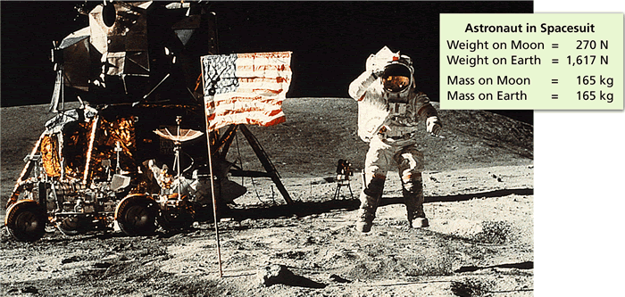
Gravity and Weight
- Friction and Gravity
The force of gravity on a person or object at the surface of a planet is known as weight.
Weight = mass * acceleration due to gravity
w= m*g
http://www.exploratorium.edu/ronh/weight/

