Slide 1
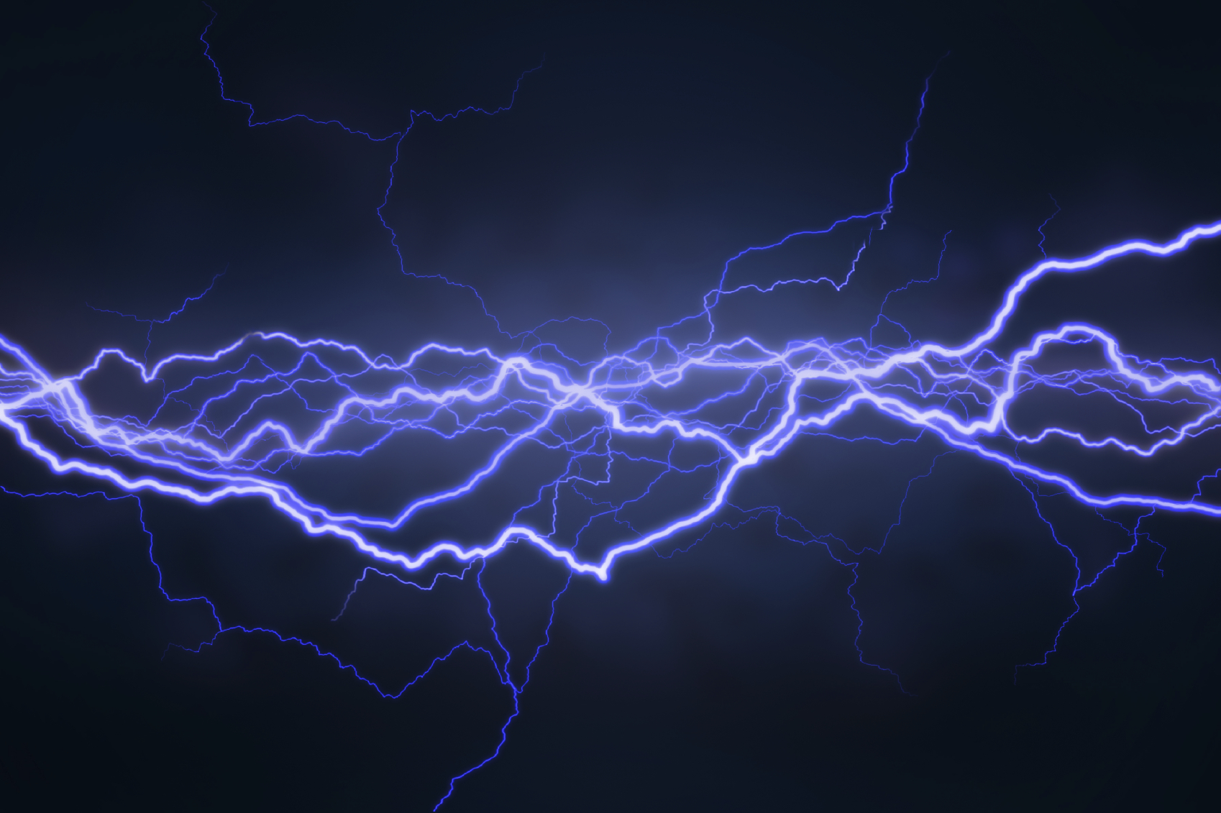
E10
Electricity & Magnetism

Slide 2
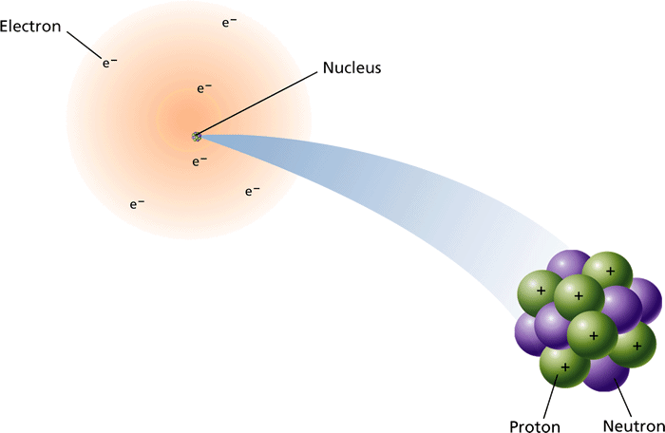
The Atom
- Inside a Magnet
Inside the atom, Negatively charged electrons move randomly throughout an atom.

Slide 3
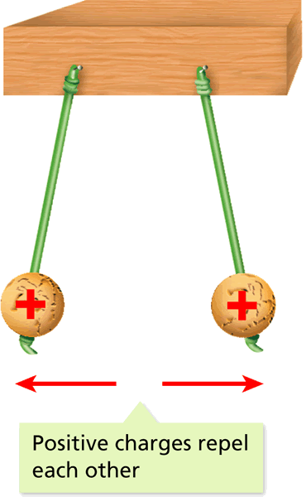
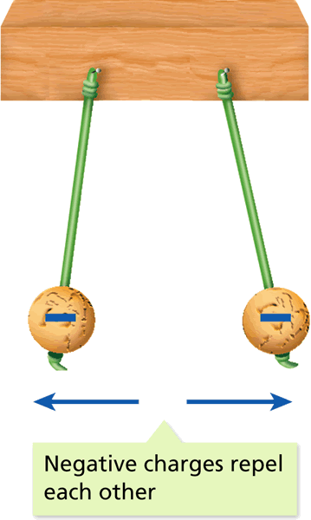
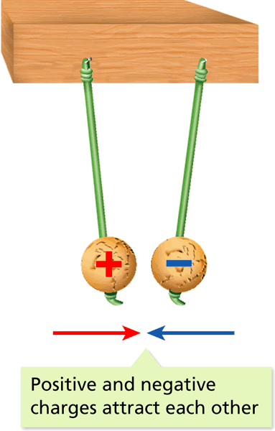
Electric Charge & Force
- Electric Charge and Static Electricity
Charges that are the same repel each other. Charges that are different attract each other.
This attraction and repulsion cause Electric Force.
An excess or storage of electrons produce a net electrical charge

Slide 4
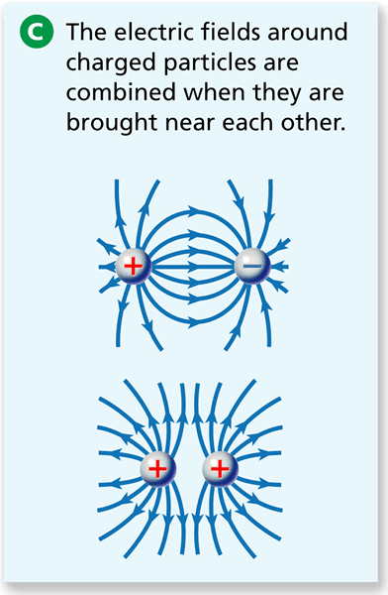
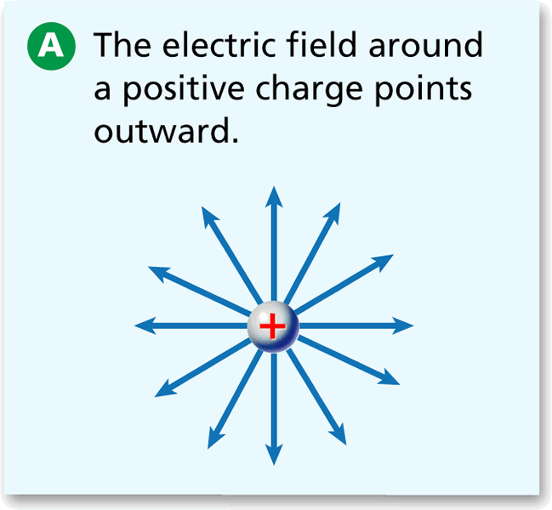
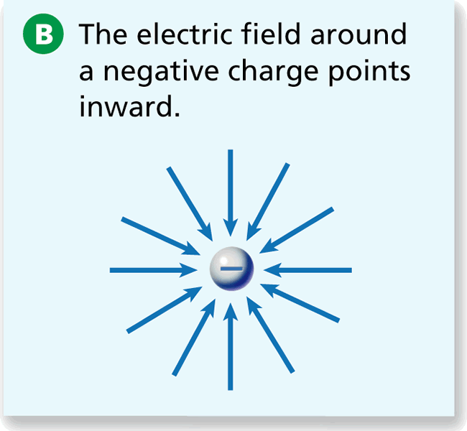
Electric Fields
- Electric Charge and Static Electricity
An electric field is a region around a charged object where the object’s electric force is exerted on other charged objects.

Slide 5
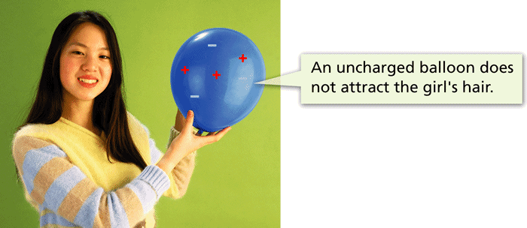
Static Electricity & Charging
- Electric Charge and Static Electricity
Static electricity-the study of how electric charges are transferred between objects.
There are three methods by which charges can be transferred to build up static electricity:
Friction:

Slide 6
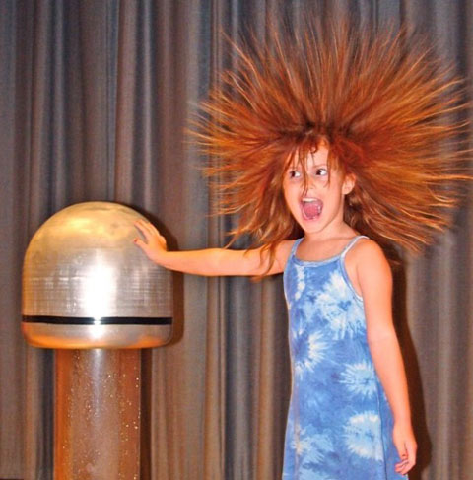
2. Contact/ Conduction

Slide 7
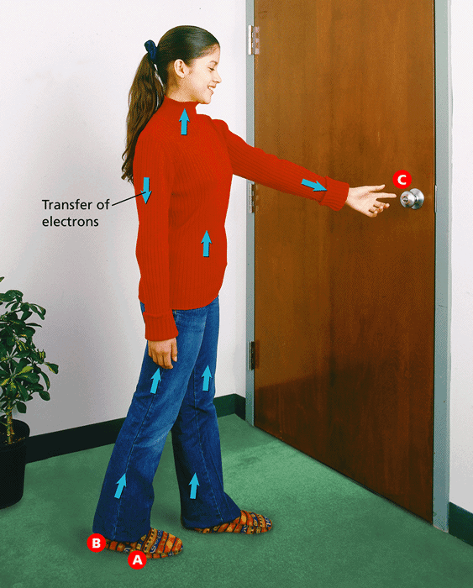
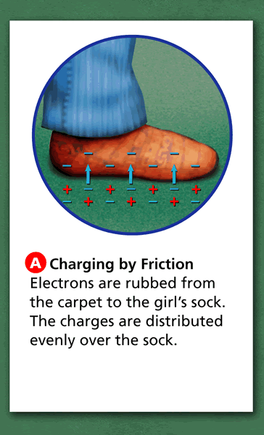
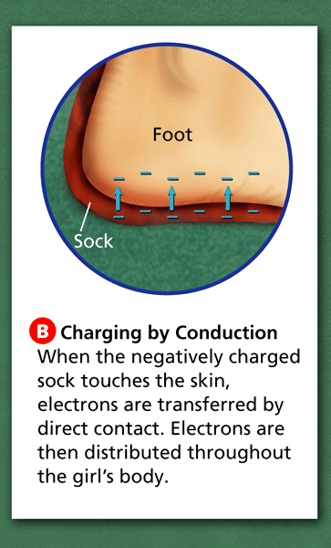
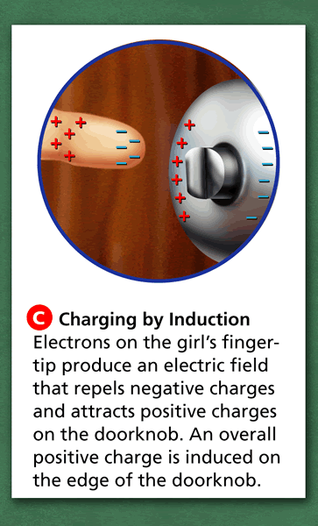
Transferring Charge
Induction-Transferring without contact.
Discharge- occurs when a pathway through which the electrons can move forms
- Electric Charge and Static Electricity

Slide 8
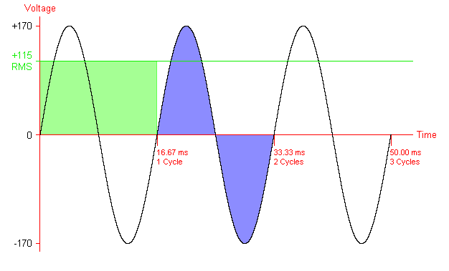
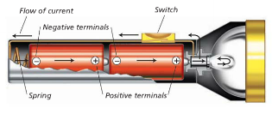
Electric Current- the continuous flow of electrical charges.
Current is measured in Ampers or Amps (A)
Alternating Current (AC)- Flow of electrons that regularly reverses it direction
Direct Current (DC)- Charges flow in only one direction

Slide 9
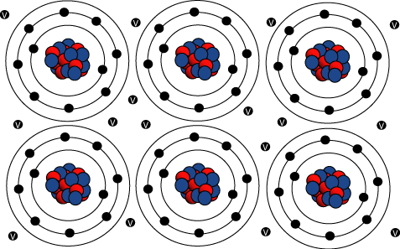
Electrical Conductor
Some of the electrons are only loosely bound to their atoms.
These electrons are able to move throughout the conductor. As these electrons flow through a conductor, they form an electric current.
Electrical Insulator
Electrons in an insulator are bound tightly to their atoms and do not flow easily.

Slide 10
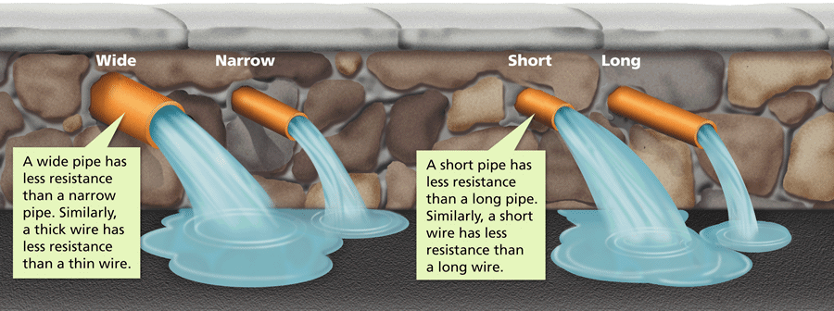
Resistance-The opposition to the movement of charges flowing through a material
Two factors that affect the resistance of water flowing in a pipe are diameter and length.
The diameter and length of a wire also affect resistance in a circuit.

Slide 11
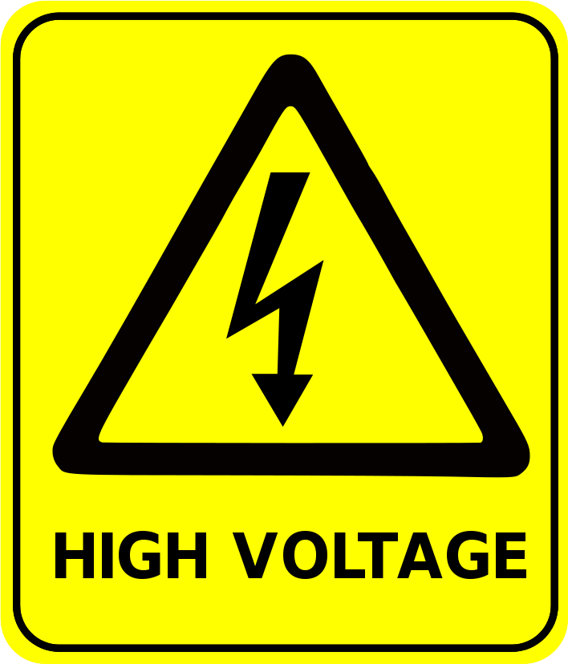
Voltage
Electrical Potential
The potential energy per unit of electric charge.
Voltage
Potential Difference
The difference in electrical potential between two places
Volt (V)=The potential difference
The unit of measure of potential difference
Voltage causes current to flow through an electric circuit.
Voltage Source
Creates a potential difference in an electric circuit. Ex. Batteries and generators

Slide 12
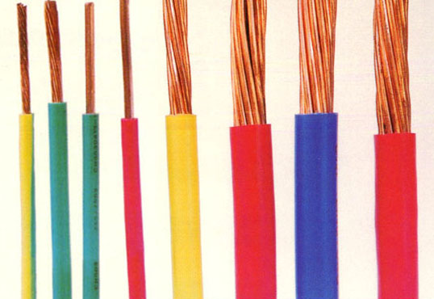
Resistance (R)-A resistor uses electrical energy as it interferes with, or resists, the flow of charge. Any thing that uses electricity is a resistor.
Measured in Ohms ( Ω )
The greater the resistance, the less current there is for a given voltage.
Current depends on the resistance offered by the material through which it travels.
The resistance of a wire depends on the thickness and length of the wire.
Long wires have more resistance than short wires.
Thin wires have more resistance than thick wires

Slide 13
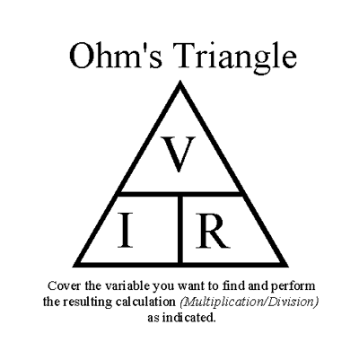
Ohm’s Law-
Ohm’s Law- Voltage (V) = Current (I) x Resistance (R)
Remember your units:
Voltage (V)=Volts (v)
Current (I) = amps (A)
Resistance (R) = Ohms (Ω)

Slide 14
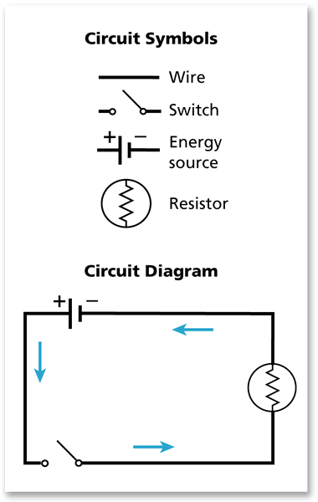
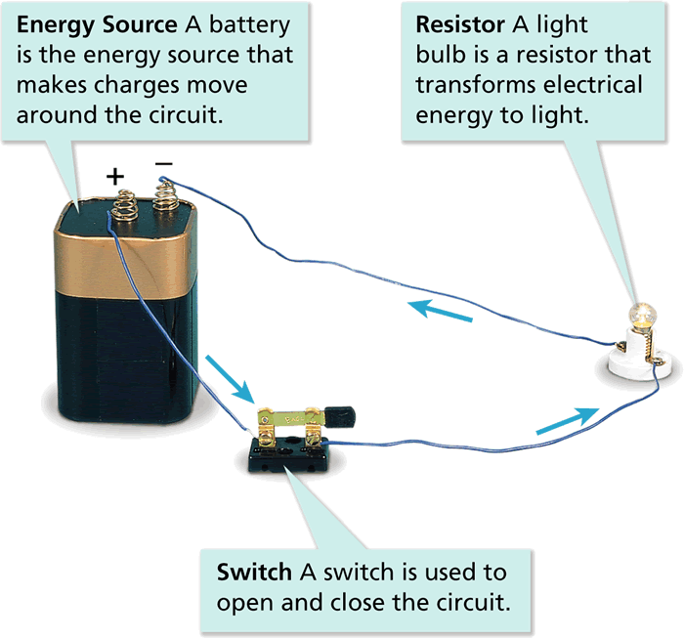
Features of a Circuit
Electric Circuit-An electric circuit is a complete, unbroken path through which electric charges can flow.
- Electric Circuits
Simple symbols are used to diagram a circuit.

Slide 15
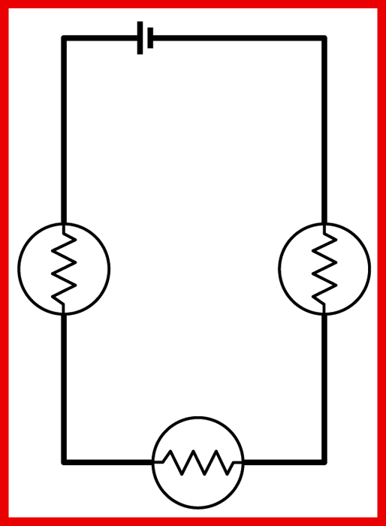
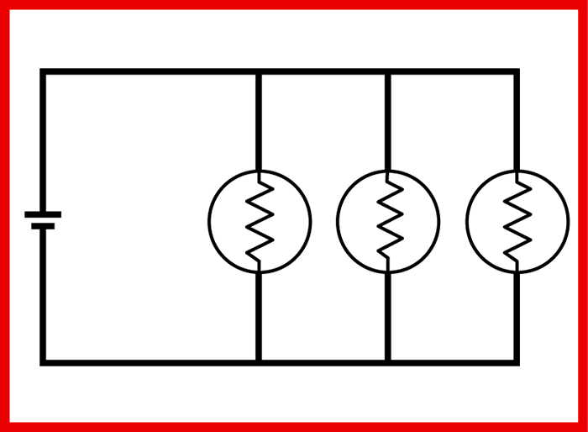
Two Types of Circuits
Series Circuits
All the parts of an electric circuit are connected one after another.
Only 1 path for the electricity to flow.
Parallel Circuits
In a parallel circuit, there are several paths for current to take.
If on path fails, there still is an alternate pathway.
Path of Least Resistance
If an electrical current can travel through either of two paths, more of the current will travel through the path with lower resistance.

Slide 16
Power & Energy Calculations
Electric Power- Rate in which electrical energy is converted into other forms of energy.
Measured on Watts (W) = J/s
Power (W) = Current (I) x Voltage (V)

Slide 17
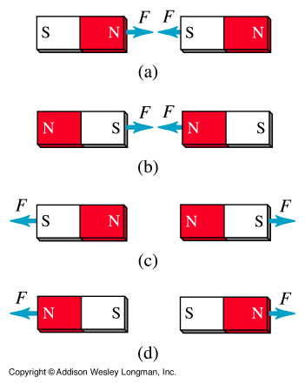
Magnetism
Magnetite or Magnet are derived from the Greek word “Magnesia”. Magnetism is the attraction of a magnet for another object.
Magnetic Pole
All magnets have two ends called magnetic poles, regardless of its shape.
A pole is the area of a magnet where in the magnet effect is at its peak.
Magnetic Poles that are alike repel each other
Magnetic Poles that are unlike attract each other

Slide 18
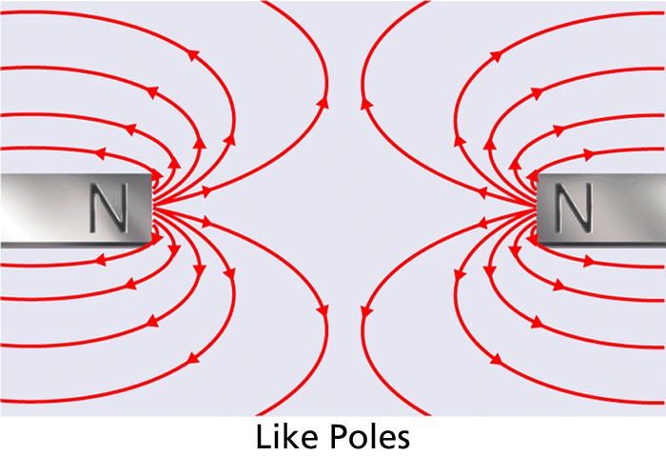
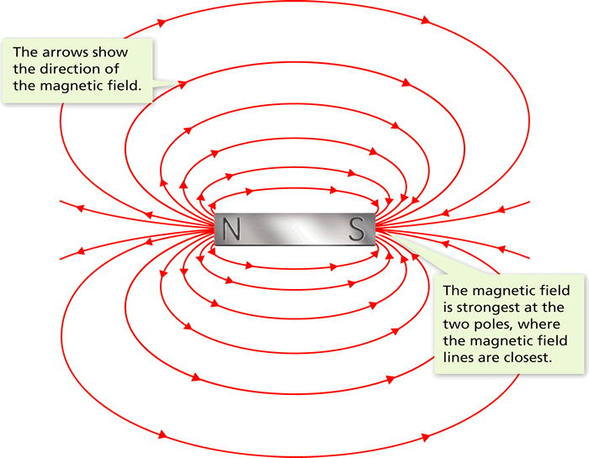
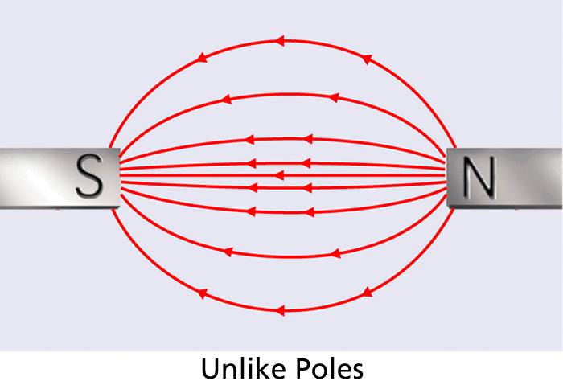
Magnetic Field Line
Magnetic Field Lines map out the magnetic field around a magnet. They spread out from one pole, curve around a magnet, and return to the other pole.
Magnetic Field
Magnetic Forces are exerted all around the magnet. The Magnetic Field is the region of magnetic forces around a magnet.

Slide 19
Why are they Magnetized?
- Inside a Magnet
Magnetic Domain
A cluster of billions of atoms that all have magnetic fields that are lined up in the same way.
Ferro-magnet- Objects that can be magnetized due to there magnetic dolmans.
In a magnetized material, all or most of the atoms are arranged in the same direction.

Slide 20
Magnetic field around a moving Charge
An electric current produces a magnetic field. The lines of the magnetic field produced by a current in a straight wire are in the shape of circles with the wire at their center.
All magnetism is caused by the movement of charges.

Slide 21
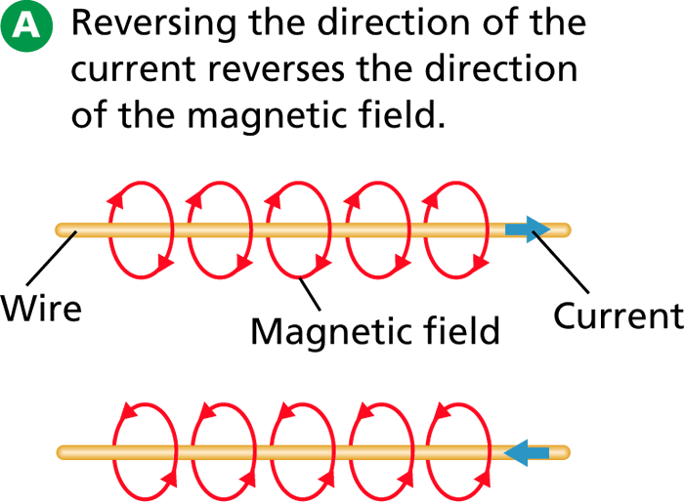
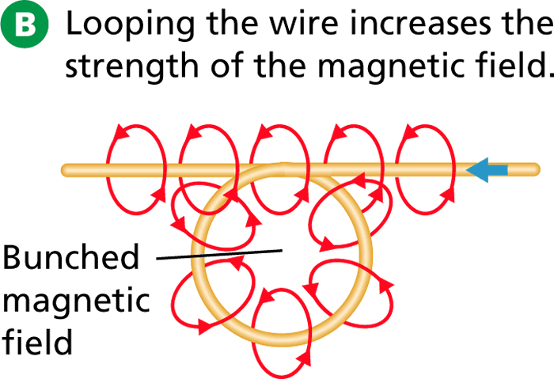
- What Is Electromagnetism?
The magnetic field produced by a current has three distinct characteristics.
The field can be turned on or off, have its direction reversed, or have its strength changed.

Slide 22
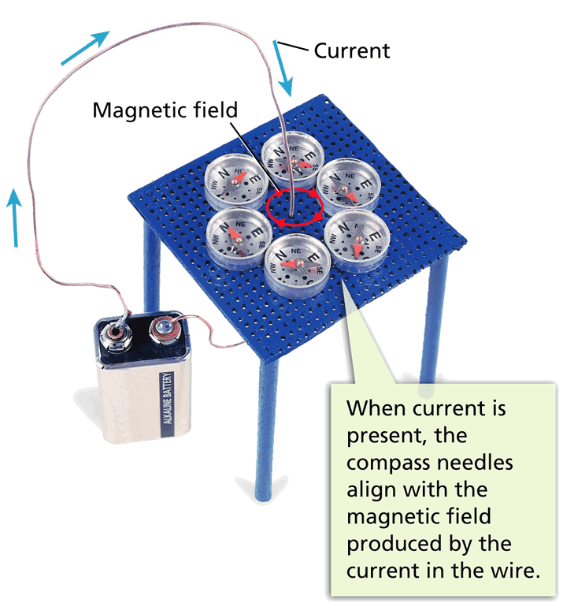
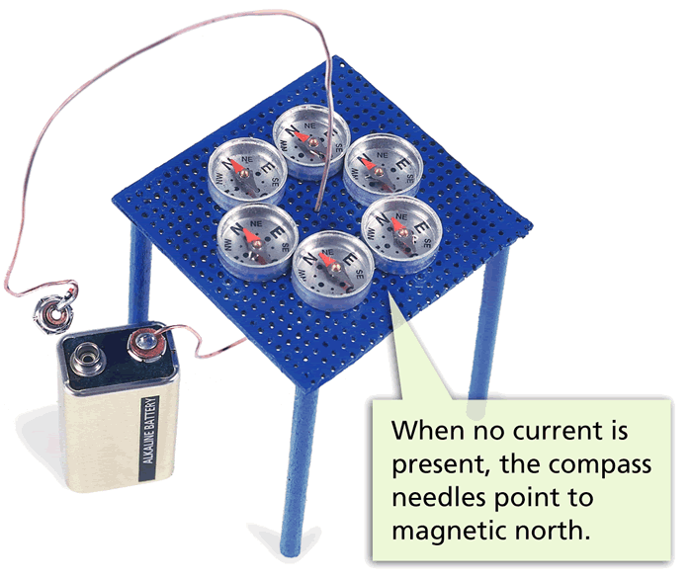
Electric Current and Magnetism
- What Is Electromagnetism?
An electric current produces a magnetic field.

Slide 23
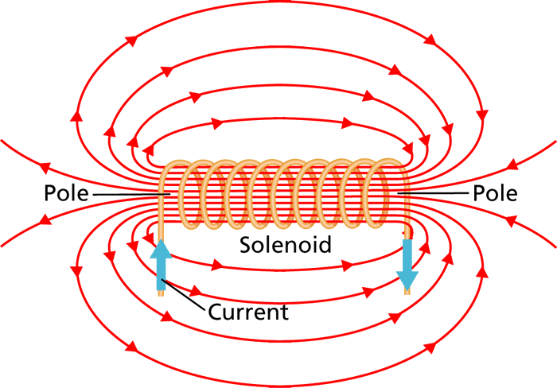
Solenoids
- What Is Electromagnetism?
Coil of current carrying wire around a bar magnet.
The magnetic field around a solenoid resembles that of a bar magnet.

Slide 24
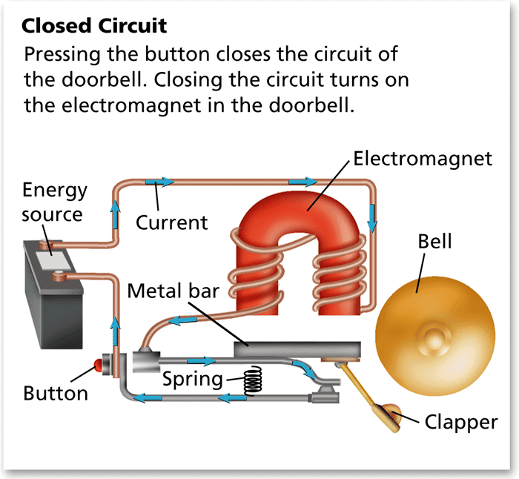
Electromagnets
- What Is Electromagnetism?
Solenoid with a ferromagnetic core.
A doorbell rings as the magnetic field of an electromagnet turns on and off.

Slide 25
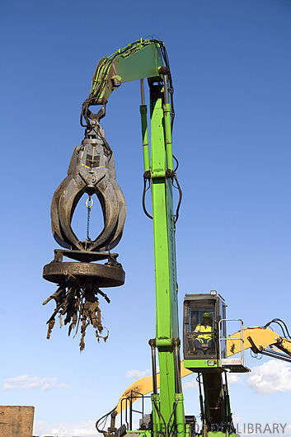
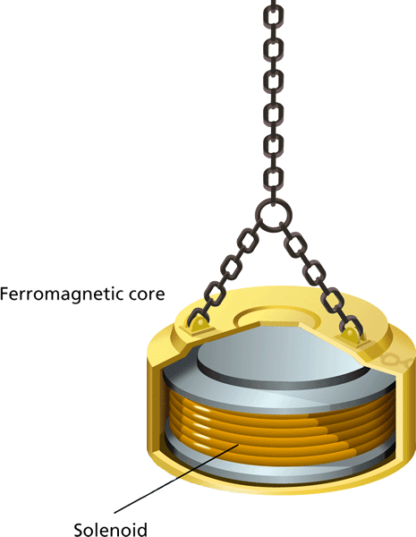
Electromagnets
- What Is Electromagnetism?
Electromagnets are used to lift heavy objects. A switch is turned on in the crane so that a current is produced in the electromagnet.

Slide 26
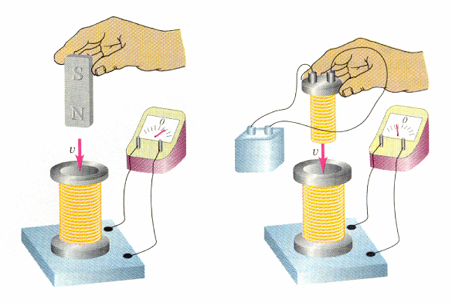
Generating Electrical Current
Electromagnetic Induction- is the process of generating a current by moving an electrical conductor ( wire) relative to a magnetic field.
Faraday's Law-

Slide 27
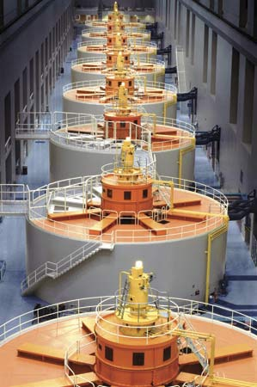
Generators
A devise that converts mechanical energy into electrical energy by rotating a coil of wire inside a magnetic field.

Slide 28
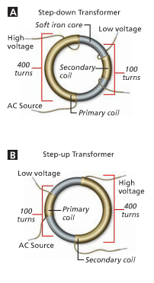
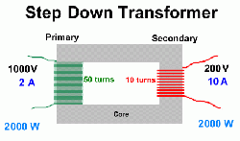
Transformers
Devise that increases or decreases voltage and current.
2 sets of coils around an iron core.
Primary- electricity coming in
Secondary- electricity going out

Slide 29
Transformers
The number of turns in the primary and secondary coil loops determines the voltage and current.
Calculate: divide the number of turns in the secondary coil by the number of turns in the primary coils.
EX- 10 turns/50 turns= 1/5 ratio
So
1000v/5= 200v

