Slide 1
WRITING A GOOD ESS
LAB REPORT

Slide 3
DESIGN & PLANNING
Aspect 1: Defining the problem and selecting variables
Variables are factors that may affect the outcome of your experiment. They are measurable factors, not pieces of equipment. Do not use the word “Amount”. It is not specific enough – terms like mass or volume are better.
Independent variable: This is the variable that you manipulate – you choose the values to investigate.
Dependent variable: This is the variable that changes in response to changes in the independent variable. It is what you are measuring or trying to find out.
Controlled variables: These are other factors that may also affect the dependent variable. They need to be kept constant in order to ensure a fair test.
Uncontrolled variables: Usually climate factors that you try to keep the same for each sample.
1. Decide what to investigate
Start with the variables!
Decide what you want to find out about – this is your dependent variable.
Brainstorm (and list) all the possible variables that could influence your dependent variable.
Choose ONE to be your independent variable.
All the others will be your controlled variables.

Slide 4
Design and Planning (PL) Aspect 1: Defining the problem and selecting variables
Aspect 1: Write an Aim/Problem/Research Question
To achieve a “2” on Aspect 1 you need to state a focused research question. To do this you should
A good format is “To determine how [the independent variable] affects [the dependent variable] in [the context of your experiment].”
e.g. To determine how acid rain affects the germination in common beans
Briefly state what you are trying to find out.
Include both the independent and dependent variables.
Specify the scope of your experiment by stating the context of your investigation.
It is unlikely that your experiment will allow you to draw a conclusion that applies to all situations.
Therefore you need to state the conditions under which your experiment is operating e.g. the species being studied (scientific name), gender, age group, location etc

Slide 5
Design and Planning (PL)
Aspect 1: Defining the problem and selecting variables

Slide 6
Design and Planning (PL)
Aspect 1: Defining the problem and selecting variables
3. Identify the variables
Make sure you have read the information on variables (.
In order to achieve a “2” for Aspect 1 you must:
State the independent Variable.
State the levels of the independent variable that will be tested
State the dependent variable.
State how the dependent variable will be measured (if it can’t be measured directly).
List several controlled variables.

Slide 7
Design and Planning (PL) Aspect 1: Defining the problem and selecting variables
3. Identify the variables
Controlled variable | Method to control the variable
Temperature at which reaction occurs | The test tubes in which the reaction occurs will be placed in a water bath set to 40°C for the duration of the reaction.
Duration (time) of the reaction | The reaction will be allowed to proceed for 300 seconds. This will be timed using a stopwatch (±0.1seconds).
Aspect 2 requires that you explain the method you will use to control each of the (controlled) variables.
Give brief (but specific) explanation of how you will control (keep at a constant value) each variable. Including this in the variables section ensures that you have considered each of the controlled variables. However, it should ultimately appear in the method.
If a variable cannot be controlled, state this. Then describe how you will try to minimize any change and/or how you will monitor the variable. See Appendix 1 for uncertainties to consider.

Slide 8
Design and Planning (PL) Aspect 2: Controlling Variables
ASPECT2 This can be done in the form of a chart
VARIABLES: |  | UNITS:/Uncertainties |  | RANGE
INDEPENDENT VARIABLE
DEPENDENT VARIABLE
CONTROLLED VARIABLES: | UNITS/Uncertainties | POSSIBLE EFFECTS: Why the need to be controled? |  |  | Method of Control:
1
2
3
4
5

Slide 9
Design and Planning (PL) Aspect 2: Controlling Variables
ASPECT 2: List the equipment (apparatus and materials) needed
Choosing appropriate equipment will allow you to achieve a “2” for Aspect 2.
Make sure that your equipment list includes all of the following:
All of the equipment and materials needed for the experiment (after writing you method read through it and check of the items used as you go on your equipment list)
Numbers of items (e.g. 2 petri dishes)
Volumes and concentrations of any solutions needed (e.g. 300ml of 0.5M hydrochloric acid)
Precision (and range if appropriate) of all measuring instruments. How precise do you need to be in your measurements?
Sizes of beakers or other items (e.g. 250ml beaker, 10cm length of dialysis tubing)

Slide 10
Design and Planning (PL)
ASPECT 3: Plan and write a method/procedure
Planning a Method
Aspect 3 of Planning assesses your ability to collect sufficient relevant data. The following considerations are important to ensure that you collect enough data and that the data will help to answer your Aim-
Number of Values
If you are looking for a correlation, at least 5 different values are needed (the more the better). 5 X 5
If you are comparing two different situations, 3 values will be sufficient.
What values of the independent variable should you test?
How many values should you test? Decide how many values will be needed to show any trend or pattern. Plan for an ideal situation – worry about time constraints later. Usually 5.
What is an appropriate range of values?
Range of Values
You may need to do some research to help you decide.
e.g. if testing acidic rain solutions then you would want to test values around 5.6pH. If you are investigating chemical spills in you might want lower pH values

Slide 11
Design and Planning (PL) Aspect 3: Developing a Method for Collection of Data
2.How will you measure your independent and dependent variables?
Can you measure it directly (raw data) or do you need measure other values (raw data) and use them to calculate values (processed data) for your independent variable?
What measuring instruments will be best to use? Do you know how to use them?
What level of precision is required in your measurements?
What units will you use to record your measurements?

Slide 12
Design and Planning (PL) Aspect 3: Developing a Method for Collection of Data
Number of Trials
All systems, because of their complexity and normal variability, require replicate observations and multiple samples of material.
Remember that a minimum of 5 values is needed for calculating means and standard deviations.
WE CALL THIS THE 5 X 5
3. How may trials or replicates need to be carried out?
Consider how you are going to process your data
Now go back and double check that you have collected enough of the right types of measurements. Plan for an ideal situation – worry about time constraints later.
CONTROL GROUP | GROUP 1 | GROUP 2 | GROUP 3 | GROUP 4
SAMPLE 1 | SAMPLE 1 | SAMPLE 1 | SAMPLE 1 | SAMPLE 1
SAMPLE 2 | SAMPLE 2 | SAMPLE 2 | SAMPLE 2 | SAMPLE 2
SAMPLE 3 | SAMPLE 3 | SAMPLE 3 | SAMPLE 3 | SAMPLE 3
SAMPLE 4 | SAMPLE 4 | SAMPLE 4 | SAMPLE 4 | SAMPLE 4
SAMPLE 5 | SAMPLE 5 | SAMPLE 5 | SAMPLE 5 | SAMPLE 5

Slide 13
Design and Planning (PL) Aspect 3: Developing a Method for Collection of Data
Experimental and Control Group (if appropriate)
_____The control group should have no changed variable and should be used to compare with the experimental group.
_____Experimental group should be the setup that has the changed variables (mv).

Slide 14
Design and Planning (PL) Aspect 3: Developing a Method for Collection of Data
4. CALIBRATE YOUR INSTRAMENTS:
Will any calibration of equipment need to be carried out to avoid any errors and uncertainties in taking measurements?
How will this be done?
ALL verier probes will need to be calibrated prior to any experiment.
Furthermore, You have to set the data collection software to your specifications, manually. You can not use the automatic scale.

Slide 15
Design and Planning (PL) Aspect 3: Developing a Method for Collection of Data
Write the Procedure
A clear, easy to follow method is necessary to achieve a “2” on Aspects 2 and 3.
Think about method you have seen and what information you like to have! Someone (who has not done the experiment before) should be able to follow your procedure and obtain similar results.
The following features contribute to writing a good method.
The method can be written as instructions like a recipe
Do not begin with “Gather all of the materials” … it is kind of a given that you will do this!!
Use numbered steps (rather than paragraphs).
Use a diagram if possible to show how to set up any equipment. Then you can say “Set up the equipment as shown in the diagram”. This would save you writing a lot of words.
Specify what will be measured (and the units to be used)
Include details of how you will measure values

Slide 16
DATA COLLECTION AND PROCESSING
RAW DATA refers to the values obtained from the measuring instruments exactly as they were shown. Once you do any addition, subtraction, multiplication or division then it becomes PROCESSED DATA.
Aspect 1: Recording Data
Record you raw data
The recording of raw data is necessary to address Aspect 1. If the data you record is not RAW data you will receive a “0” for this section.
Raw data should include quantitative (always!) and qualitative (usually appropriate) data.
Raw data should be displayed in a table (qualitative data may require some other format, but a table is still usually best).
In constructing a data table you should consider the following features:
Quantitative data – numerical values obtained from the measuring instruments (e.g. temperature, mass etc) or by other means e.g. counting
Qualitative data – non-numerical observations. Other observations made during your experiment that may have a bearing on the conclusion or help to explain patterns and trends (or the lack of!). Examples include changes in colour, texture, size etc
Any other observed sources of error should also be recorded.

Slide 17
DATA COLLECTION AND PROCESSING Aspect 1: Recording Data
1. Structure
When possible, the independent variable should come first in your columns followed by the dependent variable.
Show lines around all rows and columns
Make it clear. A good table should be able to be understood out of context (i.e. not embedded in a lab report describing the experiment)
2. Title
Title should be descriptive of the data contained in the table. It should include the key variables as well as any specific conditions of the experiment
Should be numbered consecutively throughout the report with a specific identifying title.
EXAMPLE
Table 1: The relationship between temperature and water uptake in a leafy shoot of a geranium (Geranium carolinianum)

Slide 18
DATA COLLECTION AND PROCESSING Aspect 1: Recording Data
3. Headings
Columns should be clearly annotated with a heading, units (in heading not body) and uncertainties if relevant. Headings should indicate what the data is in the column below
Headings are likely to be the name of a variable
4. Units
Units should be included with a heading (not next to each data value in the table)

Slide 19
DATA COLLECTION AND PROCESSING Aspect 1: Recording Data
5. Uncertainties
These will only apply for controlled experiments that are carried out in the lab. In field work (and some lab based experiments) the uncertainties in measuring instruments are likely to be insignificant compared to the natural variability of the system you are working with.
All measurements have uncertainties and you should indicate them in your data tables. Uncertainties should be associated with all raw data and an attempt should always be made to quantify uncertainties. In IB ESS the accuracy of a measuring instrument is equal to the smallest unit of measurement. Plus or minus (±) this value is what you should record as your uncertain.
Remember that only measurements obtained with a measuring instrument have uncertainties. e.g. Counts do not have an uncertainty
Uncertainties should appear with the units in the column heading
Uncertainties
The smallest division on a particular ruler is 1mm. The uncertainty could be recorded as ±1mm or ±0.1cm. Vernier probes uncertainties are listed in the manuals

Slide 20
DATA COLLECTION AND PROCESSING Aspect 1: Recording Data
6. Precision of data
There is no variation in the precision of raw data; the same number of decimal places (significant figures) should be used.
7.Anomalous results – any results that are particularly different from the others need to be identified and excluded from any processing. You must clearly state this.
Further advice on drawing data tables can be found at:
http://www.saburchill.com/IBbiology/sci_invest/006.html

Slide 21
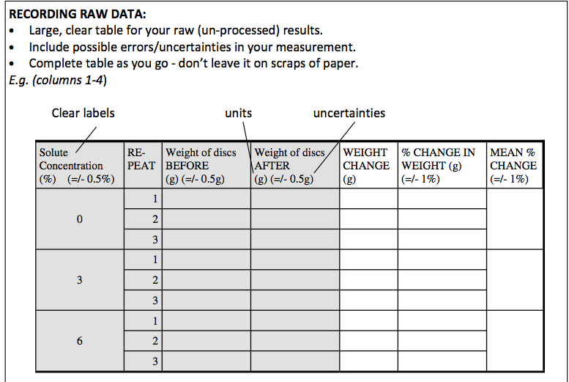
Aspect 1: Recording Data

Slide 22
DATA COLLECTION AND PROCESSING Aspect 2: Evaluating Procedure(s)an Suggesting Improvements
2. Process your Data
Data processing involves combining and manipulating raw data to determine the value of a physical quantity (adding, subtracting, squaring, dividing), and taking the average of several measurements and transforming the data into a form suitable for the graphical representation.
Simply plotting raw data is not considered processing.
If the raw data is already in a form suitable for graphical presentation, it is not considered processing unless a line of best fit/trend line is drawn.

Slide 23
DATA COLLECTION AND PROCESSING Aspect 2: Evaluating Procedure(s)and Suggesting Improvements
a) Look at Your Aim
ALWAYS CONSIDER YOUR AIM/ RESEARCH QUESTION.
The purpose of processing data is to show patterns in the data that help you draw a conclusion that answers your Aim (not to pad out a lab report!). Aspect 2 requires that any processing helps in answering the Aim.
b) Choose Your Processing Technique
In Aspect 2 you will be assessed on your ability to choose appropriate processing techniques (types of calculations) and to carry out those calculations correctly.
Some appropriate options for data processing in biology are:
i) Change in quantities (initial → final)
This is a very basic processing technique and should be used in combination with other methods.

Slide 24
DATA COLLECTION AND PROCESSING Aspect 2: Evaluating Procedure(s)and Suggesting Improvements
ii) Percentage change in quantities
This also allows you to compare quantities that have different initial and final quantities.
This often more appropriate than change in quantity as it helps to eliminate some of the error.
For example, since it is almost impossible to obtain slices of potato that are the same dimensions, same consistency throughout, and the same mass to the degree of precision that your instruments allow, it is more appropriate to do a percentage change in quantity rather than simple change in quantity calculations.

Slide 25
DATA COLLECTION AND PROCESSING Aspect 2: Evaluating Procedure(s)and Suggesting Improvements
iii) Rate
Rate is a measure of how quickly a variable changes
Mean and Standard Deviation
Whenever you have multiple trials in an experiment, it is good practice to calculate the mean and standard deviation.
Using the mean as opposed to individual values helps to minimize the error in your experiment.
Standard deviation also helps to indicate the spread of your values around the mean. A smaller standard deviation indicates that the values are clustered closely around the mean (and therefore possibly more reliable); a larger standard deviation indicates a wider spread (values are possibly less reliable).

Slide 26
DATA COLLECTION AND PROCESSING Aspect 2: Evaluating Procedure(s)and Suggesting Improvements
v) Percentage error
This is used when comparing your actual measurements to a theoretical measurement. Percentage error describes the accuracy of measurements. You should always use percentage calculations as opposed to the numerical difference. This is because 10 cm error means nothing if you are measuring the distance between Shanghai and Beijing, but it is a huge error if you are measuring the length of a piece of paper.
vi) percentage deviation
A measure of precision when a theoretical value is not known. This informs how reproducible your experiment is.

Slide 27
DATA COLLECTION AND PROCESSING Aspect 2: Evaluating Procedure(s)and Suggesting Improvements
c) Carry out your Calculations
Make sure you go back and double-check your calculations.
See section 3a to make sure that you have presented you work correctly
Treatment of Uncertainties
The uncertainties associated with the raw data should be taken into account.
Mean and standard deviation are acceptable ways of showing this in graphs with error bars. The mean should be the plotted point or height of the bar. For each point an error bar can be drawn that extends above the point/bar 1 SD and below the point/bar 1 SD. The size of the error bar is also an indication of the reliability of you data (and therefore any conclusion you draw from it)
The treatment of uncertainties in graphical analysis (scatter plots) requires the construction of appropriate best-fit lines.

Slide 28
DATA COLLECTION AND PROCESSING Aspect 3: Presenting Processed Data
Present your processed data
You are expected to decide upon a suitable presentation format without teacher assistance. Your ability to show how you processed the data, choose the correct presentation method and construct graphs etc will determine your level of achievement for Aspect 3.
Important things to consider:-
a) Present data so that stages to final results can be followed
This will often mean showing your working for each type of calculation done (not for every single calculation done!).
Each worked example should include the following:
Heading describing the calculation
Formula
Identification of which set of data is being used in that example
Fully worked example
If Excel or a graphing calculator was used to generate values (i.e. you didn’t have to plug numbers into an equation) it is OK to simply state this. In the case of Excel you should state the formula used.
Flowcharts may also be appropriate here

Slide 29
DATA COLLECTION AND PROCESSING Aspect 3: Presenting Processed Data
Significant Figures
Inclusion of metric/SI units is expected for final derived quantities, which should be expressed to the correct number of significant figures. Your processed data should not have more significant figures (or decimal places) that the raw data you collected
All processed data should be to the same number of significant figures
Ensure that your processed data does not have more decimal places than the raw data

Slide 30
DATA COLLECTION AND PROCESSING Aspect 3: Presenting Processed Data
c) Presentation formats
A few general options are listed below; however, understand that you are not limited to these options as there are many processing options specific to certain labs such as population pyramids, and logarithmic graphs:
Spreadsheets and tables showing data calculations such as mean, SD, percentage change, etc.
Line graphs and scatter-plots showing continuous data points (e.g. time, GDP, age, distance, height etc.) with line of best fit
Bar graphs showing discrete data (categories) e.g. species, sex, ethnicity
Pie charts showing percentages out of 100%

Slide 31
DATA COLLECTION AND PROCESSING Aspect 3: Presenting Processed Data
Diagrams and Tables
There should be clear, unambiguous headings for diagrams and tables or graphs similar to the heading used for tables in your data collection.
Diagrams will be labelled as figures. Figures should be numbered for reference and be placed below the figure it references.

Slide 32
DATA COLLECTION AND PROCESSING Aspect 3: Presenting Processed Data
Graphs
Think about why you are drawing your graph …. It should be a visual representation of the data that allows you to answer the Aim/Research Question. Therefore it should look like:
Dependent variable/ units
Independent variable/ units

Slide 33
DATA COLLECTION AND PROCESSING Aspect 3: Presenting Processed Data
Graphs can be drawn by hand or using graphing software such as Excel (as long as you have had to make the decisions on the format, axes, scale etc). However, an inability to manipulate the program to show the necessary elements is not an excuse for failing to include them!
Graphs must have the following:
Title. The same expectations apply as for table (see section on Recording Raw Data). Graphs will be labelled as figures. Figures should be numbered for reference and be placed below the figure it references.
Appropriate scales; if you are measuring temperatures between 30 and 40 degrees, your graph should not begin and end at 0 and 100 respectively. Your units must be appropriate as well. If you are measuring in mm, you shouldn’t have meters marked on your graph. Think of a graph like a microscope; you want to see as much detail as possible.
Labeled axes with units; axes should be labeled similarly to your table headings.
Accurately plotted data points should be clearly shown
A suitable best-fit line, trend line or curve is drawn (for a line graph or scatter plot)
DO NOT CONNECT THE DOTS
Further information on graphing can be found at:
http://www.saburchill.com/IBbiology/graphs/001.html

Slide 34
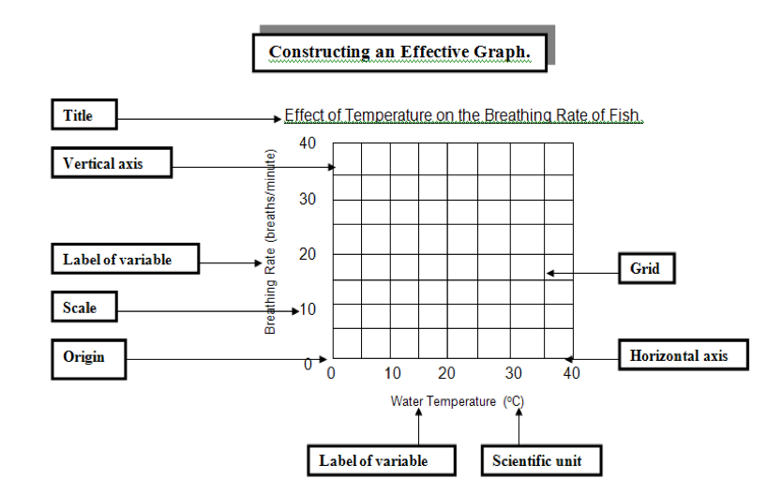
Aspect 3: Presenting Processed Data

Slide 35
DISCUSSION, EVALUATION AND CONCLUSION ASPECT 1
Discuss strengths and weaknesses in your investigation
Aspects 1 and 2 require you to evaluate the procedure. Aspect 2 deals with strengths and weaknesses in the procedure and their impact on the results. This is where you comment on the design, method of the investigation, and the quality of the data. A good format for the Evaluation is shown to the right. →
In order to achieve a 2 on Aspect 2 you should:
List specific strengths in the design and carrying out of the procedure. You could look at
procedures,
limitations of equipment,
use of equipment,
management of time,
investigation timing,
data quality (accuracy and precision) and relevance of data.

Slide 36
DISCUSSION, EVALUATION AND CONCLUSION ASPECT 2
2. List specific weaknesses in the design and carrying of out the procedure. Consider:
procedures,
limitations of equipment,
use of equipment,
management of time,
investigation timing,
data quality (accuracy and precision) and relevance of data.
See Appendix 1 for a discussion of errors
3. For each strength or weakness discuss its significance i.e. it’s effect on your results e.g. values too high/low, data values less reliable (large uncertainty/error/S.D. would indicate this), measurements less accurate or precise, trend/pattern incorrect or unclear etc

Slide 37
DISCUSSION, EVALUATION AND CONCLUSION ASPECT 2
Acceptable Example:
“Because the simple calorimeter we used was made from a tin can, some heat was lost to the surroundings—metals conduct heat well. Therefore, the value we obtained for the heat gained by the water in the calorimeter was lower than it should have been. The heat lost from the tin can would not have been a lot in the time taken for the experiment so this probably did not have a significant impact on the results”
Unacceptable Examples:
"The test tubes weren’t clean.” → careless or poor performance does not make for a valid weakness
“Human error.” → a specific description of the type of human error would be required

Slide 38
DISCUSSION, EVALUATION AND CONCLUSION ASPECT 2
Describe improvements for each identified weakness
This section deals with Aspect 2. Suggestions for improvements should be based on the weaknesses and limitations identified in Aspect 1.
For each improvement ensure that:
Modifications are specific (numerical if possible). “Next time we should work more carefully” is not acceptable.
Modifications are realistic – they can be achieved within the constraints of the timetable, school setting and budget.
Improvements are not overly simplistic or superficial – you need to demonstrate that you are a student at a Diploma level!

Slide 39
DISCUSSION, EVALUATION AND CONCLUSION ASPECT 1 Discuss, review and analyse your results
Describe what your results show in the context of you topic of investigation
Identify any trends or patterns in your results
Compare these to literature, scientific understanding or models or class discussion. If there are differences, identify them and suggest possible reasons
Identify any anomalous results and justify their exclusion from processing
All literature used to write you lab report should be fully referenced by using MLA formatting to produce:
Bibliography- Help on how to produce a bibliography can be found at http://owl.english.purdue.edu/owl/resource/747/07/
In-text referencing- advice on the correct format can be found at http://owl.english.purdue.edu/owl/resource/747/02/

Slide 40
DISCUSSION, EVALUATION AND CONCLUSION ASPECT 3
Write a Conclusion
Your conclusion is what is assessed for Aspect 3. This section should be one or more paragraphs in which you draw conclusions from your results, and reflect on whether or not they are reliable/trustworthy.
To achieve at the highest level for this aspect you should make sure that:
Conclusions are truthful and based on the data. Don’t try and twist your results to fit a hypothesis or expected outcome.
The conclusion is clearly related to the Aim.
The conclusion provides a thorough description of any trends or patterns

Slide 41
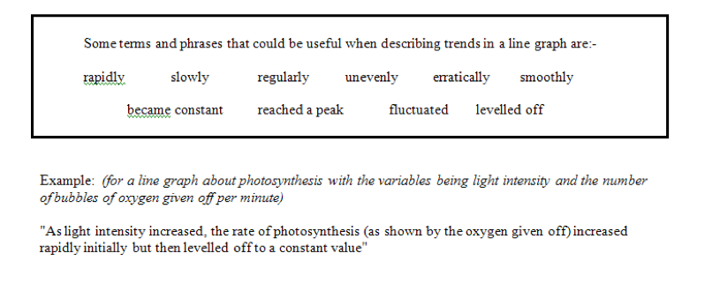

Slide 42
Bad example
The results show that the concentration of sugar affects the rate of respiration. As the sugar concentration increased so did the rate of respiration.
GOOD example
We can conclude that there is a positive, linear relationship between the concentration of sugar and the rate of respiration. The correlation coefficient of 0.9 indicates that it is a strong relationship.
Use your results to justify your conclusion (explain how your results support your conclusion). See example to the right →
The trend line in Figure 1 shows that there is a positive, linear relationship between the concentration of sugar and the rate of respiration. The correlation coefficient of 0.9 indicates that it is a strong relationship.

Slide 43
Last but not least:
Bibliography: MLA format

