Slide 1
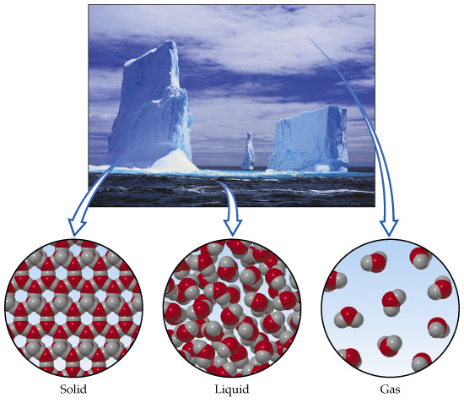
States of Matter
Here on planet Earth, almost all matter exist in 3 forms

Slide 2
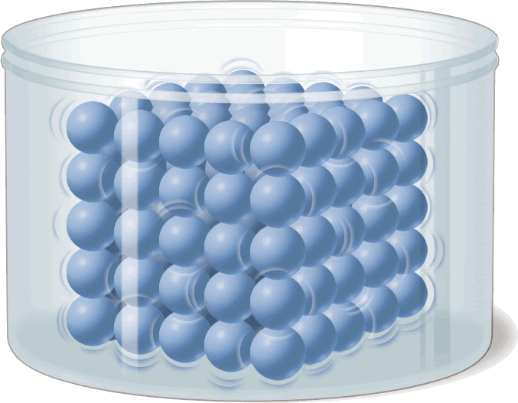
Solids
A fixed, closely packed arrangement of particles causes a solid to have a definite shape and volume.

Slide 3
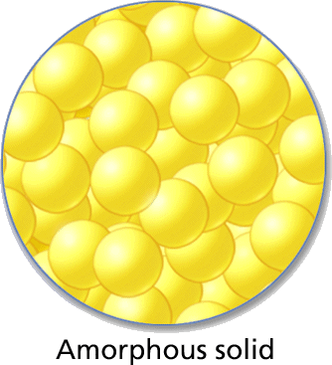
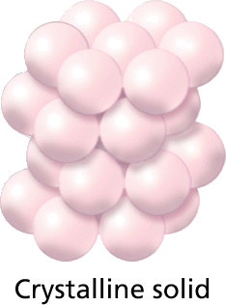
Types of Solids
Solids that are made up of crystals are called crystalline solids.
In amorphous solids, the particles are not arranged in a regular pattern.

Slide 4
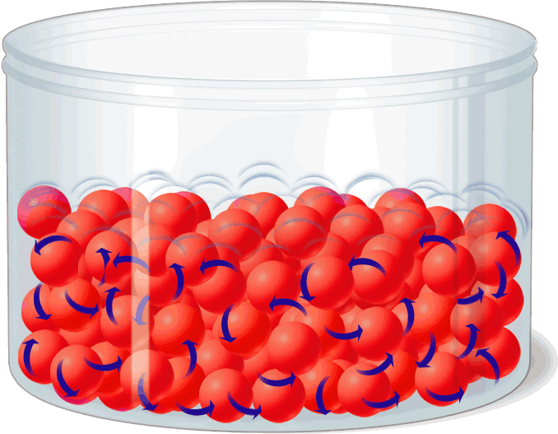
Liquids
Because its particles are free to move, a liquid has no definite shape. However, it does have a definite volume.
Take the shape of it container.

Slide 5
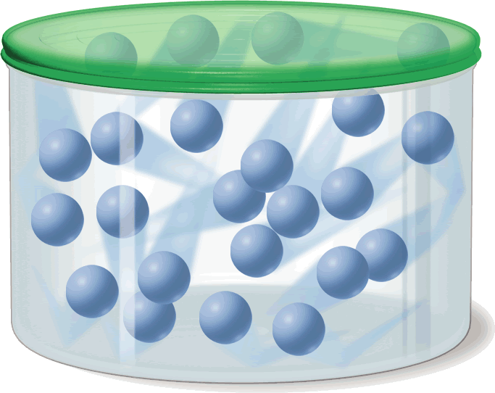
Gases
As they move, gas particles spread apart, filling all the space available. Thus, a gas has neither definite shape nor definite volume.
Take the volume of the container.

Slide 6
Graphic Organizer
Solids, Liquids, and Gases
Example (at room temperature)
State of Matter
Shape
Volume
Solid
Definite
Definite
Diamond
Liquid
Not definite
Definite
Water
Gas
Not definite
Not definite
Oxygen

Slide 7
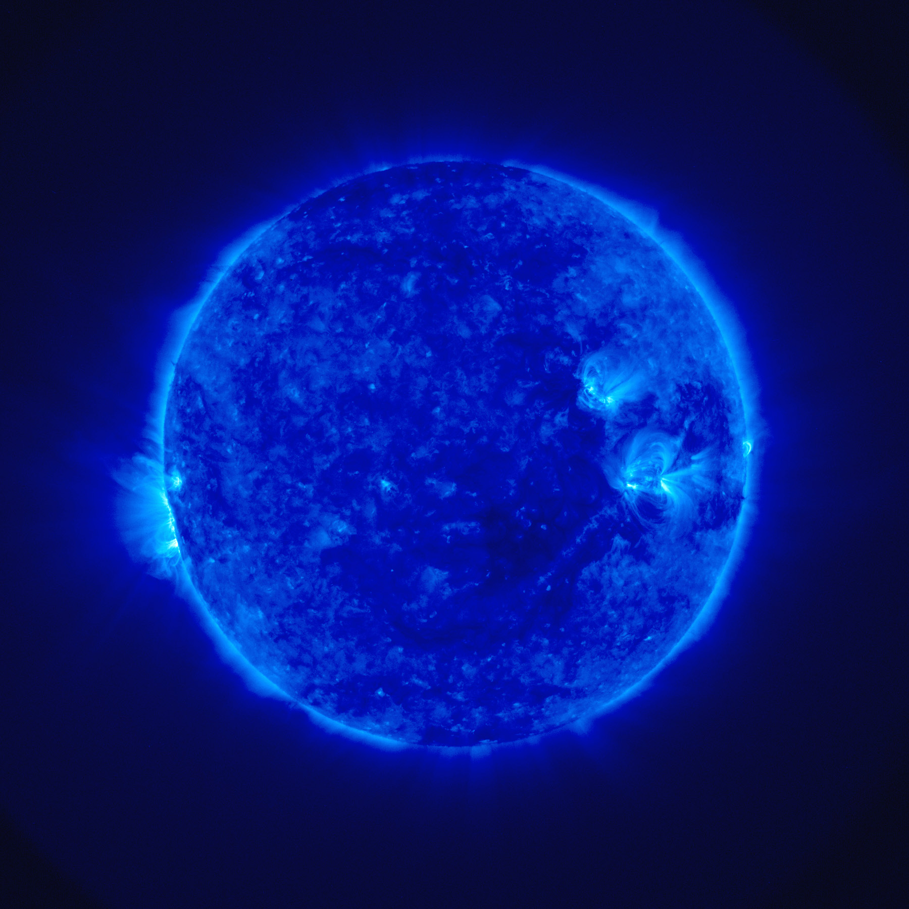
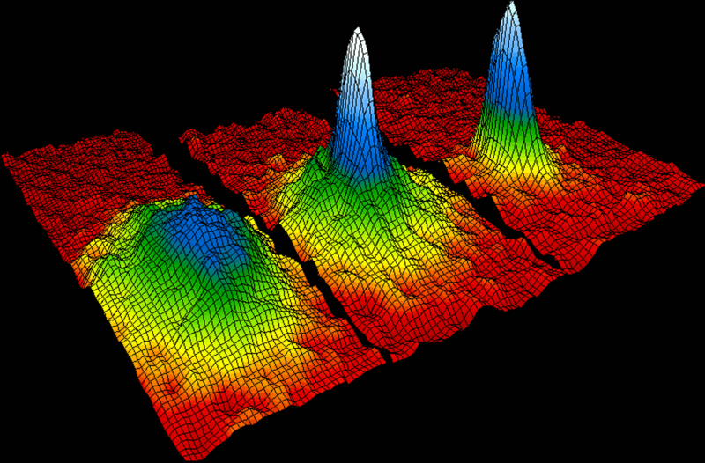
Other States of Mater
Plasma:
Exist at extremely high temperatures and pressure.
99% of all mater in the universe
Found in our sun and other stars.
Bose-Einstein Condensate:
Exist at extremely low temperatures
At -273 C or 0 K, atoms act as a single unit
Absolute Zero-0 degrees K
Temperature that all particles stop moving

Slide 8
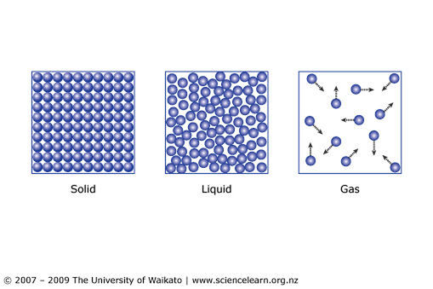
Kinetic Theory:
All particles of matter are in constant motion.
Kinetic energy:
The amount of energy an object has due to its motion
All Particles of matter have an attractive force with one another
The Kinetic theory explains why the different states of matter behave the way they do.

Slide 9
Solids:
Particle attraction is great, but they are allowed to vibrate in fixed positions.
Liquids:
Attractive force is less than solids but more than gases.
Force of kinetic energy and particle attraction are constantly in balance. “Tug of War”
Gases:
Attractive force is weak.
Particles are in constant, random motion and don not effect the other particles unless they collide.

Slide 10
Pressure
Force distributed over an area
Pressure=Force/ area
Measured in units call Pascals ( Pa)
Pa= N/ m²
kPA= kilopascal
Don’t worry about this too much now, we will revisit it later in the year.

Slide 11
Factors that affect Gas Pressure
Collisions between particles of a gas and the walls of its container causes pressure.
Temperature: Raising the temperature of a gas will increase its pressure if the volume of the gas and the number of particles are the same.
Volume: Reducing the volume of a gas increases its pressure if the temperature of the gas and the number of particles are constant.
Number of Particles: Increasing the number of particles will increase the pressure of the gas if the temperature and volume are constant

Slide 12
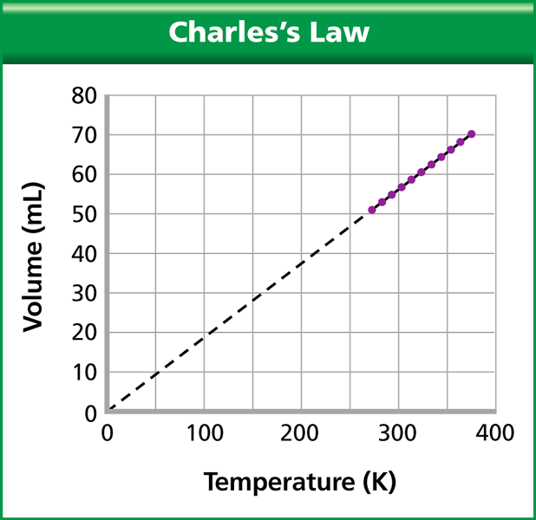
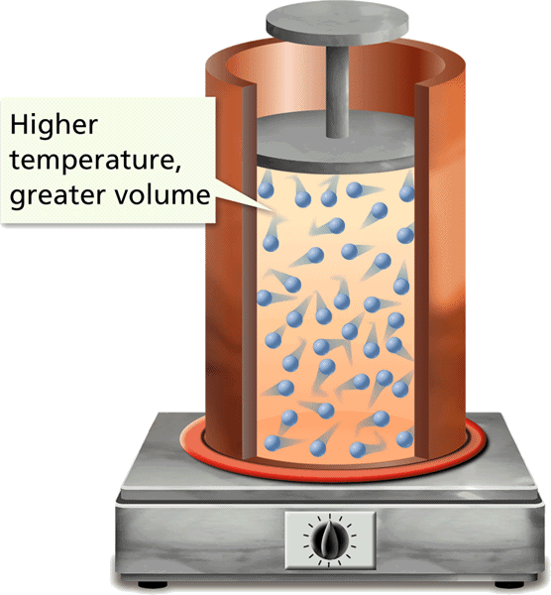
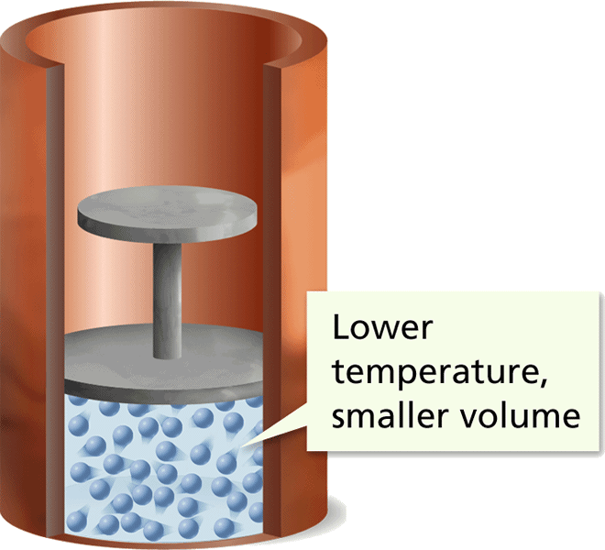
Charles’s Law
As temperature increases, volume increases
As temperature decreases, volume decreases
V₁/T₁ = V₂/T₂
The graph of Charles’s law shows that the volume of a gas is directly proportional to its kelvin temperature under constant pressure.

Slide 13
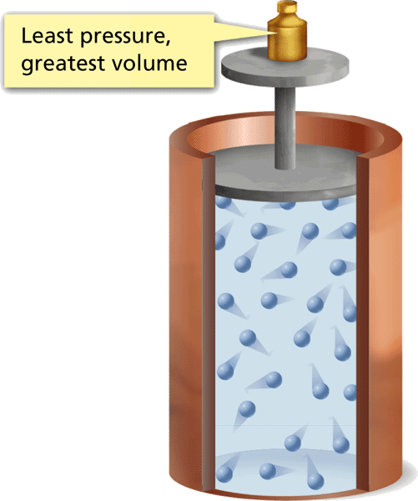
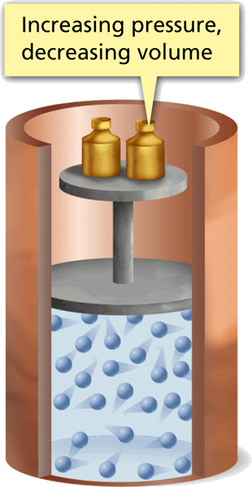
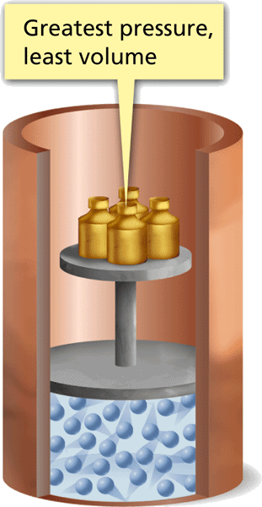
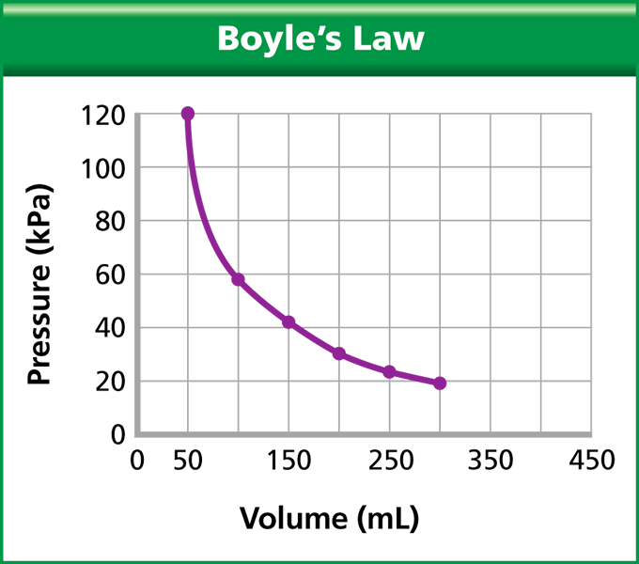
Boyle’s Law
The graph of Boyle’s law shows that the pressure of a gas varies inversely with its volume at constant temperature.
As Volume decreases, Pressure increase
As Volume increases, Pressure decreases
P₁ V₁ = P₂V₂

Slide 14
Combined Gas Laws
Describe the relationship among the temperature, volume, and pressure of a gas when the number of particles is constant.
P₁V₁
T₁
P₂V₂
T₂
=
Work the practice problems on p 80

Slide 15
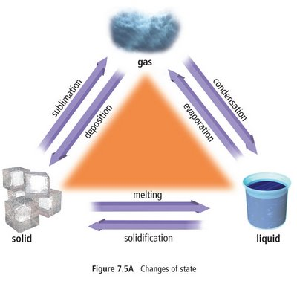
Phase Changes
A reversible physical change that happens when a substance loses or gains kinetic energy.
Energy and phase changes
Exothermic- energy is released to it environment, it gives off heat.
Endothermic- energy is absorbed by its environment, it get colder.
Freezing

Slide 16
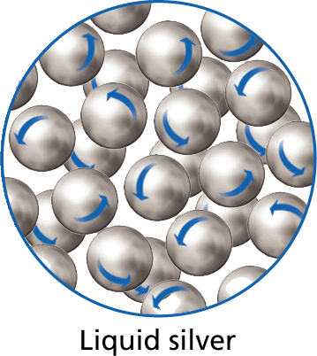
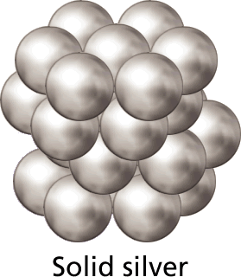
Solid & Liquid Phase Changes
The change in state from a solid to a liquid is called melting.
Endothermic

Slide 17
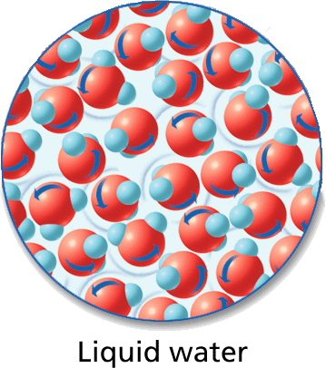
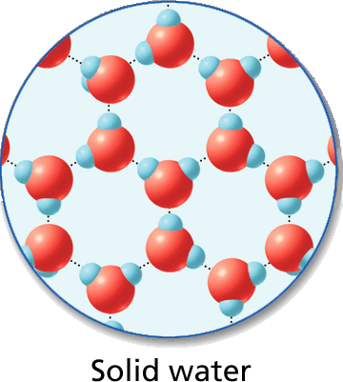
Solid & Liquid Phase Changes
The change of state from liquid to solid is called freezing.
Exothermic

Slide 18
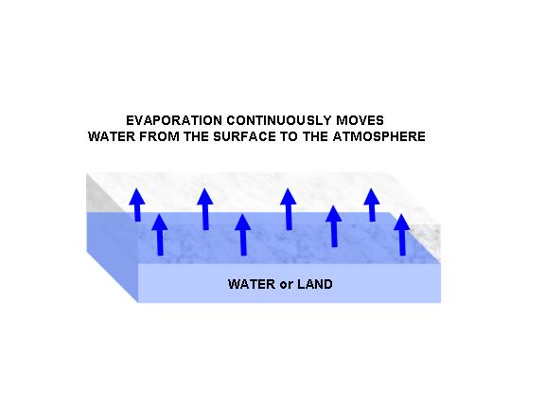
Gas & Liquid Phase Changes
Vaporization- change from liquid to a gas
2 types of vaporization
1. Evaporation- takes place on the surface of the liquid and happens at temperatures below the boiling point. Individual molecules have enough energy to change state.
Endothermic

Slide 19
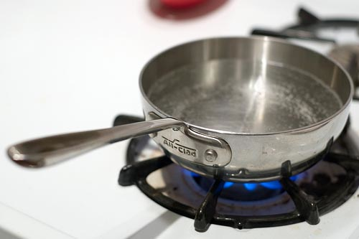
Gas & Liquid Phase Changes
2. Boiling—takes place throughout the liquid. At the boiling point, the molecules have enough energy to over come the attractive force, so the change into vapor and become less dense and rise to the top.

Slide 20
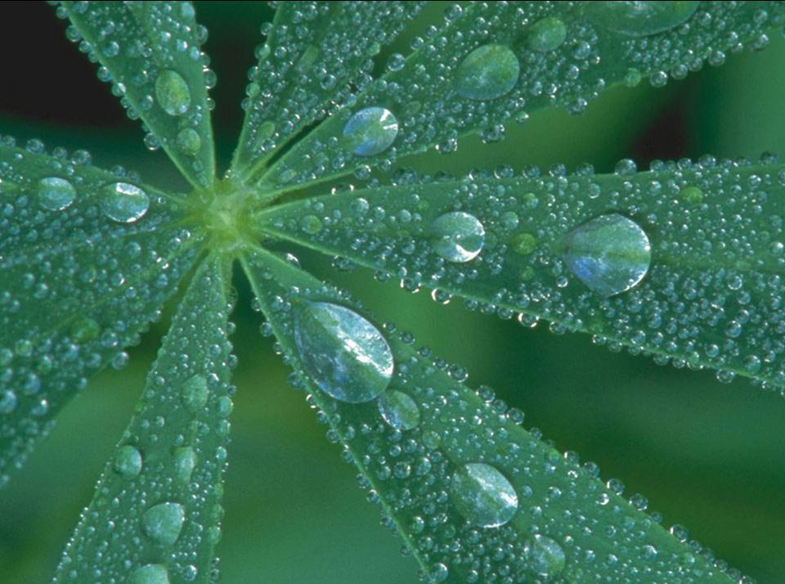
Ex: dew, clouds
Exothermic
Gas & Liquid Phase Changes
Condensation- Changes from a gas to a liquid

Slide 21
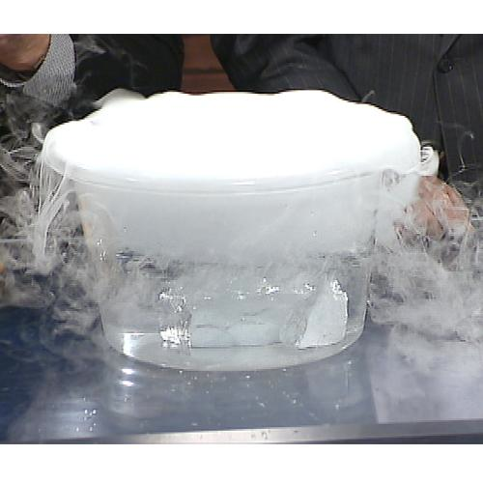
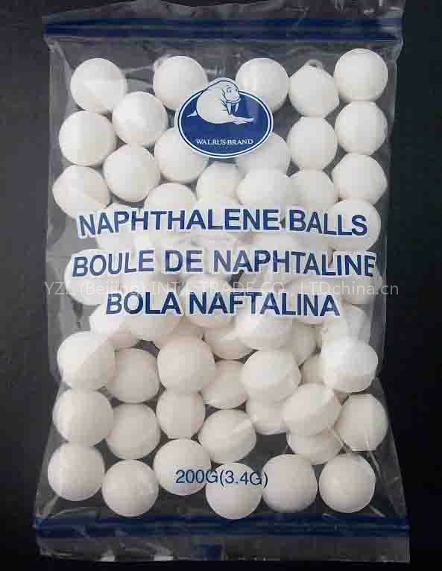
Gas and Solid Phase Changes
Sublimation- change from solid to a gas skipping the liquid phase
Endothermic
EX: Dry Ice & Naphthalene

Slide 22
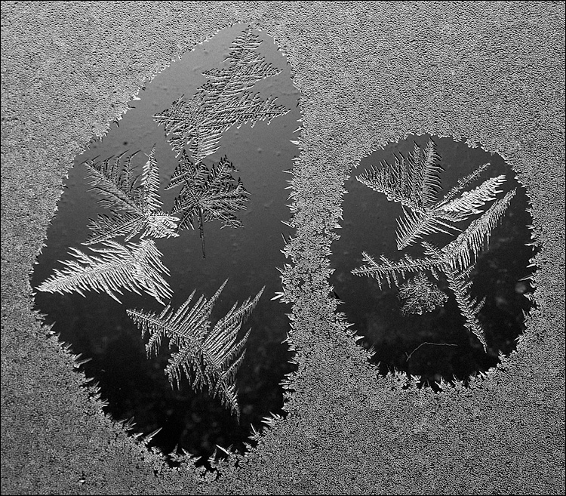
Gas and Solid Phase Changes
Deposition- Gas changing directly to a solid skipping the liquid phase.
Ex: Frost
Exothermic

