Slide 1
Physical Science EO1
Properties of Matter and the States of Matter

Slide 2
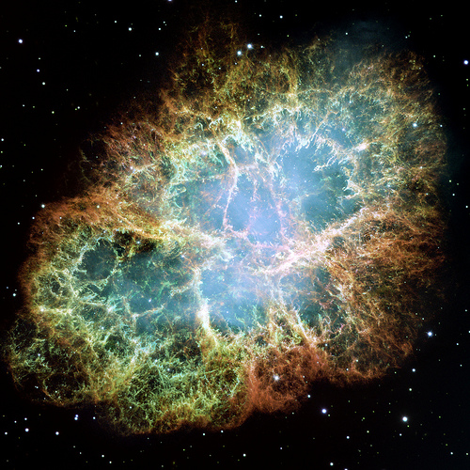
Matter- anything that has mass and takes up space.
Mass- the amount of matter a substance has.
There are 2 types of matter
Pure substances- exactly the same composition & have the same properties.
Elements
Compounds
Mixtures-Composition is not the same & its parts have different properties.
Heterogeneous
Homogeneous

Slide 3
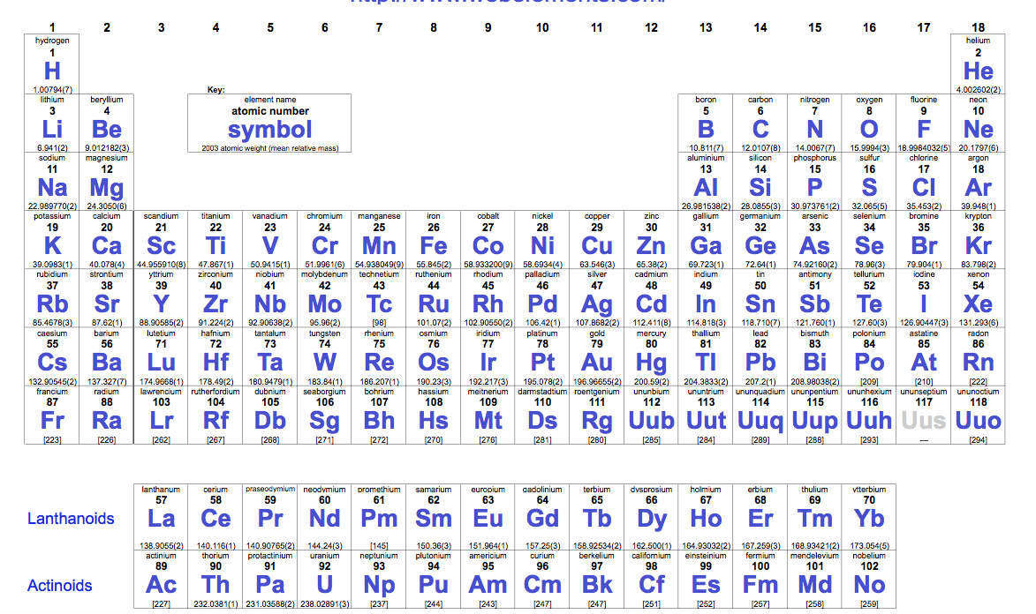
Elements- Elements are substances that can not be broken down into smaller substances.
Atoms-are the smallest pieces of the element.
Elements are organized on the periodic table. p132-133
Elements are given a 1 or 2 letter symbol that is used to abbreviate its name.
*rules for writing element symbols- 1st letter is always CAPITALIZED. 2nd letter is lower case.

Slide 4
Elements and Symbol Worksheet
Al ____________
Li ____________
Na ____________
S ____________
I _____________
V ____________
Ni _____________
B ____________
Ar ____________
P ____________
Gold ___________
Mercury ___________
Silver ___________
Platinum ___________
Zinc ___________
Iron ___________
Calcium ___________
Potassium ___________
Helium ___________
Hydrogen ___________

Slide 5
Compounds-a substance that is made of 2 or more atoms in a specific ratio.
The ratio of the compound is called it formula
Subscript- the number located after the symbol that indicates the number of that particular atom. If the element symbol has no subscript behind it, it is understood to mean that there is 1 of that atom. Ex: H₂O= 2 hydrogen & 1 oxygen
The smallest unit of a compound is called a molecule
Ratios- a mathematical relationship between 2 or more things. They are written as an expression. A:B or A:B:C……..
Name | Formula | Ratio
Water | H₂O | 2:1
Carbon dioxide | CO₂ | 1:2
Glucose | C₆H₁₂O₆ | 6:12:6
What is the ratio of boys to girls in this class?

Slide 6
Find the ratio the ratio for each.
H₂O _________
H₂ O ₂ _________
CO₂ _________
CO _________
NH₄ _________
Al₂O₃ _________
NaCl _________
N₂O _________
Fe ₂O₃ _________
CCl₄ ___________
SO₄ ___________
C₁₂H₂₄O₁₂ ___________
C₅H₁₀O₄ ___________
NO₃ ___________
C₃H₈ ___________
Watch Brain pop video on Compounds and Mixtures

Slide 7
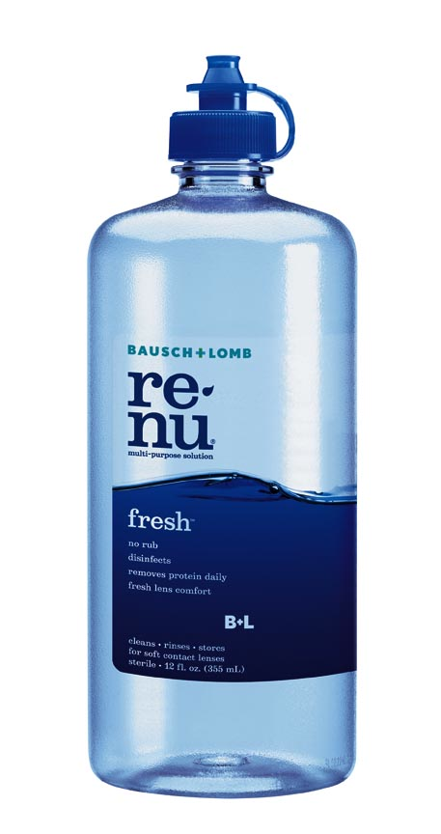
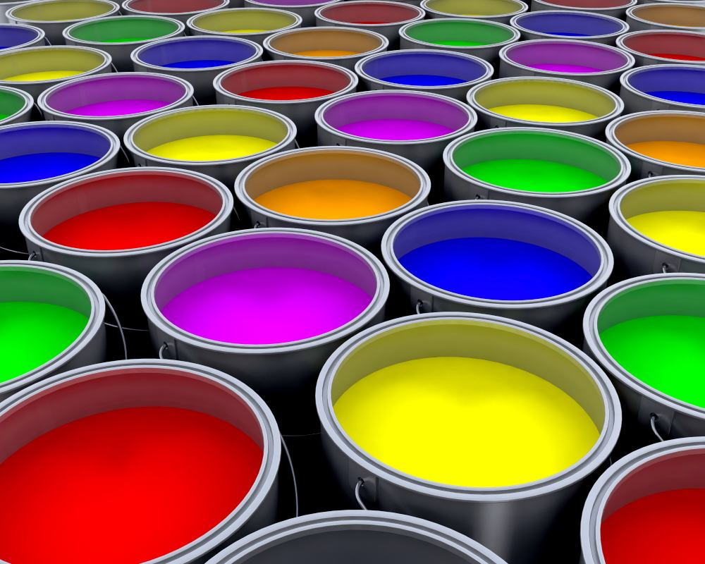
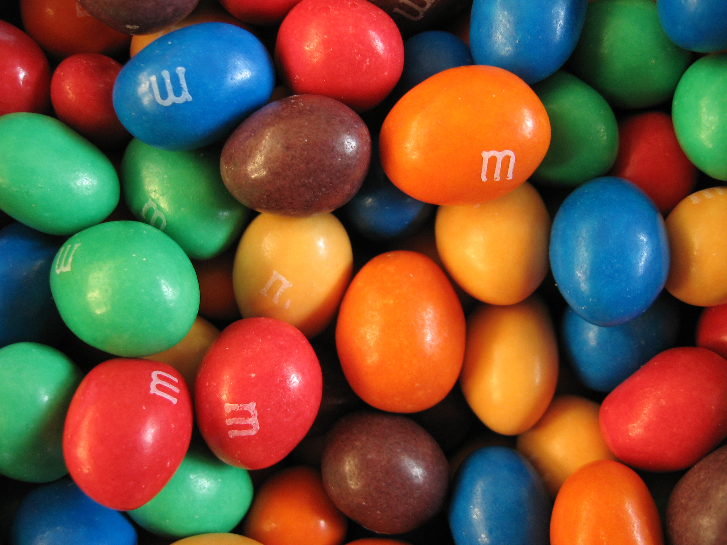
Types of Mixtures
Heterogeneous- parts of the mixture that are noticeably different from one another. Example: sand on a beach & chocolate chip ice cream.
Homogeneous- Parts of the mixture are evenly distributed (mixed) and is difficult to tell the difference between on substance in the mixture from the others.

Slide 8
Identify each of the following as an element, compound, or a heterogeneous mixture.
oxygen gas (O₂) ______________
Sand in water ______________
H₂O ______________
pizza ______________
Aluminum foil _____________
lava ______________
H₂ O _{2 ____________________}
Italian salad dressing ______________
Co _____________
CO _____________
sand on the beach __________
sugar( C₆H₁₂O₆ ) _____________
table salt ( NaCl) ____________
box cereal ________________
Pepsi ____________
Trail mix ___________
soil _________
garden salad ___________
Helium in a balloon __________
Chicken soup __________

Slide 9
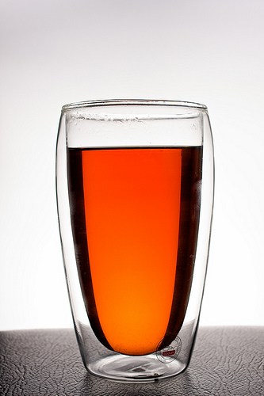
3 Types of Homogeneous Mixtures
TSW#2
Solutions, Suspensions, & Colloids
-they are classified based on the size of its largest particles
1.Solution-
forms when a substance dissolves into another.
Do not separate into layers over time.
Particles are so small they don’t get trapped by a filter.
Light can pass through a solution easily.

Slide 10
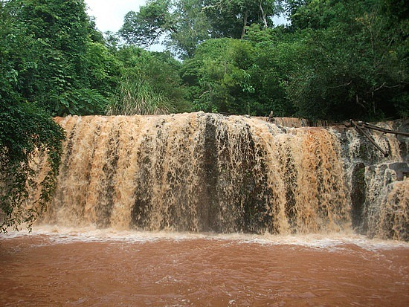
2. Suspensions-
Mixture that separates over time.
Particles are larger.
Can use a filter to separate.
Look “cloudy”

Slide 11
3. Colloids
Mixture that contains particles that larger than ones in a solution, but less that ones in a suspension. They are intermediate in size.
Do not separate into layers.
Can not be filtered.
Light is scattered when it is shined on it.

Slide 12
Property | Solution | Colloid | Suspension
Particle type | Small | Large molecules | Large particles
Particle size | 0.1 -1 nm | 1-100 nm | 100 nm & larger
Effect of Light | No scattering | Scattering | Scattering
Effect of Gravity | No separation | No separation | Separation
Filtration | Can not separate | Can not separate | Can separate
Classification | Homogeneous | < borderline>? | Heterogeneous

Slide 13
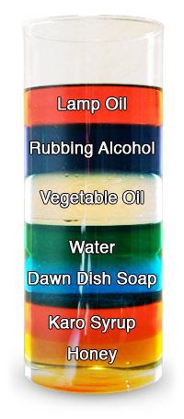
Physical Properties- Characteristics of a substance that can be observed or measured without changing what the substance is made of.
TSW#3
1. Density = mass/volume.
How much mass is in a given volume.
Water has a density of 1.0 g/ml
All elements and compounds have there own specific density.

Slide 14
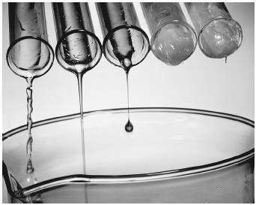
2. Viscosity-
The resistance of a liquid to flow.
viscosity is "thickness" or "internal friction".

Slide 15
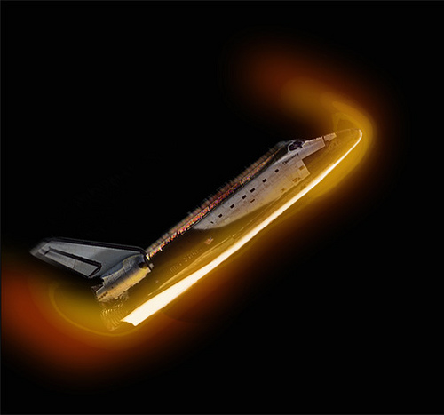
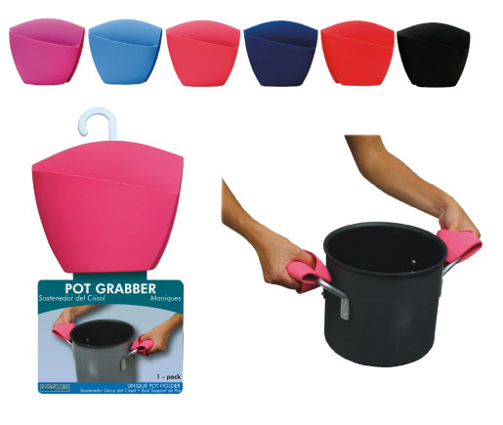
3. Conductivity
A materials ability to allow heat or electricity to flow through it.

Slide 16
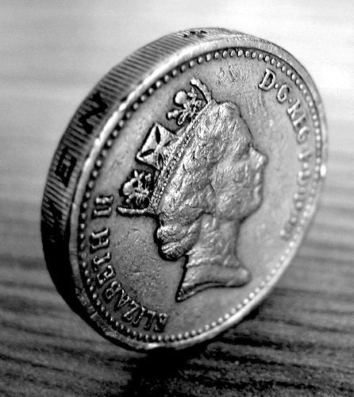
4. Malleability-
The ability of a solid to be shaped without breaking

Slide 17
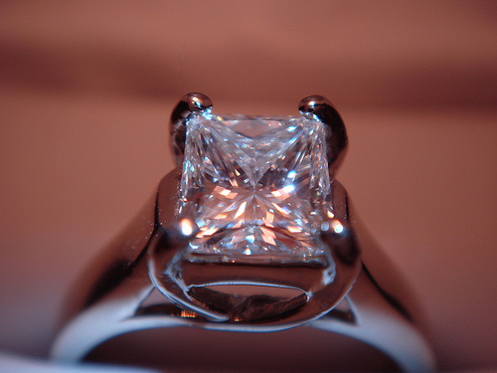
5. Hardness
Compare which materials can scratch an other

Slide 18
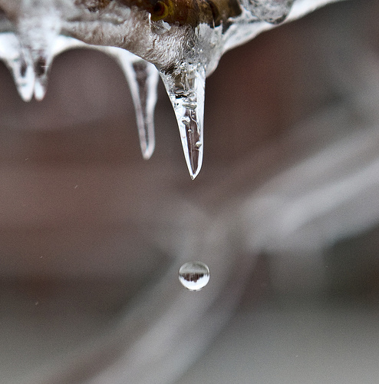
6. Melting & Boiling points
Melting point- the temperature at which a solid changes into a liquid
Boiling point-the temperature at which a liquid changes into a gas

Slide 19
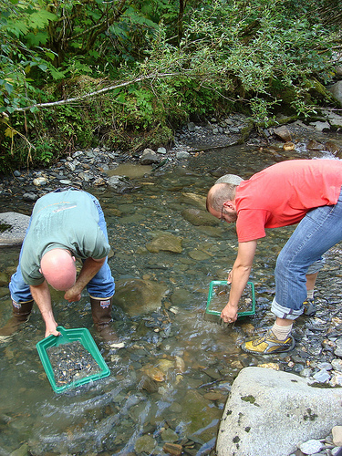
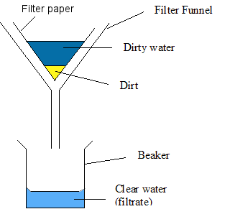
Using properties to separate mixtures
Filtration- separates particles based on size

Slide 20
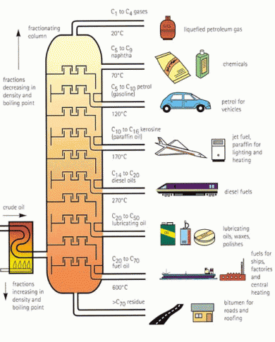
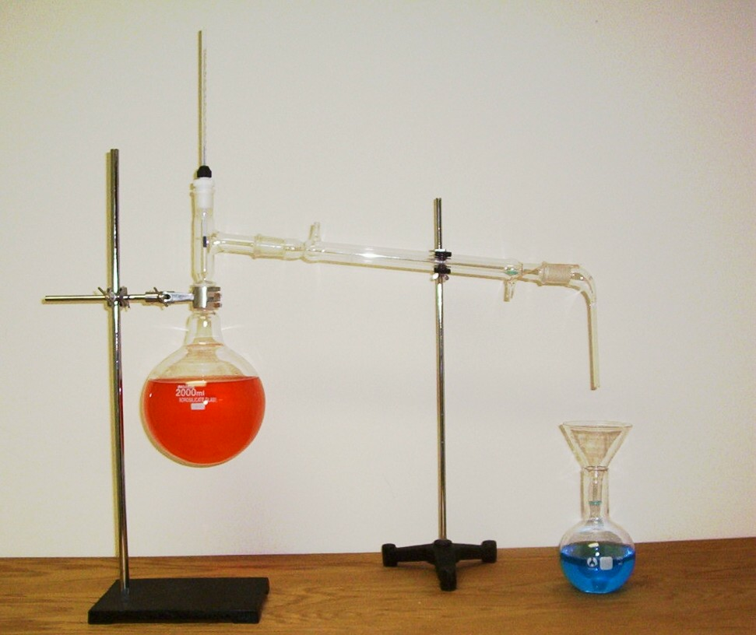
Distillation-separates substances based on there boiling points

Slide 21
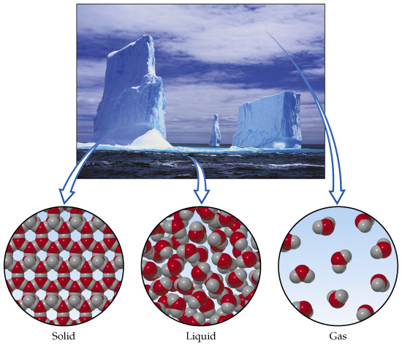
TSW #4 Physical vs. Chemical Change
Physical Change: happens when some of the properties of a change, but the substance remains the same.

Slide 22
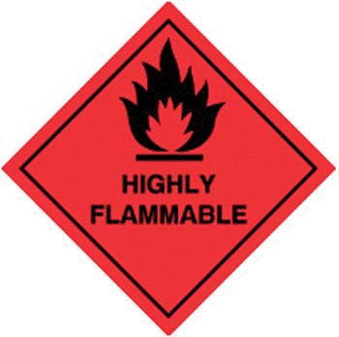
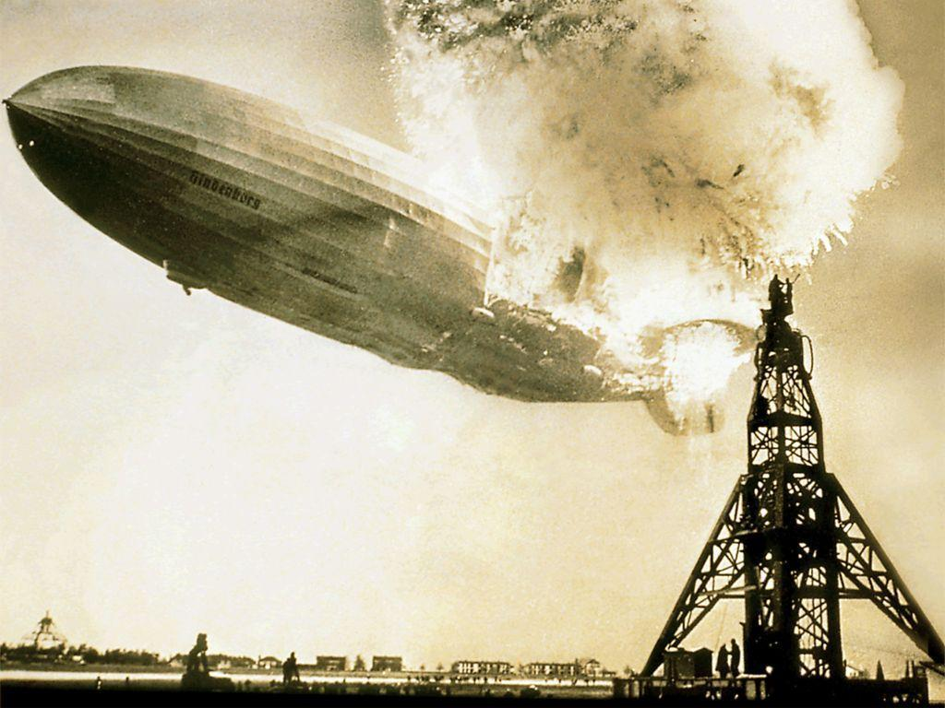
Chemical Properties-
The ability to to produce a change in the composition of matter
Can only be observed when the substance in a sample of matter are changing into different substances-
Flammability- ability of a substance to burn in the presence of oxygen.
Reactivity-how easily a substance combines with other substances.

Slide 23
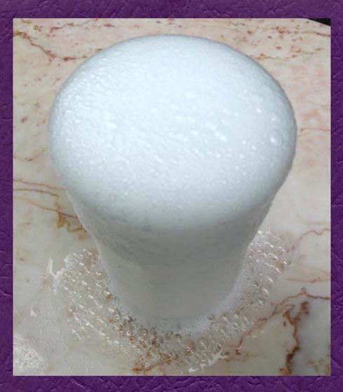
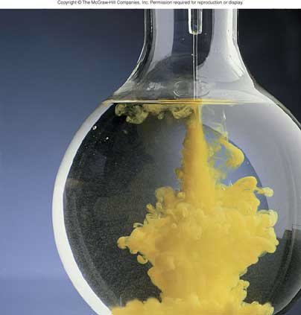
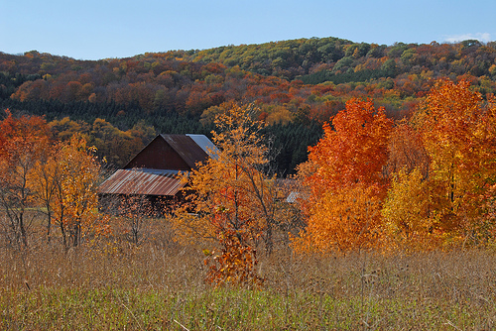
Chemical Change
Happens when a substance reacts and forms a new (one or more)substance..
Evidence of a chemical change-
Color change
Production of a gas-bubbles
Formation of a Precipitate- solid that forms and separates from mixing of liquids.

Slide 24
Label each process as a physical or chemical change: P or C
____perfume evaporating on your skin
____butter melting
____wood rotting
____charcoal heating a grill
____a hot glass cracking when placed in cold water
____melting copper metal
____burning sugar
____mixing sugar in water
____digesting food
____fogging a mirror with your breath
____breaking a bone
____mending a broken bone
____burning paper
____slicing potatoes for fries
____mixing sugar with coffee
____frying chicken
____a nail rusting
____paper ripping
____wood burning
____food molding
____bleaching fabric

