Slide 1
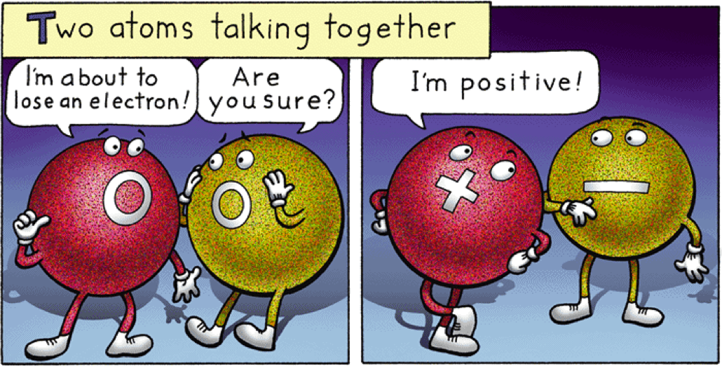
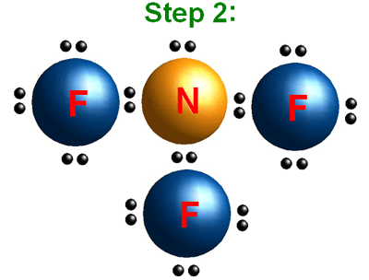
E03
Chemical Bonding

Slide 3
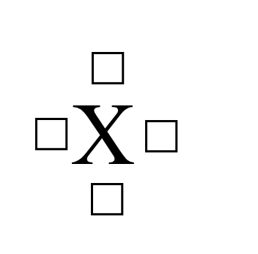
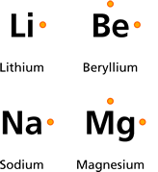
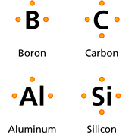
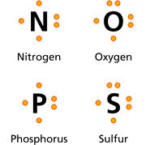
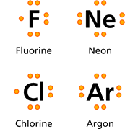
REVIEW
Valence Electrons and Bonding
The number of valence electrons in an atom of an element determines many properties of that element, including the ways in which the atom can bond with other atoms.
Electron Dot Diagrams- each member of a family has the same electron dot diagram configuration
Rule:
No more than 2 electrons per side
Has to be drawn on the N, E, S, W

Slide 4
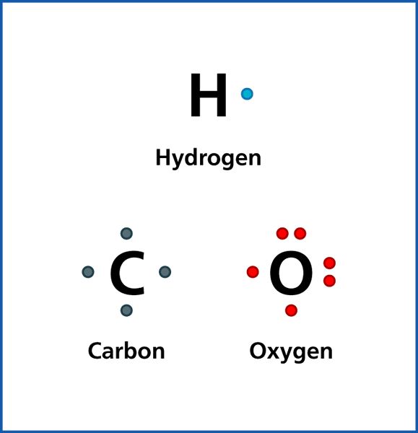
Why Do Elements Bond with Other Elements?
1st Think Back to Valence electrons.
Remember how we determined electron configurations?
1st orbital can have a maximum of 2 electrons
2nd orbital can have a maximum of 8 electrons

Slide 5
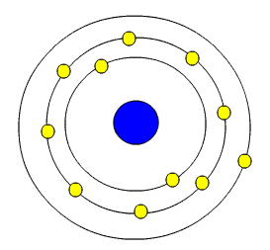
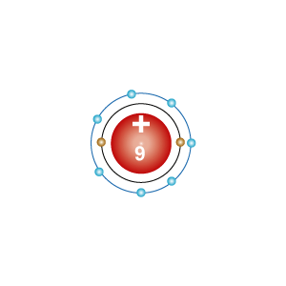
Each element wants to have stable configuration.
What does stable mean?
It wants to have its last electron configuration full ( 2 or 8). This is called the Octet Rule
In order to become stable, sometimes elements transfer or share electrons.
This is called chemical bonding
Sodium
Fluorine

Slide 6
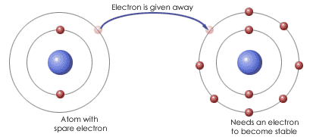
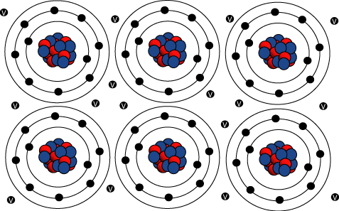
There are 3 types of Chemical bonds:
Ionic
3. Metallic
2. Covalent

Slide 7
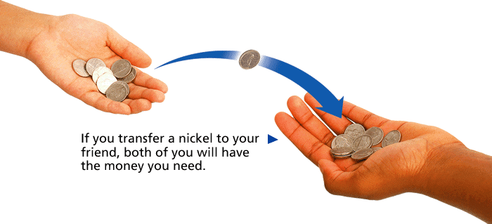
Ions and Ionic Bonds
- Ionic Bonds
Analogy:
You and a friend walk past a market that sells apples for 40 cents each and pears for 50 cents each. You have 45 cents and want an apple. Your friend also has 45 cents but wants a pear.

Slide 8
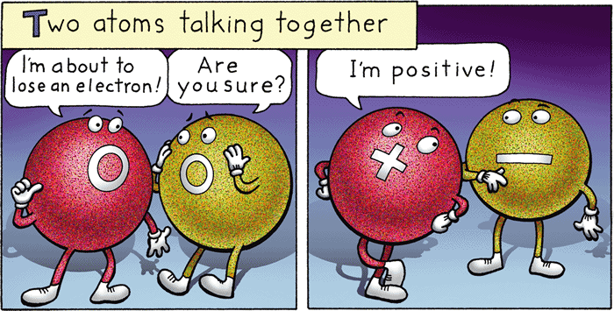
Ions and Ionic Bonds Metal and Nonmetal bonds
- Ionic Bonds
When an atom loses an electron, it loses a negative charge and become a positive ion. When an atom gains an electron, it gains a negative charge and becomes a negative ion.

Slide 9
Posi ive
Why does an atom become “Charged”?
Anions
egative
Cations
Sodium:
protons= +11
electrons = -10
Charge is now 1 +
Chlorine
protons= +17
electrons= -18
Charge is now 1-

Slide 10
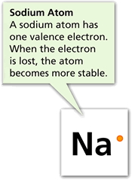
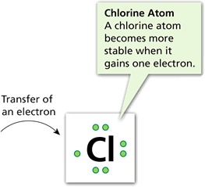
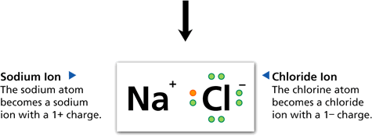
Ions and Ionic Bonds
- Ionic Bonds
Ionic bonds form as a result of the attraction between positive and negative ions.

Slide 11
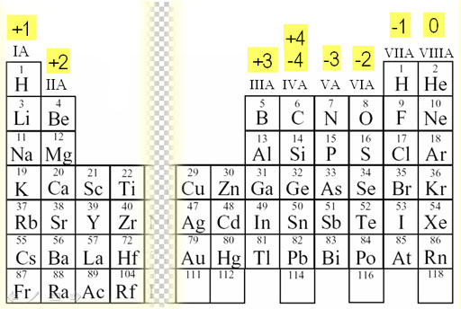
Family Ionic Charges

Slide 12
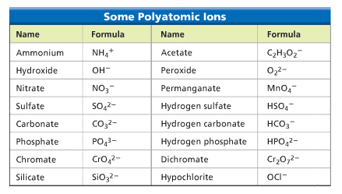
Polyatomic ions- are groups of atoms that are charged. We treat them as a group and not individual atoms
You have to memorize these for (B):
PO₄ ³⁻ Phosphate
SO₄ ²⁻ Sulfate
CO₃ ²⁻ Carbonate
NO₃ ¹⁻ Nitrate
NH₄ ¹⁺ Ammonia
OH ¹⁻ Hydroxide
HCO₃¹⁻ Bicarbonate
For (A)

Slide 13
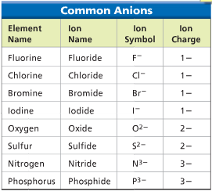
Rules for Naming Ion Compounds
Metal (cation) name is always 1st----- No change
Nonmetal (anion) name is always 2nd, and the ending is changed to -ide
Example: LiCl Na₂O

Slide 14
Rules for Naming Polyatomic Ionic Compounds
Metal (cation) name is always 1st----- No change
Polyatomic nonmetal name is always 2nd, and unchanged
Example: Na₂CO₃ MgSO₄
Sodium Carbonate Magnesium Sulfate

Slide 15
Rules for Writing Ionic Formulas
Write the symbol and charge
Switch the # of the charge to the subscript of the opposite Ion
no subscript is needed for 1
If the charges are equal, just write it as is

Slide 16
Rules for Writing Polyatomic Formulas
Write the symbol and charge
Switch the # of the charge to the subscript of the opposite Ion
Use (parentheses) if you have to add 2 or more polyatomic ions in order to balance.

Slide 17
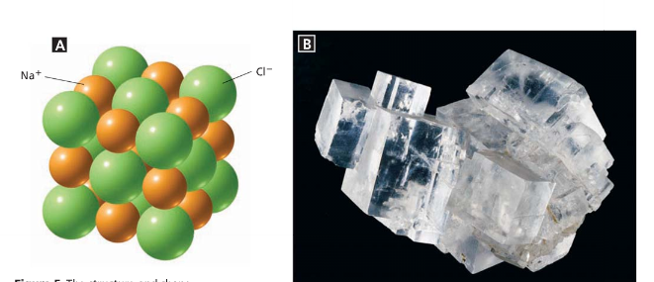
Properties of Ionic Compounds
- Ionic Bonds
All ionic compounds form crystals.
Crystals are 3-D structures of regular repeating ions

Slide 18
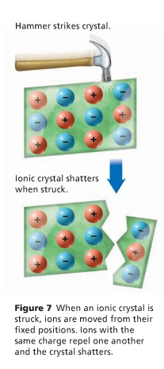
Ionic compounds are very hard and very brittle.
Again, this is because of the way that they're held together. Above, we said that it takes a lot of energy to break the positive and negative charges apart from each other.
This is the reason that ionic compounds are so hard - they simply don't want to move around much, so they don't bend at all.
This also explains the brittleness of ionic compounds. It takes a lot of energy to pull ionic charges apart from each other.
However, if we give a big crystal a strong enough whack with a hammer, we usually end up using so much energy to break the crystal that the crystal doesn't break in just one spot, but in a whole bunch of places. Instead of a clean break, it shatters.

Slide 19
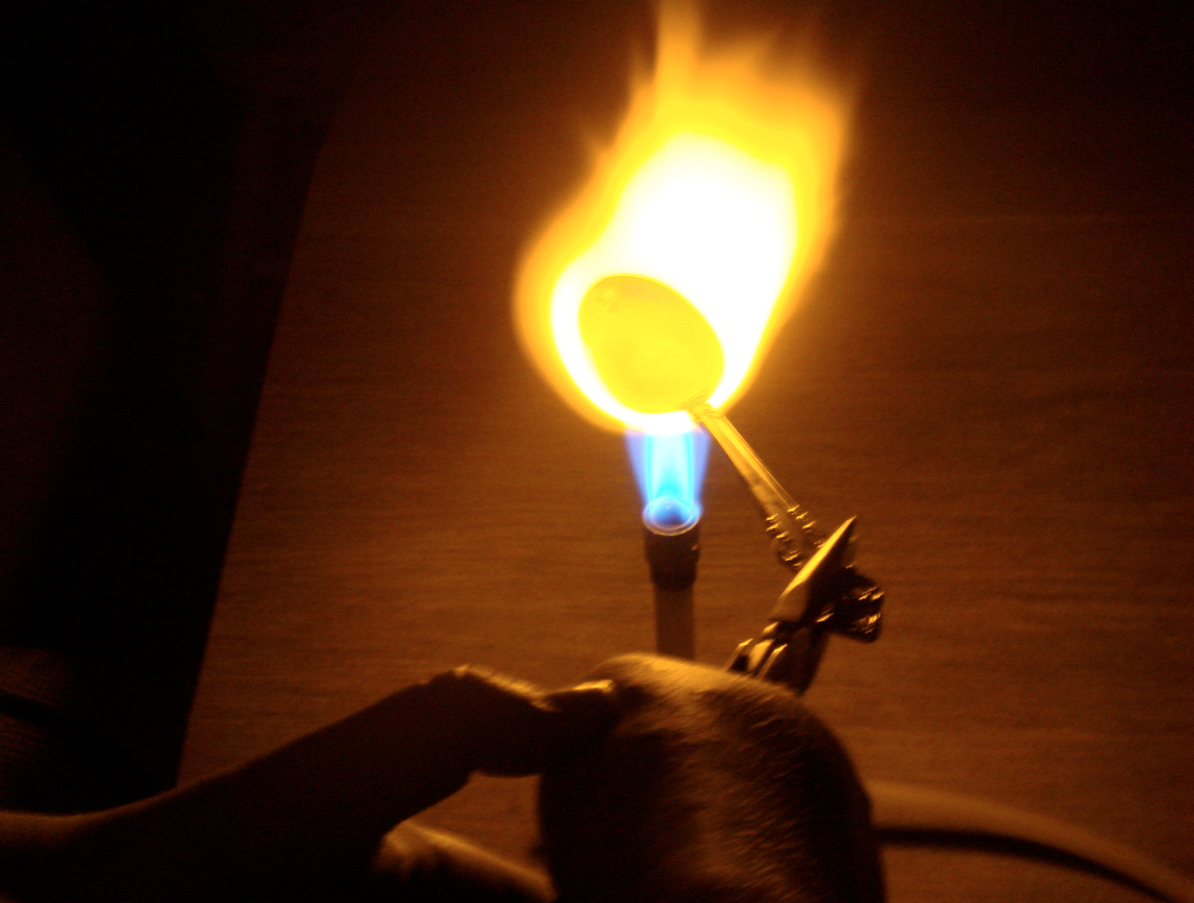
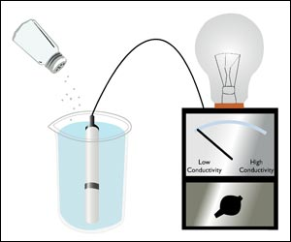
Ionic compounds tend to have high melting and boiling points.
When I say "high", what I mean is "very, very high." Most of the time, you can't melt them with a open flame.
Ionic compounds conduct electricity when they dissolve in water.

Slide 20
Rules for naming Special metals
The Roman numeral indicates the charge of the “Special Metal.”
Ion Name | Ion Symbol | Ion Name | Ion Symbol
Copper( I) | Cu ¹⁺ | Chromium (II) | Cr ²⁺
Copper (II) | Cu ²⁺ | Chromium( III) | Cr ³⁺
Iron (II) | Fe ²⁺ | Titanium (II) | Ti ²⁺
Iron (III) | Fe ³⁺ | Titanium (III) | Ti ³⁺
Lead (II) | Pb ²⁺ | Titanium(IV) | Ti ⁴⁺
Lead (IV) | Pb ⁴⁺ | Mercury (I) | Hg ¹⁺
Tin (II) | Sn ²⁺ | Mercury (II) | Hg ²⁺
Tin (IV) | Sn ⁴⁺
When writing the name of a compound of a special metal, the subscript of the nonmetal indicates the charge of the metal.
Do the switch in reverse.

Slide 21
Metallic Bonding

Slide 22
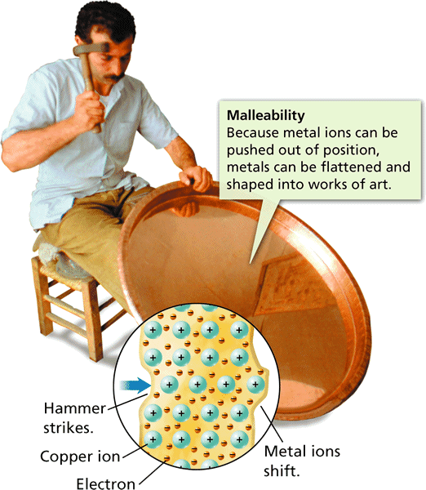
Metallic Bond (transition metals)- is the attraction between the metal cation and the shared electrons that surround it.
These electrons form a “ sea of electrons” and are more flexible than ionic bond s that are in ridged fixed positions so they can “ bend” more
These explains some of the properties of metals such as conductivity, malleability and ductility.

Slide 23
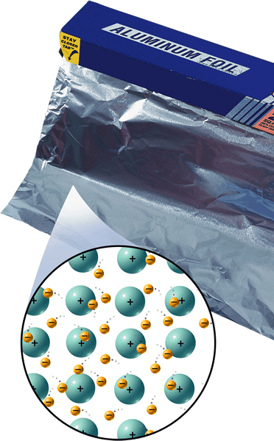
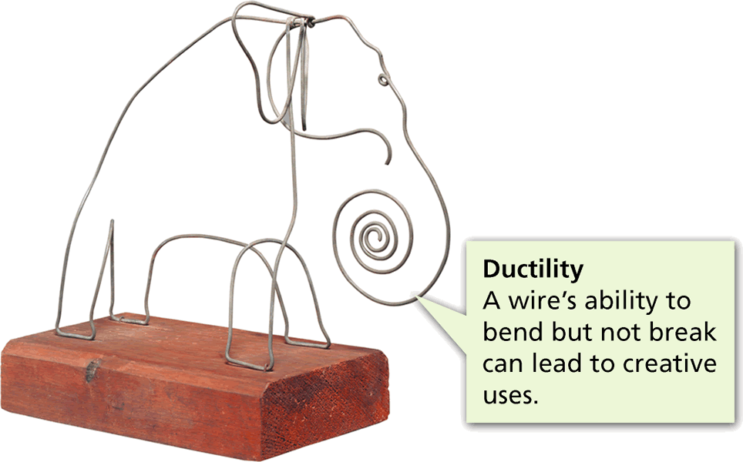
Metallic Bonding
- Bonding in Metals
A metal crystal consists of positively charged metal ions embedded in a “sea” of valence electrons.
These valence electrons are highly mobile and are free to move

Slide 24
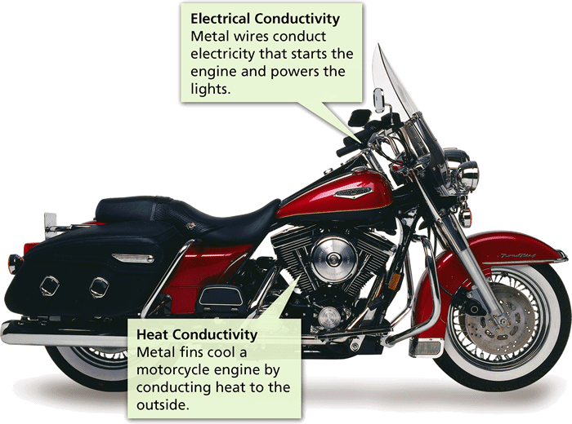
Metallic Properties
- Bonding in Metals
The “sea of electrons” model of solid metals explains their ability to conduct heat and electricity, the ease with which they can be made to change shape, and their luster.

Slide 25
Alloy-A mixture of two or more elements where at least one is a metal.
Are designed to use the good qualities of individual metals to make a better quality metal
Bronze- copper and tin

Slide 26
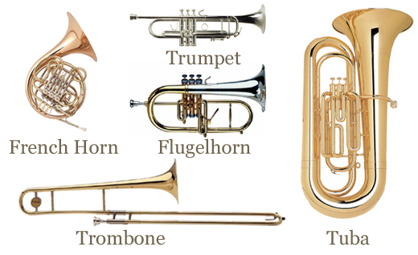
Brass-copper & zinc

Slide 27
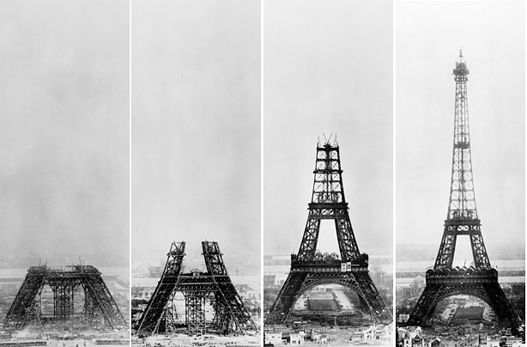
Steel – Iron & Carbon

Slide 28
Stainless steel – Iron , Carbon, Chromium, Nickel & Vanadium

Slide 29
Covalent Bonds-
Bonds between two or more non-metals where electrons are shared.
Molecule= a neutral group of atoms that are joined together by two or more covalent bonds.
Diatomic molecules- two of the same type of atoms share a pair of electrons. Many non-metals exist as diatomic molecules.
H₂, N₂, O₂, F₂, Cl₂, Br₂, and I₂

Slide 30
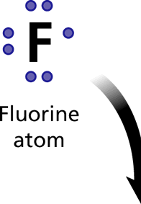
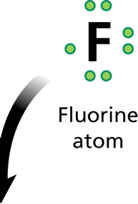
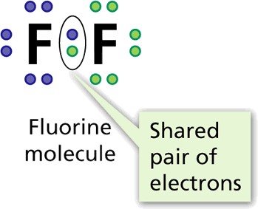
How Covalent Bonds Form
- Covalent Bonds
The force that holds atoms together in a covalent bond is the attraction of each atom’s nucleus for the shared pair of electrons.

Slide 31
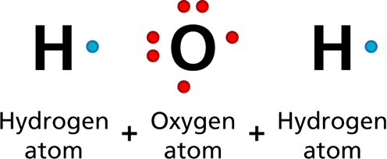
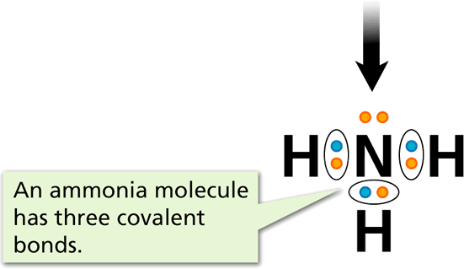
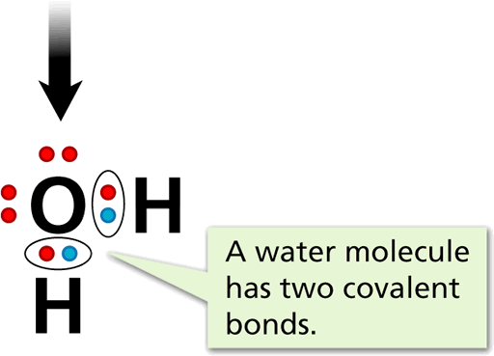
How Covalent Bonds Form
- Covalent Bonds
The oxygen atom in water and the nitrogen atom in ammonia are each surrounded by eight electrons as a result of sharing electrons with hydrogen atoms.

Slide 32
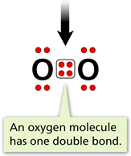
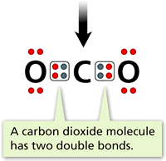
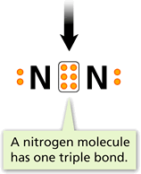
How Covalent Bonds Form
- Covalent Bonds
Share a pair of electrons-
The Number of bonds an atom can form is equal to the number of valence electrons needed to make 8 ( except H , 2)
One pair= single bond=2 electrons
Two pair= double bond=4 electrons
Three pair= triple bond=6 electrons

Slide 33
Rules for naming molecular compounds
1. The first element is named first, using the elements name.
2. Second element is named as an Anion (suffix "-ide")
3. Prefixes are used to denote the number of atoms
4. "Mono" is not used to name the first element
Note: when the addition of the Greek prefix places two vowels adjacent to one another, the "a" (or the "o") at the end of the Greek prefix is usually dropped; e.g., "nonaoxide" would be written as "nonoxide", and "monooxide" would be written as "monoxide". The "i" at the end of the prefixes "di-" and "tri-" are never dropped.
Prefix | Number Indicated
mono | 1
di | 2
tri | 3
tetra | 4
penta | 5
hexa | 6
hepta | 7
octa | 8
nona | 9
deca | 10

Slide 34
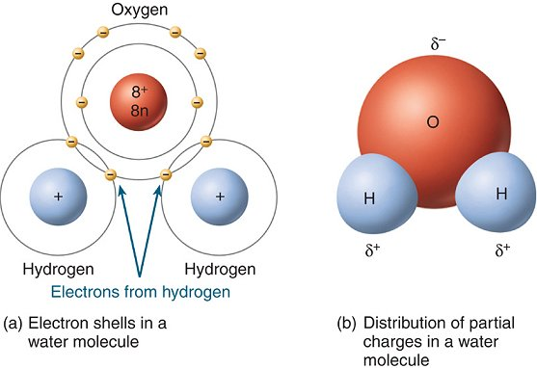
Polar bond – unequal sharing of electrons due to unequal attractive forces of the different atoms
Nonpolar Bond- Equal sharing of electrons.
Polar molecules have a slight charge towards the direction of the atom that has the greater attractive force.
Polar and Nonpolar molecules do not mix with each other! We will study this more in the next unit
We use the greek lowercase symbol δ + or δ -to show the slight charges of the atoms
http://phet.colorado.edu/en/simulation/molecule-polarity
Polarity

Slide 35
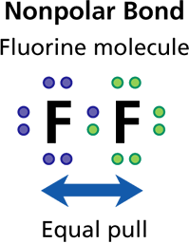
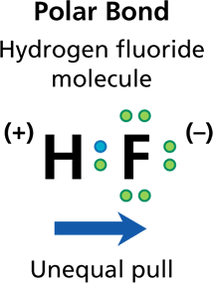
Unequal Sharing of Electrons
- Covalent Bonds
They type of atoms in a molecule and its shape are factors that determine whether a molecule is polar or nonpolar
Fluorine forms a nonpolar bond with another fluorine atom. In hydrogen fluoride, fluorine attracts electrons more strongly than hydrogen does, so the bond formed is polar.

Slide 36
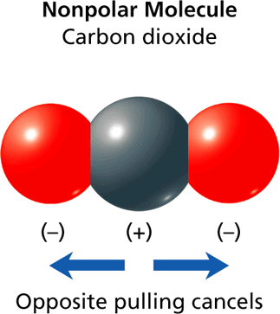
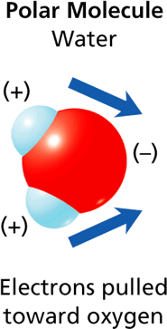
Unequal Sharing of Electrons
- Covalent Bonds
A carbon dioxide molecule is a nonpolar molecule because of its straight-line shape. In contrast, a water molecule is a polar molecule because of its bent shape.

Slide 37
Properties of Covalent Molecular Compounds
The bond attractive force is weak compared to ionic, so its properties reflect that property
Low Melting and Boiling Points
Do not usually from crystals
( except Sugar, & water)
Poor conductors of electricity
Melting & Boiling Points of some Molecular Compounds
Compound | Formula | Melting Point (C) | Boiling Point (C)
Water | H₂O | 0 | 100
Methane | CH₄ | -182 | -164
Carbon Dioxide | CO₂ | - | -78.6
Ammonia | NH₄ | -77.7 | -33.6
Rubbing Alcohol | C₃ H₇ OH | -89.5 | 82.4
Sugar | C₁₂H₂₂ O₁₁ | 186 | decomposes

