Slide 1
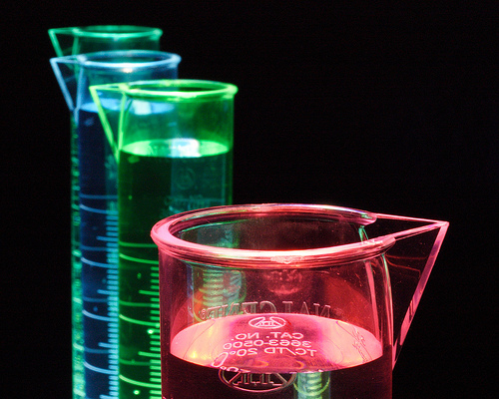
E04
3 quizzes
TSW 1-4
TSW 5-7
TSW 8-10

Slide 2
Balancing Chemical Reactions
Reactant(s)= the things that change in a reaction, found on the left side of the equation.
Product(s)= the new substances formed from the change, found on the right side of the equation
Yield sign ; this means that a reaction is/has taking place.
Reactant Product

Slide 3
Types of reactions
Synthesis
A + B → AB
8 Fe + S₈ → 8 FeS
Decomposition
AB → A + B
2 H₂O → 2 H₂ + O₂

Slide 4
Types of reactions
Single-Replacement
A + BC → AC + B
Zn + 2 HCl → ZnCl₂ + H₂

Slide 5
Types of Reactions
Double-Replacement
AB + CD → AD + CB
NaCl + AgNO₃ → NaNO₃ + AgCl

Slide 6
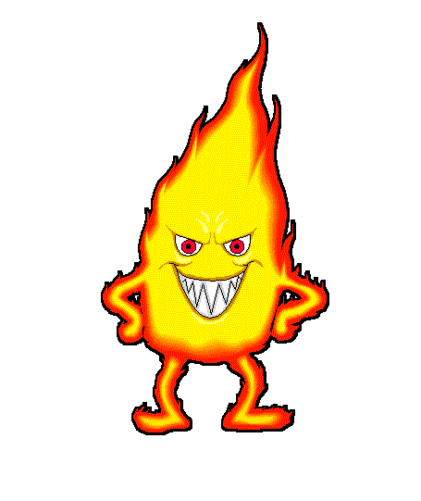
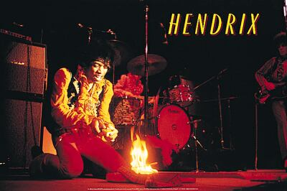
Combustion
Cx Hy+ O₂ CO₂ + H₂O

Slide 7
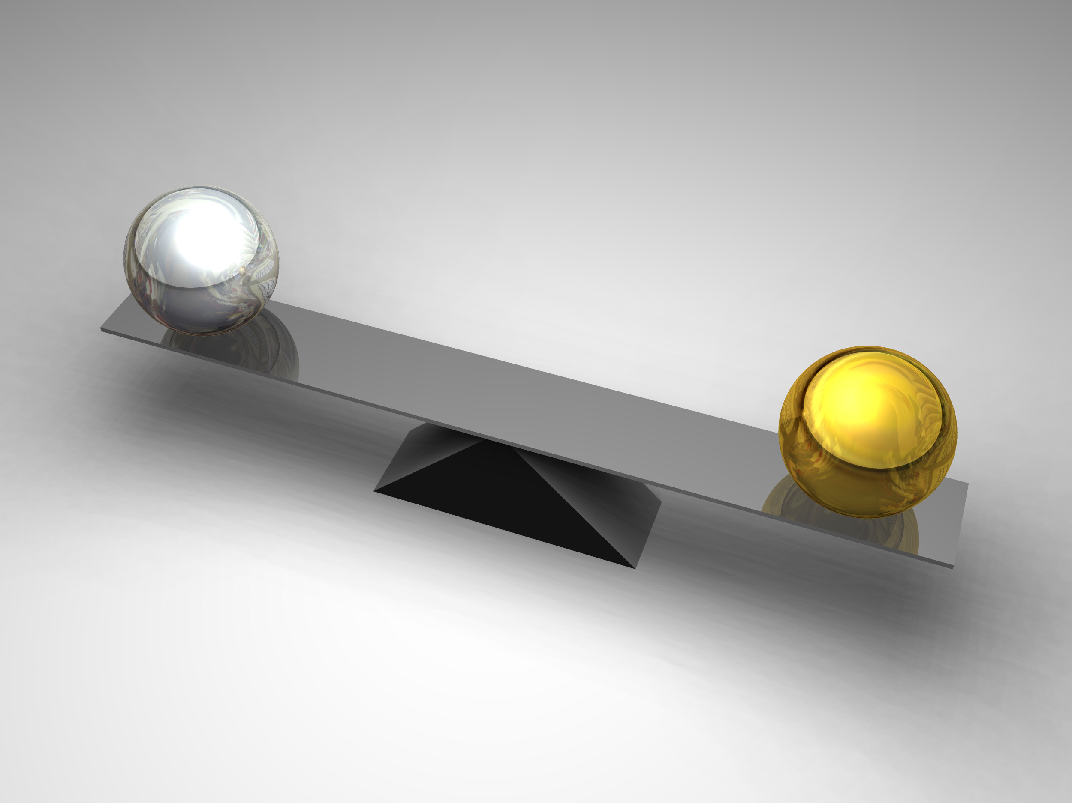
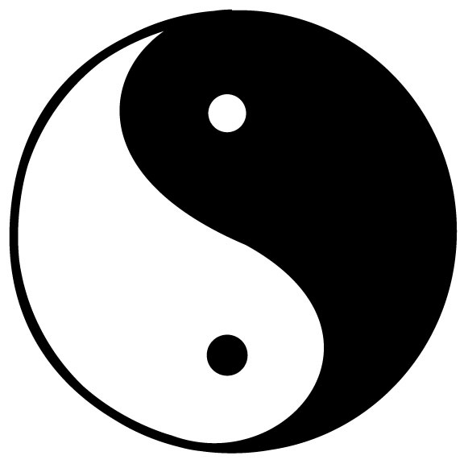
Law of Conservation of Mass
States that matter can not be created or destroyed
In other words; the number of elements on the reactants side of the equation must equal the number of elements on the products side. The equation must be balanced.

Slide 8
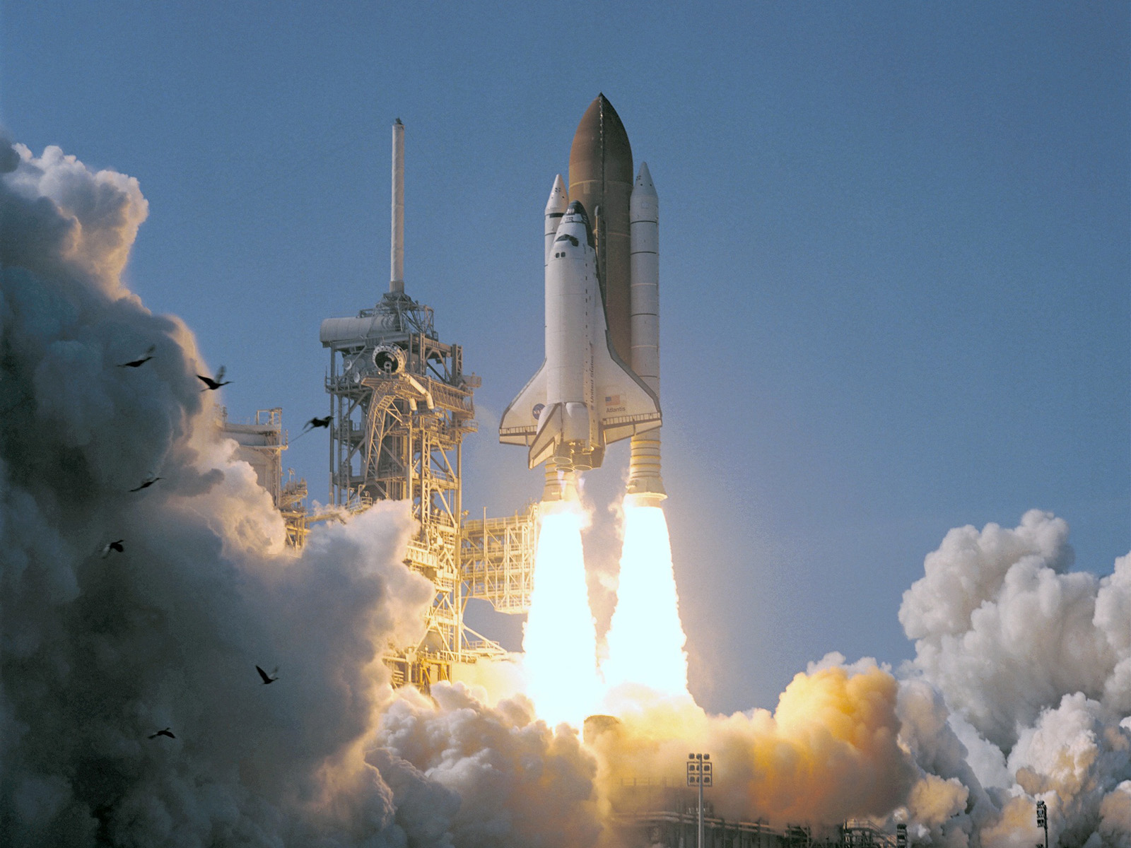
Reactants
Product
H₂ + O₂ H₂O
We read this as: hydrogen plus oxygen yields water

Slide 9
What is wrong with this equation?
Step 1: count
H₂ + O₂ H₂O
2
2
2
1

Slide 10
What is wrong with this equation?
Step 2: add a coefficient to the increase the number of the elements that are needing to be increased to be balanced.
* The coefficient multiplies every element in the formula*
H₂ + O₂ 2 H₂O
***Coefficients can only be placed in FRONT of the compound/ molecule! ***
4
2
2
2
Step 3: Recount
Step 4: Is it balanced? Yes- you are done; No- repeat step 2

Slide 11
What is wrong with this equation?
Step 5: add a coefficient to the increase the number of the elements that are needing to be increased to be balanced.
2H₂ + O₂ 2 H₂O
4
4
2
2
Step 6: Recount
Step 4: Is it balanced? Yes- you are done

Slide 12
Redox reactions: reduction-oxidation
The term comes from the two concepts of reduction and oxidation. It can be explained in simple terms:
Oxidation is the loss of electrons or a increase in oxidation state by a molecule, atom, or ion ( Such as O, F, Cl, & Br)
Reduction is the gain of electrons or a decrease in oxidation state by a molecule, atom, or ion. ( such as Li, Na, Mg, Fe, Zn, & Al)

Slide 13
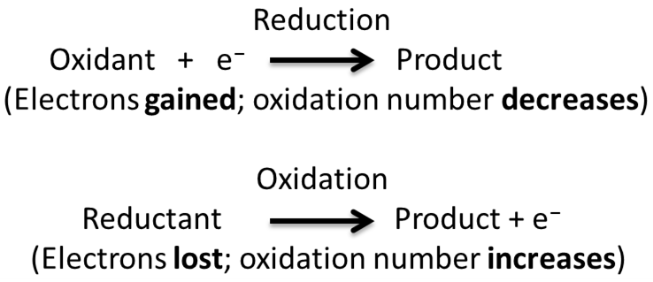

Slide 14
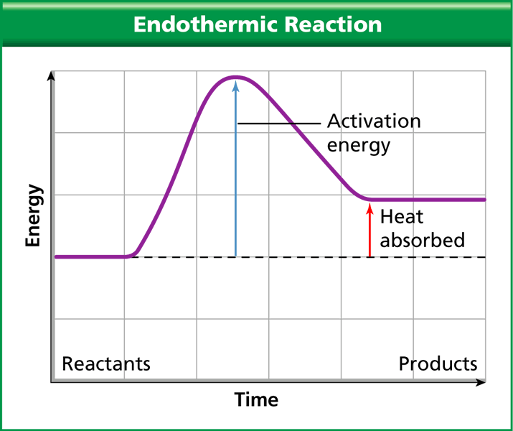
TSW#4
Changes in Energy
Chemical Energy-Energy that is stored in the bonds of molecules and compounds.
Energy is needed to break the existing chemical bonds
Activation energy: The minimum amount of energy needed to get a reaction started.

Slide 15
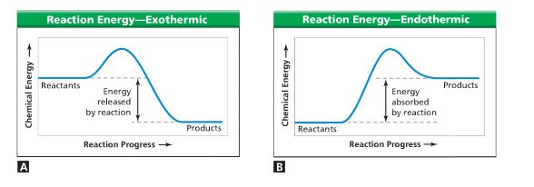
During a chemical reaction this energy is either given off or absorbed
Exothermic- Reactions that release energy to its surroundings.
Endothermic- Reactions that absorb energy from its surroundings.

Slide 16
Controlling Reactions

Slide 17
Concentration
Amount of one material in a given amount of another.
Increasing the concentrations of the reactants will make more particles react.
Stirring:
Stirring- increases the exposure of the reactants to each other.

Slide 18
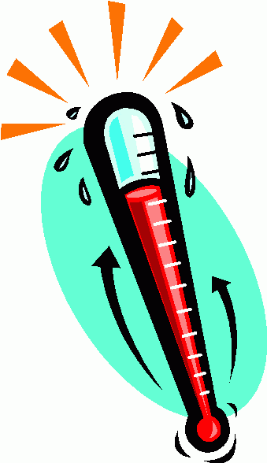
Temperature
Increasing temperature will cause particles to move faster.
If the particles move faster, they come in contact more often.
If the particles move faster they will have more energy, which helps react the required activation energy

Slide 19
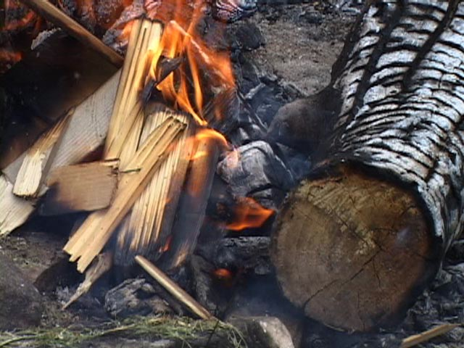
Surface Area
Increasing the particles of a material that are exposed, the reaction can happen faster.

Slide 20
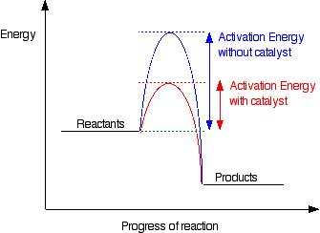
Catalysts
A material that increases the speed of a reaction by lowering the activation energy.
Enzymes are catalysts in the cell and body that provide a place or surface for reactions to take place.
They are temperature sensitive. Also, they are not used up in the reaction

Slide 21
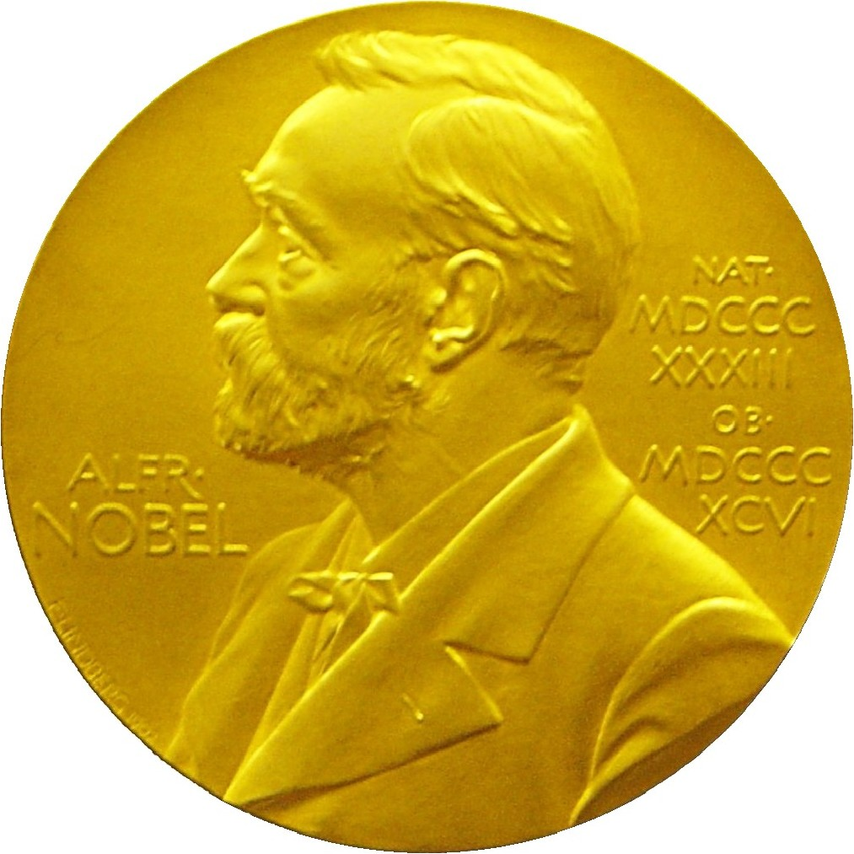
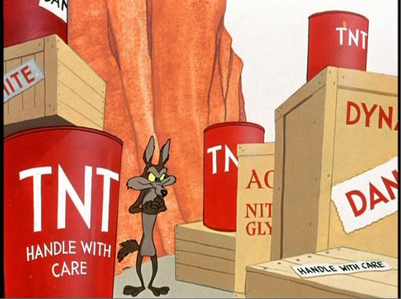
Inhibitors
Materials that decrease the speed of a reaction
Alfred Nobel-Nitroglycerin to Dynamite
Quiz #1

Slide 22
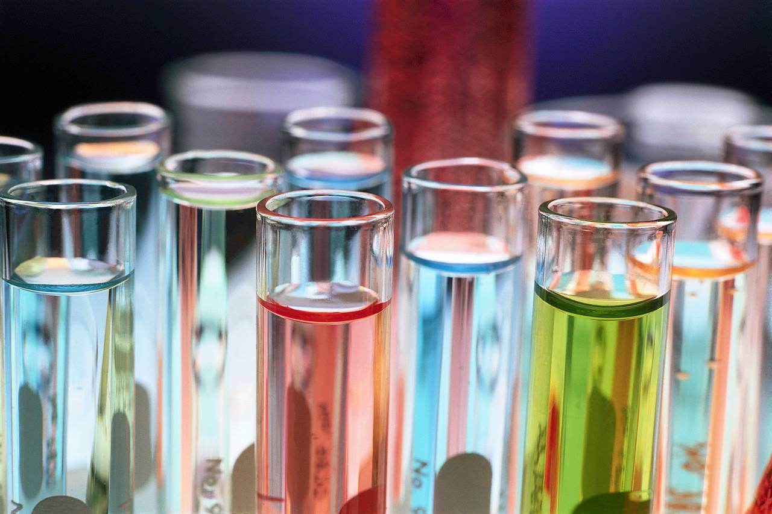
TSW #6 Forming Solution
Remember?
Particles are well mixed not seen with the naked eye

Slide 23
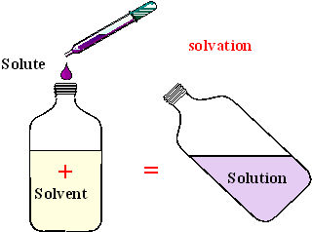
Parts of a solution
Solvents-part of solution in the largest amount
It dissolves the other substance
Solute- part of the solution in the smallest amount
It is dissolved by the other substance

Slide 24
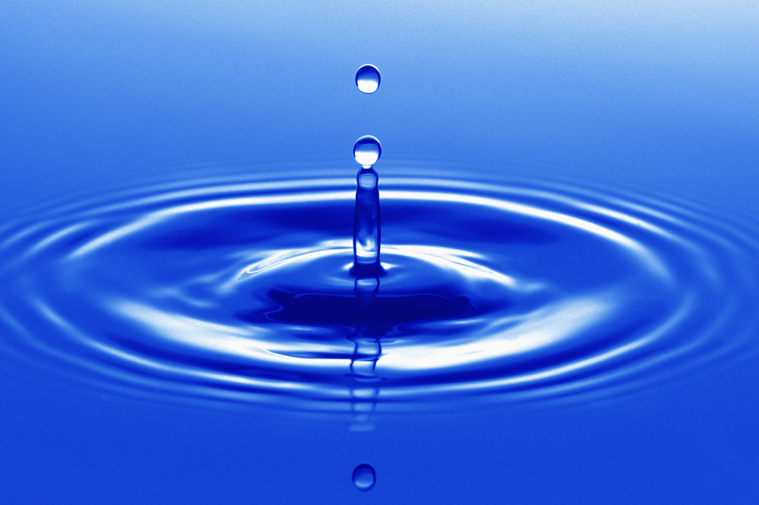
Universal Solvent
Water is called the “Universal Solvent” because it dissolves so many substances.

Slide 25
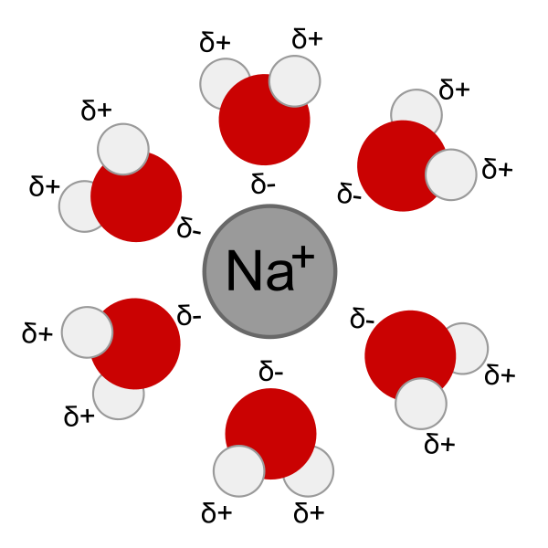
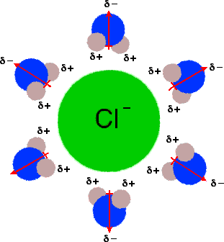
Substances can dissolve in water 3 ways:
Disassociation- ionic compounds separate to form ions

Slide 26
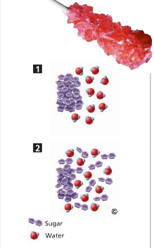
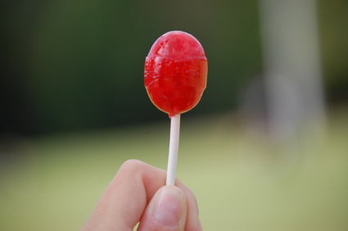
2. Dispersion: Molecular compounds break into small pieces and spread evenly through out the solution.

Slide 27
Ionization of Molecular Compounds
Ionization: When neutral molecules gain or lose electrons and changes chemically by a reaction of the solute and solvent

Slide 28
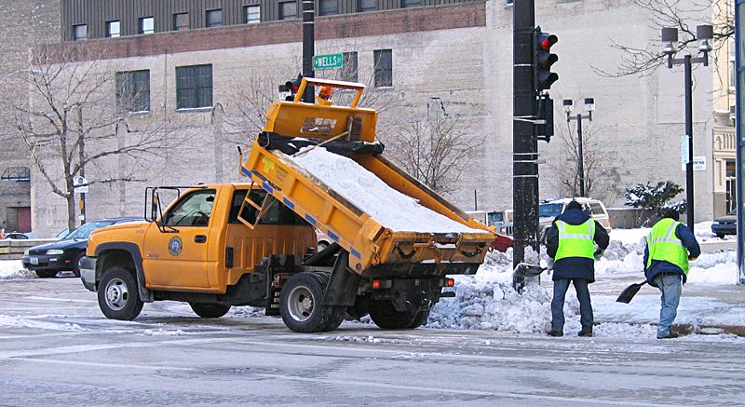
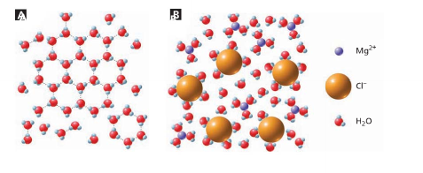
Properties of Liquid Solutions
Physical properties of a solution can differ from those of its solute and solvent in three ways:
Conductivity- ionic compounds do dot conduct electricity until the are dissolved in water.
Boiling & melting points change:

Slide 29
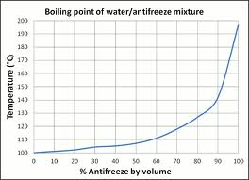
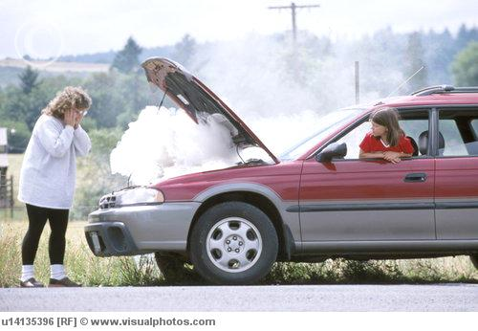
Boiling point

Slide 30
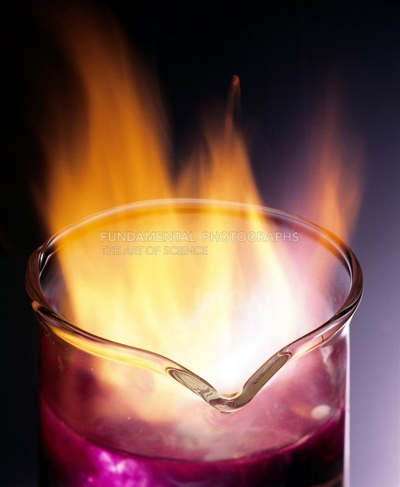
Heat of Solutions
During the formation of a solution Energy is either given of or absorbed. “Endo or Exo”

Slide 31
Factors that Effect Dissolving
Surface area- an increase in surface area will speed up a reaction, by making the solute into smaller pieces.
Stirring- mixes the solute come into contact with the solvent at a faster rate.
Heat: increases the particle motion so, it come into contact with the solvent at a faster rate.

Slide 32
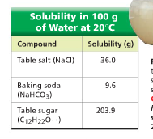
TSW#7 Solubility
The maximum amount of a solute that dissolves in a given amount of solvent at a constant temperature.
* grams of solute per 100 grams of solvent at a specific temperature.
Characteristic property of a compound that can be used to identify a compound.
* notice all are white powdery substances?

Slide 33
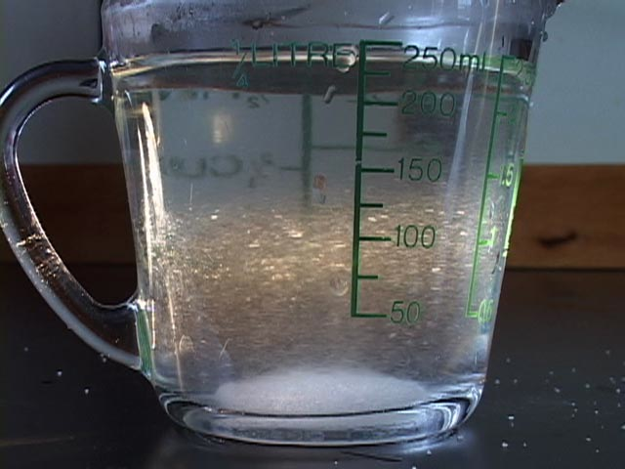
Saturated- the maximum amount of solute is dissolved in a solution at a given temperature. It is full and can not dissolve any more solute.
If more is added, it well settle to the bottom
Unsaturated- the solvent can hold more solute at the given temperature.

Slide 34
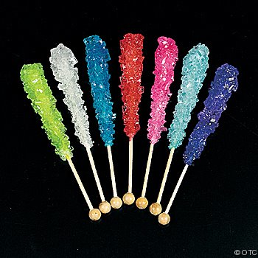
Supersaturated Solution
Contains more solute than it can normally hold at a given temperature.
If a saturated solutions is cooled slowly, sometimes extra solute will remain dissolved but, it is very unstable.
Ex: sodium acetate & Rock Candy

Slide 35
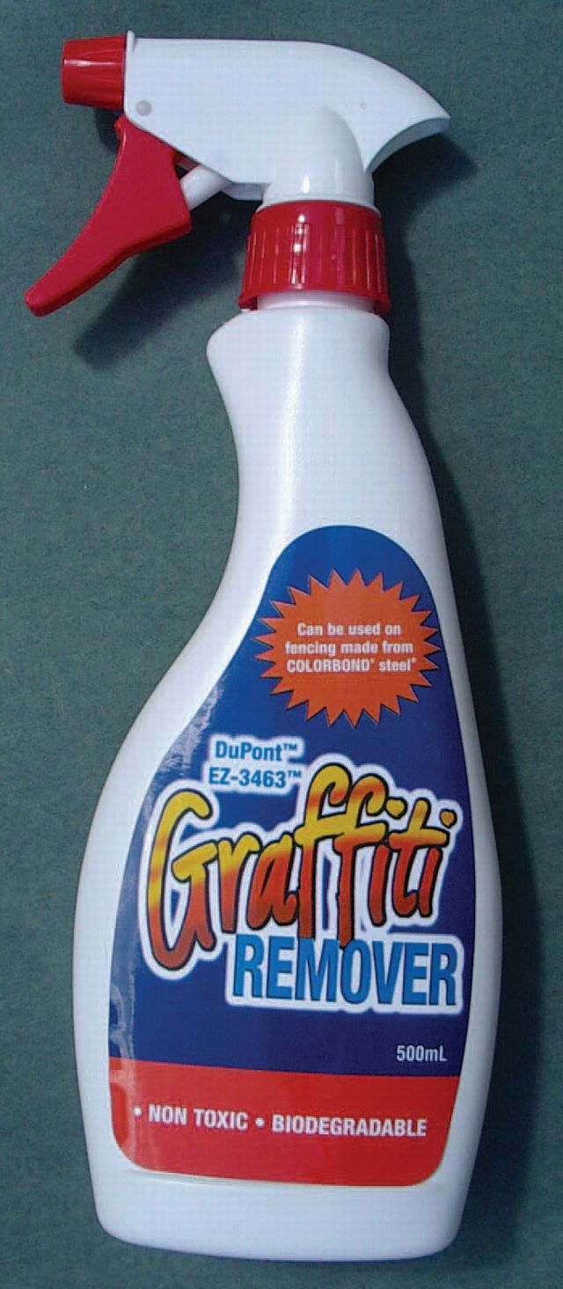
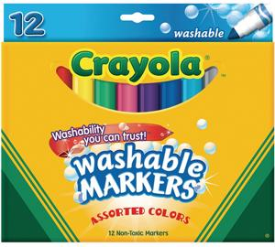
1.Polar & Nonpolar Solvents
3 Factors that Effect Solubility
“Likes dissolve Likes”
Polar dissolves Polar
Nonpolar dissolves Nonpolar
A Less dense dissolves a more dense
Oil and Water based paint
Vitamins- fat and water soluble

Slide 36
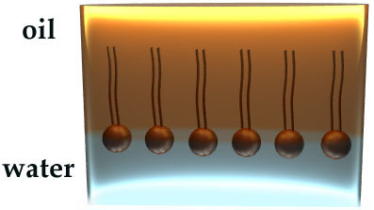
Soap and Detergents are bipolar molecules. One side “likes” water & the other “likes” dirt.
In other words, one side of the molecule is polar and the other is nonpolar.

Slide 37
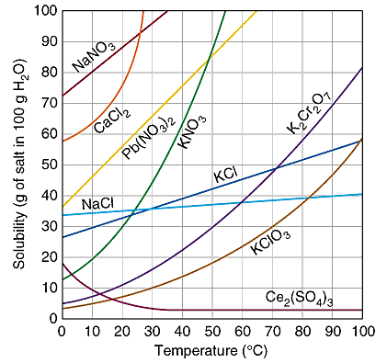
2.Temperature
Generally, Solubility Increases as Temperature Increases

Slide 38
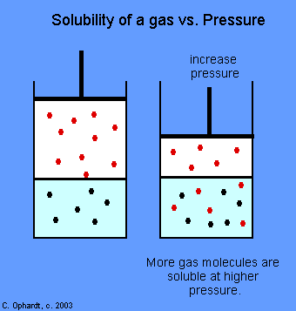
3. Pressure
As pressure increases, solubility increases
Scuba driver- “the bends” – happens gasses comes undissolved when they return to the surface to quickly

Slide 39
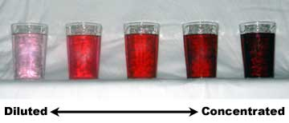
Concentration
Quiz #2
Amount of solute dissolved in a specific amount of solvent
Dilute- little solute is dissolved
Concentrate-more solute is dissolved
Ways to change concentration:
Add solute, Add solvent, or Remove solvent

Slide 40
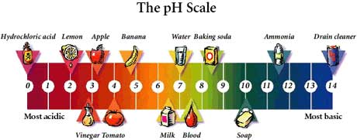
TSW#9 & #10
Acids & Bases
H⁺ & OH⁻

Slide 41
Properties of Acids
Sour taste
Reacts with metals & carbonates (CO₃)
Turns blue litmus paper red ( indicator)
Any substance that produces H⁺ (or H₃O⁺)(Hydronium) in water
Electron donors
Acids in solution:
HCl → H⁺ + Cl⁻
H₂SO₄ → H⁺ + H⁺ + SO₄⁻²

Slide 42
Properties of a Base
Taste Bitter
Feels Slippery
Turns red litmus paper blue
Substance that produces OH⁻¹ ( hydroxide) in water
Electron acceptors
Bases in Solution:
NaOH → Na⁺ + OH⁻¹
Ca(OH)₂ → Ca⁺² + OH⁻¹ + OH⁻¹

Slide 43
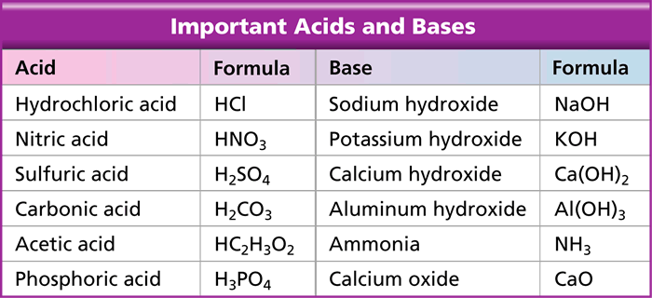
Strengths of Acids & Bases
Strong=High Concentration of H⁺or OH⁻¹
Weak= Low Concentration of H⁺or OH⁻¹

Slide 44
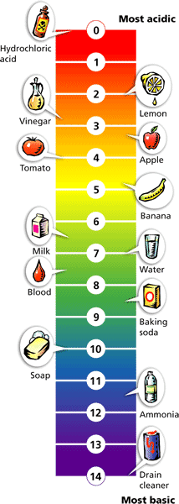
pH Scale
Scale of 0-14
The lower the number the higher pH or more H⁺ ion
Higher the number the lower the pH or more OH⁻¹ ion
7 is neutral ( not an acid or a base)
The closer to 7; the weaker the acid or base

Slide 45
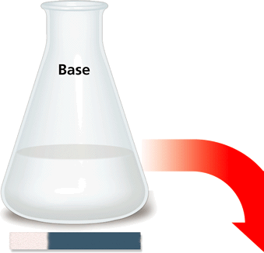
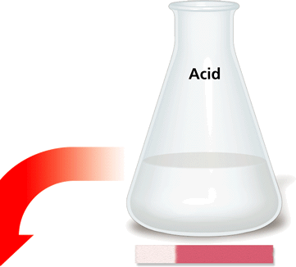
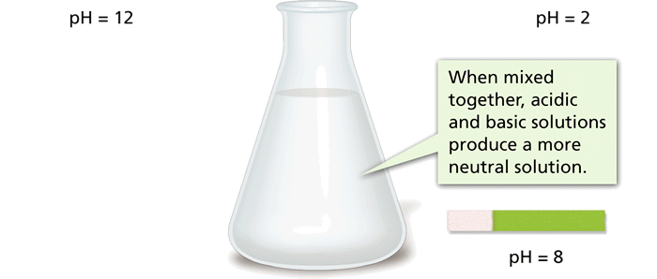
Acid-Base Reactions
- Acids and Bases in Solution
A reaction between an acid and a base is called neutralization. An acid-base mixture is not as acidic or basic as the individual starting solutions.

Slide 46
Neutralization Reaction
Acid + Base → Salt + Water
HCl + NaOH → Na⁺ + Cl⁻ +H₂O
Salt is an ionic compound produced by a neutralization reaction.
Common salt- p 244
Quiz #3

