Slide 1
Carbon & Nuclear Chemistry
E05

Slide 2
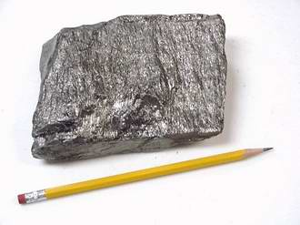
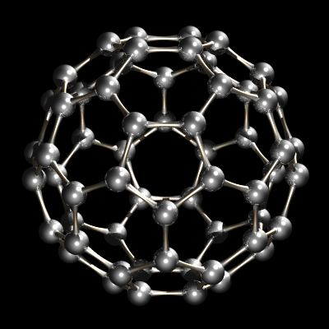
Allotropes = forms of pure carbon with different structures, & chemical/physical properties.

Slide 3
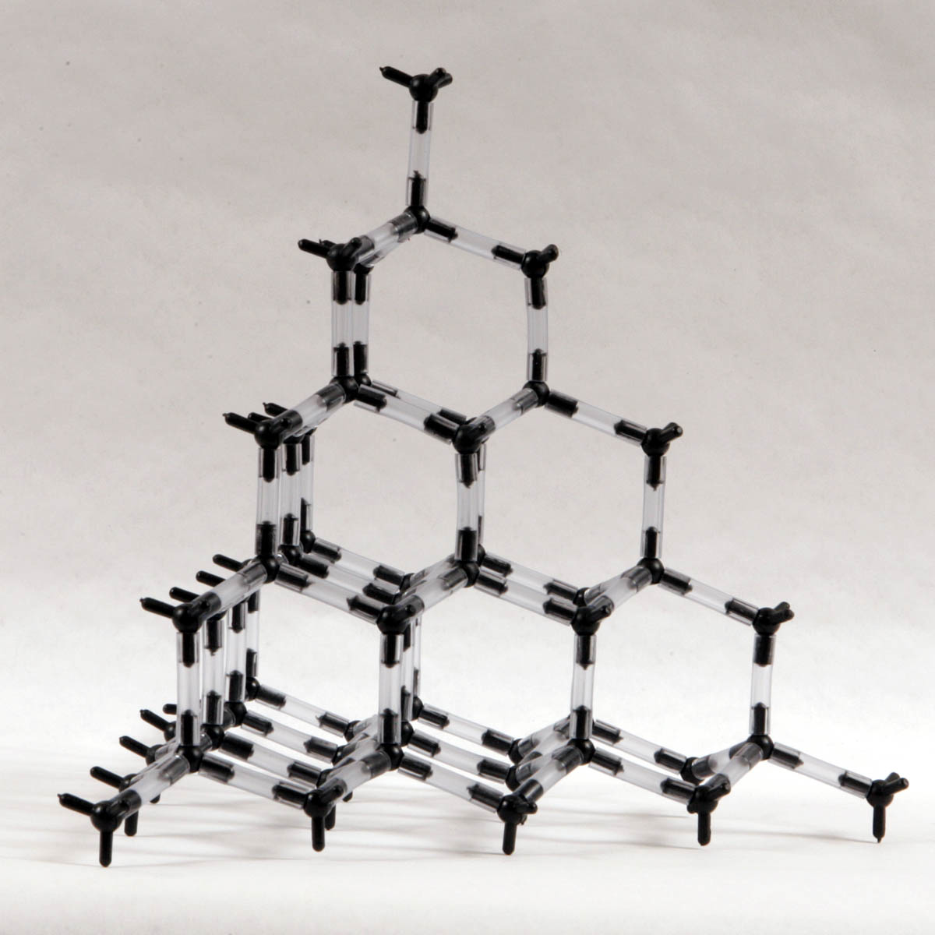
Allotropes: 3 Structures of Carbon atoms
Diamond:
Forms a tetrahedral
3-D structure
Hardest “natural” mineral on Earth
Formed from very high temperatures & Pressures
Prized for their brilliance & clarity when cut as gems
Artificial diamonds are used only in industry as industrial cutting tools, such as drills.

Slide 4
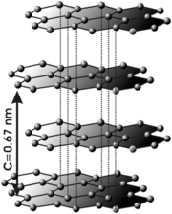
Allotropes
Graphite:
Most common form of Carbon
Arranged in hexagonal layers. (These layers have bonds between atoms that are very weak, so they slide past each other).
Only form that conducts electricity
Forms flat layers; like a sheet of paper, and is very flexible
Used for:
Pencil “Lead”
Excellent lubricant in machines, b/c it is so slippery

Slide 5
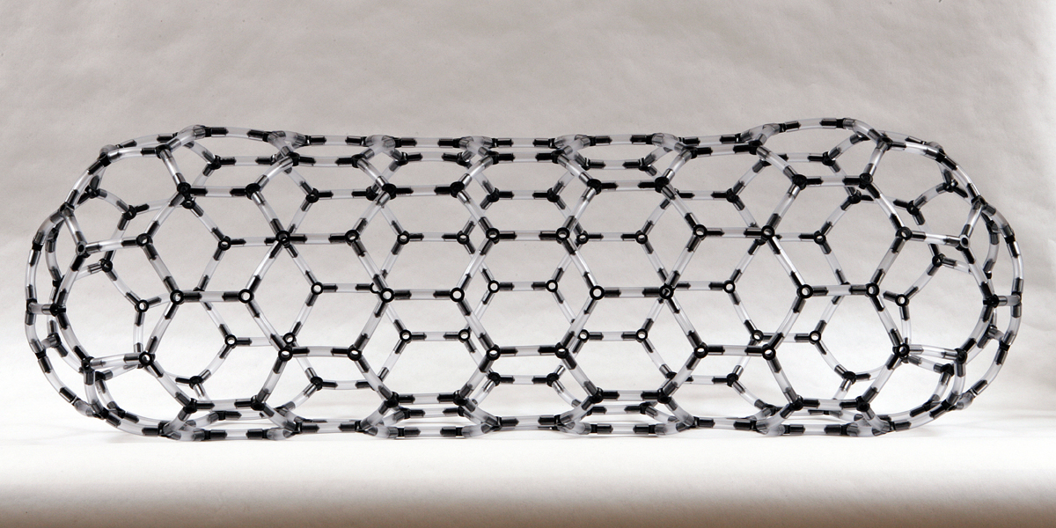
Allotropes
Fullerenes:
C₆₀ = Alternating Hexagons and Pentagons
Nicknamed “buckyballs” b/c of its “sphere” shape
Similar to Graphite
Arranged in a repeating pattern similar to the surface of a soccer ball
*Chemists are looking for ways to use fullerenes*

Slide 6
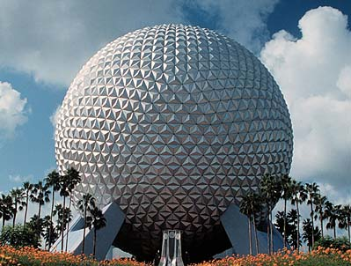
Fullerenes:
Called “buckminsterfullerene” b/c of designer Buckminster Fuller, who designed dome-shaped buildings called geodesic domes

Slide 7
Carbon-Carbon Bonding
A carbon atom has 4 valence electrons in its outer shell.
In order to achieve an octet, it needs to form 4 covalent bonds.
Carbon atoms can form single, double, & triple bonds.
C

Slide 8
A carbon atom can thus achieve an octet in many ways:
1). By forming 4 single bonds
2). By forming a double bond & 2 single bonds
3). By forming 2 double bonds
4). By forming a triple bond & a single bond.
C
C
C
C

Slide 9
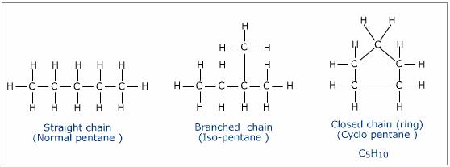
Carbon Bonding: “Arrangements”
Hydrocarbon- a organic compound that contains only hydrogen and carbon.
Carbon can form so many compounds because it can link together with other carbon atoms in many different arrangements-straight chains, branched chains & even rings..

Slide 10
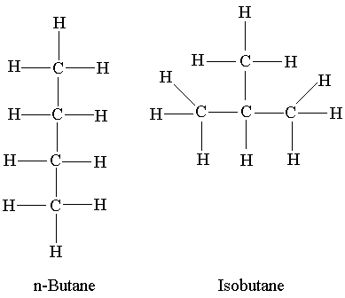
“Straight Chain” Arrangement
2 or more carbon can form a straight line. Each line between atoms represents a single covalent bond.
Structural arrangement: C-C-C
Examples: Butane ( C₄H₁₀ )

Slide 11
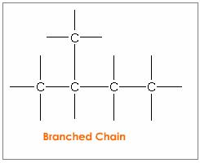
“Branched Chain” Arrangement
4 or more carbon can form a different arrangement. Example: Isobutane ( C₄H₁₀ )
Structural arrangement:

Slide 12
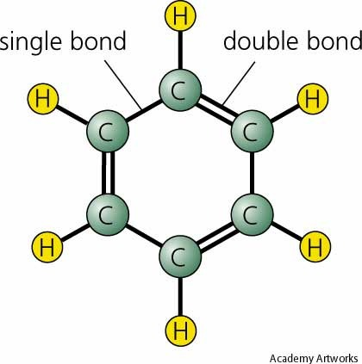
“Ring” Arrangement
“Ring” contains 5 or 6 carbon atoms bonded into a ring. The ring can contain single or double bonds between the carbon atoms.
Example: Benzene “ring”

Slide 13
Isomers = compounds that have the same chemical/molecular formula, but different structural formulas & shapes. * Makes different substance with unique/different properties.
Examples: Butane ( C₄H₁₀ )
And Isobutane ( C₄H₁₀ )

Slide 14
Naming Hydrocarbons:
The prefix tells you the number of carbon atoms
1 | Meth- | 6 | Hexa
2 | Eth | 7 | Hept
3 | Pro | 8 | Oct
4 | But | 9 | Non
5 | Pent | 10 | Dec
The ending of the name tells you the types of bonds it makes:
Single Bond- Name ends in “ane” -
Double Bond- Name ends in “ene”
Triple Bond-Name ends in “yne”-

Slide 15
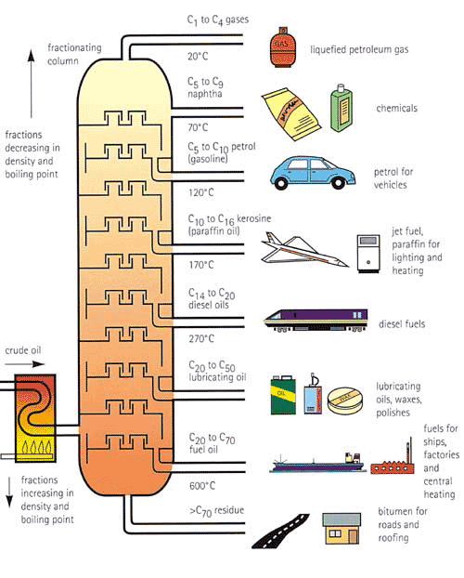
Boiling point

Slide 16
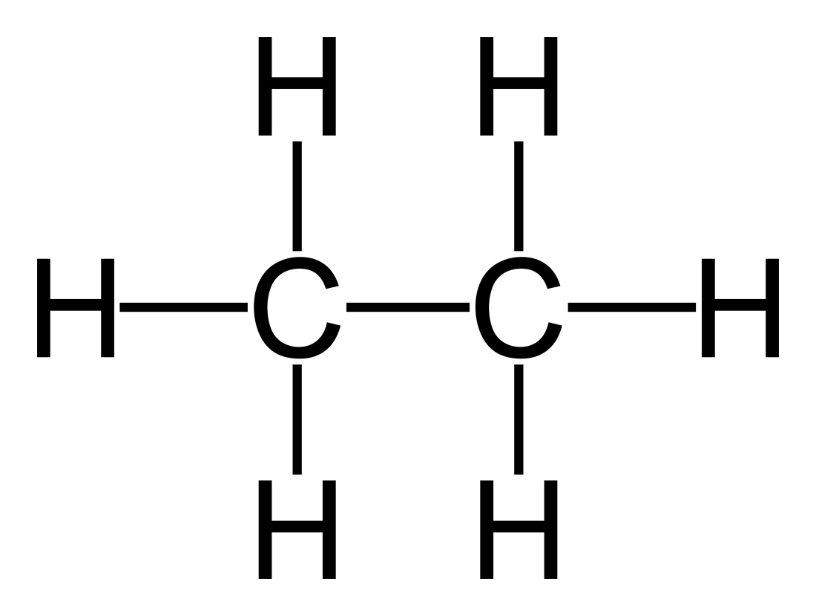
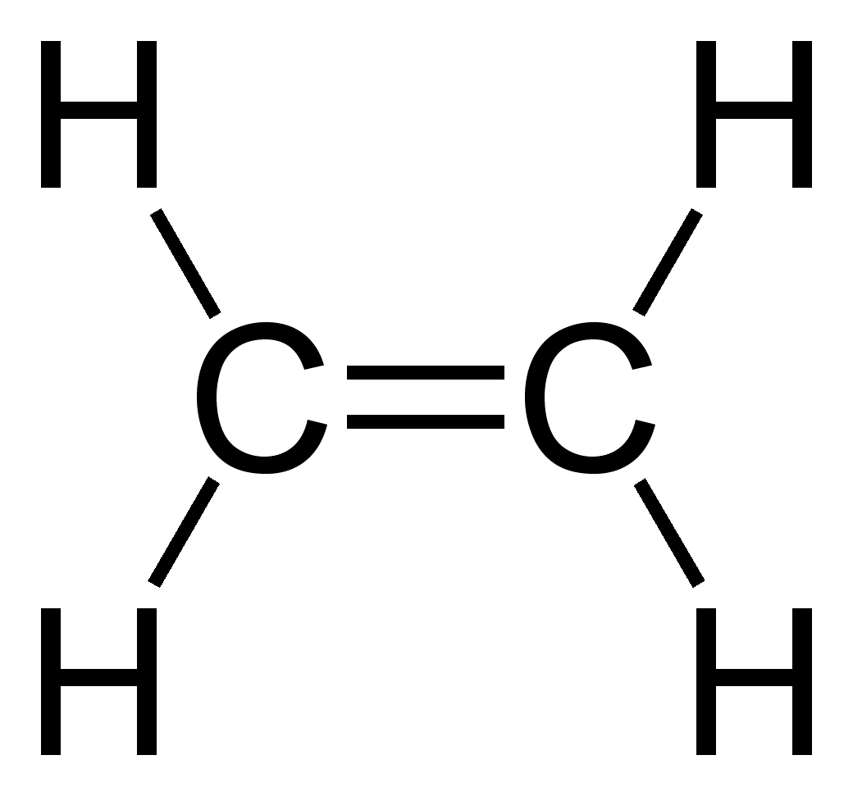
Saturated Hydrocarbons-
Have all single bonds
Names end in “ane”
Have the maximum possible number of hydrogen atoms attached to each carbon atom.
Unsaturated Hydrocarbons-
Have one or more double or triple bond
Name ends in “ene or yne”

Slide 17
Saturated or Unsaturated?

Slide 18
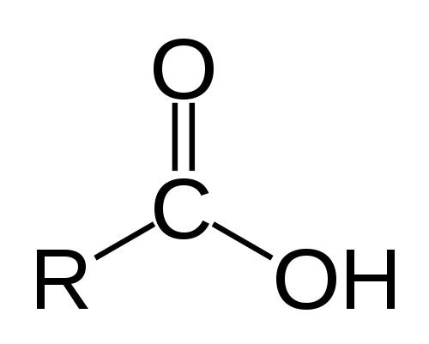
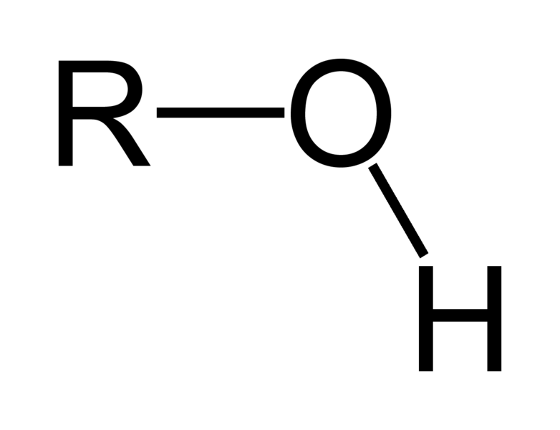
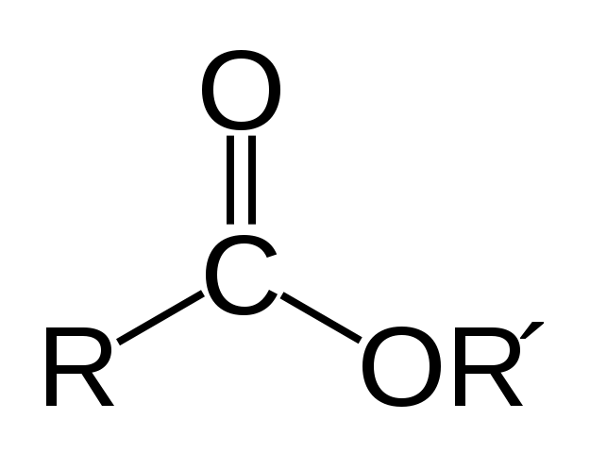
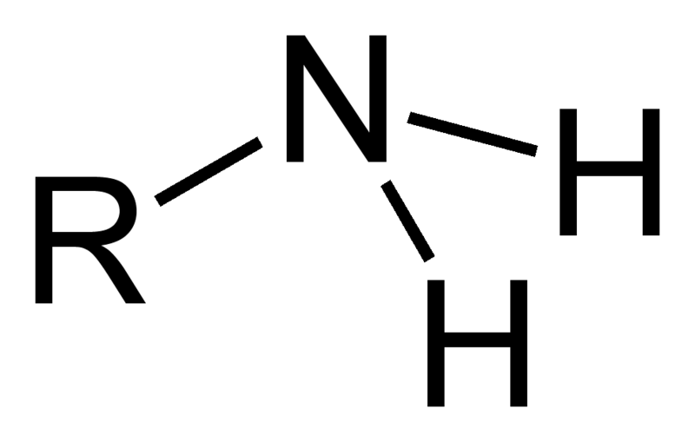
Substituted Hydrocarbons- a hydrocarbon( base group) in which one or more hydrogen has been replaced by an atom or group of atoms
Functional group- the substituted atom or group of atoms
Base group
1.Alcohol group
2. Carboxyl group
3. Amine group
4. Ester group

Slide 19
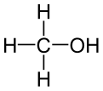
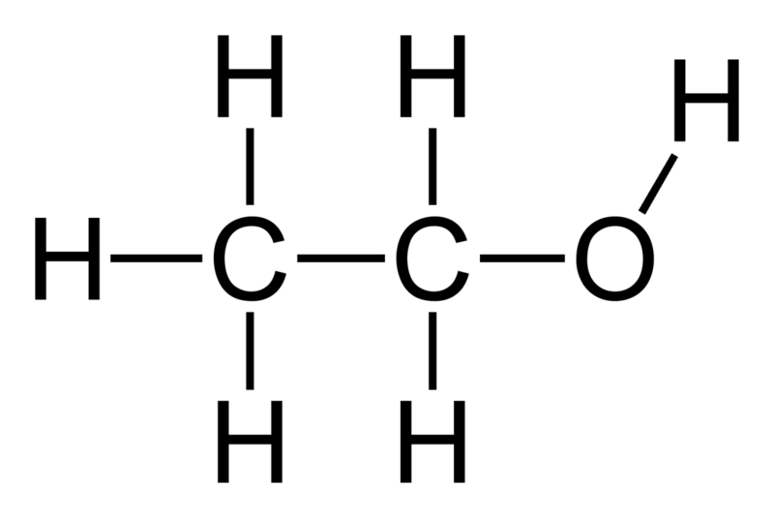
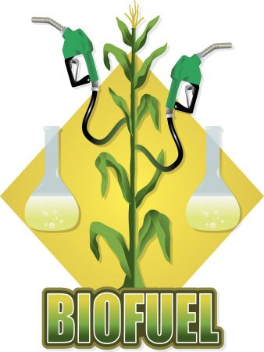
Functional group #1: Alcohols
Have –OH group called hydroxyl
Methanol
Alcohols have numerous uses such as fuel
Ethanol
Watch Video on Ethanol

Slide 20
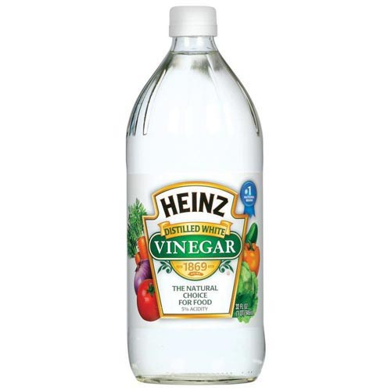
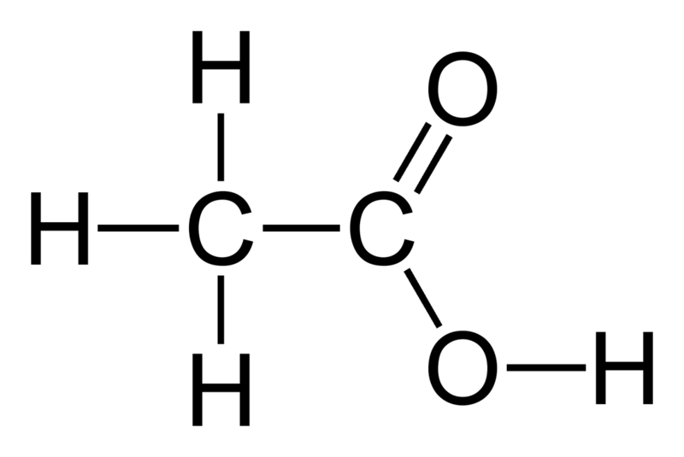
Functional group #2: Organic Acids & Bases(carboxyl)
Have a -COOH group called a carboxyl group
Ethanoic acid (acetic acid)CH₃COOH

Slide 21
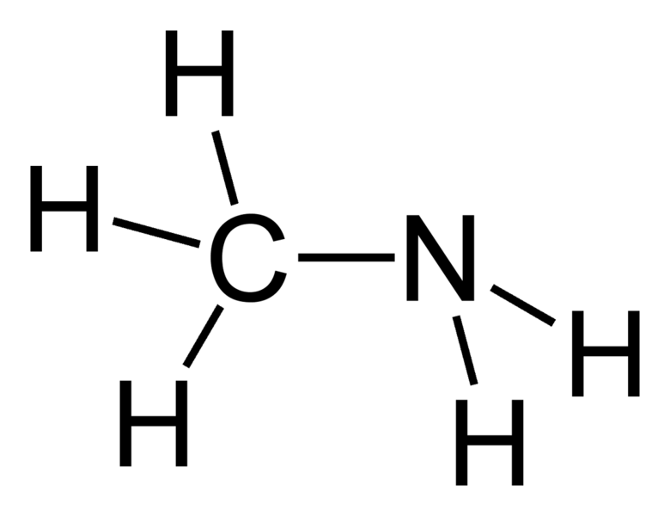
Functional group #3 Amines:
Have an amino group –NH₂
They make amino acids that build proteins
Methylamine

Slide 22
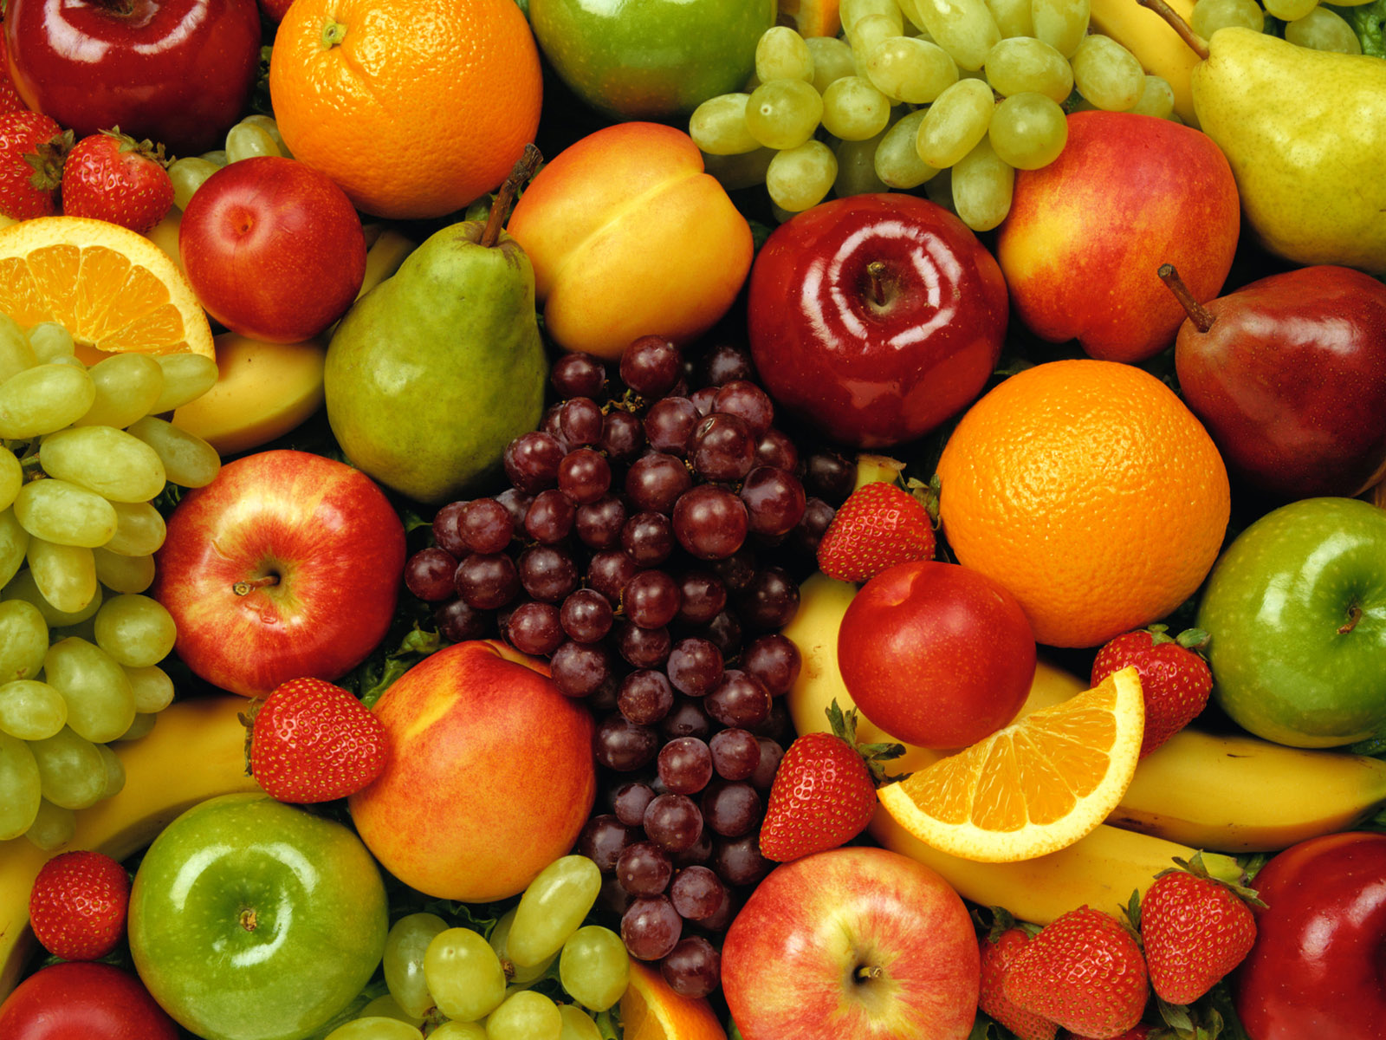
Functional group #4:Ester
Have an ester group- COO
Cause the flavor in many foods
Give of pleasant smells
Used to make artificial flavors in processed foods
O=
C
o
http://en.wikipedia.org/wiki/Ester

Slide 23
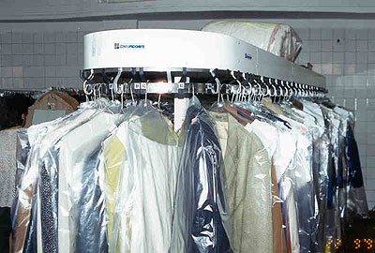
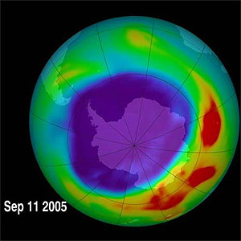
Functional group #5:Groups containing Halogens
One or more halogen atoms replace a hydrogen atom
Chlorofluorocarbon (CFC)- used in aerosols and refrigeration
Responsible for the hole on the Ozone layer.
Freon:CCl₂F₂
Trichloroethane C₂ H₃Cl₃ & Dichloroethylene C₂ H₂Cl₂ are used in dry cleaning solutions

Slide 24
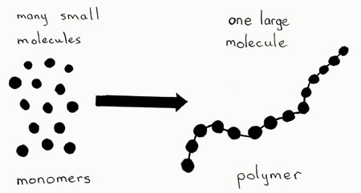
Polymers
Poly- “many”
Polymer- very large molecule made of a chain of many smaller molecules bonded together
Mono- “one”
Monomers- the smaller molecules that make up the chain
Polymers can be classified as natural ( made in nature or synthetic ( man made)

Slide 25
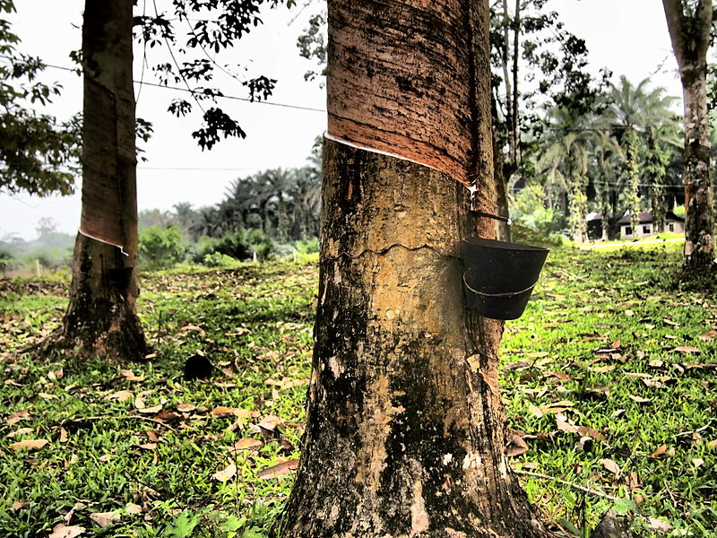
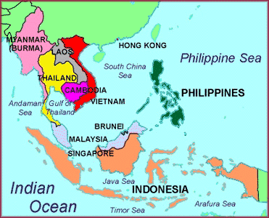
Synthetic Polymers- most are made from petrochemicals (oil)
Rubber was invented to imitate natural rubber from the sap of the Pará rubber tree

Slide 26
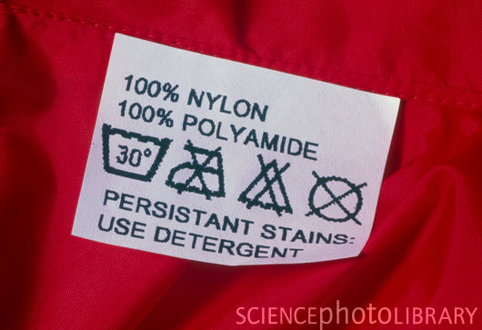
Synthetic Polymers-
Nylon- was invented to imitate silk

Slide 27
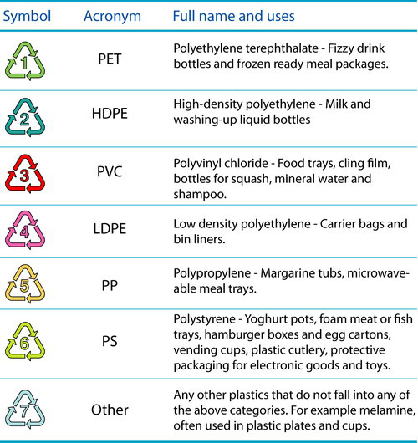
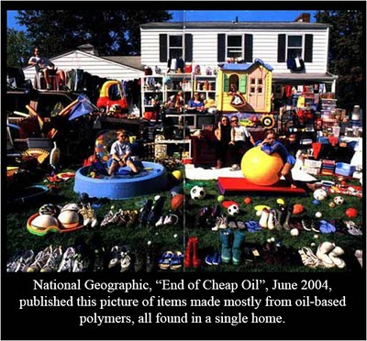
Synthetic Polymers: Polyethylene- most common type of plastic; used in packaging and container manufacturing

Slide 28
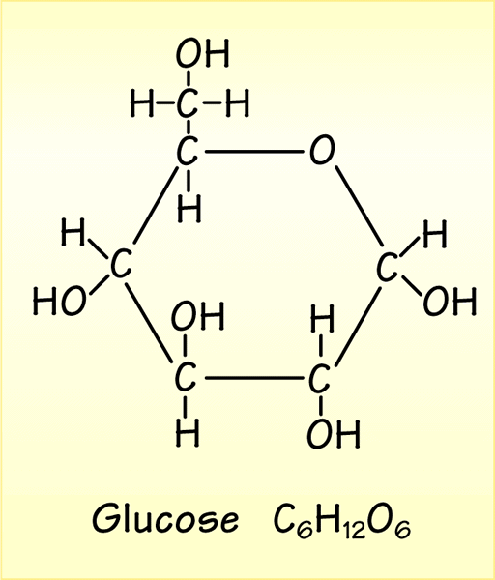
Carbohydrates
Natural Polymers
- Life With Carbon
A carbohydrate is an energy-rich organic compound.
One of the most important sugars in the body is the monomer glucose.

Slide 29
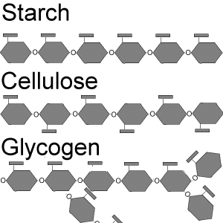
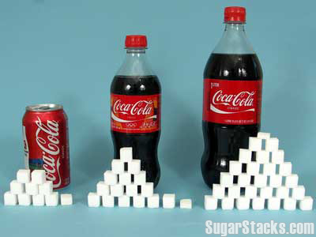
Sugars
Polymers “complex sugars”
Starches-long chains of glucose
Cellulose- different structure than starch; cell wall of plants; most abundant on earth; body can not digest. ( fiber)
Glycogen- animal store it in the liver.
Monomers--”simple sugars”
Glucose- blood sugar
Sucrose- Plant sugar
Fructose- fruit sugar
Lactose- milk sugar
Maltose-grain sugar - when fermented it produces alcohol

Slide 30
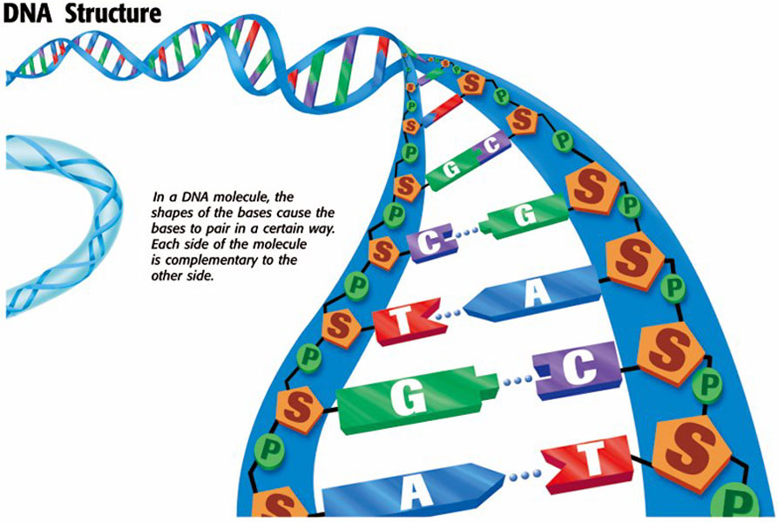
Nucleic Acids
DNA & RNA -(polymers) made of Nucleotides(monomers)
DNA-Thymine, Guanine, Cytosine, Adenine.
RNA-thymine replaced by Uracil

Slide 31
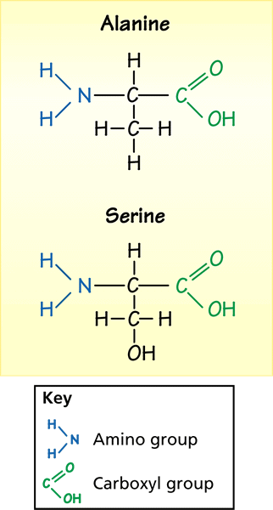
Proteins
- Life With Carbon
Different proteins (polymers) are made when different sequences of amino acids (monomers) are linked into long chains.
Alanine and serine are two of the 20 amino acids, all of which have a similar structure.
Each amino acid has a carboxyl group (–COOH) and an amino group (–NH₂).
Quiz 1

Slide 32
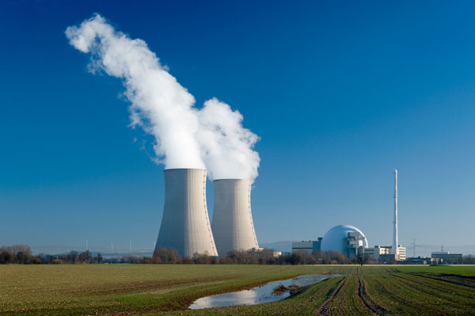
Nuclear Chemistry

Slide 33
Start Quiz#2
Radioactive Decay
Radioactivity- is the process in which an unstable atomic nucleus releases charged particles and energy.
During radioactive decay, atoms of one element can change into different elements.

Slide 34
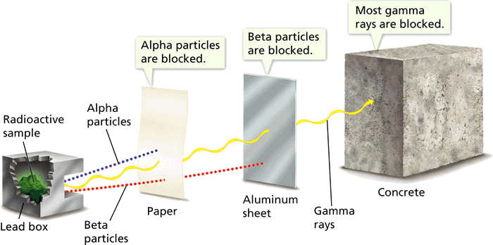
Types of Radioactive Decay
- Radioactive Elements
The three types of nuclear radiation were named based on how easily each one could be blocked. Alpha, Beta, and Gamma are the first three letters of the Greek alphabet.

Slide 35
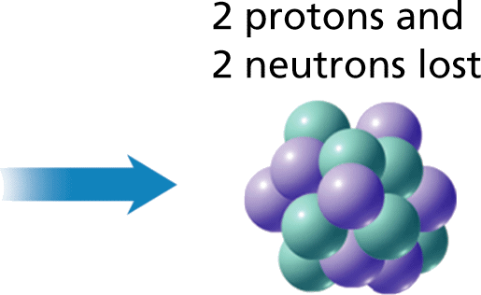
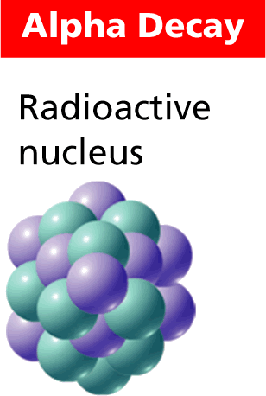
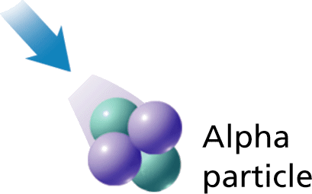
Types of Radioactive Decay
- Radioactive Elements
During alpha (α) decay, a nucleus loses an alpha particle, which consists of two protons and two neutrons.
₄
₂ ^{He}
=

Slide 36
Alpha Decay creates a new element that is 4 (amu) less and that has an atomic number that is 2 less.
X
A
Z
Atomic mass minus 4 A - 4=
Atomic number minus 2 Z - 2=
Alpha decay of Uranium-238
238- 4= 234
92- 2= 90
α
₄
₂^{He}
238
92
U
234
90
Th
+

Slide 37
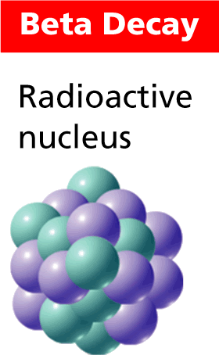
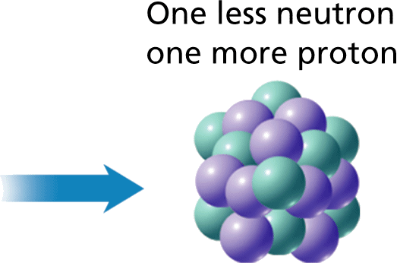
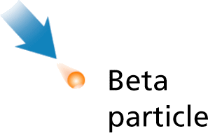
Types of Radioactive Decay
- Radioactive Elements
During beta decay(β), a neutron inside an unstable nucleus changes into a beta particle and a proton.

Slide 38
Beta Decay creates an element with the same atomic mass, but with one additional proton.
X
A
Z
Atomic mass minus 0 A – 0 =
Atomic number plus 1 Z +1=
Beta decay of Thorium-234
234- 0= 234
90 + 1= 91
β
234
90
Th
234
91
Pa

Slide 39
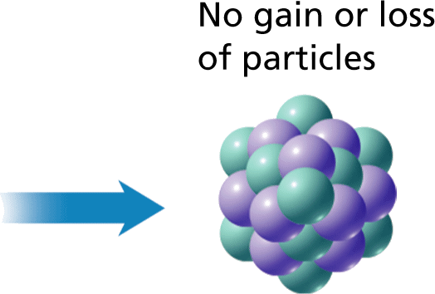
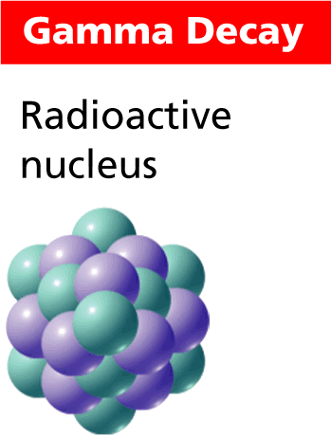
Types of Radioactive Decay
- Radioactive Elements
Gamma radiation ( ϒ)has no charge and does not cause a change in either the atomic mass or the atomic number.
Practice worksheet

Slide 40
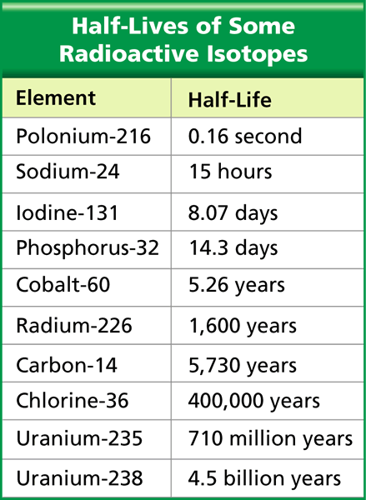
Radioactive Isotopes
- Radioactive Elements
Half-life is the time required for one half of a radioactive sample to decay.
The half-lives of radioactive isotopes range from a fraction of a second to billions of years.
Half-lifes are constant

Slide 41
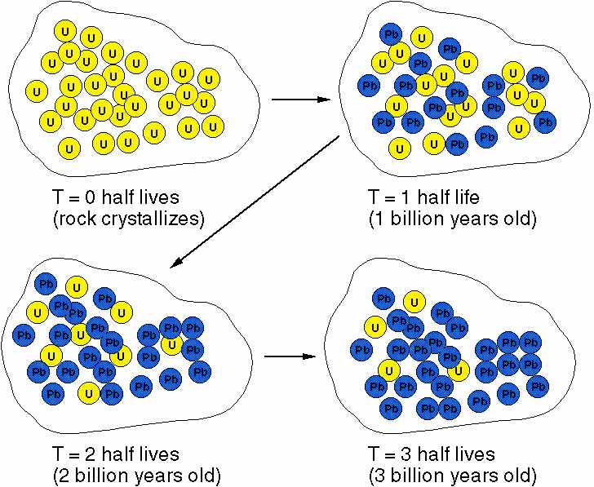
Radioactive Dating- the age of objects can be determined by comparing the objects isotope amount with a known constant amount.

Slide 42
Carbon Dating is often used to date the age of once living organisms
How Carbon dating works:
Carbon-14 is created when cosmic rays form the sun collide with nitrogen in the upper atmosphere.
Carbon-14 reacts with Oxygen to form CO₂ and is absorbed in plants( photosynthesis) in equal amounts as normal Carbon( C-12)
Animals eat the plants and have the same ratio as the plants they eat.
When the plant/ animals dies, it does not take in any more Carbon
From that point on the C-14 levels will decay and decrease.
Carbon-14 undergoes Bata decay and turns into Nitrogen-14
Scientist compare the amount of C-14 to N-14 and calculate the age.
Watch the Khan Academy video if you need to review

Slide 43
Video on carbon and other types of radiodating
Worksheet for practice

Slide 44
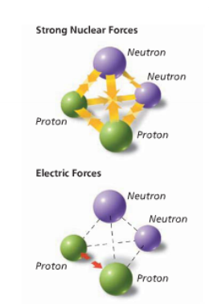
Nuclear Forces
Strong Nuclear Force-The force that holds protons and neutrons together in the nucleus.
Is very strong over short distances.
Does not depend on the charge of the subatomic particles.
Does not increase with the size of the nucleus.

Slide 45
Nuclear Forces
Electric Force-(EF)Force of the positively charge protons repelling each other.
The more protons the stronger the repel.
Larger nuclei have greater electrical force, visa versa for smaller nuclei
Unstable nuclei- the nucleus becomes more unstable, or radioactive, when the SF is no longer greater than EF. All elements with more than 83 protons are radioactive.

Slide 46
Using the Force:
Nuclear Fission- the splitting of an atomic nuclei into 2 smaller parts.
Can release amount of energy from a very small amount of mass
1 kg of U-235 = 17,000 kg of coal.

Slide 47
Albert Einstein explained this relationship in 1905 with his Mass/Energy Equation
E=mc²
E= energy
m=mass
c= speed of light (3.0 x 10⁸ m/sec)

Slide 48
Fission works as result of a chain reaction.
When neutrons are released during the splitting of the initial nucleus trigger a series of other nuclear fissions
*Video

Slide 49
Uses of Nuclear Fission

Slide 50
Uses of Nuclear Fission

Slide 52
Nuclear Fusion- process where 2 smaller nuclei combine to form a larger nucleus .
Forms the Plasma state of mater

Slide 53
Cold fusion: The energy “Holy Grail”
Scientist are currently working to design fusion reactors.
Why? Energy with no pollution! Uses Hydrogen commonly found in ocean water as “fuel”
Major problems:
Need to create extremely high temperatures ( 10 million degrees C) to start the reaction
Must contain the plasma once it has been created
Uses:
Fusion H-Bomb: Tsar Bomba
This is equivalent to 1,400 times the combined power of the bombs that destroyed Hiroshima and Nagasaki

Slide 56
Health and Medical Preparatory Programs | 142,345 | 11.8% | 0.9%
Economics | 1,237,863 | 8.2% | 5.4%
Biochemical Sciences | 193,769 | 7.2% | 0.7%
Zoology | 159,935 | 6.9% | 0.6%
Biology | 1,864,666 | 6.7% | 6.6%
International Relations | 146,781 | 6.7% | 0.5%
Political Science and Government | 1,427,224 | 6.2% | 4.7%
Physiology | 98,181 | 6.0% | 0.3%
Art History and Criticism | 137,357 | 5.9% | 0.4%
Chemistry | 780,783 | 5.7% | 2.4%
Molecular Biology | 64,951 | 5.6% | 0.2%
Area, Ethnic and Civilization Studies | 184,906 | 5.2% | 0.5%
Finance | 1,071,812 | 4.8% | 2.7%
History | 1,351,368 | 4.7% | 3.3%
Business Economics | 108,146 | 4.6% | 0.3%
Miscellaneous Psychology | 61,257 | 4.3% | 0.1%
Philosophy and Religious Studies | 448,095 | 4.3% | 1.0%
Microbiology | 147,954 | 4.2% | 0.3%
Chemical Engineering | 347,959 | 4.1% | 0.8%
Physics | 346,455 | 4.1% | 0.7%
Pharmacy, Pharmaceutical Sciences and Administration | 334,016 | 3.9% | 0.7%
Accounting | 2,296,601 | 3.9% | 4.7%
Mathematics | 840,137 | 3.9% | 1.7%
English Language and Literature | 1,938,988 | 3.8% | 3.8%
Miscellaneous Biology | 52,895 | 3.7% | 0.1%
Undergraduate Degree / Total / % Who Are 1 Percenters / Share of All 1 Percenters

