Slide 1
E02 Atomic Structure and the Periodic Table

Slide 2
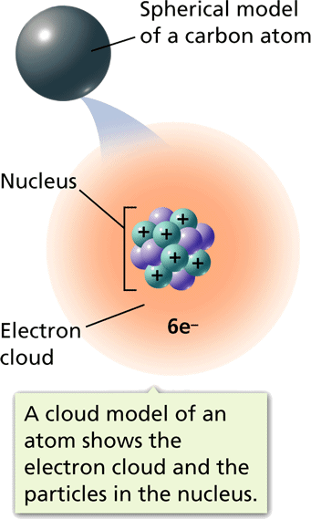
Inside the atom
The atom is made up of 3 main parts.
Protons
Neutrons
Electrons.

Slide 3
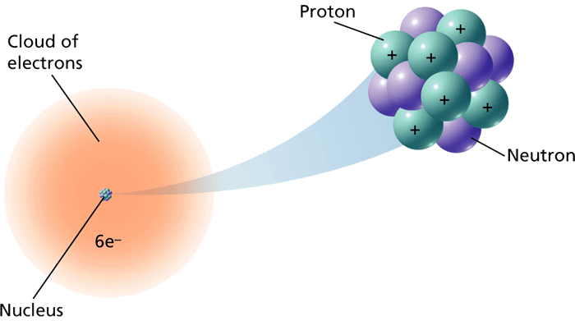
Protons
Protons = p+
Have a positive charge
Located in the nucleus of the atom
Have a weight of one Atomic Mass Unit
( AMU)

Slide 4
Neutrons
Neutrons= n
DO NOT HAVE A CHARGE
Located inside the nucleus
Have a weight of one Atomic Mass Unit
( AMU)

Slide 5
Electrons
Electrons= e⁻
Have a negative Charge
Located out side the Nucleus in the electron cloud
Have a weight of 1/1836 AMU

Slide 6
Fill in the Chart
Particle | Symbol | Charge | Atomic mass | Location

Slide 7
Atomic Theory and Models
Dalton’s Atomic Theory
Thomson and Smaller Parts of Atoms
Rutherford and the Nucleus
Bohr’s Model
A Cloud of Electrons
The Modern Atomic Model

Slide 8
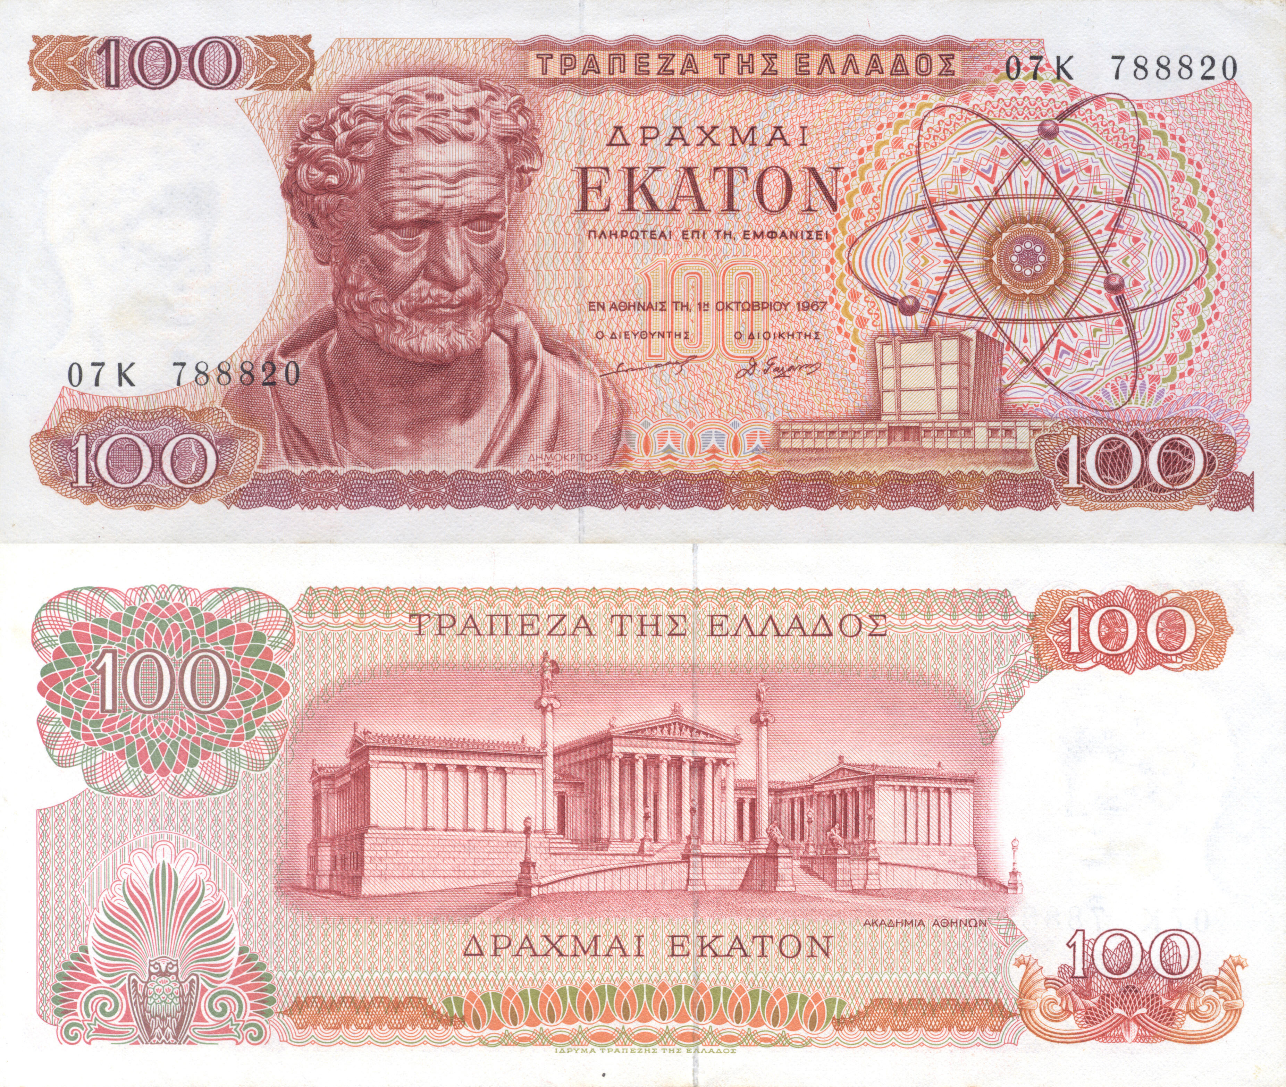
Early ideas about the atom…… 2,500 years ago
Atomos- “uncut” or “indivisible” in Greek
Modern times……..
For over two centuries, scientists have created models of atoms in an effort to understand why matter behaves as it does. As scientists have learned more, the model of the atom has changed.

Slide 9
Atomic Theory and Models
- Elements and Atoms
Five main points of Dalton's atomic theory
Elements are made of extremely small particles called atoms.
Atoms of a given element are identical in size, mass, and other properties; atoms of different elements differ in size, mass, and other properties.
Atoms cannot be subdivided, created, or destroyed.
Atoms of different elements combine in simple whole-number ratios to form chemical compounds.
In chemical reactions, atoms are combined, separated, or rearranged.

Slide 10
Dalton’s Evidence for Atoms Existence
Measuring the masses of the elements that combined when the compounds form.
Ratios of the masses of the elements are always the same.
EX.
100g of Mg combines with 65.8g of Oxygen
10 g of Mg combines with 6.58g of Oxygen

Slide 11
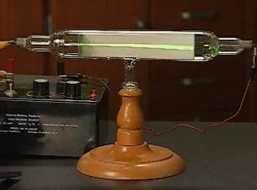
Thomson’s Model
Experiment proved:
Particles in the beam had a negative charge.
1st evidence that atoms were made of even smaller particles.
What did this say for Dalton’s Theory?
http://www.mrteverett.com/video/cathode%20ray%20tube%202.mov

Slide 12
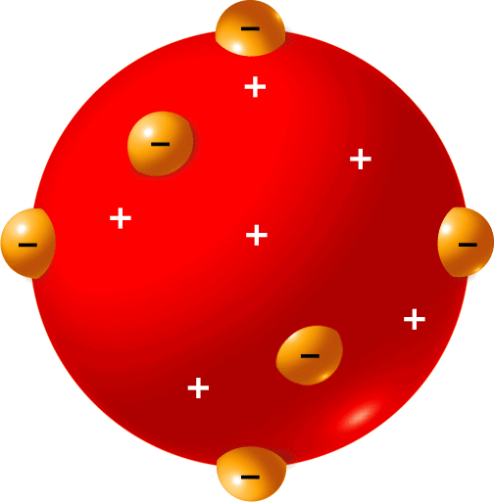
Atomic Theory and Models
- Elements and Atoms
Thomson suggested that atoms had negatively charged electrons embedded in a positive sphere.

Slide 13
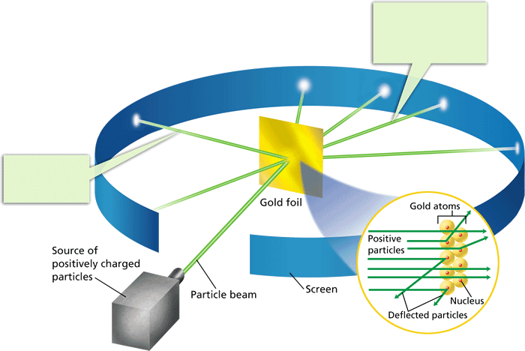
Atomic Theory and Models
- Elements and Atoms
Rutherford’s experiment led him to propose an atomic model with a positively charged nucleus.
What did this do for Thompson’s model?
http://www.youtube.com/watch?v=XBqHkraf8iE

Slide 14
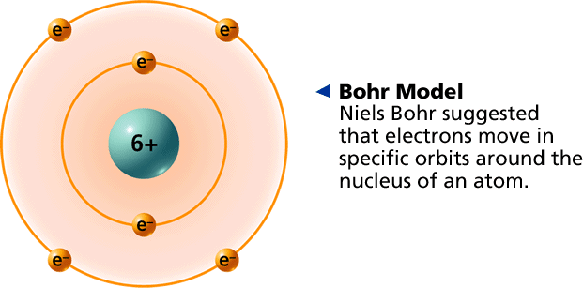
Atomic Theory and Models
- Elements and Atoms
Through the first part of the 20th century, atomic models continued to change.

Slide 15
Bohr Model
Electron exist in fixed orbitals like the planets around the sun.
Each atom has a specific amount of energy.
If an atom gains or loses energy, the energy of the electron can change.
The possible energies that an electron can have are called energy levels.

Slide 16
Evidence of changing energy levels? Light!!
The heat of the explosion causes some electrons to move to higher energy levels.
When they lose energy, it is given off in the form of light.
Why different colors? No two elements have the same energy levels, so they produce different colors of light.

Slide 17
Evidence of changing energy levels? Light!!

Slide 18
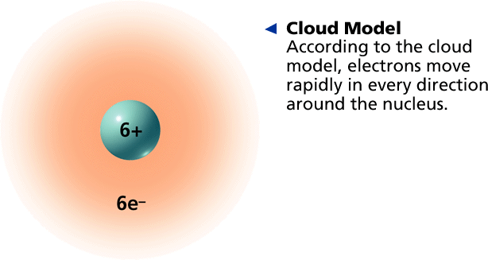
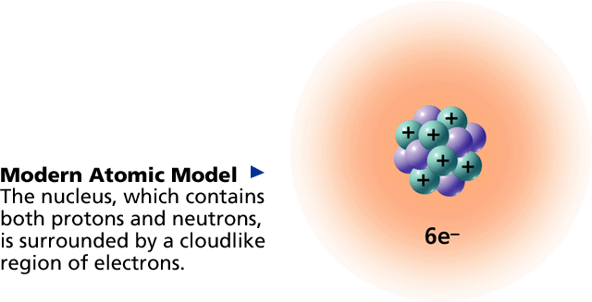
Cloud Model
Electrons move in unpredictable ways and it is impossible to know the exact location of an electron at any given time.
Scientist have to use a probability function to determine the best possible location. This is called the “cloud”
Ex- Windmill blades

Slide 19
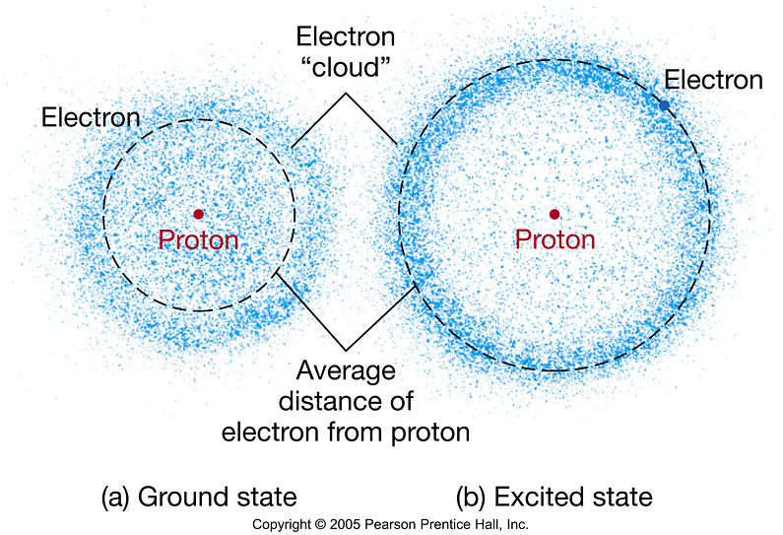
Orbitals:
Region of space around the nucleus where the electron is likely to be.
Electron configuration- arrangement of electrons in the orbitals of the atom.
Ground state- when all electrons are at the lowest state.

Slide 20
Electron configurations for elements at the ground state
1st energy level: Maximum of 2 electrons
2nd energy level :Maximum of 8 electrons
3rd energy Level: Maximum of 18 electrons
4th energy Level: Maximum of 32 electrons
Lets Draw!

Slide 21
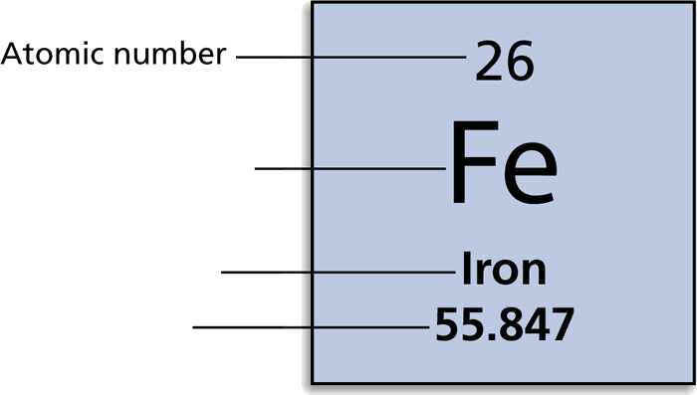
Periodic Table
The periodic table Is arranged by increasing atomic number.
Atomic number is the number of protons in the atom.
It also indicates the number of electrons

Slide 22
Periodic Table
Mass number = the sum of protons and neutrons
Masses are measured in Atomic mass units= (AMU)
1 amu is equal to the mass of one proton.

Slide 23
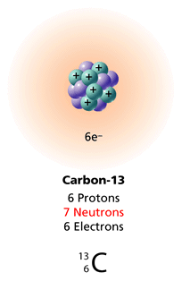
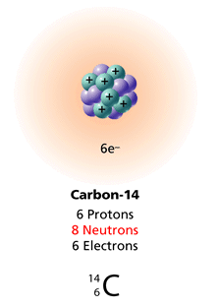
Isotopes- Atoms of the same element that have different number of neutrons
Atomic mass number are an average of all the isotopes that exist on Earth.
Isotopes and Atomic Mass Animation:
http://phet.colorado.edu/en/simulation/isotopes-and-atomic-mass

Slide 24
Calculating the Number of Neutrons
^{A = atomic mass number}
^{Z = atomic number}
^{N = number of neutrons}
^{X=isotope element N=A–Z}
^{A}
^{Z}
is the symbol for an isotope of element X with atomic number Z and atomic mass number ^{A}
^{For the element 23}
¹¹
the number of neutrons (N) is determined as follows: N = 23 – 11 = 12
X
^{Na}

Slide 25
Mendeleev is credited with creating the 1st working periodic table.
He arranged his periodic table according to:
increasing mass
in columns of similar properties.
His table was widely excepted because he was able to predict the properties and masses of elements that had not yet been discovered.

Slide 26
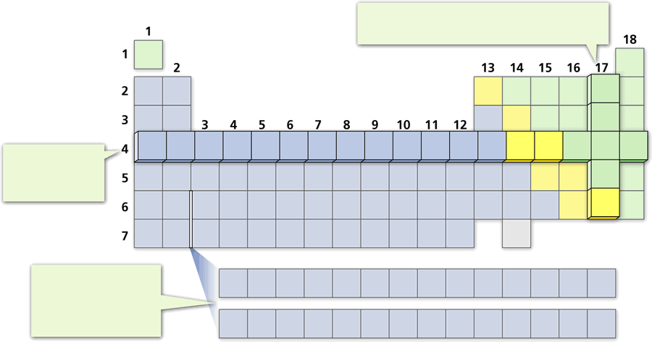
The Modern Periodic table is arranged by increasing atomic number.( Number of Protons)
Properties of elements repeat in predictable way when atomic numbers are used to arrange elements into groups.
The 18 columns of the periodic table reflect a repeating pattern of properties that generally occur across a period.

Slide 27
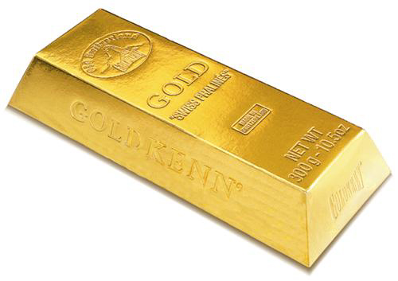
Classes of Elements
Metals-
Largest amount of elements on the periodic table
Malleable-
Ductile-drawn into wire
Good Thermal &Electrical conductors
Shiny 'metallic' appearance
Solids at room temperature (except mercury)
High melting points

Slide 28
Nonmetals-
Poor thermal conductors
Poor electrical conductors
Brittle solids
Little or no metallic luster

Slide 29
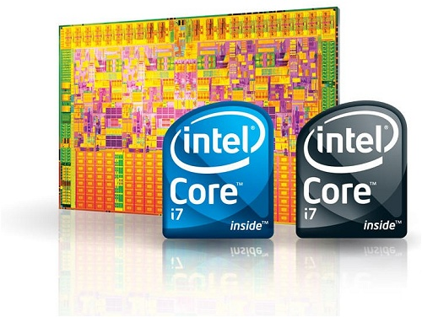
Metalliods-
Possess some characteristics of metals/some of nonmetals

Slide 30
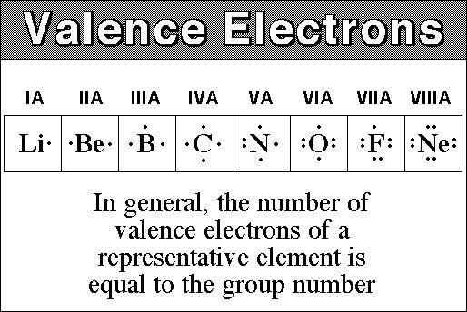
Valence Electrons
The number of electrons in the outermost orbital.
The number of valence electrons in an atom of an element. determines many properties of that element, including the ways it reacts with other elements
Lets draw!

Slide 31
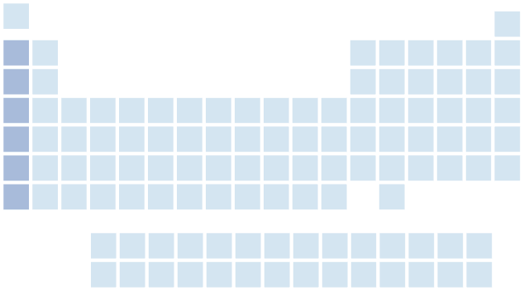
Metals in the Periodic Table
The metals in Group 1, from lithium to francium, are called the alkali metals. Alkali are the most reactive metals, increasing in reactivity from top to bottom. All member of group 1 have 1 valence electron.

Slide 32
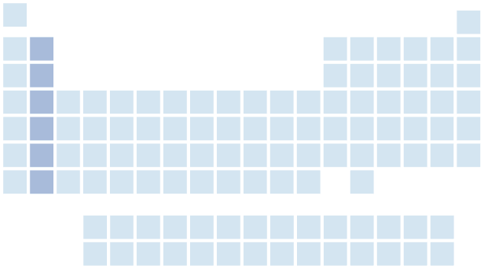
Metals in the Periodic Table
- Metals
Group 2 of the periodic table contains the alkaline earth metals. These elements are not as reactive as the metals in Group 1, but they are more reactive than most other metals. They all have 2 valence electrons.

Slide 33
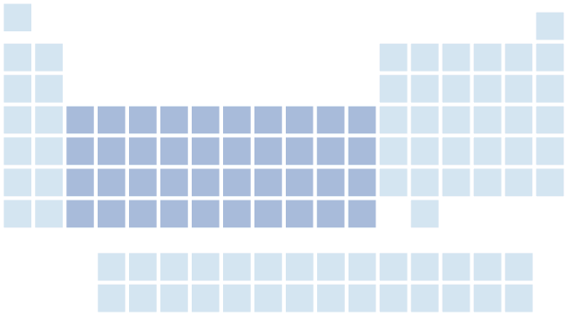
Metals in the Periodic Table
- Metals
The transition metals are less reactive than the metals in Groups 1 and 2.

Slide 34
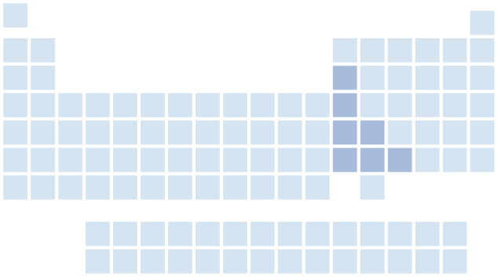
Metals in the Periodic Table
- Metals
Only some of the elements in Groups 13 through 15 of the periodic table are metals. These metals are not nearly as reactive as those on the left side of the table. These are called the mixed metals.

Slide 35
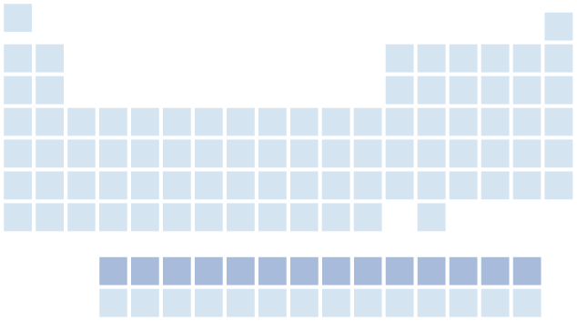
Metals in the Periodic Table
- Metals
Lanthanides are soft, malleable, shiny metals with high conductivity.

Slide 36
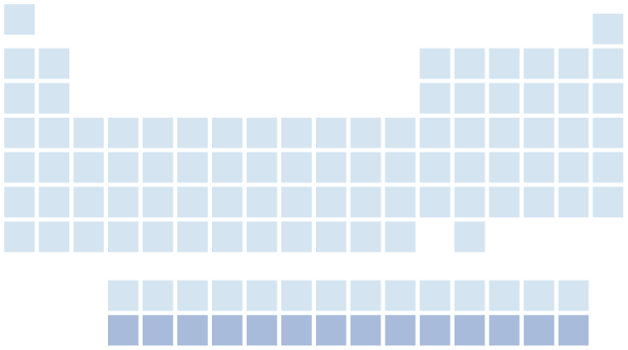
Metals in the Periodic Table
- Metals
The elements below the lanthanides are called actinides. Many of these elements are so unstable that they last for only a fraction of a second after they are made.

Slide 37
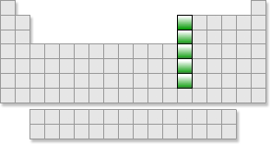
Boron Family
The Boron family are all metals except Boron.
Contains the most abundant metal on earth: Aluminum
The all have 3 valence electrons

Slide 38
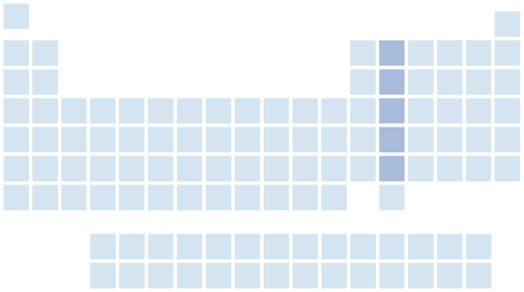
Carbon Family
Have 4 valence electrons.
Carbon makes up most of the compounds in living things. ( except water)

Slide 39
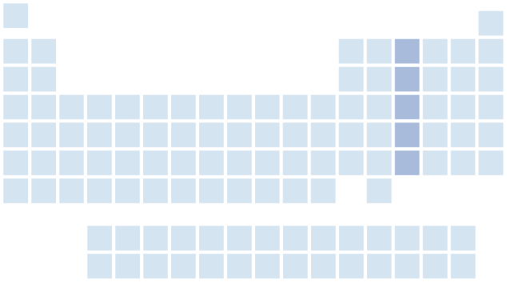
Nitrogen Family
Group 15, the nitrogen family, contains two very important nonmetals: nitrogen and phosphorus.

Slide 40
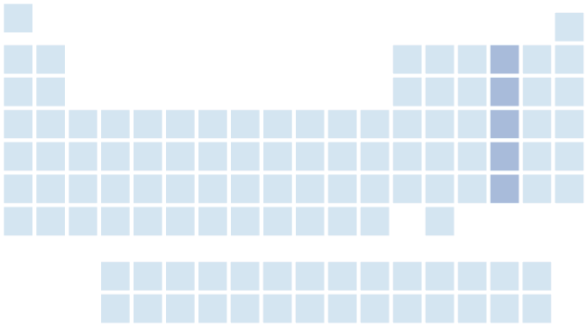
Oxygen Family
- Nonmetals and Metalloids
Group 16, the oxygen family, contains three nonmetals: oxygen, sulfur, and selenium.
Oxygen is the most abundant element in Earths crust.
All have 6 Valence electrons.

Slide 41
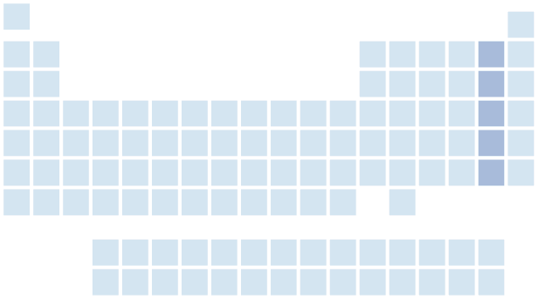
Halogens
- Nonmetals and Metalloids
The Group 17 elements are the most reactive nonmetals. Atoms of these elements easily form compounds with other elements.
They all have 7 valence electrons

Slide 42
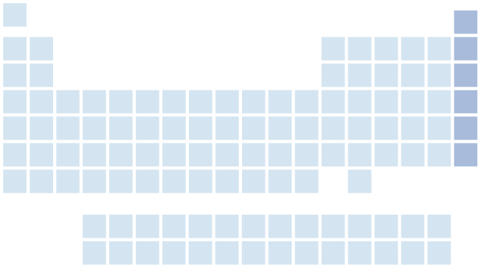
Nobel Gases
- Nonmetals and Metalloids
The elements in Group 18 are known as the noble gases. They do not ordinarily form compounds because atoms of noble gases do not usually react with other elements.
They have 8 valence electrons.

