Slide 1
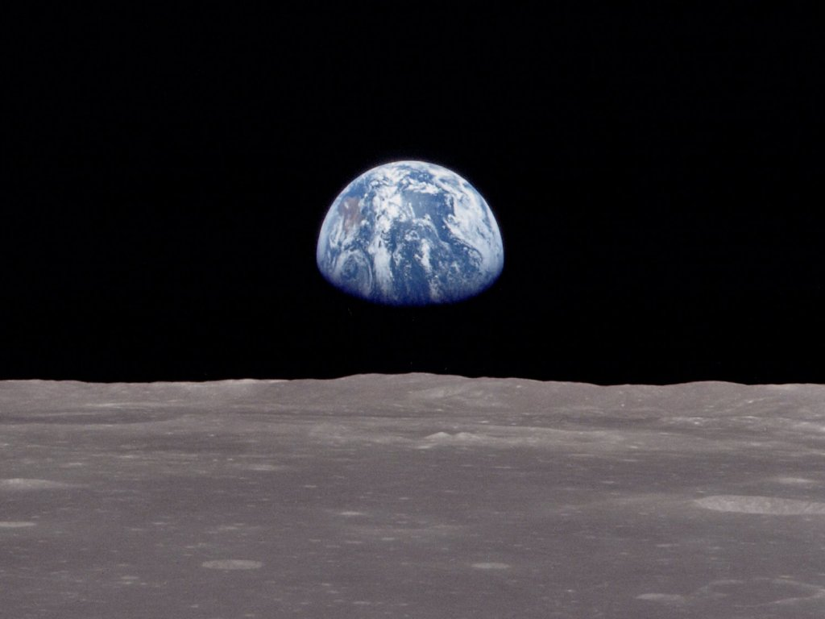
Environmental Systems and Societies
Topic 1
Systems and Models

Slide 2
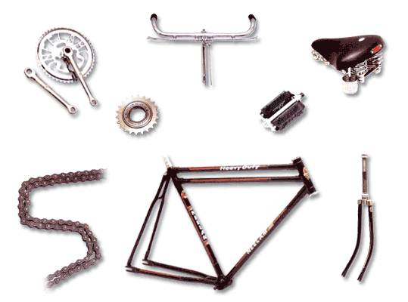
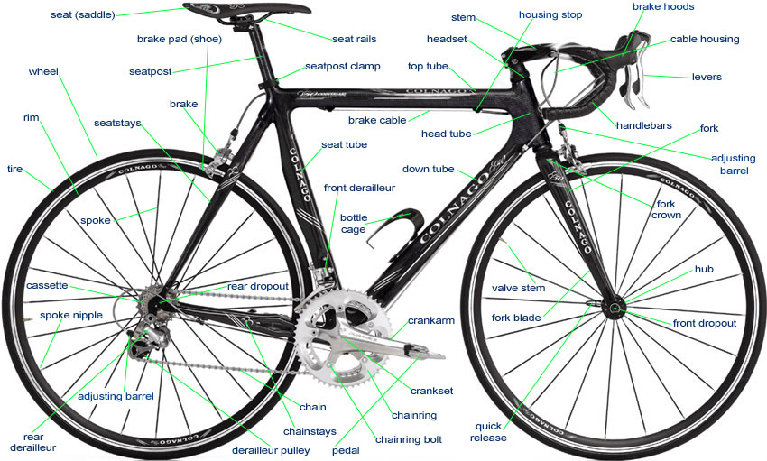
A System
Is an organized collection of interdependent components that perform a function and which are connected through the transfer of energy and/or matter
All the parts are linked together and affect each other.

Slide 3
Why use Systems Concept
Why do we use Systems?
Useful for understanding and explaining phenomena
A holistic approach that can lead to a deeper understanding and possibly to further discoveries

Slide 4
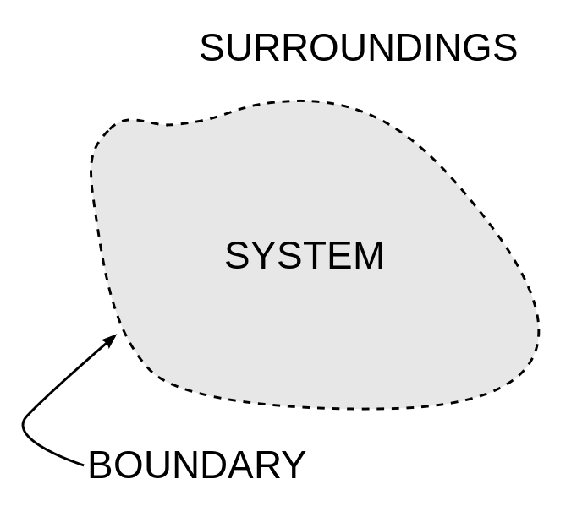
Storages of mass or energy
All systems have:
Storages: matter or energy
Boundaries:
Processes: transfer or transform energy or matter from storage to storage e.g. respiration, precipitation, diffusion
Flows: Energy or matter into, through, and out of the system
Inputs
Outputs
Flows: energy or matter into or out of a system
Inputs
Outputs

Slide 5
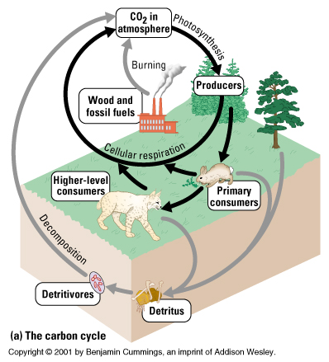
Systems are defined by the source and ultimate destination of their matter and/or energy.
1. OPEN SYSTEM: a system in which both matter and energy are exchanged across boundaries of the system.

Slide 6
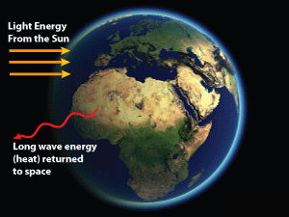
2. CLOSED SYSTEM: a system in which energy is exchanged across boundaries of the system, but matter is not.

Slide 7
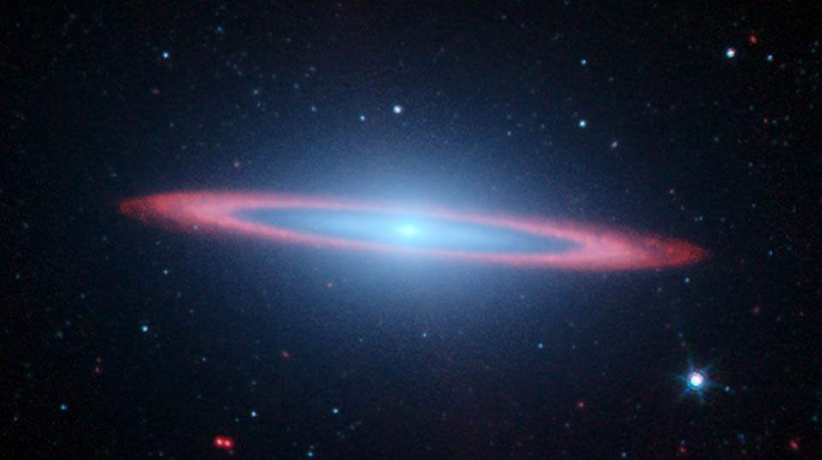
3. ISOLATED SYSTEM: a system in which neither energy nor matter is exchanged across boundaries of the system.
NO SUCH SYSTEM EXISTS!!!
Most natural living systems are OPEN systems.

Slide 8
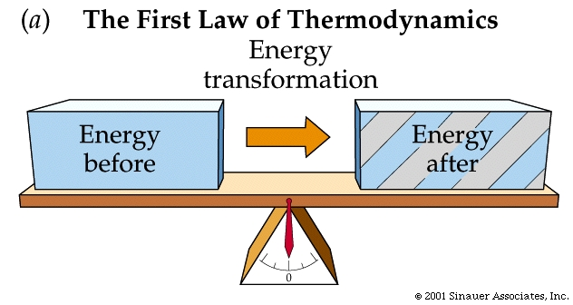
1st Law of Thermodynamics
States that energy can be transferred and transformed, but it CANNOT be created nor destroyed. AKA: Law of Conservation of Energy.
Energy of the universe is constant.
Energy is conserved, changes form but never destroyed

Slide 9
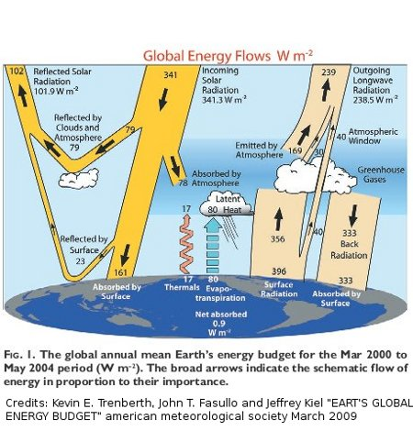
2nd Law of Thermodynamics
Energy transfers and transformations increase ENTROPY (disorder, randomness or chaos).
Law of Entropy: Energy conversions are never 100%
Plants can use less than 1% of incoming light for photosynthesis

Slide 10
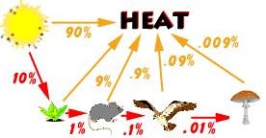
Example in food chains: energy always tends to go from a more usable (higher quality) form to a less usable (lower quality) form.
10 % rule: Herbivores can assimilate into new tissue, 10% of the chemical energy of the consumed plants leaves…and so on up the food chain…

Slide 11
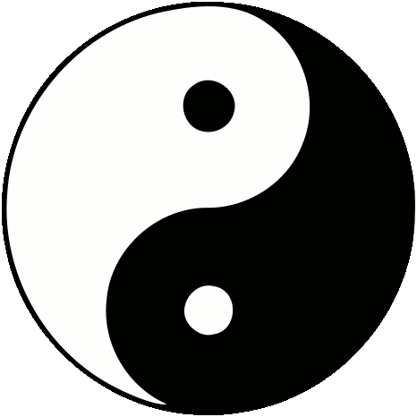
Equilibrium – A state of balance among the components of a system.

Slide 12
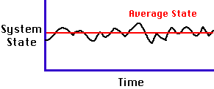
Steady-state equilibrium
The condition of an open system in which there are no changes over the longer term, but in which there may be oscillations in the very short term. There are continuing inputs and outputs of matter and energy, but the
system as a whole remains in a more or less constant state (for example, a climax ecosystem).
Energy in a mature ecosystem

Slide 13
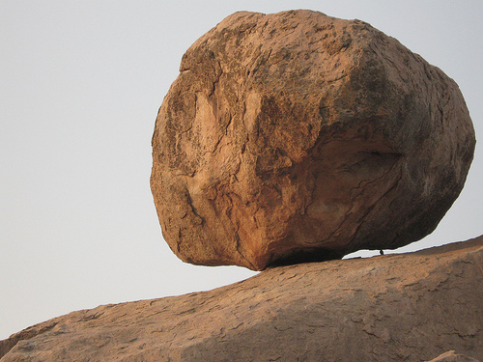
Static equilibrium
Stable (no change over time), found in non-living systems
Usually related to balanced forces or energy
Example geological systems, lakes

Slide 14
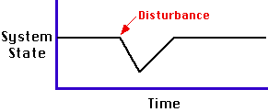
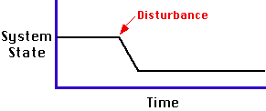
Stability of equilibrium
Stable equilibrium The condition of a system in which there is a tendency for it to return to a previous equilibrium condition following disturbance.
has self regulating negative feedback, a small change in variables will not disrupt the equilibrium
Example – a cell, human physiology
Unstable equilibrium will return to a new equilibrium after the disturbance
positive feedback cycles can cause destruction / large modification of the equilibrium from a small initial change.

Slide 15
Positive Feedback Feedback that amplifies or increases change; it leads to exponential deviation away from an equilibrium.
A
B
A
Larger B
Larger
A
A
B

Slide 16
Negative feedback
Negative Feedback, Feedback that tends to damp down, neutralize or counteract any
deviation from an equilibrium, and promotes stability.
The initial change produces a reaction that will reduce the change initially observed
Most natural systems at a physiological and ecological level maintain stability through many negative feedback loop responses

Slide 17
Lotka-Volterra model
Predator/prey relationships are usually controlled by negative feedback where:
The increase in prey-→increase in predator-→ decrease in prey→ decrease in predator→increase in prey---and so on in a cyclical manner. The classic study in Northern Canada between the Lynx and the hare populations is famous for its regular 11 year cycle of rising and falling populations.

Slide 18
Lotka-Volterra model

Slide 19
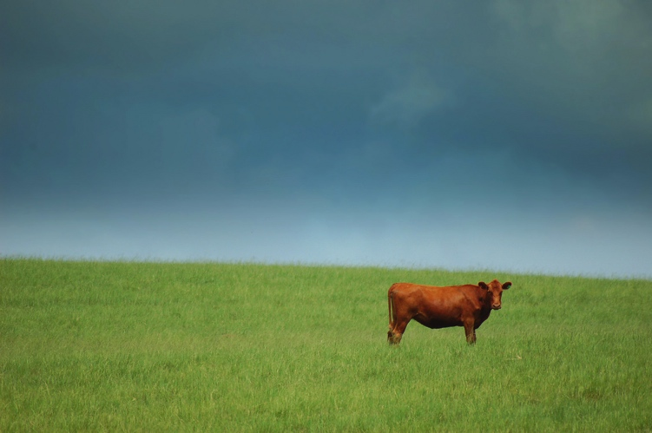
Transfers and Transformations types of flow through the ecosystem
Transfers – when flows do not involve a change in form or state; Change location
Ex: Water from plant tissue to animal tissue, nitrogen molecules from soil to plant to consumer to decomposer

Slide 20
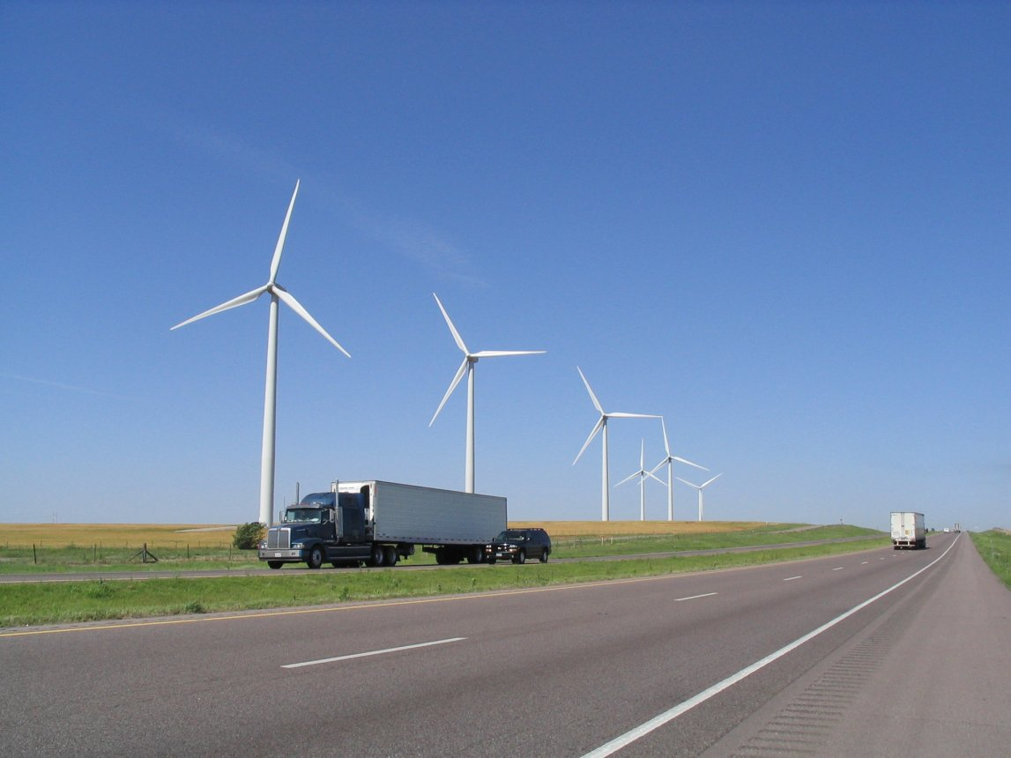
Transformations – changes of state or change in form
Ex. liquid water to atmospheric vapor, glucose chemical energy to movement (kinetic energy), light energy to chemical energy (potential energy)

Slide 21
Matter and Energy Storage
Matter and energy flow through the ecosystem, sometimes they are stored, that is a point when they are locked into the non-living environment for long periods of time.
Ex. ground water trapped between impermeable rock layers, carbon and calcium forming limestone rock from buried corals/plankton , animal/plant tissues buried slowly becoming peat, coal or gas.

Slide 22
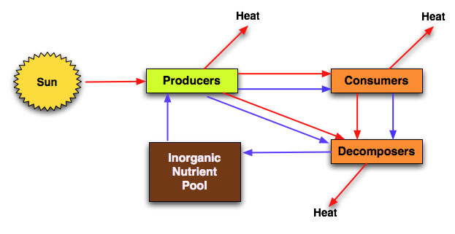
Energy
Matter

Slide 23
Models of systems:
Help predict changes in a system
Systems sometimes work in predictable ways and follow “rules”; we know some of the rules but not all.
Models change as information becomes available.
What kind of question could you expect to see? Which command term?

Slide 24
Gaia – James Lovelock
A famous theory –Idea and it is supported by much evidence.
The planet as a whole acts like a single organism, through global negative feedback mechanisms it regulates atmospheric and hydrological stability despite variable abiotic influences like solar energy and geological off-gassing

Slide 25
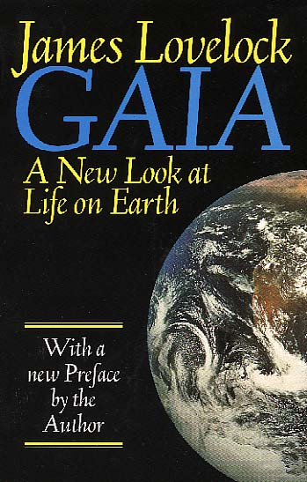
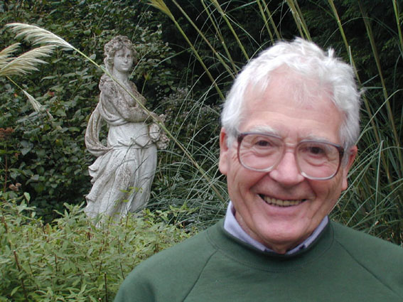
Negative feedbacks – self regulating, if void of external interruption
It is more than 30 years since James Lovelock, a freelance chemist with a background in medical research and a gift for devising sensitive detectors, worked for NASA on the Mars exploration program. While doing so, he began to form the idea of the biosphere as a self-regulating entity, of life and the planet as a kind of sensitive organism, not sensitive to any particular form of life, just to the principle of life. He called it the Gaia hypothesis. The novelist William Golding, a friend and neighbor, suggested the name. Gaia was the Earth goddess, the Greeks' Mother Nature.

