Slide 1
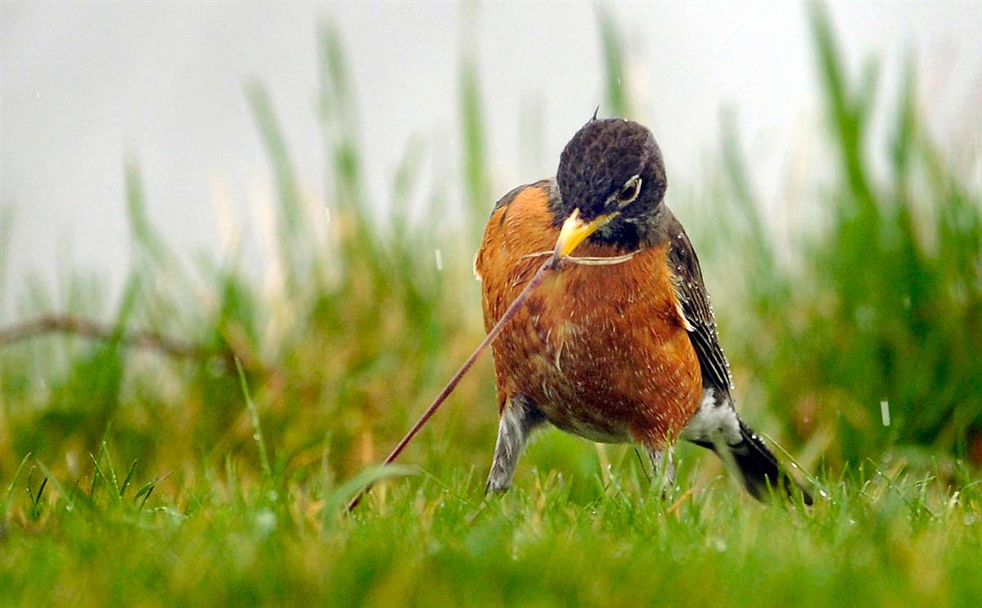
Topic 2: Ecosystems
2.1 Structure

Slide 2
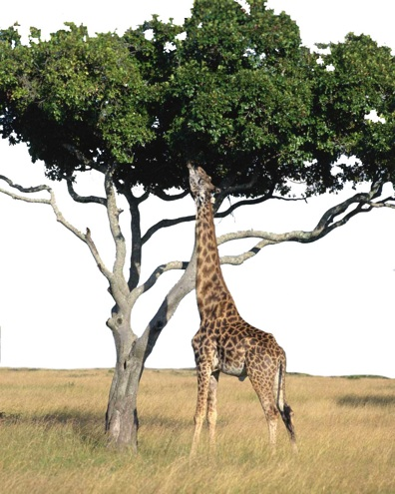
Ecology
CO₂
O₂
Ecology is the study of the relationships between organisms and their physical and biotic environment:
Relationships involve interactions with the physical world as well as interrelationships with other species and individuals of the same species.
Nutrients

Slide 3
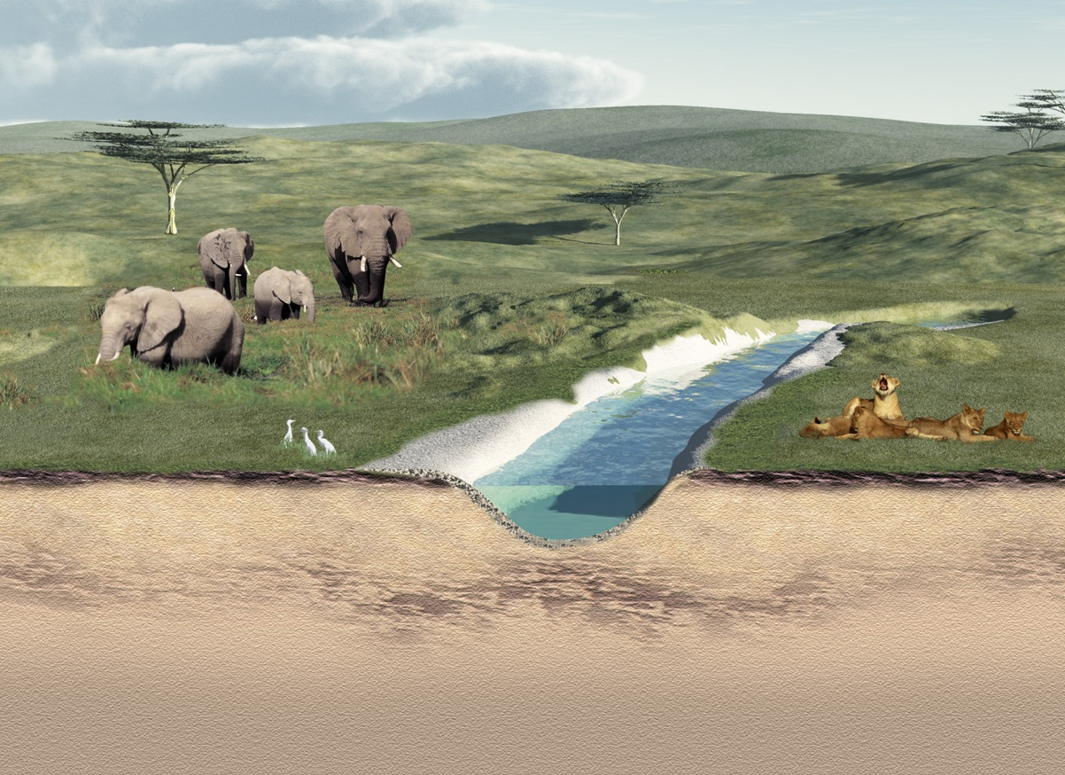
Components of an Ecosystem
Physical environment
Community
A biome is a large geographical region comprising natural units called ecosystems.
An ecosystem encompasses the physical environment and the community.

Slide 4
Ecosystem
Abiotic (physical) factors are the influences of the non-living parts of the ecosystem.
Abiotic factors
atmosphere soil water
wind speed
wind direction
pH, salinity, temperature, humidity, precipitation, water pressure, and light intensity and quality.
Physical environment
Community
Biotic factors are the influences of the living parts of the ecosystem
Biotic factors
Competitors, symbionts, predators, parasites, pathogens

Slide 5
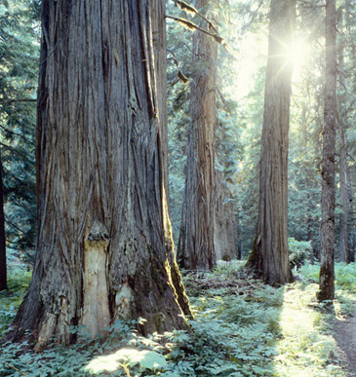
Trophic Structure 1
Every ecosystem has a trophic structure: a hierarchy of feeding relationships which determines the pathways for energy flow and nutrient cycling.
Species are assigned to trophic levels on the basis of their nutrition.
Producers (P) occupy the first trophic level and directly or indirectly support all other levels. Producers derive their energy from the sun in most cases.

Slide 6
Trophic Structure 2
Producer
(P)
All organisms other than producers are consumers (C).
Consumers are ranked according to the trophic level they occupy. First order (or primary) consumers (herbivores), rely directly on producers for their energy.
A special class of consumers, the detritivores, derive their energy from the detritus representing all trophic levels.
Photosynthetic productivity (the amount of food generated per unit time through photosynthesis) sets the limit for the energy budget of an ecosystem.
Consumer
(C1)
Consumer
(C2)
Consumer
(C3)

Slide 7
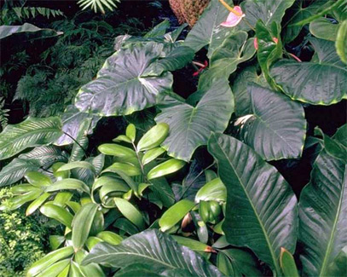
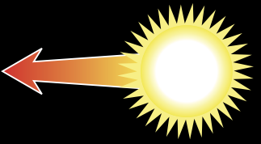
Producers
Producers are able to manufacture their food from simple inorganic substances (e.g. CO₂). Producers include green plants, algae and other photosynthetic protists, and some bacteria.
Respiration
Heat given off in the process of daily living.
Growth and new offspring
New offspring as well as new branches and leaves.
Eaten by consumers
Some tissue eaten by herbivores and omnivores.
Wastes
Metabolic waste products are released.
Producers
Solar radiation
Reflected light
Unused solar radiation is reflected off the surface of the organism.
Dead tissue
Death
Some tissue is not eaten by consumers and becomes food for decomposers.

Slide 8
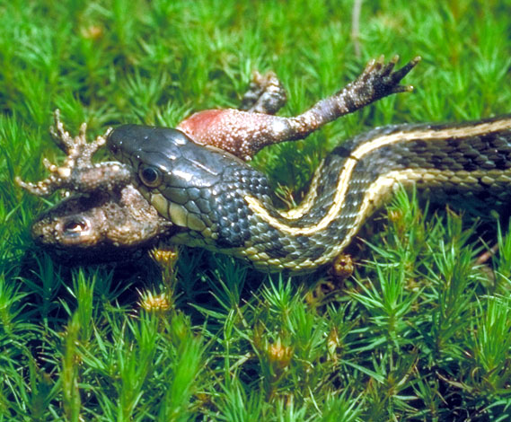
Consumers
Consumers are organisms that feed on autotrophs or on other heterotrophs to obtain their energy.
Includes: animals, heterotrophic protists, and some bacteria.
Respiration
Heat given off in the process of daily living.
Growth and reproduction
New offspring as well as growth and weight gain.
Eaten by consumers
Some tissue eaten by carnivores and omnivores.
Wastes
Metabolic waste products are released
(e.g. urine, feces, CO2)
Consumers
Food
Consumers obtain their energy from a variety of sources: plant tissues (herbivores), animal tissues (carnivores), plant and animal tissues (omnivores), dead organic matter or detritus (detritivores and decomposers).
Death
Some tissue not eaten by consumers becomes food for detritivores and decomposers.
Dead tissue

Slide 9
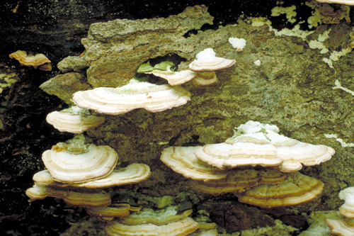
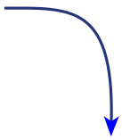
Decomposers
Decomposers are consumers that obtain their nutrients from the breakdown of dead organic matter. They include fungi and soil bacteria.
Respiration
Heat given off in the process of daily living.
Growth and reproduction
New tissue created, mostly in the form of new offspring.
Producer tissue
Nutrients released from dead tissues are absorbed by producers.
Death
Decomposers die; their tissue is broken down by other decomposers and detritivores
Wastes
Metabolic waste products are released.
Decomposers
Dead tissue
Dead tissue of producers
Dead tissue of consumers
Dead tissue of decomposers

Slide 10
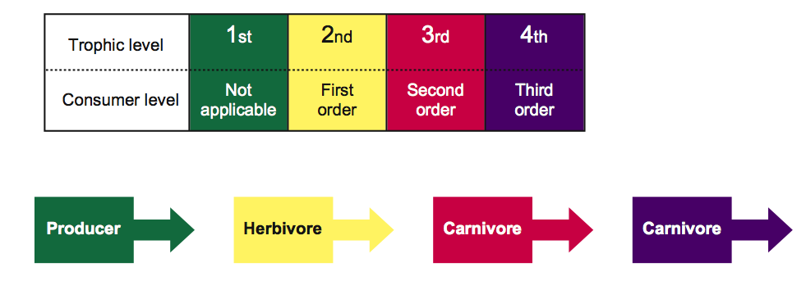
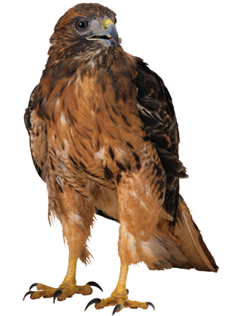
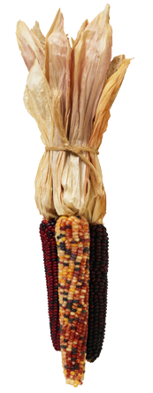
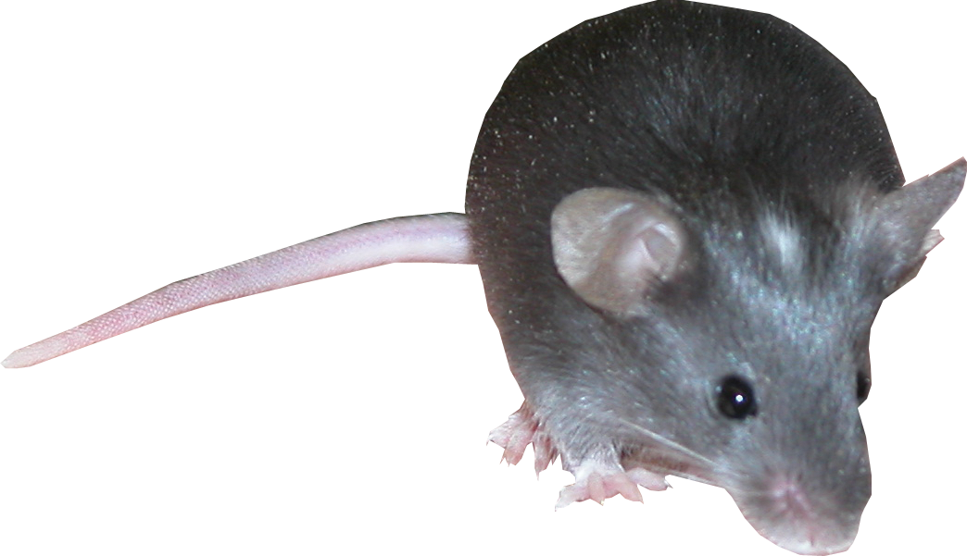
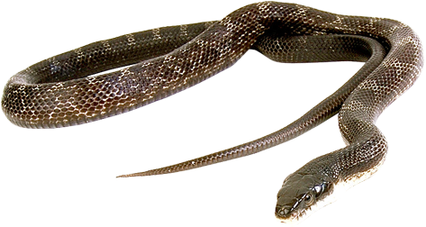
Organisation of Trophic Levels
Trophic structure can be described by trophic level or consumer level:

Slide 11
Major Trophic Levels
Trophic Level | Source of Energy | Examples
Producers | Solar energy | Green plants, photosynthetic protists and bacteria
Herbivores | Producers | Grasshoppers, water fleas, antelope, termites
Primary Carnivores | Herbivores | Wolves, spiders, some snakes, warblers
Secondary Carnivores | Primary carnivores | Killer whales, tuna, falcons
Omnivores | Several trophic levels | Humans, rats, opossums, bears, racoons, crabs
Detritivores and Decomposers | Wastes and dead bodies of other organisms | Fungi, many bacteria, earthworms, vultures

Slide 12
Food Chains
The sequence of organisms, each of which is a source of food for the next, is called a food chain.
Food chains commonly have four links but seldom more than six.
In food chains the arrows go from food to feeder.
Organisms whose food is obtained through the same number of links belong to the same trophic level.
Examples of food chains include:
Producer
(P)
1° carnivore
2° carnivore
Herbivore
seaweed
cat’s eye
whelk
seagull
aquatic macrophyte
freshwater crayfish
brown trout
kingfisher

Slide 13
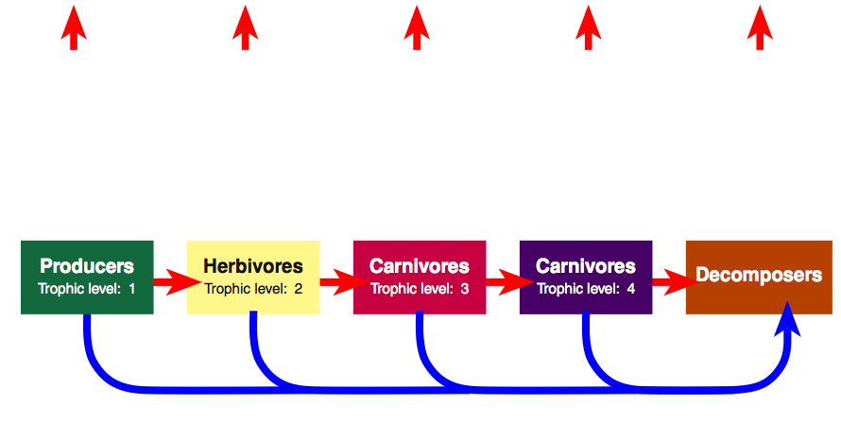
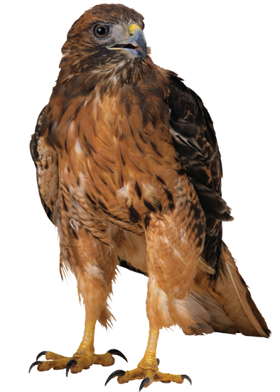
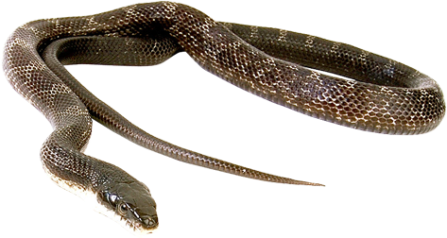
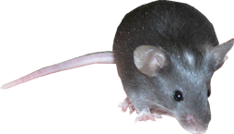
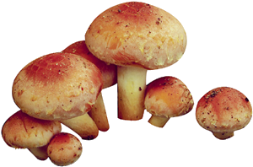
Food Chain Energy Flow
Energy is lost as heat from each trophic level via respiration.
Dead organisms at each level are decomposed.
Some secondary consumers feed directly off decomposer organisms.
Heat
Heat
Heat
Heat
Heat

Slide 14
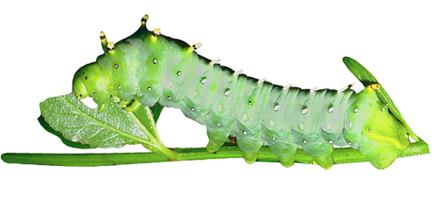
Ecological Efficiency
The percentage of energy transferred from one trophic level to the next varies between 5% and 20% and is called the ecological efficiency.
An average figure of 10% is often used. This ten percent law states that the total energy content of a trophic level in an ecosystem is only about one-tenth that of the preceding level.
Plant material consumed by caterpillar
200 J
100 J
33 J
67 J
Feces
Growth
Cellular respiration

Slide 15
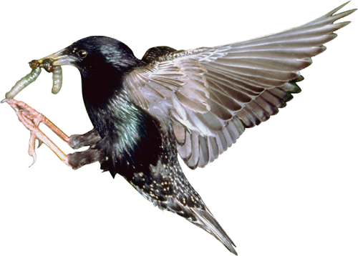
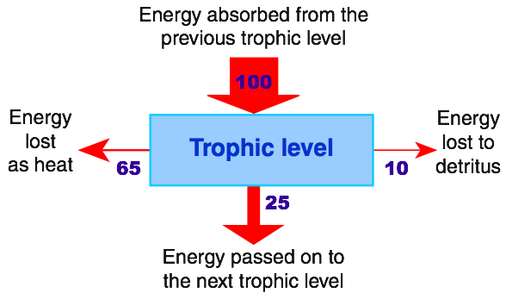
Energy Flow in Ecosystems
Energy flow into and out of each trophic level in a food chain can be represented on a diagram using arrows of different sizes to represent the different amounts of energy lost from particular levels.
The energy available to each trophic level will always equal the amount entering that trophic level, minus total losses to that level.

Slide 16
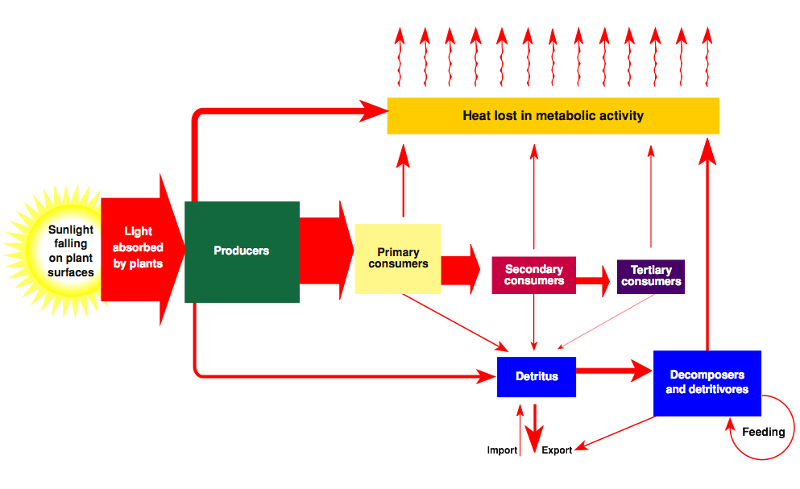
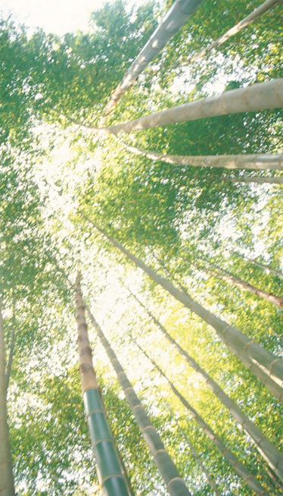
Energy Flow Diagrams
The diagram illustrates energy flow through a hypothetical ecosystem.

Slide 17
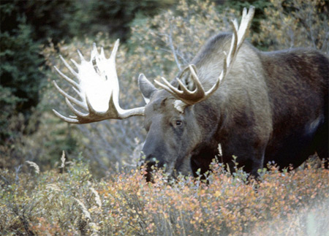
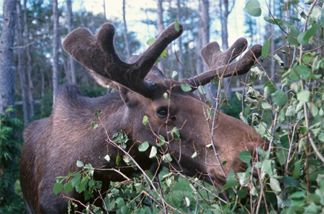
Food Webs
Some consumers (particularly ‘top’ carnivores and omnivores) may feed at several different trophic levels, and many herbivores eat many plant species.
For example, moose feed on grasses, birch, aspen, firs, and aquatic plants.
The different food chains in an ecosystem therefore tend to form complex webs of feeding interactions called a food web.

Slide 18
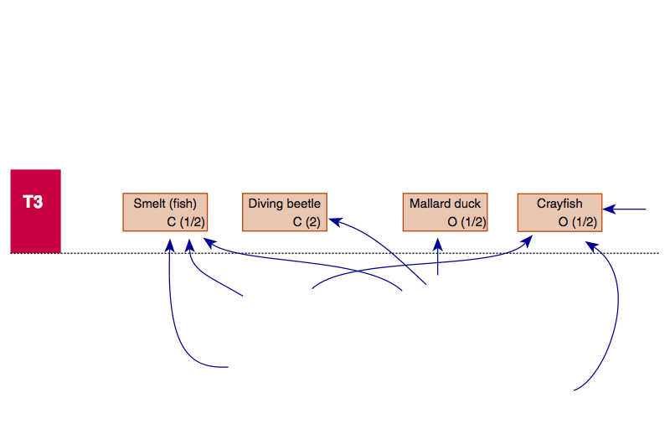
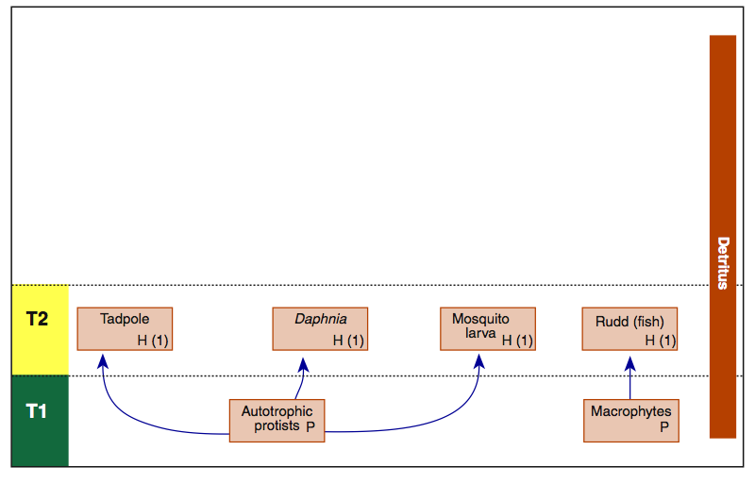
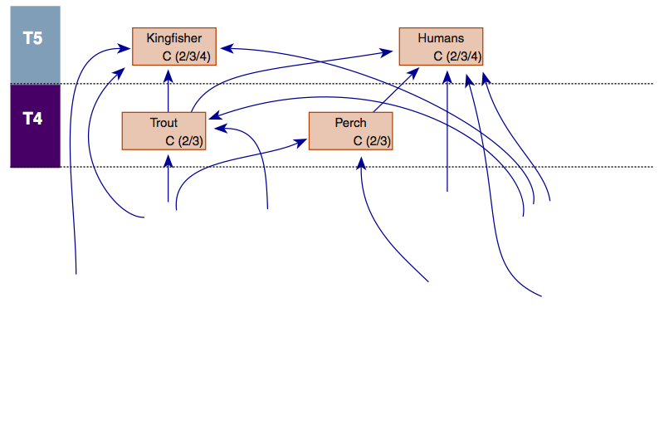
A Simple Lake Food Web
This lake food web includes only a limited number of organisms, and only two producers. Even with these restrictions, the web is complex.

Slide 19
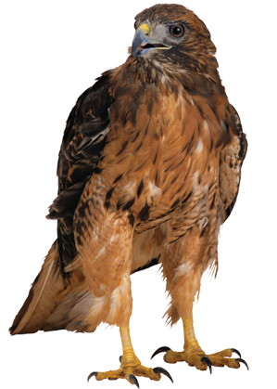
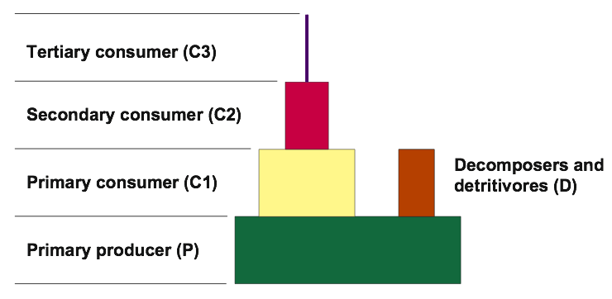
Ecological Pyramids 1
Trophic levels can be compared by determining the number, biomass, or energy content of individuals at each level.
This information can be presented as an ecological pyramid.
The base of each pyramid represents the producers and the subsequent trophic levels are added on top in their ‘feeding sequence’.

Slide 20
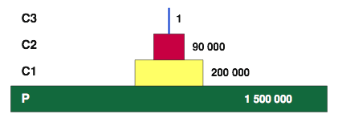
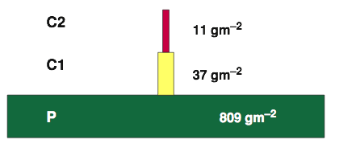
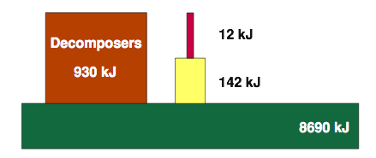
Ecological Pyramids 2
Various types of pyramid are used to describe different aspects of an ecosystem’s trophic structure:
Pyramids of numbers: In which the size of each tier is proportional to the number of individuals present at each trophic level.
Pyramids of biomass: Each tier represents the total dry weight of organisms at each trophic level.
Pyramids of energy (production): The size of each tier is proportional to the production (e.g. in kJ) of each trophic level.
Pyramid of numbers
Pyramid of biomass
Pyramid of energy

Slide 21
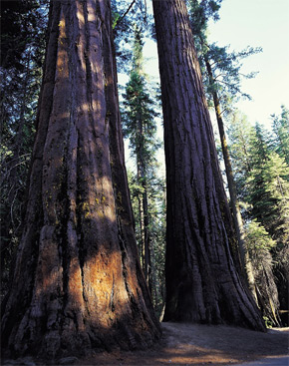
Pyramids of Numbers
In a typical pyramid of numbers, the number of individuals supported by the ecosystem at successive trophic levels declines progressively.
This reflects the fact that the smaller biomass of top level consumers tends to be concentrated in a relatively small number of large animals.
There are some exceptions. In some forests a few producers (of a very large size) may support a larger number of consumers, and the pyramid is inverted. This also occurs in plant/parasite food webs.
Forest
Grassland

Slide 22
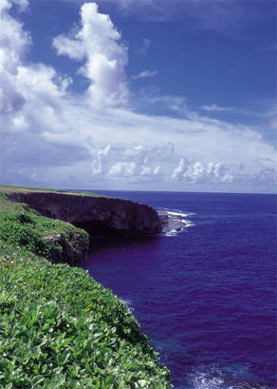
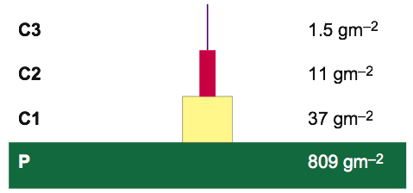
Pyramids of Biomass
In pyramids of biomass, dry weight is usually used as the measure of mass because the water content of organisms varies.
Organism size is taken into account so meaningful comparisons of different trophic levels are possible.
Biomass pyramids may be inverted in some systems (e.g. in some plankton communities) because the algal (producer) biomass at any one time is low, but the algae are reproducing rapidly and have a high productivity.
A Florida bog community
The English Channel

Slide 23
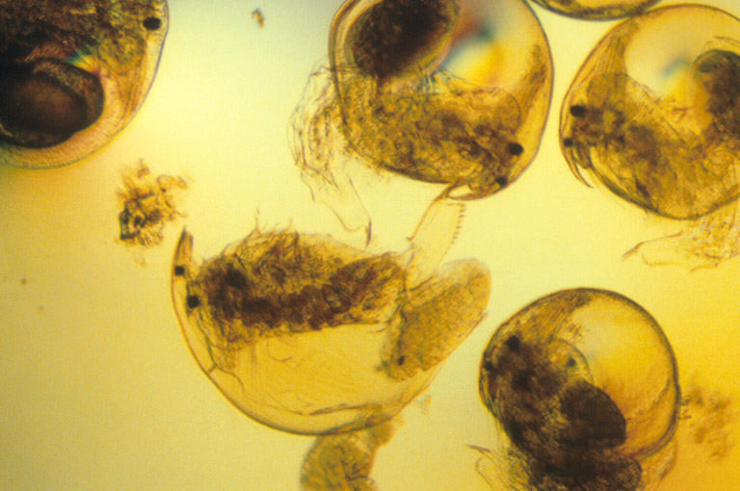
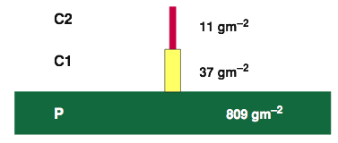
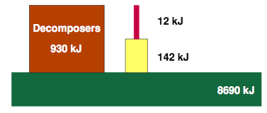
Pyramids of Energy
Pyramids of energy (or production) are often very similar in appearance to pyramids of biomass.
The energy content at each trophic level is generally comparable to the biomass because similar amounts of dry biomass tend to have about the same energy content.
This example illustrates the similarity between pyramids of biomass (gm⁻²) and energy (kJ) in a freshwater lake community. During warm months, when algal turnover time is short, pyramids of energy and biomass may be inverted.
Zooplankton (C1)

Slide 24
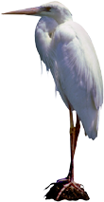
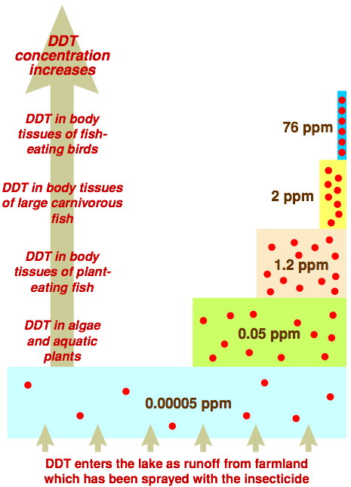
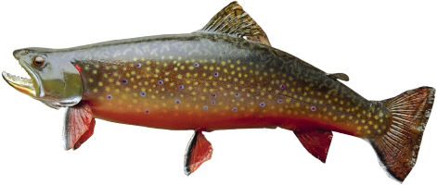
Bioaccumulation
Biomagnification of DDT in an aquatic ecosystem
Bioaccumulation (also called biological magnification) occurs when highly persistent pesticides, which cannot be metabolized or excreted, are stored and accumulate in the fatty tissues of the body.
There is a progressive concentration of the pesticides with increasing trophic level; higher order consumers are at greater risk because they eat a large number of lower order consumers.

Slide 25
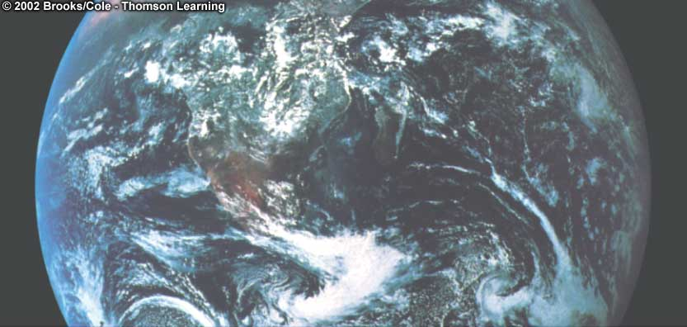
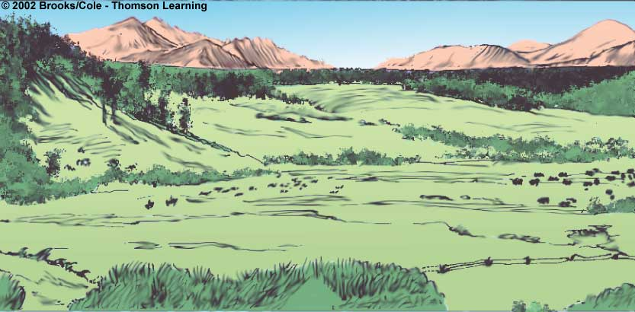
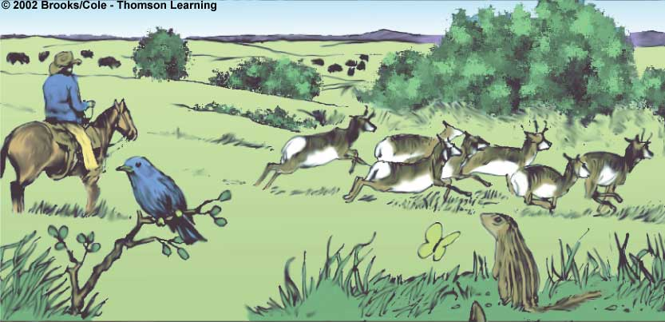
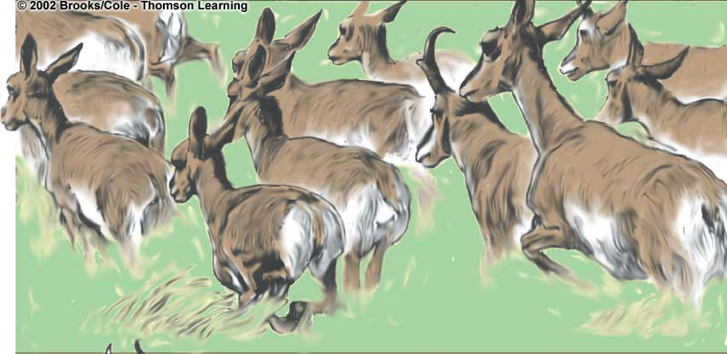
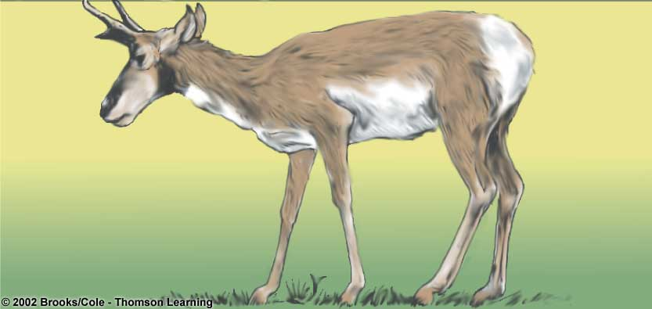
Biosphere
Species
A group of similar organisms whose members freely interbreed
Population
A group of organisms of the same species that occupy that live in the same area at the same time
Ecosystem
A community and its physical (abiotic) environment
Ecosystems
Communities
Populations
Organisms

Slide 26
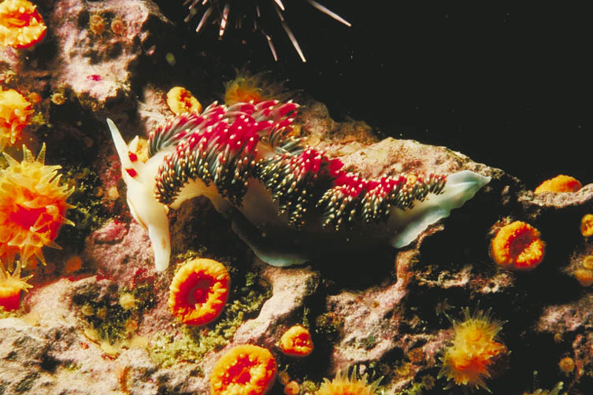
Communities
A community is a naturally occurring group of organisms living together as an ecological entity; the biological part of the ecosystem.
A nudibranch snail feeding on rock encrusting organisms

Slide 27
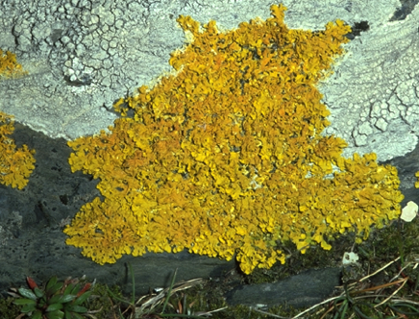
Habitat
An organism’s habitat is the physical place or environment in which it lives.
Organisms show a preference for a particular habitat type, but some are more specific in their requirements than others.
Lichens are found on rocks, trees, and bare ground.
Most frogs, like this leopard frog, live in or near fresh water, but a few can survive in arid habitats.

Slide 28
Physical Conditions
The physical conditions influence the habitat in which an organism lives. These include:
substrate
humidity
sunlight
temperature
salinity
pH (acidity)
exposure
altitude
depth
Each abiotic (or physical) factor may be well suited to the organism or it may present it with problems to overcome.

Slide 29
Law of Tolerance
The law of tolerance states that “For each abiotic factor, an organism has a range of tolerances within which it can survive.”
Tolerance range
Optimum range
Number of organisms
Unavailable niche
Marginal niche
Preferred niche
Marginal niche
Unavailable niche
Examples of abiotic factors that influence size of the realized niche:

Slide 30
Niche
An organisms particular role or how it makes its living.
Ex- the food it eats, how it gets its food, what other organism use it as food.
When and how an organism reproduces.
Physical conditions required for survival
2 Species can not occupy the same niche!

Slide 31
Ecological Niche
Habitat
Adaptations
The ecological niche describes the functional position of an organism in its environment.
A niche comprises:
the habitat in which the organism lives.
the organism’s activity pattern: the periods of time during which it is active.
the resources it obtains from the habitat.
Activity patterns
Presence of other organisms
Physical conditions

Slide 32
Species Interactions
No organism exists in isolation. Each participates in interactions with other organisms and with the abiotic components of the environment.
Species interactions may involve only occasional or indirect contact (predation or competition) or they may involve a close association between species. Symbiosis is a term that encompasses a variety of such close associations, including parasitism (a form of exploitation), mutualism, and commensalism.
Canopy tree with symbionts attached
Oxpecker birds on buffalo

Slide 33
Types of Interaction

Slide 34
Parasitism
Many animal taxa have representatives that have adopted a parasitic lifestyle.
Parasites occur more commonly in some taxa than in others. Insects, some annelids, and flatworms have many parasitic representatives.
Parasites live in or on a host organism. The host is always harmed by the presence of the parasite, but it is not usually killed. Both parasite and host show adaptations to the relationship.
Parasites may live externally on a host as ectoparasites, or within the host’s body as endoparasites.
Tick ectoparasite on bird wing
Many birds and mammals use dust bathing to rid themselves of external parasites

Slide 35
Ectoparasites
Ectoparasites, such as ticks, mites, lice, bed bugs, and fleas, live attached to the outside of the host, where they suck body fluids, cause irritation, and may act as vectors for pathogens.
Insect vectors include human lice, rat fleas, mosquitoes and tsetse flies.
Bed bug (Cimex lectularis)
Human flea (Pulex irritans)
Head louse (Pediculus humanus)
Mosquito vector for Dengue fever (Aedes albopictus)

Slide 36
Endoparasites
In many endoparasites, a primary host (in which the parasite becomes sexually mature) and one or more intermediate hosts (which usually house larval stages) are required to complete the life cycle.
Endoparasitic species such as the pork tapeworm, Taenia solium, are highly specialized to exploit the resources of the host.
Adaptations, such as specialized mouthparts and lack of a digestive tract, enable them to spend their life inside the intestines of their vertebrate hosts.
Taenia scolex (head region)
Taenia proglottid (reproductive segment)
Horse gut nematode
Sheep liver fluke

Slide 37
Mutualistic Relationships
Mutualistic relationships occur between some birds (such as oxpeckers) and large herbivores (such as zebra, Cape buffalo, and rhinoceros). The herbivore is cleaned of parasites and the oxpecker gains access to food.
Lichens are an obligate mutualism between a fungus and either a green alga or a cynobacterium. The fungus obtains organic carbon from the alga. The alga obtains water and nutrient salts from the fungus.
Cape buffalo and oxpecker birds
Lichen: an obligate mutualism

Slide 38
Commensal Relationships
In commensal relationships, one party (the commensal) benefits, while the host is unaffected.
Epiphytes (perching plants) gain access to a better position in the forest canopy, with more light for photosynthesis, but do no harm to the host tree.
Commensal anemone shrimps (Periclimenes spp.) live within the tentacles of host sea anemones. The shrimp gains protection from predators, but the anemone is neither harmed nor benefitted.

Slide 39
Amensalism
Amensalism describes the situation where the presence of one species has a harmful effect on the other, but is not itself affected by the association.
In this respect, it is opposite to the relationship between a commensal and its host.
Grazing mammals trample and destroy vegetation around waterholes, creating bare zones. The mammals are unaffected by the loss as they go there primarily to drink and not to feed.

Slide 40
Exploitation
Exploitation describes relationships where one species benefits at the expense of another. It includes several familiar interactions:
Predation: Predator kills the prey outright, e.g. lions hunting zebra.
Herbivory: The herbivore feeds on, but usually does not kill, the plant, e.g. zebra grazing on grass.
Parasitism: The parasite does not usually kill its host, e.g. ticks feeding on the blood of a zebra.

Slide 41
Plant Parasites
A great diversity of plant parasites exist. Some depend only partly on their host plant for nutrition; they are photosynthetic but utilize the host’s nutrients, e.g. mistletoe.
Others are entirely parasitic and are unable to photosynthesize, e.g. cancer root (Conopholis americana) dodder, and wood rose (Dactylanthus taylorii).
Cancer root (top) and wood rose are holoparasitic and dependent entirely on the host plant.
Mistletoe Phoradendren spp. are hemiparasites; photosynthesizing but lack their own roots and rob their host plant of water and nutrients.

Slide 42
Antibiosis
Antibiosis describes the chemical inhibition of one party by another. One party is harmed; the other is unaffected, or may even benefit.
In allelopathy, one plant releases toxic compounds (e.g. phenols or alkaloids) which inhibit the growth of nearby plants. Allelopathic plants include black walnut, swamp chestnut oak, and eucalyptus and neem trees. In cases of autotoxicity, a parent plant produces chemicals to inhibit the growth of its own seedlings.
Fungi produce antibiotics to inhibit the growth of bacteria.
Inhibition around a eucalypt
Many moulds produce antibiotics

Slide 43
Competition
Competition is one of the most familiar of species relationships. It occurs both within (intraspecific) and between (interspecific) species.
Individuals compete for resources such as food, space, and mates. In all cases of competition, both parties (the competitors) are harmed to varying extents by the interaction.
Neighboring plants compete for light, water, and nutrients. Interactions involving competition between animals for food are dominated by the largest, most aggressive species (or individuals).

Slide 44
Intraspecific Competition
Environmental resources are finite. Competition within species for resources increases as the population grows. At carrying capacity (K), it reduces the per capita growth rate to zero.
When the demand for a resource (e.g. water, food, nesting sites, light) exceeds supply, that resource becomes a limiting factor.
Animals compete for resources such as water (left) or mates (right), especially when these are in short supply or access to them is restricted.

Slide 45
Responses to Competition 1
Populations respond to resource limitation by reducing their population growth rate through lower natality or higher mortality.
Individuals respond variably to resource limitation.
In most cases, food shortage reduces both individual growth rate and survival, as well as population growth.
In many invertebrates and some vertebrates such as frogs, individuals reduce growth rate and mature at a smaller size.
Tadpoles metamorphosing into frogs
Trout are smaller when food is limited

Slide 46
Responses to Competition 2
In some species, including frogs and butterflies, adults and juveniles reduce the intensity of intraspecific competition by exploiting different food resources. There may even be one or more non-feeding stages.
Caterpillars of the Atlas moth feed on a variety of tree species, but the adults do not feed. The adults of other species feed on nectar.
The aquatic tadpoles frogs feed on algae whereas the adults are carnivorous and feed exclusively on live invertebrates.

Slide 47
Competition for Mates
Intraspecific competition may be for mates or breeding sites. Ritualized display behavior and exaggerated coloration may be used to compete successfully.
During the breeding season, some species occupy small territories called leks, which are used solely for courtship display. The best leks attract the most females to the area.
In some vertebrates, territoriality spaces individuals apart so that only those with adequate resources are able to breed.
The egret’s courtship display exposes the lacy breeding plumage
Topi use leks for courtship

Slide 48
Golden Eagle Competition
Territoriality in birds and other animals is usually a consequence of intraspecific competition. This often produces a pattern of uniform distribution over an area of suitable habitat.
Golden eagle (Aquila chrysaetos)
breeding territories in Northern Scotland,1967
Single site
Group of sites belonging to one pair
Breeding, year of survey 1967
Marginal site, not regularly occupied
Low ground unsuitable for breeding eagles

Slide 49
Competition in Groups
Animals may form rather loose associations or live in well organized social groups. The nature of the competition is different in each case:
Scramble competition occurs when members of the same species compete directly for an available resource. Some or all of the individuals may not acquire adequate resources.
Contest competition occurs in social groups with hierarchical structures. Dominant individuals receive adequate resources, but subordinate individuals must contest what remains.
Scramble competition in caterpillars
Contest competition in wolves

Slide 50
Competition in Tadpoles
In tank populations of tadpoles (Rana tigrina), individual growth rate declines as the density increases from 5 to 160 individuals (in the same sized space). At high densities, tadpoles grow more slowly, taking longer to reach the minimum size for metamorphosis and decreasing their chances of successfully reaching adulthood.
Scramble competition in tadpoles of Rana tigrina
Minimum size for metamorphosis: 0.75 g
High density increases scramble competition. At high densities, no tadpoles have adequate food.

Slide 51
Interspecific Competition
Species with similar niche requirements may coexist naturally through niche differentiation, e.g. developing slightly different habitat or feeding preferences.
When two similarly adapted species, which do not naturally coexist, are brought into direct competition, one will usually benefit at the expense of the other.
In Britain, introduction of the larger, more aggressive, American gray squirrel in 1846 was followed by a steady contraction in the range of the native red squirrel.
Red squirrel
(Sciurus vulgaris)
Gray squirrel
(Sciurus carolinesis)

